Slide 1




Experimental study of materials radiation resistance in reactor mixed fields for construction of the SPES facility at the LNL Laboratories of INFN
Legnaro National Laboratories of INFN, Padua, Italy
University of Brescia, Italy
LENA Laboratory, University of Pavia, Italy
The 2017 International Conference on the Applications of Nuclear Techniques
Crete, Greece June 11-17, 2017
Notes:
The aim of my talk is to report about a project of experimental study of materials radiation resistance in mixed neutron and gamma fields developed in the framework of the SPES project at the Legnaro Laboratories of INFN.

Slide 2
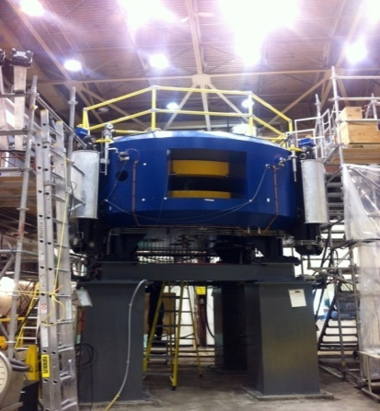
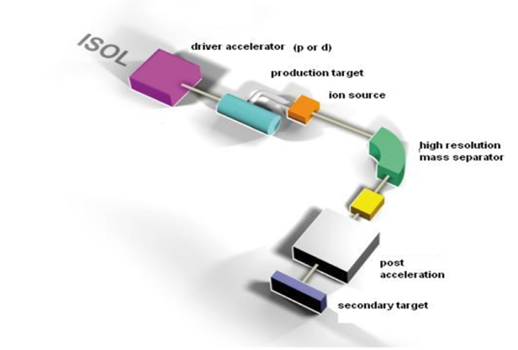
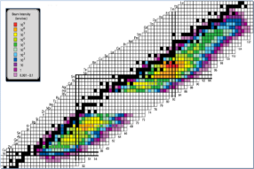

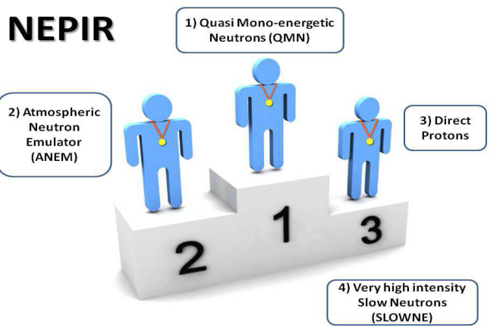
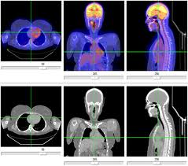
SPES: The future of LNL
SPES is: 1) A second generation ISOL facility (for neutron-rich ion beams)
2) An interdisciplinary research center (for p,n applications)
SPES-DRIVER
SPES-RIB facility
Financed &
Under construction
Commissioned
α
β
Cyclotron installation & commissioning:
E=70 MeV proton beam, I= 750 μA
Production & re-acceleration of exotic beams, from p-induced Fission on UCx
SPES for medicine
γ
δ
SPES Neutron facility
Proposal
Financed
LARAMED & ISOLPHARM projects
Radisotopes for medical applications
Accelerator based neutron source
(Proton and Neutron Facility for Applied Physics)
Notes:
Let me only recall that the SPES project aims at the construction of a second generation ISOL facility for the production of neutron rich ion beams as well as at the realization of an interdisciplinary research center for proton and neutron beams applications. The first phase of the project, the installation of the cyclotron for the primary proton beam was already completed, whereas the second one the construction of the radioactive ion beam is under completion. On the ISOL application to production of pharmaceuticals we have heard yesterday by Dr. Andrighetto.

Slide 3
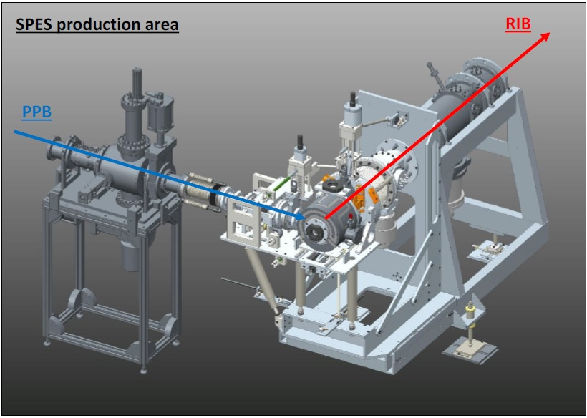
The RIB production area
Front-End complex
40 MeV p
200 μA
Life cycle 15 days automatically removed every 30 days
TIS complex
Automatic handling mechanics
Target & Ion Source (TIS)
ISOL target
²³⁸UC_{x} fission
Notes:
The heart of the project is the radioactive ion beam production system, the so called Front_End. The radioactive species are produced with ISOL technique by a primary proton beam which impinges on an uranium target producing fission. Fission products are transferred, ionized and pre accelerated to form Radioactive Ion beams. The target & Ion Source system is submitted to so intense thermo mechanical and radiation stresses that must be substituted every 30 days.

Slide 4
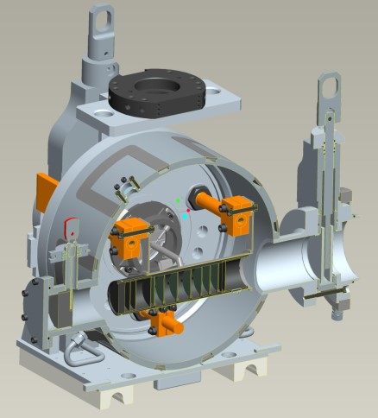
Target & Ion Source complex (TIS)
HV 40 kV
Ionizer & transfer tube
TIS Heater
2000°C
High thermo mechanical stresses
15 day life cycle
5 year cooling
10¹³ fissions/s
Highly radioactive environment
Radioactive ion effusion and diffusion
40 MeV protons
200 μA, 8 kW
Intense fission neutron and gamma fields
(10¹⁰ particle/cm²/s)
200 mm
7 ²³⁸UC_{x}
coaxial disks
1.3 mm thickness
Only automatic handling is possible
3 graphite dump disks
Notes:
Here is a cross section of the Target Chamber with the segmented Uranium Target where fission occurs at a rate of 10^13 fission/s. All the complex is so submitted to intense neutron and gamma fields as in the interior of a nuclear reactor. Activation of the components allows only automatic handling to be performed.

Slide 5
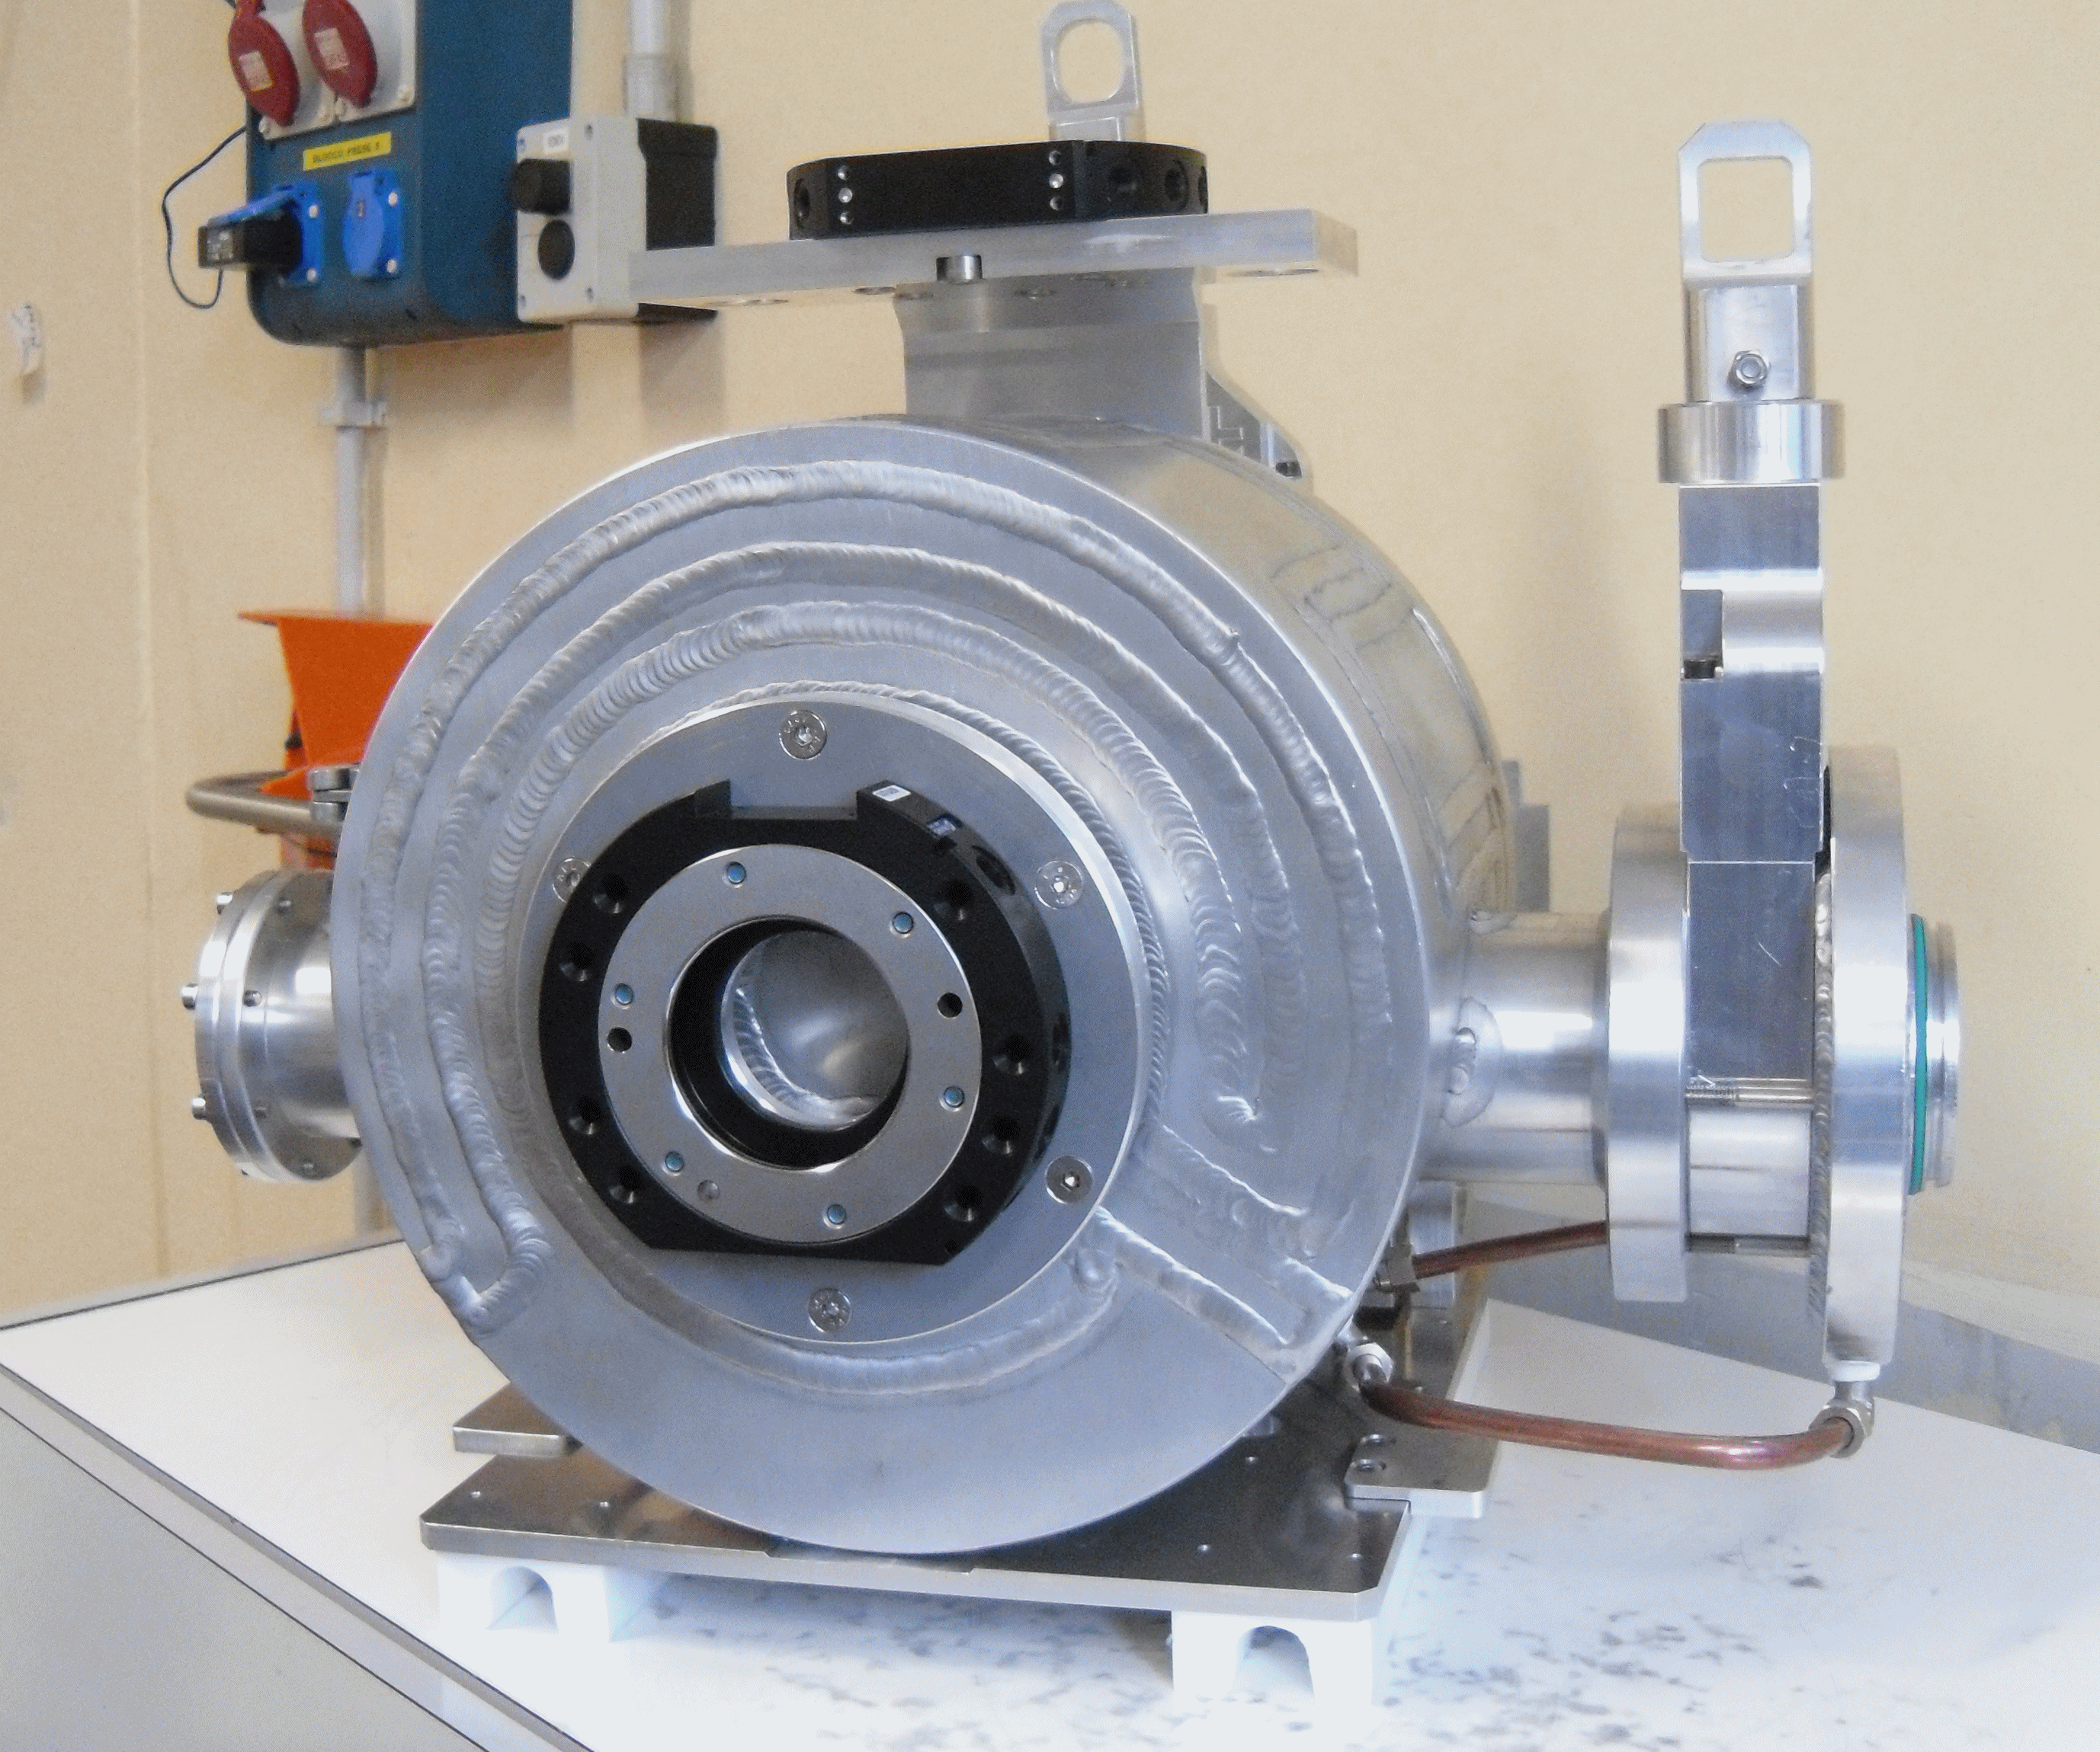
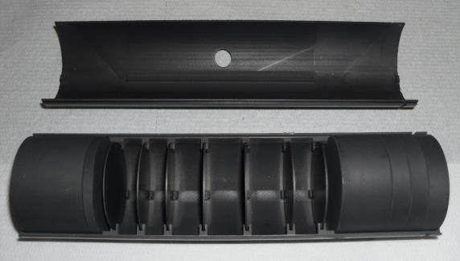
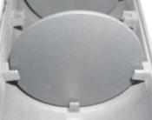
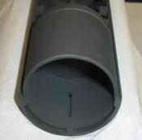
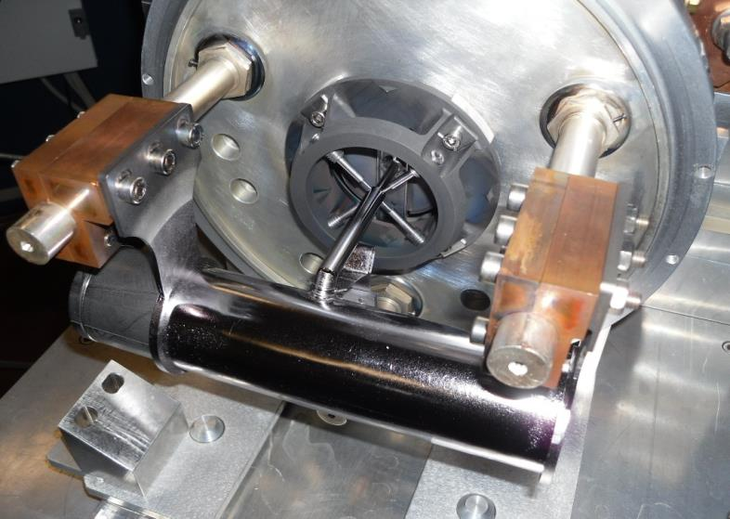
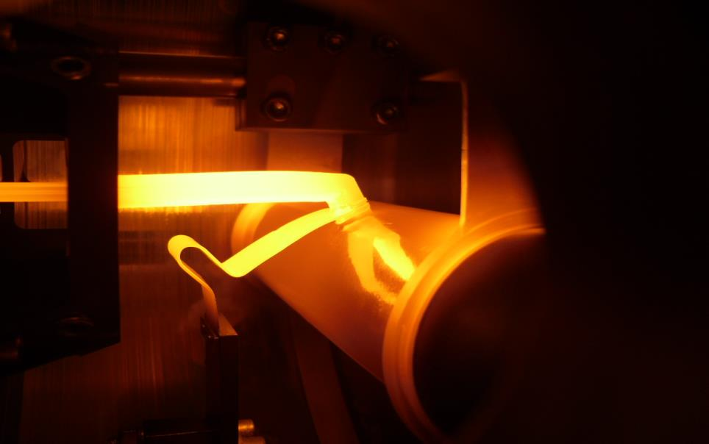
Target & Ion Source complex (TIS)
I_{Target}= 700A -> 1200A max
I_{Line}= 200A -> 600A max
Notes:
Here same pictures of the segmented Uranium target and of the Target Chamber components.

Slide 6
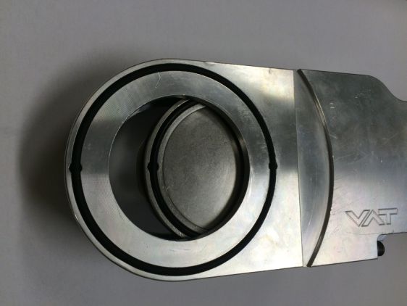
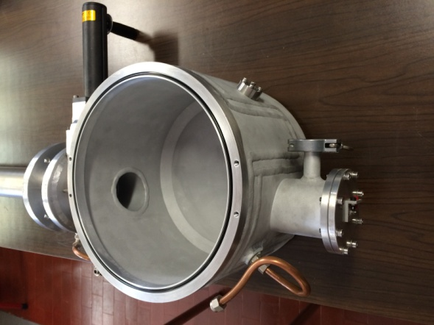
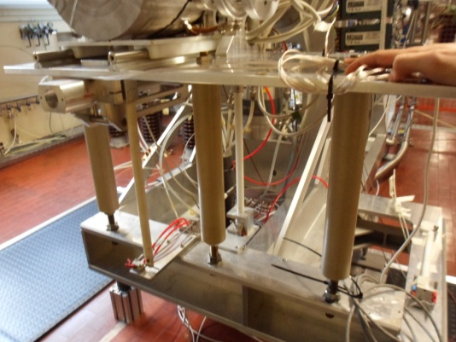
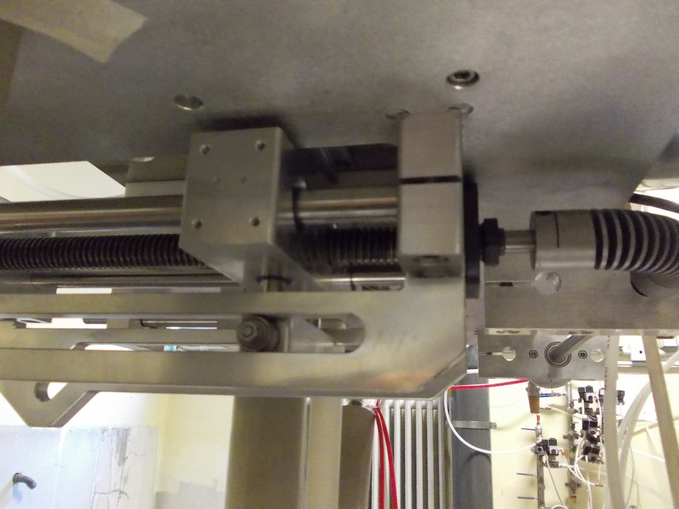
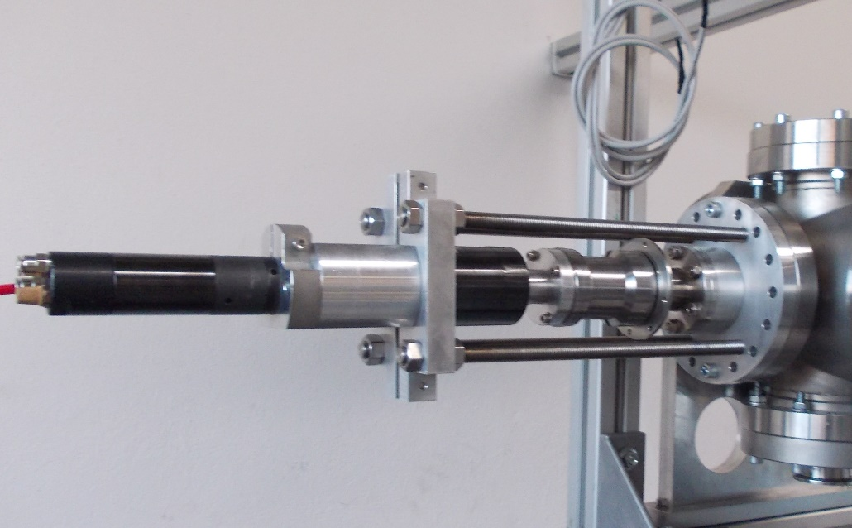
Modification of material properties by radiation effects (radiation damage)
VAT valves O-rings
Some critical Front-End components
(mainly polymeric materials)
Elastomeric joints (O-rings)
Lubricating oils and greases
Beam line insulators
Chamber base insulators
Chamber handling guides
Pneumatic motors
AC power wire jackets
Signal cable insulators
Optical fiber core/cladding
Electronic components
vacuum O-rings
chamber base insulators
mechanical lubrication
cabling
pneumatic motors
Operator interventions very problematic
Component failure must be prevented
Notes:
Several material and components used in the construction of the Front-End are be sensitive to radiation damage, mainly polymeric materials, from elastomeric joints to plastic insulators, to lubricants, to optical fibers. It is mandatory that the different materials do not fail under radiation damage to prevent failure of the entire system. We concentrate first on elastomeric materials for the construction of O-rings and on lubricants.

Slide 7
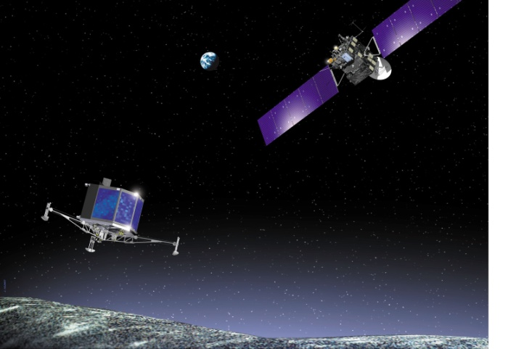
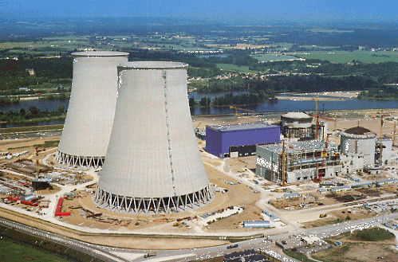
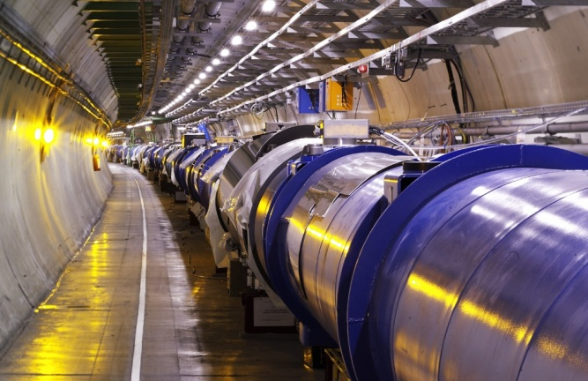
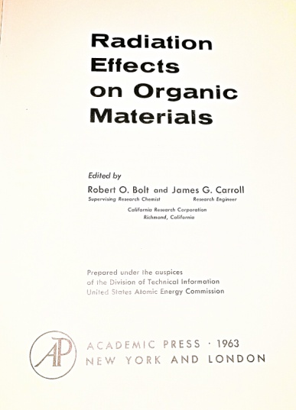
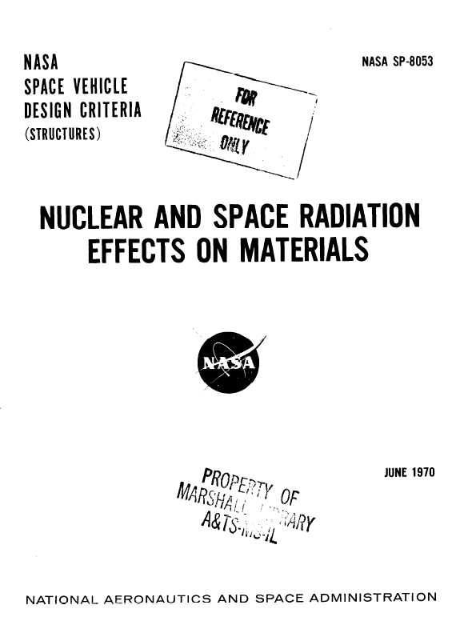
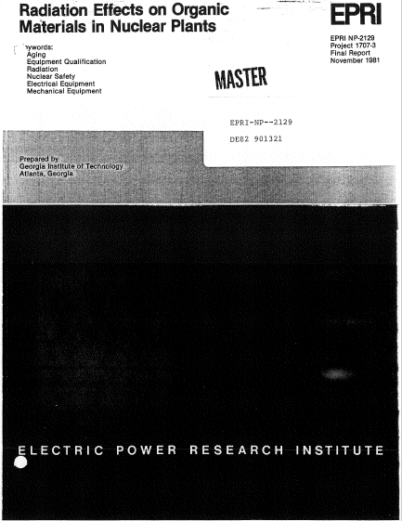
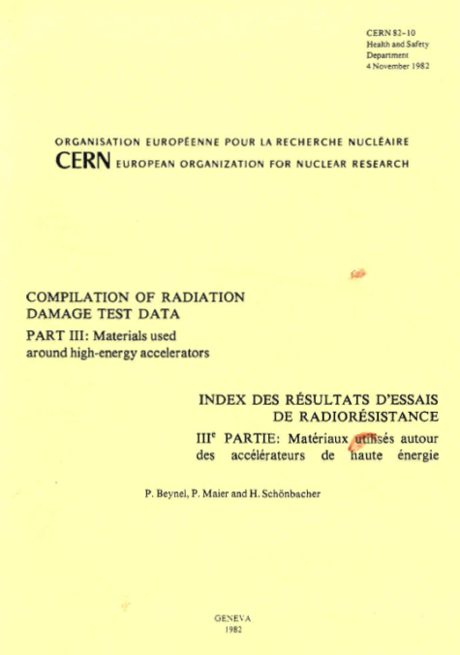
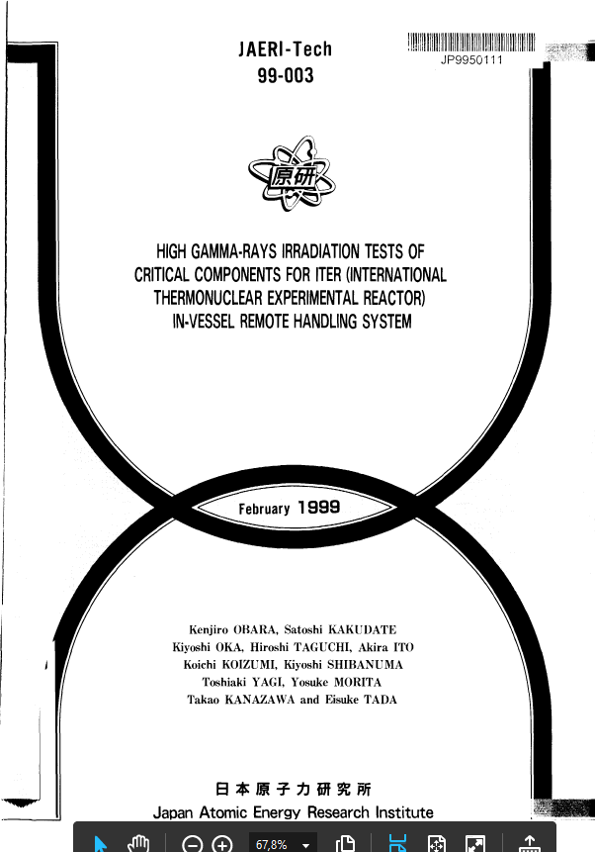
Damage of materials by radiation is a long-known technological problem
Space science
Nuclear reactor technology
Accelerator technology
1963
1970
1981
CERN 1980-2000
ITER 1999
In accelerator technology and nuclear physics research, CERN Yellow Reports are the main reference
+
information by producers
Notes:
Damage of materials by radiation is a long-know technological problem in application to space science, nuclear reactor technology and accelerator construction. As great wealth of studies have been produces in last decades. In accelerator technology and nuclear physics research the CERN Yellow reports are still the main reference, together with the information on radiation resistance of materials by the producers, when available.

Slide 8
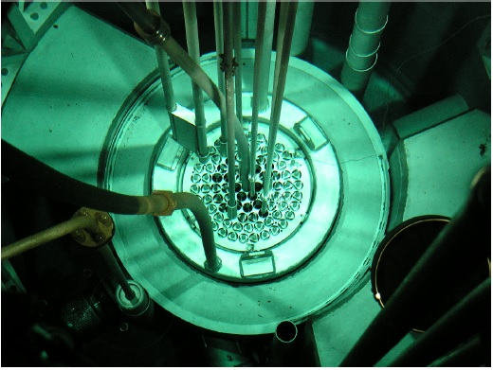
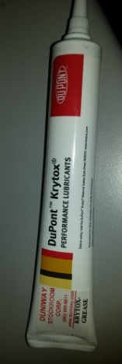
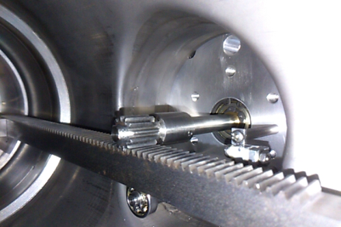
Motivations for a new materials rad-hard study for SPES
Rapid obsolescence of the data; new materials and suppliers available
Rad-hard data are in general obtained in gamma fields only; very scarce data are available in mixed neutron and gamma fields
Large uncertainties in the rad-hard data provided by suppliers
End use limits and dose thresholds are in general poorly defined
TRIGA Mark II research reactor core
LENA Lab., Pavia University
Specific applications
Nuclear reactor n + γ testing field
Market available products
Notes:
However there are reasons to motivate a new rad-hard study for the construction of SPES. Data in the CERN report and in the literature are abundant but often obsolescent; in general rad-hard data are obtained only with gamma fields, whereas data with mixed fields are scarce; there are in general large uncertainties in rad-hard data provided by the suppliers and end points of materials are poorly defined. For a new project we need to study the behavior of specific materials and products available on the market in the appropriate radiation fields for the specific application.

Slide 9
Elastomeric materials for vacuum O-ring construction
Notes:
Let me report a sample of the results on elastomeric materials for O-ring construction.

Slide 10
Selected elastomeric materials
Selection criteria
Good mechanical performance for vacuum and high temperatures
EPDM is considered more radiation resistant than FPM
FPM is more transparent to neutron fields (hydrogen content :1% vs 7-8%)
Market availability and radiation stability indications by producers
Product | Type/producer | Curing | Mechanical properties | Radiation Hardness | Quality | Notes
VITON | FPM/Generic |  | Good | Not declared | Standard | Low H content
EPDM1 | EPDM/Generic | sulfur | Fair | Not declared | Cheap | LNL off-the-shelf
EPDM2 | EPDM/ Dichtomatik (DE) | peroxide | Good | Not declared | High standard | Alternative standard
EPDM3 | EPDM/ James Walker (UK) | peroxide | Very good | 1.6 MGy dose ⁶⁰Co gammas | Certified material | Expensive
Notes:
For the study we have selected four materials having good performance for withstanding vacuum and high temperature. One of then, a flouroelastomer VITON, has been selected to profit of its lower hydrogen content, which is and advantage in fast neutron fields. The three EPDM based elastomers are: the standard LNL off-the-shelf material, a possible alternative from a different producer and, finally, a radiation resistant special material, tested in gamma field up to 1.6 MGy dose.

Slide 11
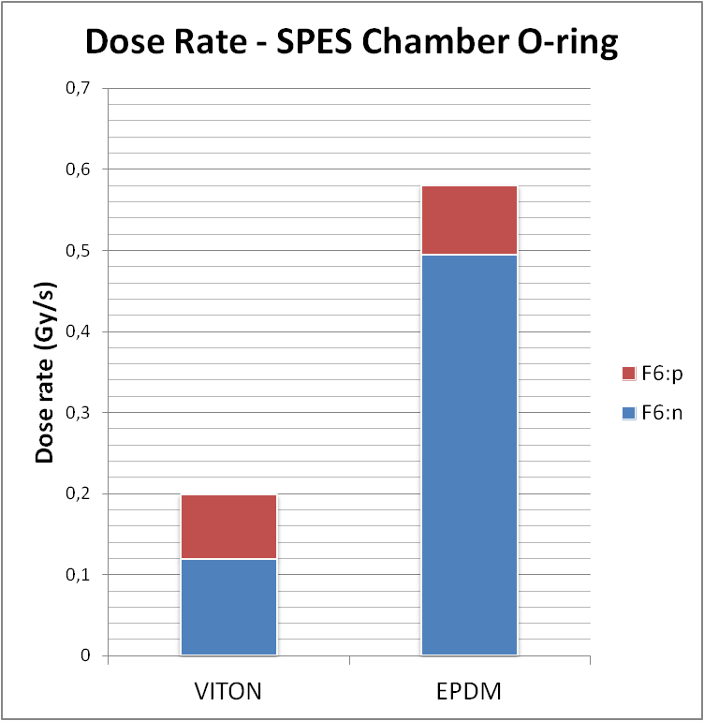
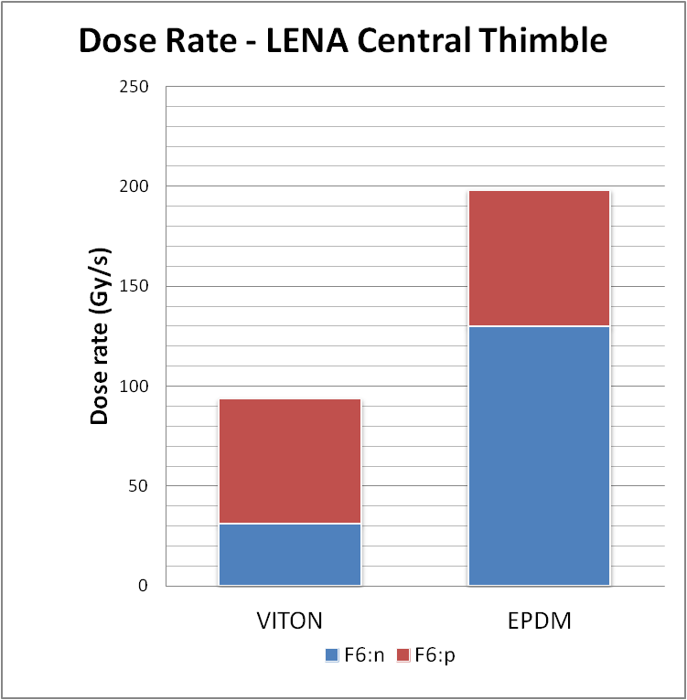
Dosimetry calculations (MCNPX)
TRIGA
γ dose
γ dose
n dose
n dose
FPM is more transparent to neutrons than EPDM
Most dose is delivered by fast neutrons
Irradiation time to deliver 1 MGy by TRIGA Mark II reactor
Doses n + γ on TIS integrated over 15 days
VITON | 2 h 58 min
EPDM | 1 h 24 min
VITON | 0.26 MGy
EPDM | 0.75 MGy
Notes:
The dosimetry calculations were performed with MCNPX both for the SPES Front-End model and for the TRIGA Mark II reactor central thimble. It appears clearly as flouroelastomers are more transparent to neutrons than EPDM and the most dose in these conditions is delivered by neutrons and not by gammas. The integrate dose delivered in 15 days operation is about 0.26 MGy for VITON and 0.75 MGy for EPDM. The same dose is delivered to the materials in about 1 hour reactor irradiation.

Slide 12
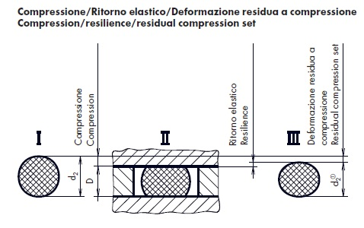
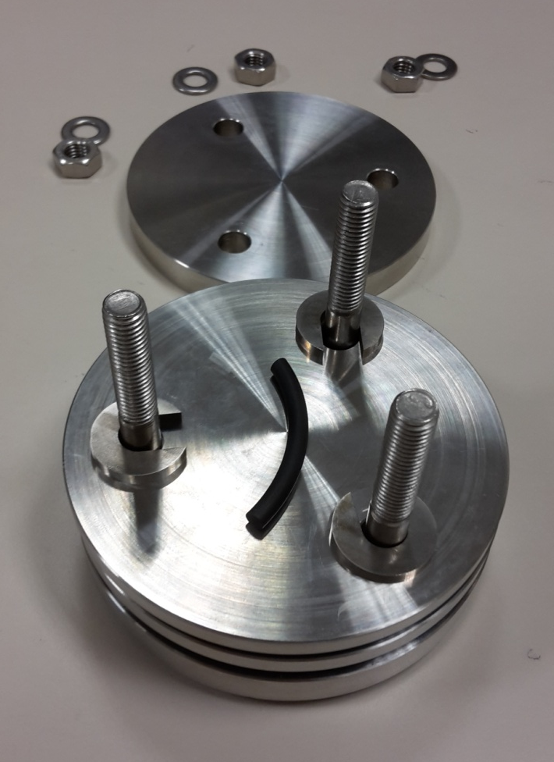
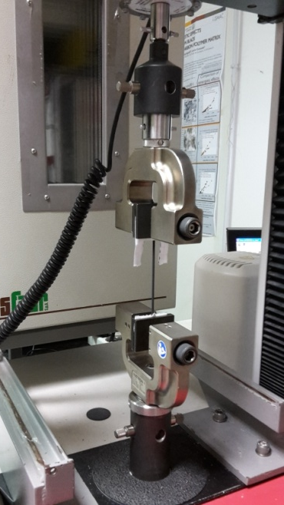
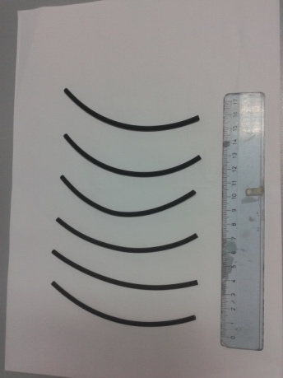
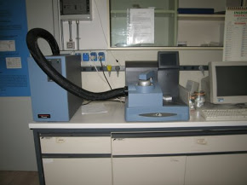
Materials properties tested as a function of absorbed dose
(ASTM D395-03)
Mechanical and tensile properties
Compression set (25% squeeze + ageing 24h at 100°C) (%)
Elongation at break (%)
Elastic Modulus (MPa)
Tensile strength (MPa)
Hardness (Shore, IRHD)
Physical and chemical properties
Density, FTIR analysis, DSC Calorimetry, CHNS composition, swelling test, DMTA
Compression set
Universal dynamometer
O-ring samples
(ASTM D1414)
Correlate change in mechanical properties with microscopic modification
Calorimeter DSC
Notes:
Standard mechanical and tensile properties of the materials were tested on unirradiates samples and irradiates samples at different values of absorbed dose. Also physical and chemical properties of the considered materials were tested to try to correlate change in mechanical properties with microscopic modifications.

Slide 13
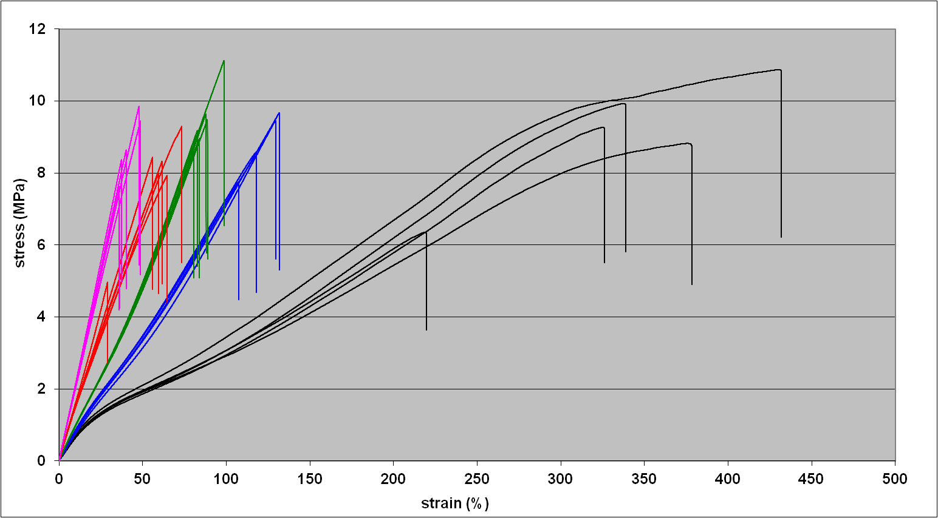
A sample of results: tensile properties EPDM2
3.0 h irr. 2.14 MGy
2.0 h irr. 1.43 MGy
1.0 h irr. 0.71 MGy
0.5 h irr. 0.36 MGy
Non irradiated
Tensile strength (TS)
EPDM2
Elastic modulus (EM) slope
Elongation at break E@B
stress (MPa) vs strain (%)
Material properties change considerably with irradiation
Good repeatability
EPDM 2: 15 days in TIS | 0.75 MGy
Notes:
Le me show a sample of the results for tensile properties of EPDM 2 in terms of stress vs strain curves at different values of absorbed dose. It is evident how the main tensile properties: elastic modulus, elongation at break, tensile strength, change considerably with irradiation. The material changes nature and behavior with irradiation.

Slide 14
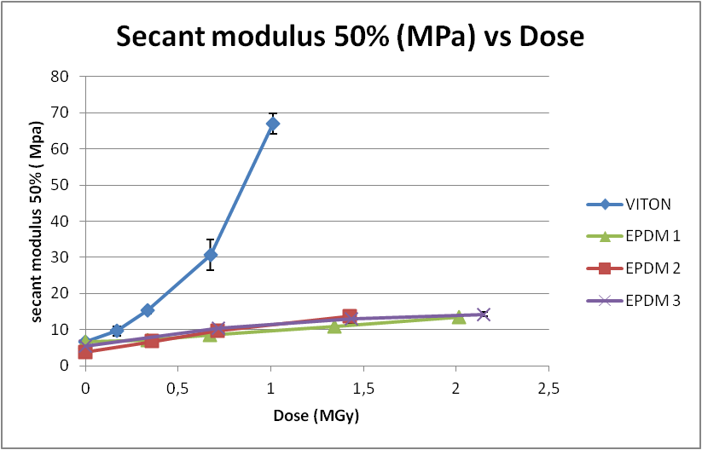
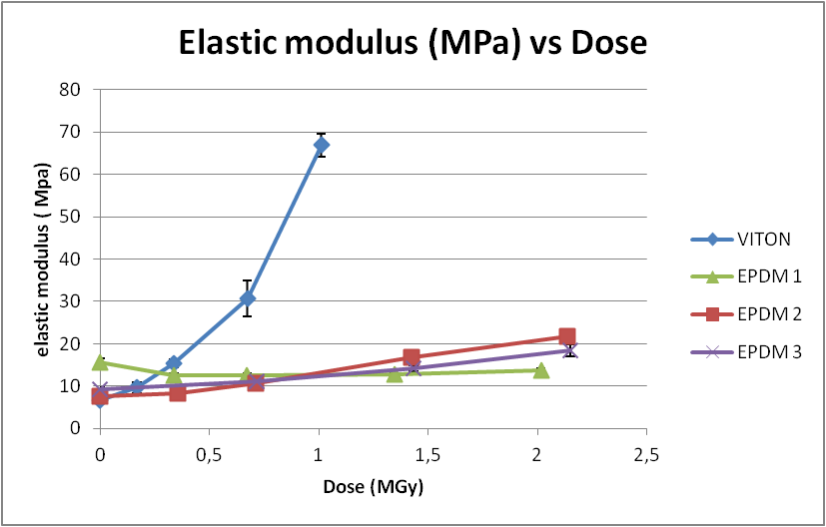
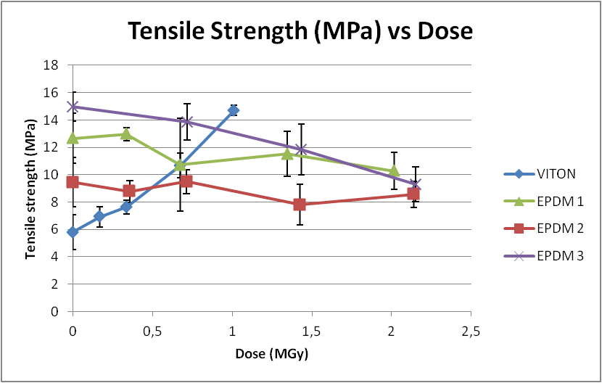
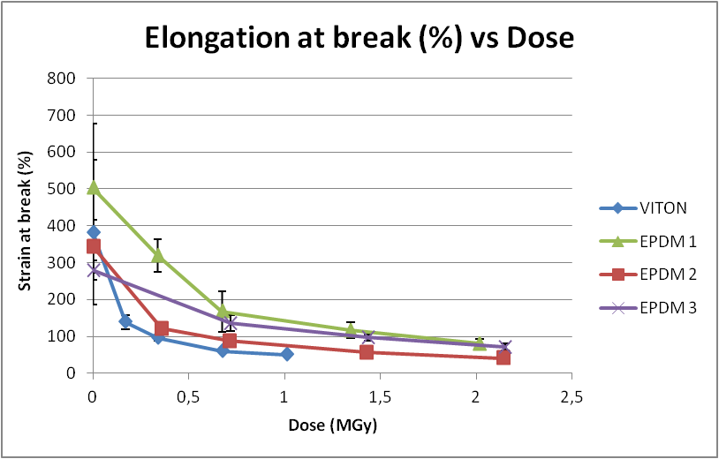
Comparison of tensile properties
Modulus increase: stiffness, cross linking
VITON
VITON
Ultimate properties: dramatic decrease of E@B
VITON
VITON
100%
Elastomer: E@B > 100%
Notes:
In this picture the evolution of the tensile properties of the four materials are shown in the same graph. Modulus increase with irradiation shows as the materials stiffen, owing possibly to polymeric chain cross-linking. The stiffening of VITON compared to EPDM based materials is particularly enhanced. Dramatic is the reduction of the elongation at break with absorbed dose. Elongation at break is indeed the properties which characterizes elastomers; below 100% elongation at break a material can no longer be defined as an elastomer.

Slide 15
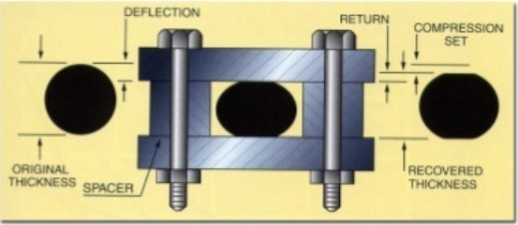
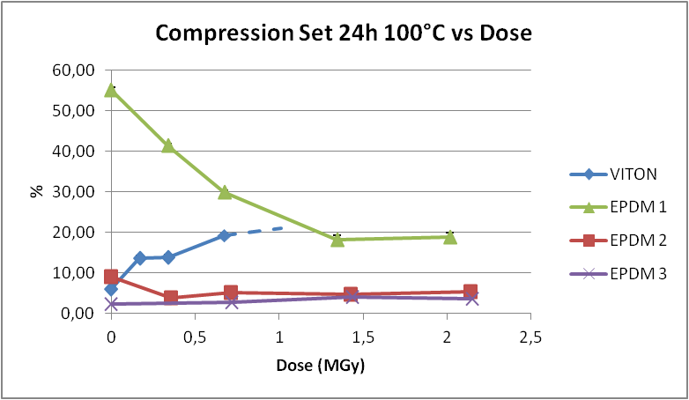
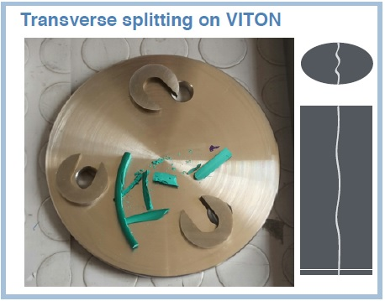
Comparison of functional response: compression set
EPDM1: poor CS with large variations
Test conditions: 100°C, 25% strain, 24 hours
brittle
EPDM2, EPDM3: stable at few %
Notes:
Also compression set show dramatic effects. At less than 1.0 MGy absorbed dose , VITON breaks suffering transverse splitting. EPDM1 material, the standard SPES material, show fair properties with large variations with dose. EPDM2 and EPDM3, on the contrary, are stable at few percent compression set.

Slide 16
Conclusions on tested elastomers
VITON (FPM) is more transparent than EPDM to fast neutron fields, but mechanical properties change a lot with dose. Dramatic increase of stiffness and brittleness under test irradiation conditions. (Not recommended).
EPDM polymer based elastomers may have very different behaviors against irradiation, depending on the specific compound.
EPDM1 (standard SPES) has fair mechanical properties that change considerably with irradiation. (Not recommended).
EPDM2 and EPDM3 feature good mechanical properties that remain stable with absorbed dose (apart from E@B). Large price difference, apparently not justified by performance.
The results provide essentially a guideline of the behavior of the elastomers irradiated in the same conditions, on a comparative base.
Notes:
Finally some conclusions for elastomers. VITON is more transparent in neutron fields than EPDM, however its mechanical properties change dramatically with dose. EPDM based polymers feature different behavior with dose, depending on the specific compound. EPDM1 (standard SPES) features fair mechanical properties which change considerably with irradiation, which is problematic for a safe design. EPDM2 and EPDM3 feature good mechanical properties that remain stable with dose (apart form E@B). However, the large price difference of the special material, seems not justified by performance. Due to the large difference in irradiation rates, the obtained results may be considered predictive for O-ring irradiate in vacuum (as the VAT valve ones). For other O-ring they constitute anyway a guideline.

Slide 17
Lubricating oil and greases Some preliminary results
Notes:
Let me now shortly show some preliminary results of the study obtained for lubricants.

Slide 18
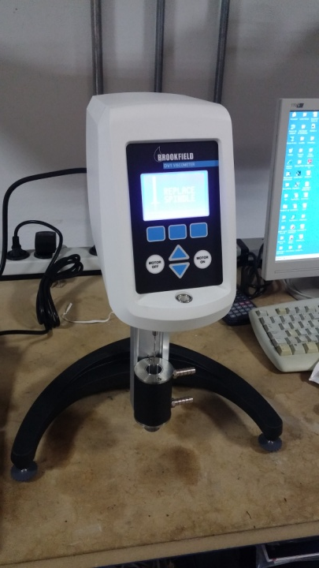
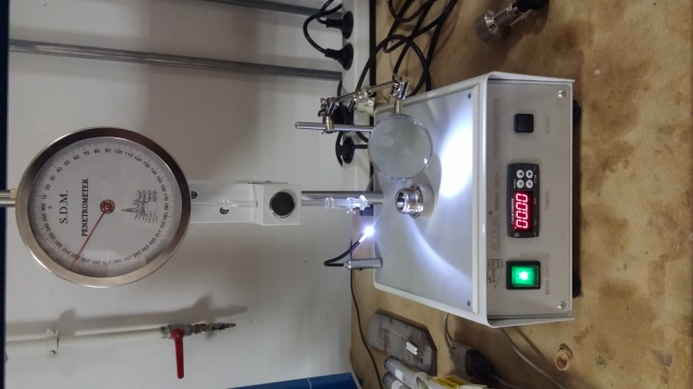
Lubricant typical composition
Lubricant | Blend | Phase | Characteristic property
Oil | Base oil >75% Additives < 5% | Fluid | Dynamic Viscosity (cP=mPa s): the ratio between the applied shear stress and the rate of shear of a liquid (Viscometer)
Grease | Base oil > 75% Additives <5% Thickener 5%-25% sponge structure (metallic soap, fatty acids) | Semisolid two-phase systems | Consistency (mm/10): resistance to deformation and flow; penetration of a cone of specified dimensions and mass under gravity within 5 s (Penetrometer)
ASTMD445-06
Brookfield DV1 Viscometer
ASTMD1403
Polymeric materials 75% - 100% of the blend, petroleum based or synthetic
Viscosity improvers
Antiwear
Foam inhibitors
Corrosion inhibitors
Thickeners
Antioxydants
Radiation Damage Inhibitors
Radiation sensitive or used up during irradiation
Additives <5% improve base oil performance
SDM Semi automatic penetrometer
Notes:
Lubricating oils and greases are completely different materials from elastomers. Lubricating oils are fluids, composed mainly by a base oil and additives to improve the base oil performance. Lubricating greases are composed of a base oil and a thickener which provides a sponge structure in which the base oil is immobilized. Greases are semisolid two phase systems. The main characteristic properties to be measured against dose are: viscosity for oils and penetration for greases.

Slide 19
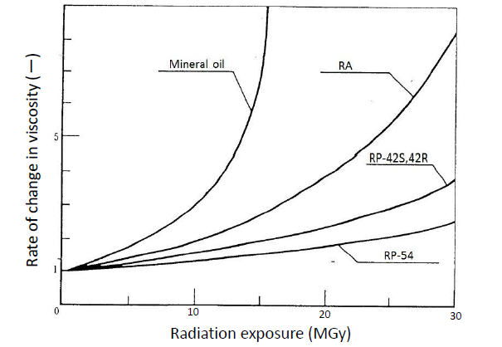
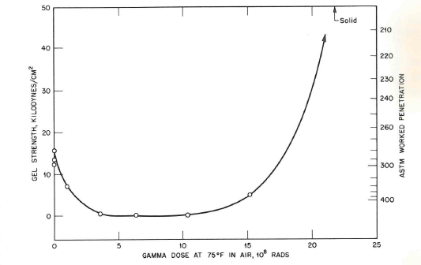


Expected effects of radiation on lubricants
Lubricating oils
Radiation stability mainly determined by base oil nature (aromatic content)
Dominant effect: cross-linking
Viscosity increase
Lubricating greases
More complex situation
Two main effects on consistency
worked penetration
Paraffinic mineral oil gelled with sodium stearate (Bolt, 1963)
hard
Moresco Hirad
viscosity
soft
Damage to the thickener grease softening
Cross-linking of the base oil
grease hardening
Dropping risk
Notes:
Viscosity of the oil is expected to increase with irradiation, due to cross linking of the polymeric content. A more complex behavior is expected for the consistency of a grease. At lower doses it is expected to soften du to damage to the thickener; at higher doses it is expected to harden due to the cross-linking of the base oil.

Slide 20
Selected greases to be tested
Product/Class | Producer | Base Polymer + Thickener | Consistency/ Viscosity (cSt) | Radiation Hardness | Quality
Grizzly Grease n.1 (grease) | Lubcon (DE) | Mineral + Li/Ca | NLGI 0 | 1.0 MGy, gamma | Used at CERN
Petamo GHY 133N (grease) | Kluber (DE) | Ester oil + polyurea | NLGI 2 | Not declared | Standard SPES product
KrytoxTM 240 AC (grease) | Dupont-Chemours (USA) | PFPE + PTFE, H free | NLGI 2 | 1.0 MGy, reactor mixed field | Fluorinated Hydrogen free
RG-42R-1 (grease) | MORESCO (JP) | PPE + Inorganic | NLGI 1 | 15 MGy, gamma | High radiation hardness
RP-42R (base oil) | MORESCO (JP) | PPE | 240 cSt at 40°C | 15 MGy, gamma | base oil
Apiezon-M (grease) | M&I Materials | Hydrocarbon, halogen free | Molten grease 413 cSt at 50°C | 1 MGy, electrons | Ultra high vacuum
More information on radiation resistance, large uncertainties in testing procedures
High radiation resistance
No H content , more transparent to neutrons
Notes:
Different products were selected for testing in mixed fields matching the SPES requirements. Most of them have radiation resistance declaration by the producers, in general obtained in gamma fields only, with large uncertainties in the testing procedures. Some products are standard in use at CERN or at LNL, one product is a fluorinated grease, selected since it is hydrogen free, so more transparent in fast neutron fields.

Slide 21
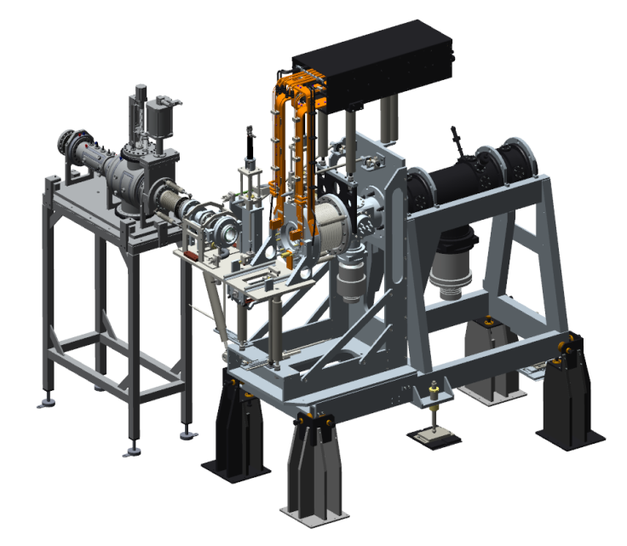
Dosimetry calculations (MCNPX)
Two composition models for a grease
C + F + O (H free)
C + H (H 14.3% in mass)
Dose rate in lubricated point closest to the Target (TIS mechanical coupling system)
CAD Front-End Model
TIS coupling system
Neutron dose, highly dependent on H content
6 y integrated dose
60 cycles (15 days)
photon dose, independent on material
model 1
4.1 MGy
model 2
24.5 MGy
Notes:
Dosimetry calculations were performed with MCNPX showing, once again, that fluorinated materials are advantaged in fast neutron fields and that most dose is delivered by neutrons, whereas photon dose is independent on composition. Concerning lubrication of the main acme screw of the TIS coupling system, in 6 year foreseen activity it should absorb 4 MGy using a fluorinated grease and 24 Mgy using a standard grease.

Slide 22
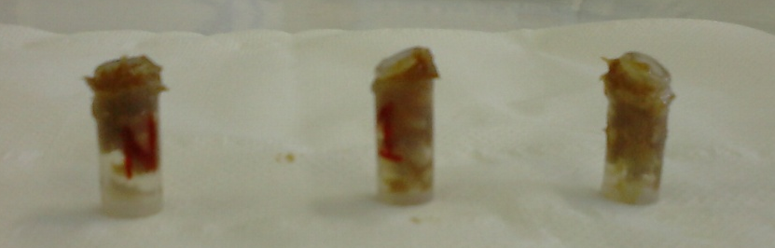



Preliminary tests performed
CHNS analyses to evaluate composition of materials: in particular Hydrogen content.
Product | C | H | N | Base oil
Grizzly Grease n.1 | 79.23% | 11.63% | 1.01% | Mineral
Krytox 143 AA | 21.03% | 0.0% | 0.18 | PFPE (fluorinated)
Gas development evolution under irradiation: mobility evaluation, design of irradiation set-up and protocol
Grizzly Grease n.1
Stopper removed
Grease mobility
Safe conditions
Residual contact dose and NAA : activation, contamination and radioactive waste production
Sample 100 mg (6 h irr) | 3 day cooling | 10 day cooling
Petamo GHY-133N | 0.4 μSv/h | 0.1 – 0.2 μSv/h
Krytox 283 AB | 30 μSv/h (²⁴Na) | 0.1 – 0.2 μSv/h
Safe handling after 10-15 days
Petamo pH=4
Grizzly Grease n.1 pH=7
neutral
Acid production: halogen formation and ambient corrosion
Krytox pH<1 F content critical
Notes:
Some preliminary tests were performed on the selected materials before designing the irradiation set-up and defining the irradiation and testing protocols: material composition, gas development, neutron activation analysis and residual dose to predict possible contaminations and waste production, acid formation to predict possible ambient corrosion.

Slide 23

Sample of first obtained results
Grizzly Grease n. 1, NGLI 0, consistency test
1 h irradiation
Declared by the producer as radiation resistant up to 1.2 MGy in gamma fields
soft
OUT OF SCALE
0.5 h
1.0 h
2.0 h
NGLI 00
definitely less consistent (almost fluid)
NGLI 0
hard
NGLI 1
hard
Total absorbed dose is not enough to define radiation resistance
Radiation fields (neutron vs gammas) and dose rate are crucial factors
soft
penetration increase expected as first effect (few MGy)
Notes:
Finally a sample of the preliminary results obtained. Here you see the measurement of consistency of the Grizzly Grease n.1, a standard grease in use at CERN. The material is declared as resistant to radioactive radiation up to 1.2 MGy, tested with gamma rays. The consistency grade of the material is 0. It is evident that the behavior in mixed fields is completely different since the material became practically fluid already at 0.5 MGy absorbed dose. This result raises questions about definition of radiation resistance and effects of mixed fields versus gamma fields and dose rates.

Slide 24





Conclusions and prospects
Radiation-hardness study for the SPES project devoted to elastomeric materials (O-rings) is provisionally concluded
Irradiation and testing for lubricating oils and greases is in progress. First systematic results are expected by the end of the year
Rheological and physical properties of irradiated samples will be hopefully measured (non newtonian behavior, Bingham model; NMR spectra)
Non irradiated Grizzly Grease n.1
NMR spectrum
C-H bond
base oil
Cone plate rheometer
The Materials Group of the Target Division of ESS has recently joined the RDS_SPES project to profit of synergies in common problems on materials radiation resistance
Notes:
In conclusion we can say that: the rad-hard study of elastomeric materials for the SPES project has been concluded (at least provisionally); irradiation and testing protocol for lubricating oils and greases is in progress. The first systematic results are expected by the end of the year; we plan to investigate also rheological and chemical properties of irradiate samples to have better insight in the material modifications. Finally, the Materials Group of the target Division of ESS ha recently joined the RDS_SPES project, to profit of the synergy of the common problems on non metallic materials radiation resistance of the two new projects.

Slide 25
Spare

Slide 26




The SPES construction at LNL
A new building
Cyclotron commissioned
Notes:
Here an aerial view of the laboratory building with the new building devoted to the SPES project, which is connected with the other laboratory facilities. On the to of the building the hole by which the cyclotron was lowered in the building.

Slide 27

The SPES facility layout
Charge Breeder
MRMS
Front-End
RFQ
SPES building
Exp. Hall
Cyclotron
ALPI building
Radio isotopes
PIAVE
HRMS
Applied physics
Beam Cooler
RIB target stations
Exp. Hall
XTU-Tandem
First low energy RIBs, (1+ up to 42 keV) in 2020

Slide 28



Cyclotron commissioned
Dual exit Cyclotron
Proton beam 35-70 MeV
Tot current 750μA

Slide 29


The SPES Radioactive Ion Beam (RIB) Front-End line
Steerers and triplet of quadrupoles
Diagnostic box (FC+BP)
Slits and Diagnostic box (BP+FC)
Triplet of quadrupoles
Wien filter
Emittance meter
Target-ion source

Slide 30


The SPES off-line Front end
(working since 2010 - evolution of ISOLDE FE6)
Beam diagnostic
devices
Beam transport devices
Target & Ion source
(platform 30 kV)

Slide 31

RIB production area
Cyclotron
Target & Ion Source TIS (2)
TIS storage
Substitution with automatic handling of TIS every 15 days
Target & Ion Source TIS (1)
TIS storage

Slide 32



The RIB production complex
Target chamber unit
Vertical device
Front End & LEBT
Horizontal device
Chamber Storage

Slide 33



Comparison of physical quantities
Density vs Dose, Time in SPES
VITON | 1.87 g/cm³
EPDM 1 | 1,21 g/cm³
EPDM 2 | 1,16 g/cm³
EPDM 3 | 1,16 g/cm³
VITON: Density increases rapidly: cross linking
EPDM: Density increases slowly with dose
EPDM 1: nearly constant, lower cross linking
EPDM 3: increases almost linearly

Slide 34

Physical tests on VITON: Differential Scanning Calorimetry (DSC), Density, Swelling
The material evolves towards more glassy conditions
1.01 MGy
0.67 MGy
0.34 MGy
Swelling in solvent
0.17 MGy
0.0 MGy | 35%
1.0 MGy | 3%
Non irradiated
T_{g} glass transition Temperature
Cross linking

Slide 35



Differential Scanning Calorimetry (DSC)
VITON
EPDM1
3,0 h
3,0 h
2,0 h
2,0 h
1,0 h
1,0 h
0,5 h
0,5 h
non irr.
non irr.
EPDM2
3,0 h
EPDM3
non irr.
2,0 h
1,0 h
1,0 h
2,0 h
0,5 h
3,0 h
non irr.

Slide 36

EXPERIMENTAL RESULTS
Viscosity Measurements: Krytox 143 AA
23 of 32
Matteo Ferrari 02.03.2017 Lund
At 20°C (datasheet)
At 25°C (measured)
At 38°C (datasheet)
ESS Shaft: about 23 rpm
Newtonian fluid
Liquid oils
Benchmark with datasheet
Krytox Datasheet

Slide 37



QUANTITIES TO BE TESTED AND INSTRUMENTS
Mechanical Quantities for Greases
3 of 27
Matteo Ferrari 31.05.2017 Brescia
Greases characterized by consistency
Cone penetration test
[tenths of mm]
5 mL
small sample adapter
NLGI consistency numbers
for worked penetration
Consistency of lubricating grease:
the resistance to movement under stress
ASTM
D 217 -02
Notes:
Consistency is the main quantity to characterize greases, according to std proofs (ASTM) and to the producers datasheet
The test associated consist in evaluating the penetration of a cone in free fall into a determined grease amount.
The penetration is evaluated in tenths of mm.
The values of worked penetration can be converted in the NLGI scale, that describes consistency according to some measured ranges.
A penetrometer has been purchased by the SPES project for the study. We are waiting to receive it.

Slide 38
10 of 27
Matteo Ferrari 31.05.2017 Brescia
QUANTITIES TO BE TESTED AND INSTRUMENTS
Examples of Cone-Plate Viscosity
Viscosity [Pa s]:
Semi-solid materials
unworked
5 min measure
Constant Share Rate
50 rad/s
Decreasing Share Stress
Decreasing Viscosity
worked
Typical expected grease behaviour
Excellent measurement
High history-dependent: unworked/worked
Notes:
I would like to show you some of the results that can be acheved with the cone-plate, because they are incredibly rich.
In this first measurement, we applied a constant share rate of 50 rads/s and we measure the viscosity for 5 minutes.
What we can see is that the shear rate, indicating the resistance of the material to the applied rate, decreases with time. This is a typical expected behaviour for greases, because during operation they need to lower their resistance and lubricate the instrumentation. During the test, the material change from “unworked state” to a sort of manipulated rate.
I want to highlight that this measurement is excellent and that the rheological properties of a grease are highly dependent on the manipulation history of the material itsel.

Slide 39
10 of 27
Matteo Ferrari 31.05.2017 Brescia
QUANTITIES TO BE TESTED AND INSTRUMENTS
Examples of Cone-Plate Viscosity
10 min measure
Double slope S.R.
(set by the user)
newtonian
As expected
higher rates – lower viscosity
High history-dependent: not symmetrical
Non newtonian (viscosity depends on SR)
Notes:
I performed another test changing the share rate input.
In this case, the test lasted 10 minutes, with a double share rate slope. The sr started from zero and increased in 5 min up to 50 rad/s. In the following 5 minutes it decreased the same way.
In case of a newtonian fluid, the viscosity does not depend on the share rate, so we would see a constant.
As expected, for greases the viscosity decreases at higher dose rate.
As a consequence, this test highlight that the rheological properties of greases are highly history dependent and exhibit highly non-newtonian behaviours.

Slide 40


IRRADIATION SET-UP
Irradiation Set-Up #1
16 of 27
Matteo Ferrari 31.05.2017 Brescia
20 mL plastic syringe
Customized piston
(air valve)
Welded tip
Dropping
Overflow
Grease amount
14 mL: critical
8 mL: ok
Low amount
1 Consistency test
Handling
Cleaning
Cost
Disposable
perforated
tapper
gas evolution
not sealed
gas evolution
Cooperation with the group of Industrial and Technical Design, Unibs
Notes:
The first kind of irradiation set-up was realized using a 20 mL standard plastic syringe. A customized piston was realized in cooperation with the group of Industrial and Technical design of this University.
The piston can work in 2 different ways: can let the air pass through it or can be totally sealed. This way, the piston can be removed more easily. The syringe is irradiated without the piston.
The tip of the syringe is welded to avoid the risk of grease dropping or overflow. The tap is perforated to allow gas evolution.
As a first test, we tried to irradiate 14mL of material, but the conditions of the set-up were critical (more details in the following slides).
8 ml of grease can be accepted as limit not to damage the experimental set-up
As a conclusion, this set-up allow an easy and efficient handling of the grease, it has a very low cost and it is disposable.

Slide 41


IRRADIATION SET-UP
Irradiation Set-Up #2
17 of 27
Matteo Ferrari 31.05.2017 Brescia
Plastic bag
Grease amount
8 mL:
Low amount
1 Consistency test
Handling
Cleaning
Cost
Disposable
Not sealed
gas evolution
Sac a poche
to be handled
Both working set-up
Set-up #1
better handling
reduced grease losses
Set-up #2:
reduced grease mobility
prevented overflow
Notes:
A second kind of set-up was developed. In this case, the grease is placed in the corner of a plastic bag that is folded and place into the aluminum cartridge you saw before. To transfer the grease to the instrument you can easily make a hole in the corner of the bag and push.
Both the set-up are now working and it is possible to perform one worked consistency measurement with 8mL of material

Slide 42


EXPERIMENTAL RESULTS
First Grease Irradiation, Central Thimble
20 of 27
Matteo Ferrari 31.05.2017 Brescia
Grizzlygrease
1h IRR in C.T.
≈ 0.9 MGy
14 mL
Great mobility
Grease Overflow
Plastic failure
Tip damaged
Gas evolution
Critical pressure
Container stopper removed
Extreme radiation-induced effect
Grease amount to be reduced
Set-Up to be updated
Notes:
The effects of radiations were extreme.
The set-up needed to be updated and, in particular, the grease amount to be irradiated needed to be reduced.

Slide 43


Slide 44



T.R.I.G.A. Mark II pool research reactor
(Irradiation facilities)
Radial graphite reflector 30 cm thickness
neutron fluxes in n/(s cm²)
Rabbit channel
(7.40x10¹²) pneumatic sample extraction
Central thimble (1.72x10¹³) aluminum pipe
3.8 cm diameter
Thimble F aluminum pipe 3.8 cm diameter
Lazy Susan
(2.40x10¹²)
Thermal channel
(2.52x10¹¹)
7.0 cm diameter
Rotating rack for 80 samples at a time
27 polyethylene vials
0.8 cm diameter
3.0 cm height

Slide 45




Modeling of the neutron and photon fields in the SPES-TIS and LENA Central Thimble (MCNPX)
SPES Target & Ion Source
Central Thimble LENA
(0.0-0.05-0.15-0.8-3.0-5.6-9.0-23-75 eV -0.5-20-35 MeV)
thermal n
thermal n
fast neutrons
fast neutrons

