Slide 1
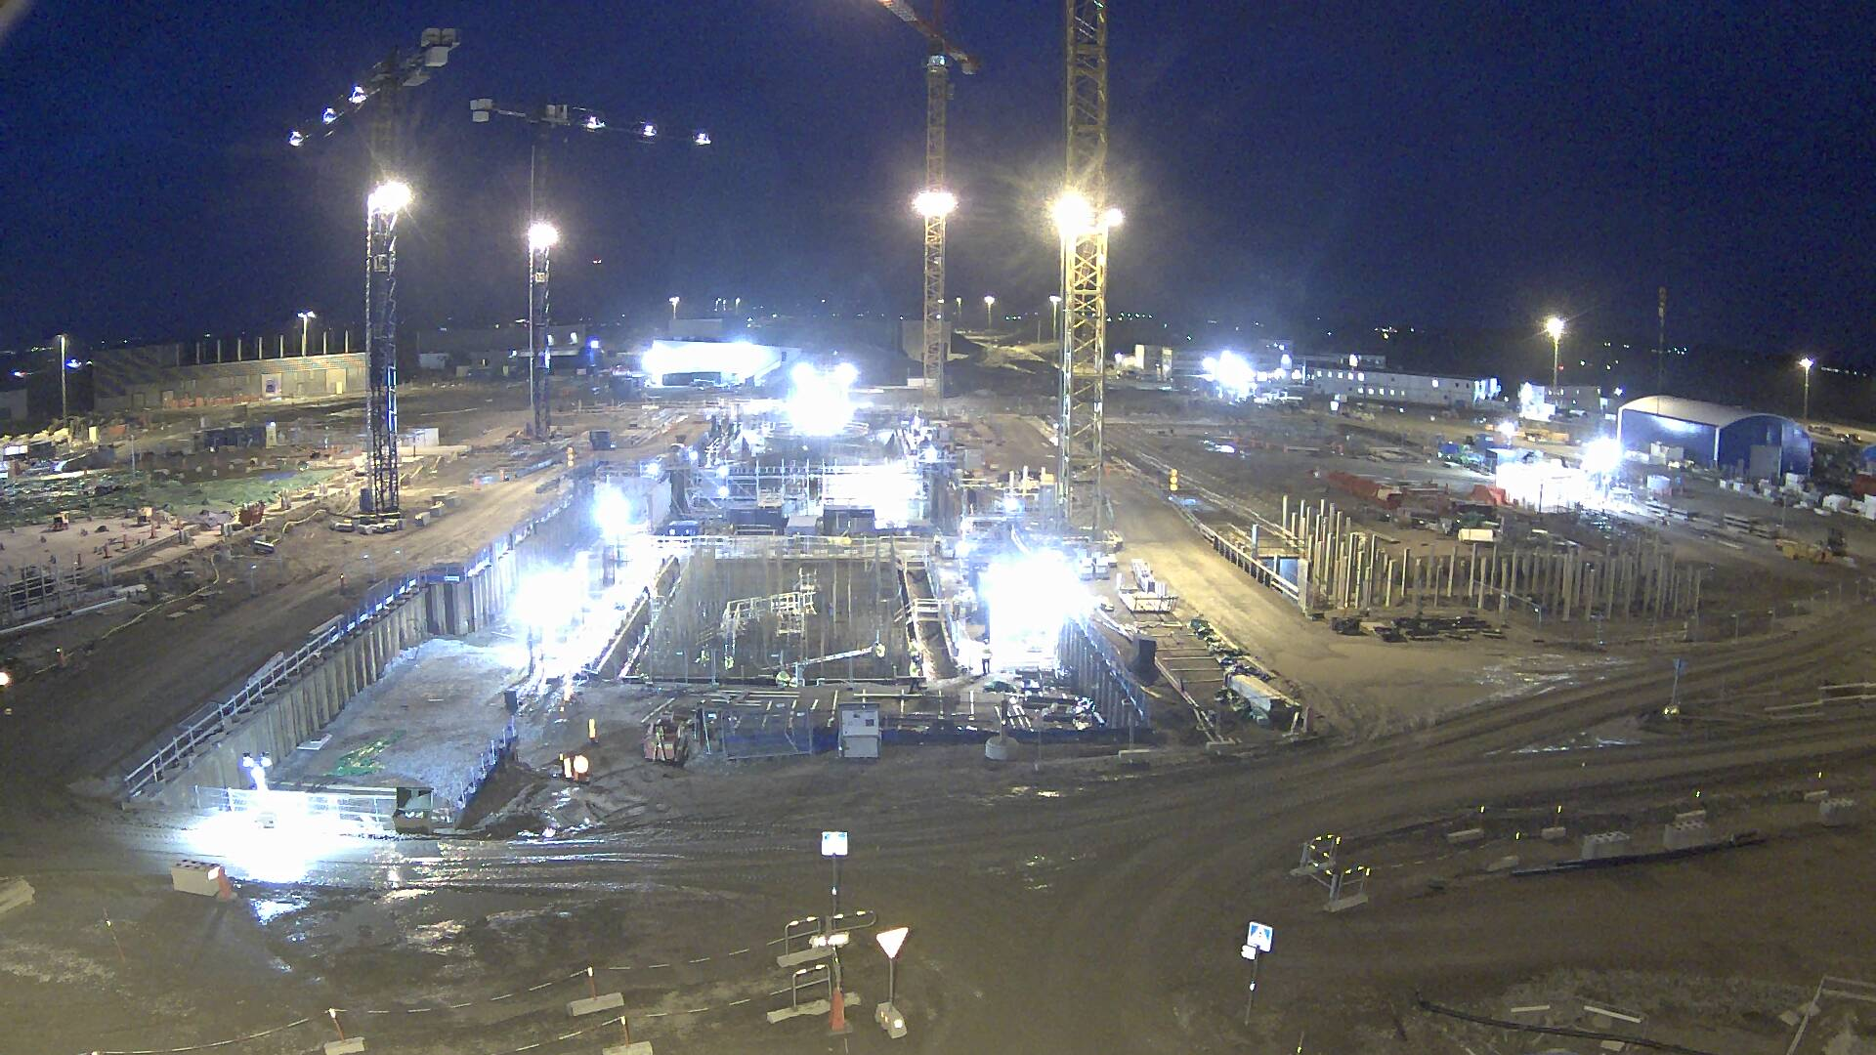


ESS Accelerator Engineering Integration,
Installation & Non-Destructive Testing Implementation
The 2017 International Conference
on Applications of Nuclear Techniques
Crete, Greece June 11-17, 2017
Dr. Eng. Nick Gazis
Accelerator Installation Coordinator
on behalf of Accelerator Installation Team & Engineering Resources Group
www.europeanspallationsource.se

Slide 2
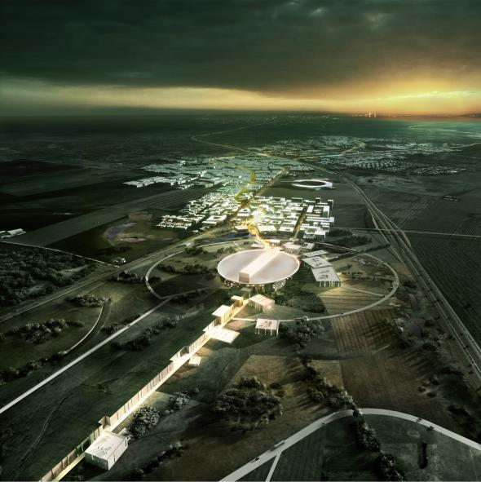



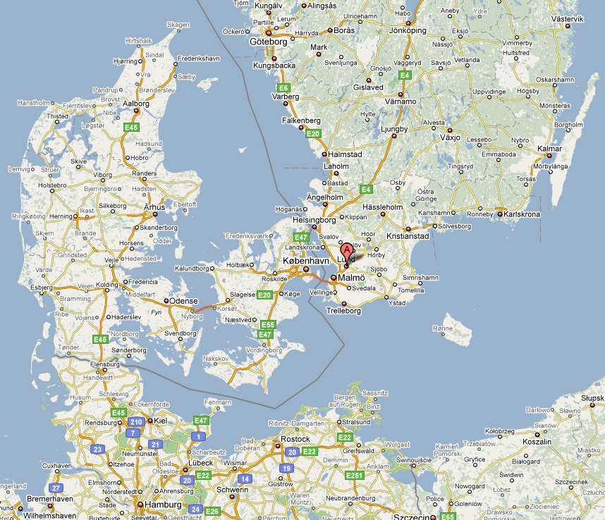

The European Spallation Source (ESS)
ESS is a neutron spallation source that is being built by a collaboration of 17 European countries.
ESS is located in southern Sweden adjacent to MAX-IV (A 4th generation light source)

Slide 3
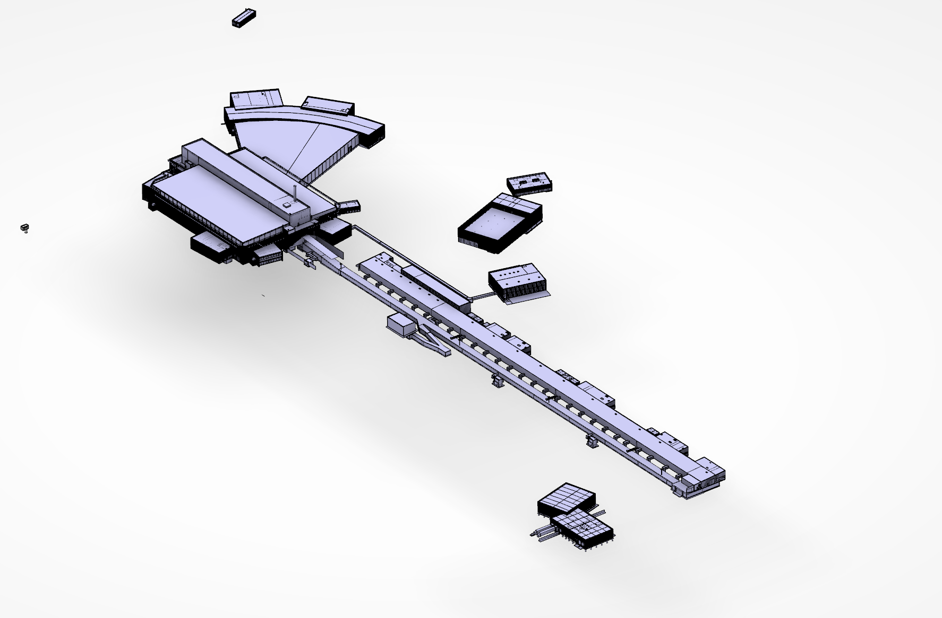
ESS buildings under construction
(Mar. 2016)
Instruments
Electrical
Cryo compressor
Target
Klystron Gallery
HEBT Loading Bay
Front-End Building
Accelerator
Logistics

Slide 4
Collaboration
Why the engineering integration is important
for ESS installation..

Slide 5
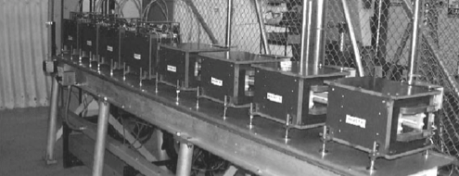
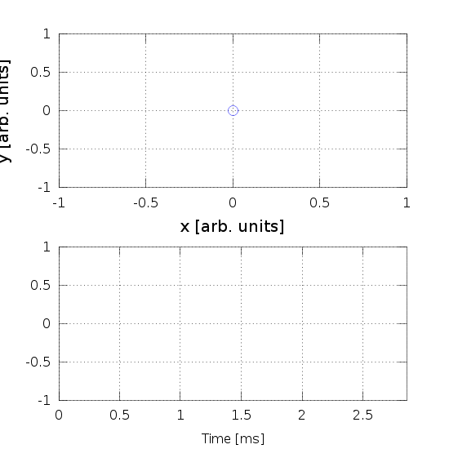
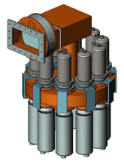
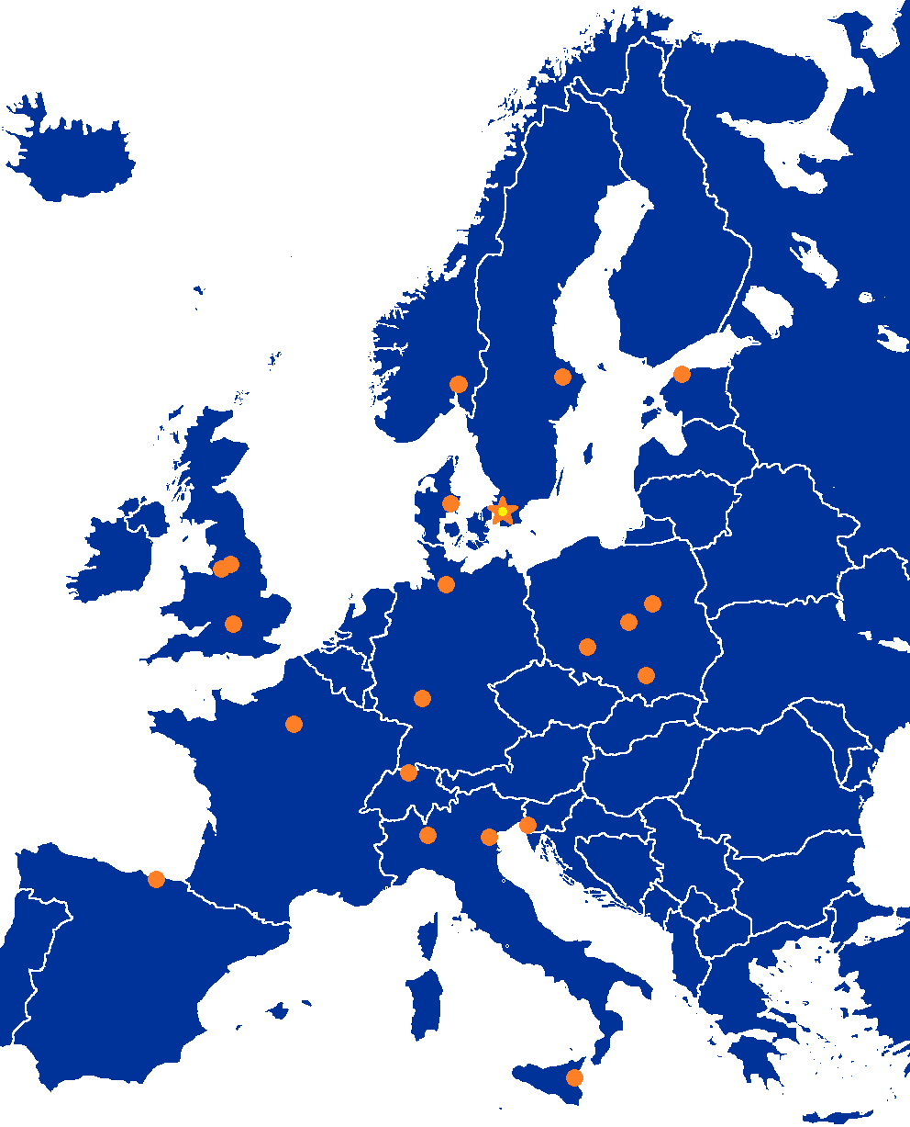
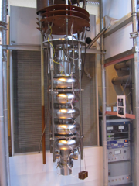
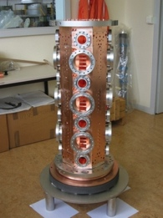
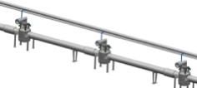
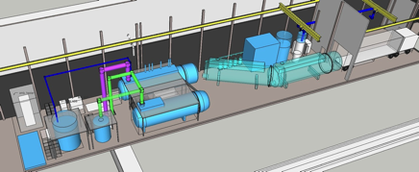
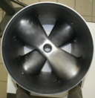
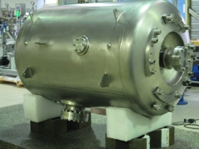
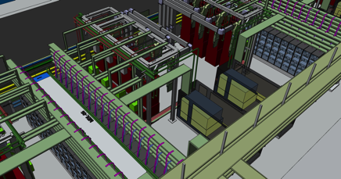
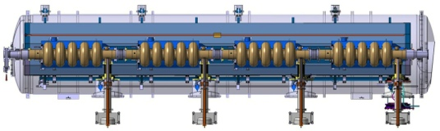
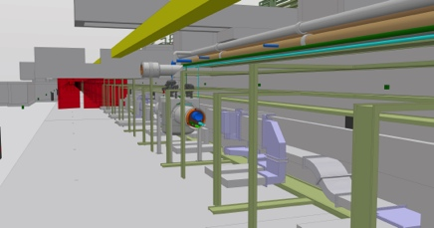
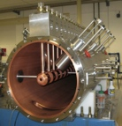
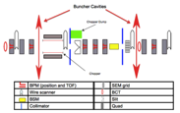
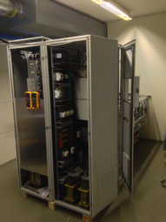
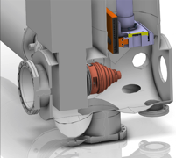

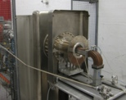
Accelerator Selected technologies
PARTNERS
ESS AD

Slide 6
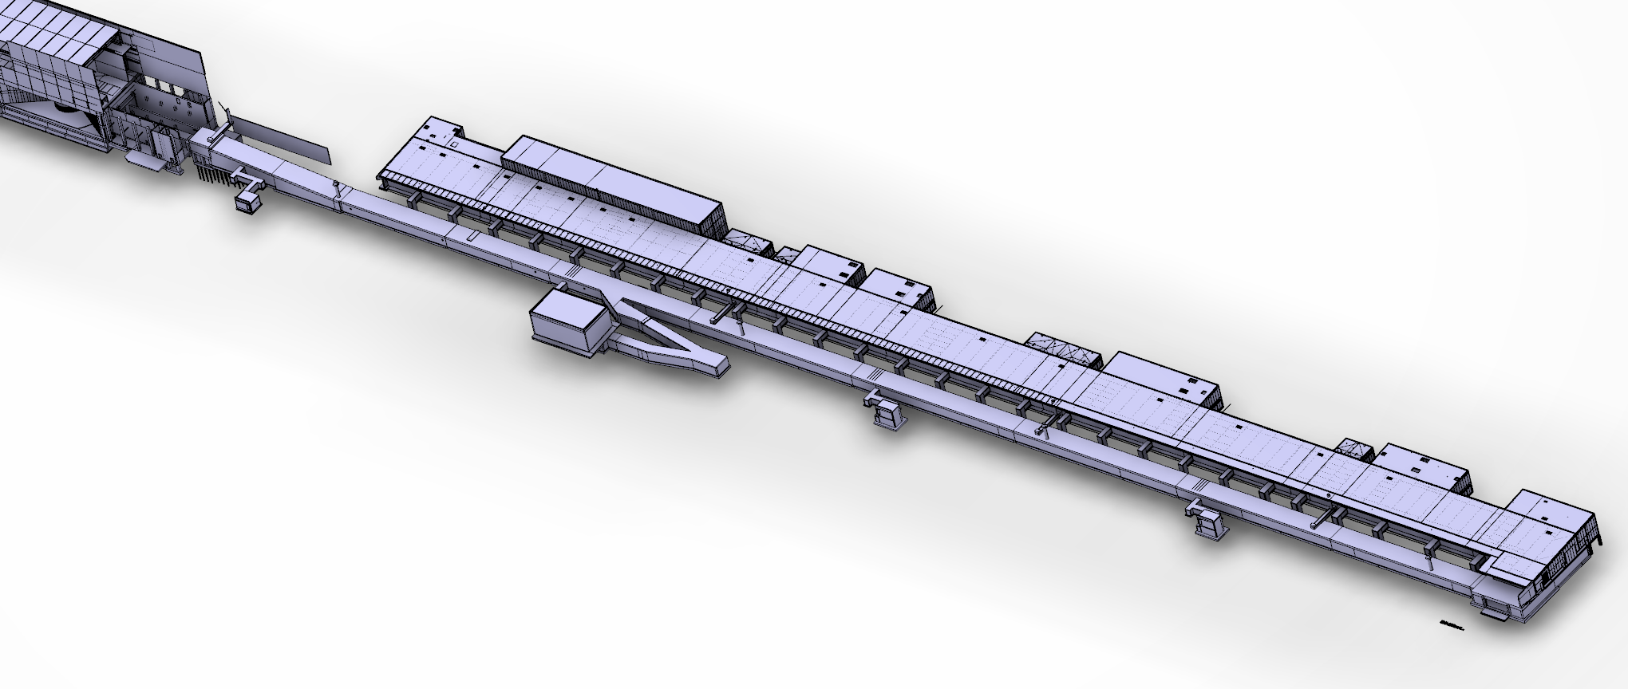
Integration and Verification
Design Drivers:
High Average Beam Power
5 MW
High Peak Beam Power
125 MW
High Availability
> 95%
Target
A2T ← DgLg ← HEBT
Key parameters:
    -2.86 ms pulses
    -2 GeV
    -62.5 mA peak
    -14 Hz
    -Protons (H+)
    -Low losses
    -Minimize energy use
    -Flexible design for mitigation and future upgrades
2000 MeV
High β
Cryo
(179 m)
Medium β
571 MeV
(77 m)
Spoke
Warm
DTL
216 MeV
(56 m)
MEBT
90 MeV
(39 m)
(3.8 m)
RFQ
3.6 MeV
(4.6 m)
LEBT
(2.4 m)
Source
75 keV

Slide 7
The ESS accelerator
Developing the accelerator digital mock-up

Slide 8
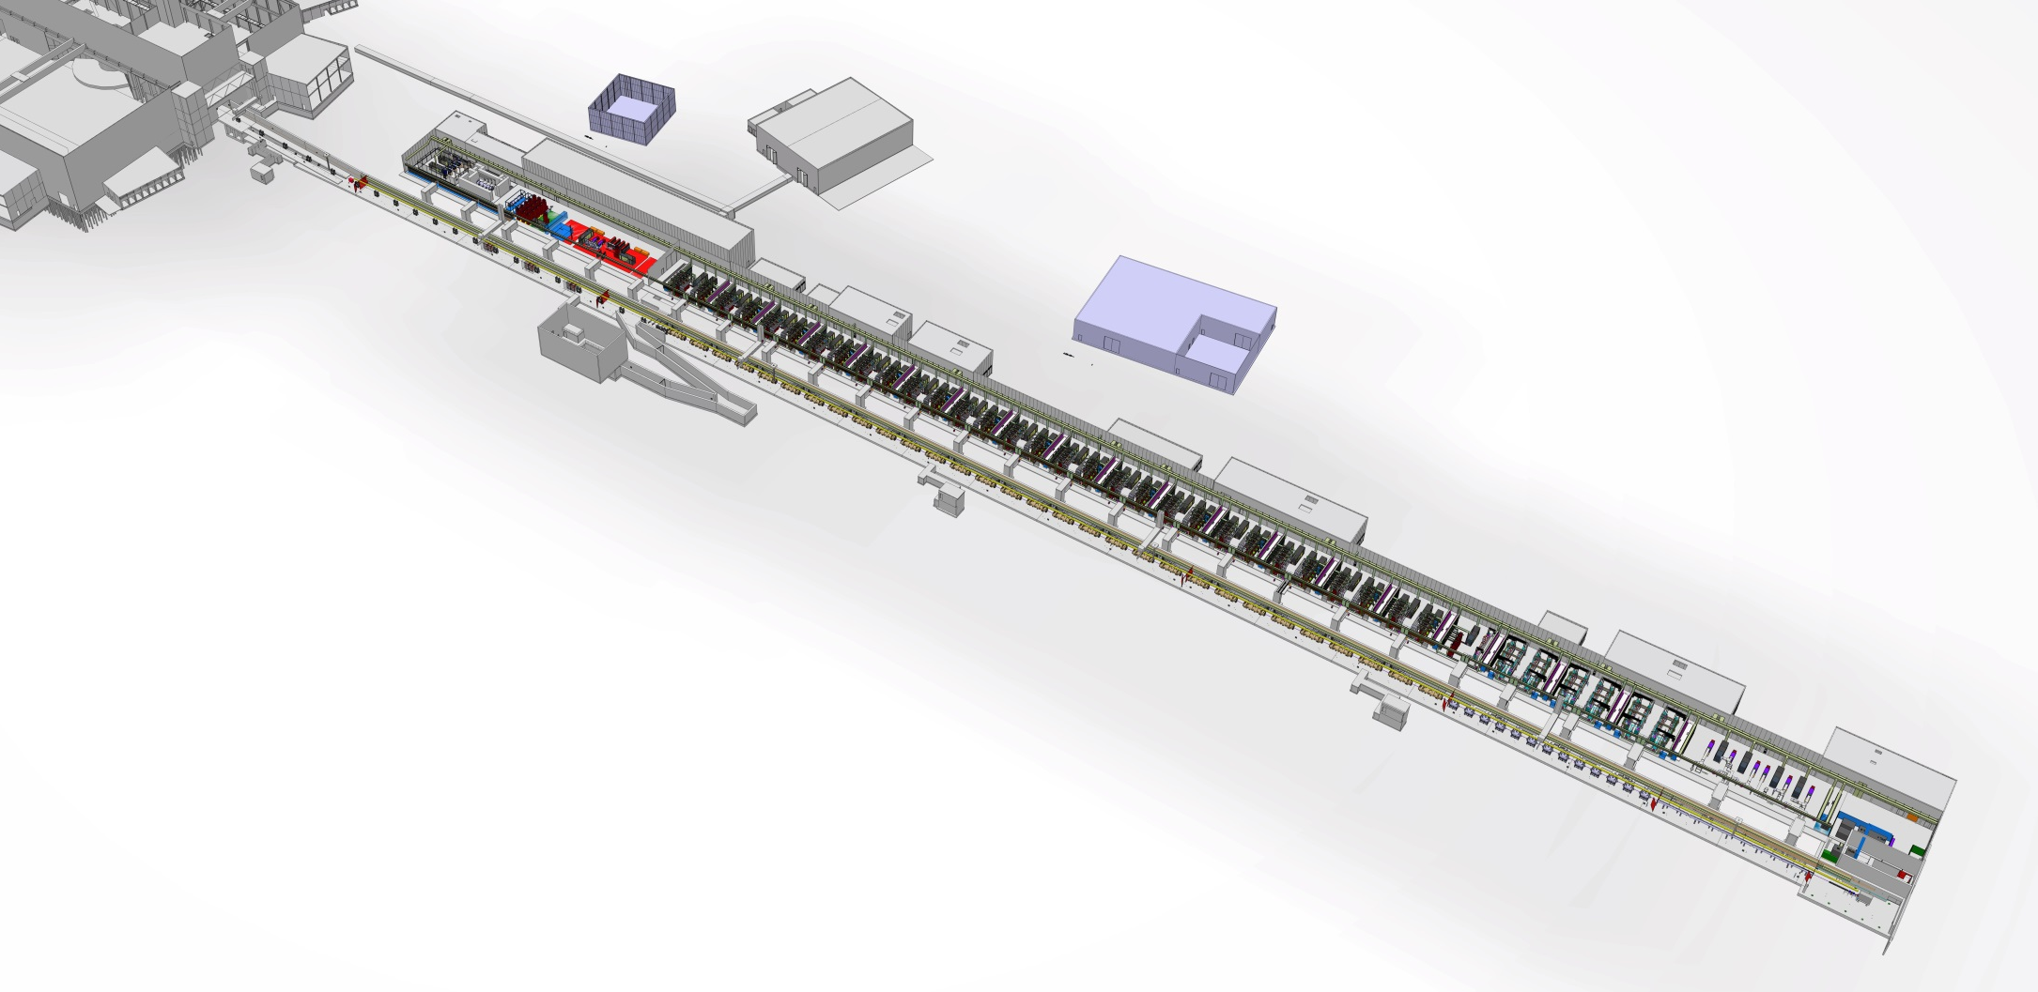
The ESS accelerator

Slide 9
Facility Breakdown Structure (FBS) Levels L1 – L4 for the ESS Accelerator
L1
ESS FACILITY
ICS – INTEGRATED CONTROL SYSTEMS
‘CONTROLS’
SI – SITE INFRASTRUCTURE
‘CONVENTIONAL FACILITIES’
NSS
‘INSTRUMENTS’
RMHF – RADIOACTIVE MATERIALS HANDLING FACILITY
L2
ESS SYSTEMS ‘PROJECTS’
ACC – LINEAR ACCELERATOR (LINAC)
‘ACCSYS’
TS – TARGET STATION
‘TARGET’
ISrc
DTL
(DTL tanks)
SPK
(LWUs, CMs)
MBL
(LWUs, CMs)
HBL
(LWUs, CMs)
Beam to Target
L3
LEBT
RFQ
MEBT
HEBT*
A2T
LINAC SECTIONS
CRYOGENICS DISTRIBUTION
DmpL
(inc. beam dump)
PWRC
PS, HV Power Convertors
ISS
Ion Source
Specialties
BMD
Beam Magnets &, Deflectors
EMR
EM Resonators
(Bunchers, RFQ, DTL tanks,
CMs)
PBI
Proton Beam Instrumentation
ID*
Intercepting Devices
L4
SUPPLIED BY WP 3, 6, 17
SUPPLIED BY WP 3
SUPPLIED BY WP 2, 3, 6, 17
SUPPLIED BY WP 3,4,5
SUPPLIED BY WP 7, 3**
SUPPLIED BY WP 3, 6
DISCIPLINE SYSTEMS (Mapping to WBS Work Packages shown)
RFS
Radio Frequency
Systems
VAC
Vacuum
CRYO
Cryogenics Systems
WTRC
Water Cooling
CNPW
Conventional Power
SA
Survey &
Alignment
SUPPLIED BY WP 8
SUPPLIED BY WP 3, 6, 12**
SUPPLIED BY WP 11
SUPPLIED BY WP 16, 3***
SUPPLIED BY WP 15
SUPPLIED BY Eng.&Int. Support Div.
Safety
To Be Determined or
To Be Agreed Upon
*Intercepting devices that are not part of VAC and PBI (not instrumented)
** Some vacuum chambers supplied by WP3, for raster magnets by WP6
*** RFQ and DTL cooling skids supplied by WP3
CM =CryoModule PWRC =PoWeR Convertors
HEBT=High Energy Beam Transport ISS =Ion Source Specialities
LWU=Linac Warm Unit CNPW=CoNventional PoWer
SUPPLIED BY WP 13
Date: 18-Jan-2016
Prepared by: E.Tanke, ESS-ACCSYS
CHESS#: ESS-0008904 R7

Slide 10
Integration Drawing Exchange Solutions – IDES Purpose
The ESS Linac is being built with contributions from 25 different institutions located throughout Europe
  Most of the components in the tunnel by In-Kind partners
  … but each partner uses a different CAD system to design
ESS integrates all these contributions.
  ESS needs to assimilate all the different design packages →one ESS design with Released contributions
  Without requiring in-kind partners to use a specific CAD software
ESS needs current status and rapid feedback on the progress of in-kind partner designs
  Civil construction of the ESS facility is well underway
  ESS needs to keep up with changes in designs as soon as they are available to assess impact on civil construction
  To keep track of changes, ESS uses file versioning and released revisions

Slide 11

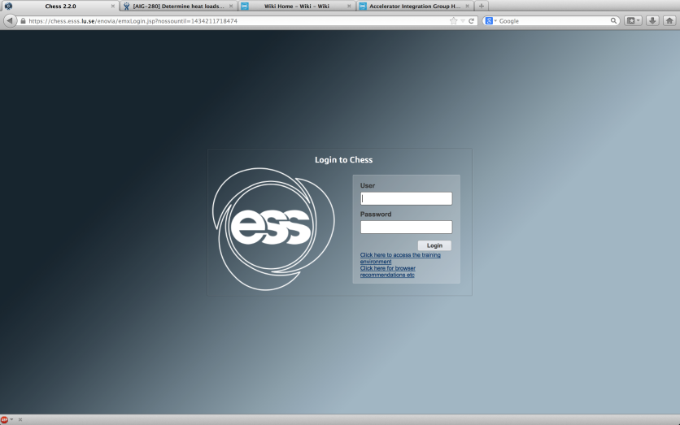
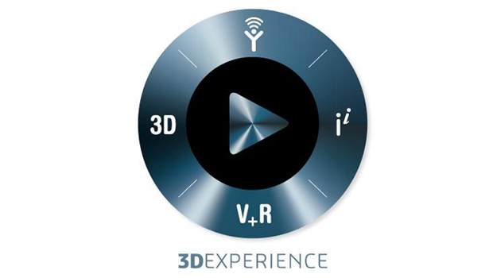
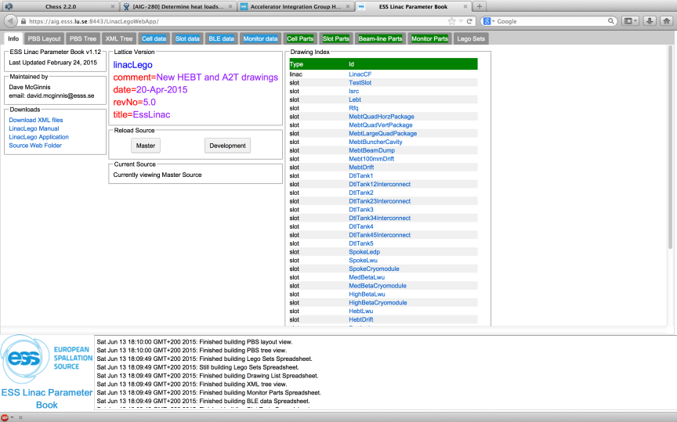
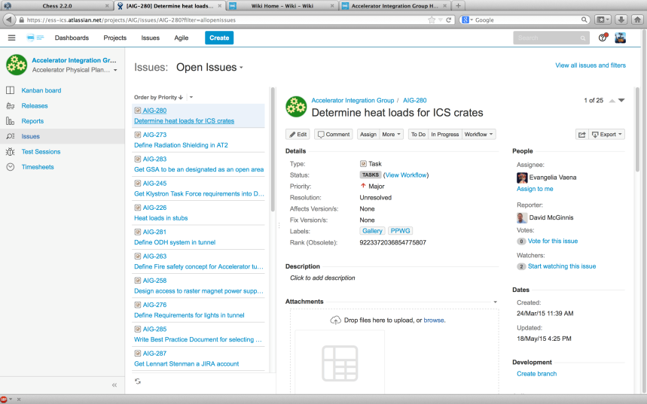
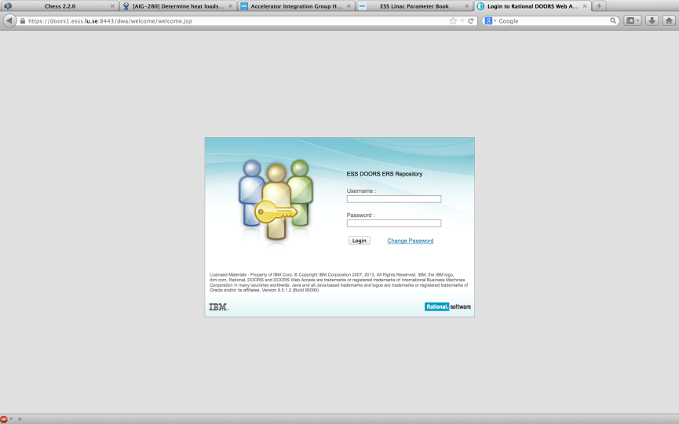
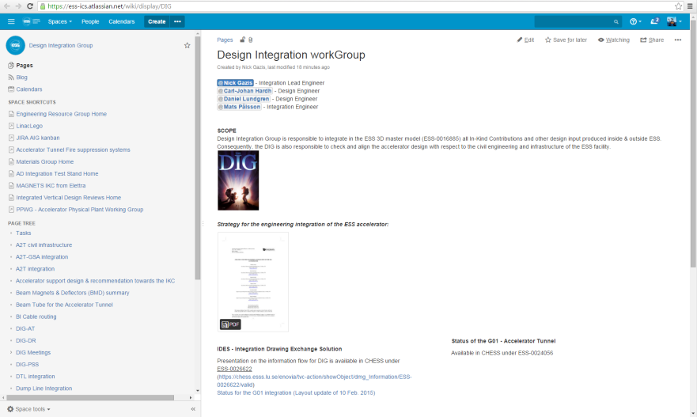
Selected technologies for the engineering integration strategy
3. CHESS
4. CATIA
Atlassian tool suite
5. JIRA
2. LinacLego
6. Wiki
1. DOORS

Slide 12


Selected technologies for the engineering integration strategy
SECTION
ISRC
LEBT
RFQ
DTL
SPK
MBL
etc…
CELL
SPK-01
SPK-02
SPK-03
…
SPK-13
SLOT
SPK-02-LWU
BEAMLINE ELEMENTS
SPK-02-LWU-QH01,
SPK-02-LWU-QH02, …
Level of exchange for the CAD files between IKC-ESS
SPK-02-CM

Slide 13
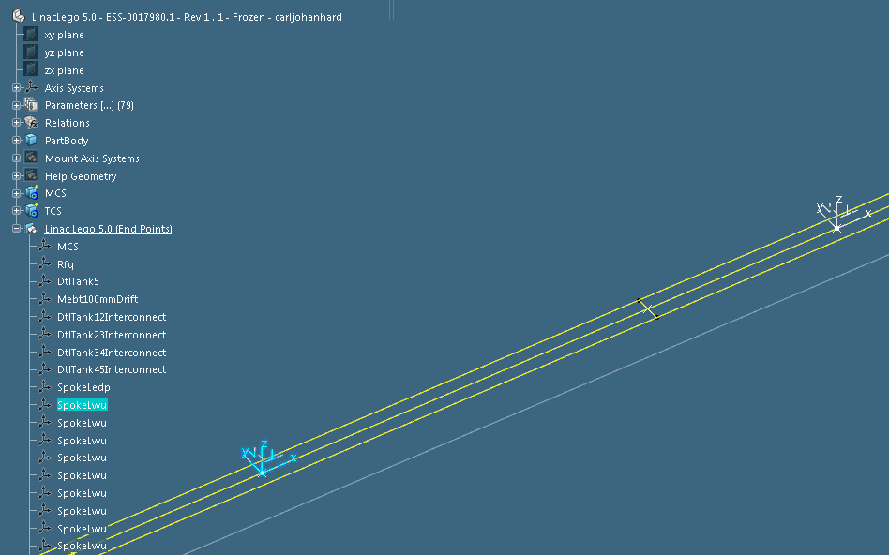
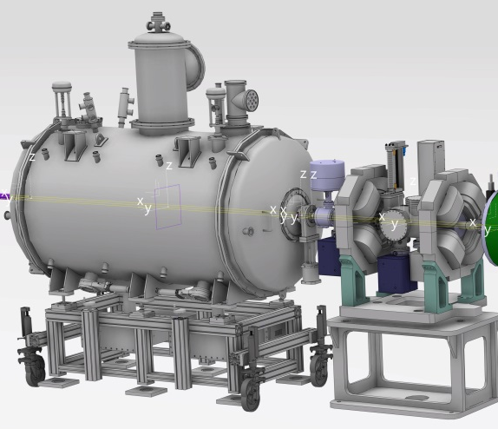
Integration and Verification
[cell] SPK-1
[slot] SPK-LWU-2
[slot] SPK-CM-1
[End Point]
SPK-LWU-1
Beam line
Beam line
Beam line
Beam line
SPK-CM-1
SPK-LWU-2
13

Slide 14
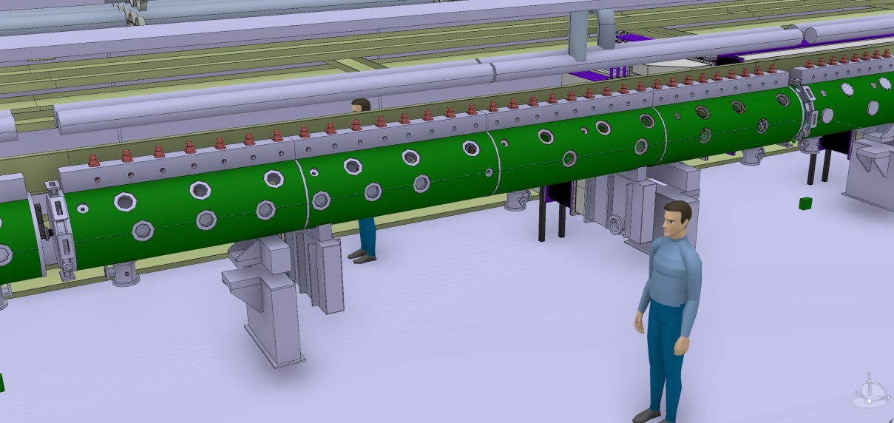
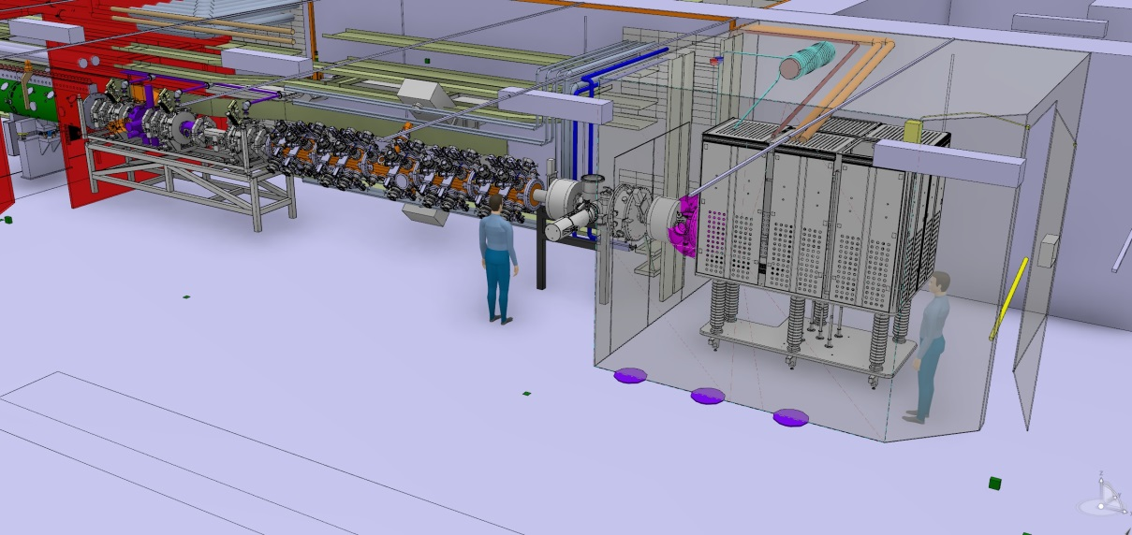
Integration and Verification – Warm linac
ISRC is situated inside the HV cage
Access to the installations (north) tunnel wall could be possible under the LEBT/RFQ/MEBT (t.b.d.)
Access to the installations (north) tunnel wall is possible under the DTL

Slide 15
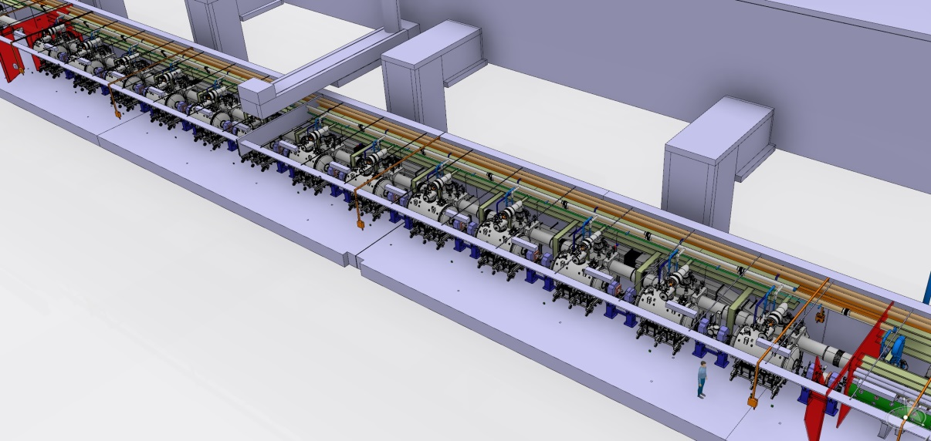
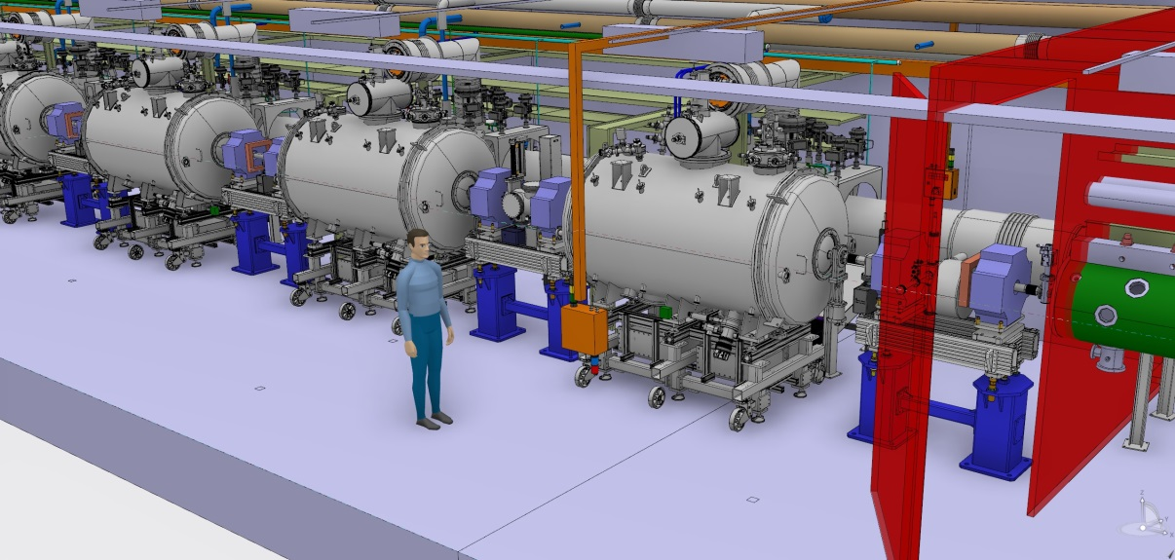
Integration and Verification – Spoke
Access to the installations (north) tunnel wall is possible under the LWU (through the LWU support table)
Temporary ladders can be installed on top of the LWU for access around it
SPK CM do not allow for access route to the installations (north) tunnel wall

Slide 16
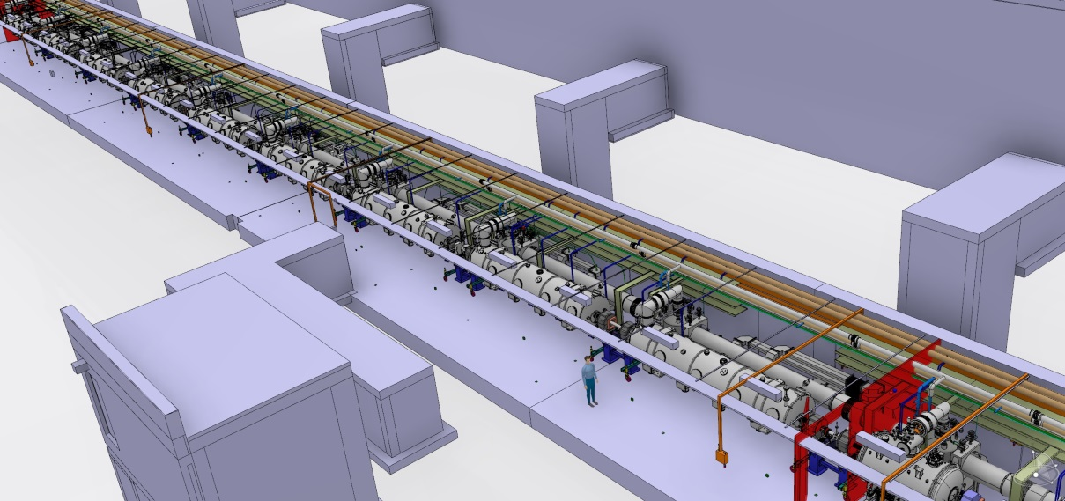
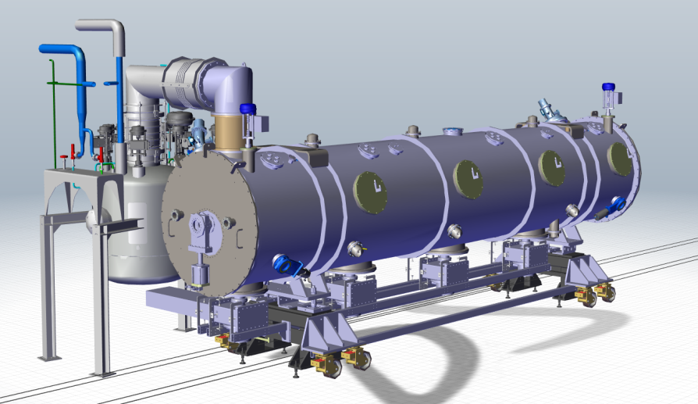
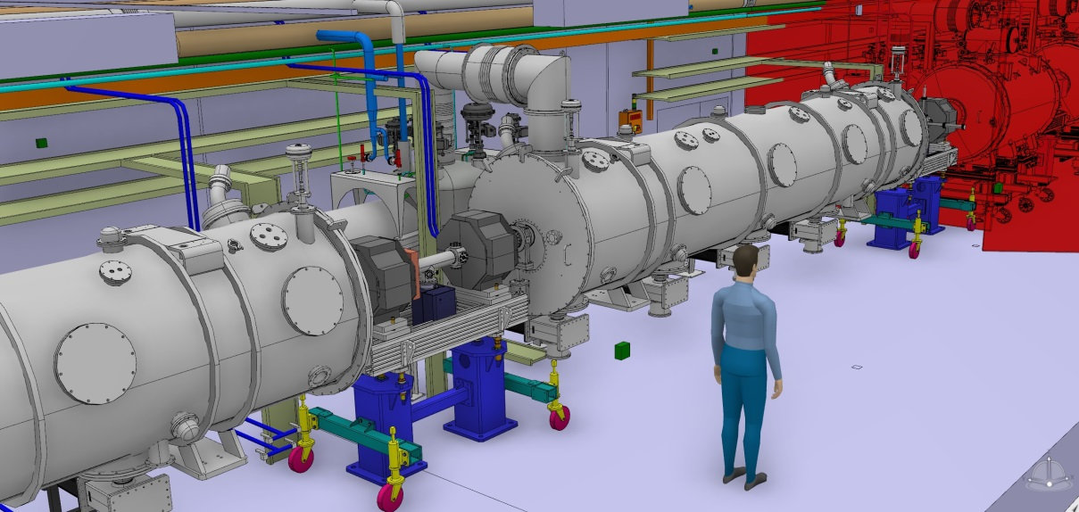
Integration and Verification - Medium & High Beta Linac (MBL & HBL)
Elliptical CM
Access to the installations (north) tunnel wall is possible under the LWU (through the LWU support table)
Temporary ladders can be installed on top of the LWU for access around it

Slide 17
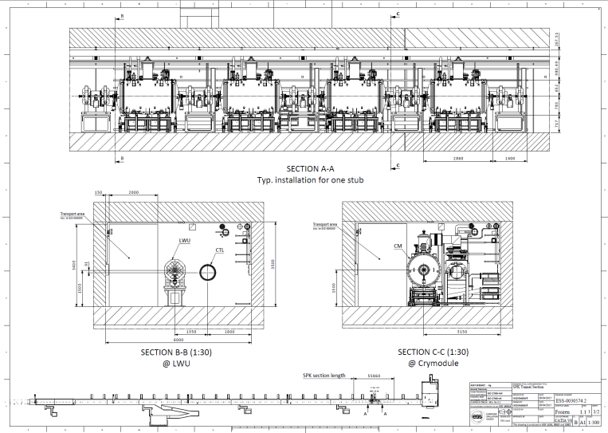
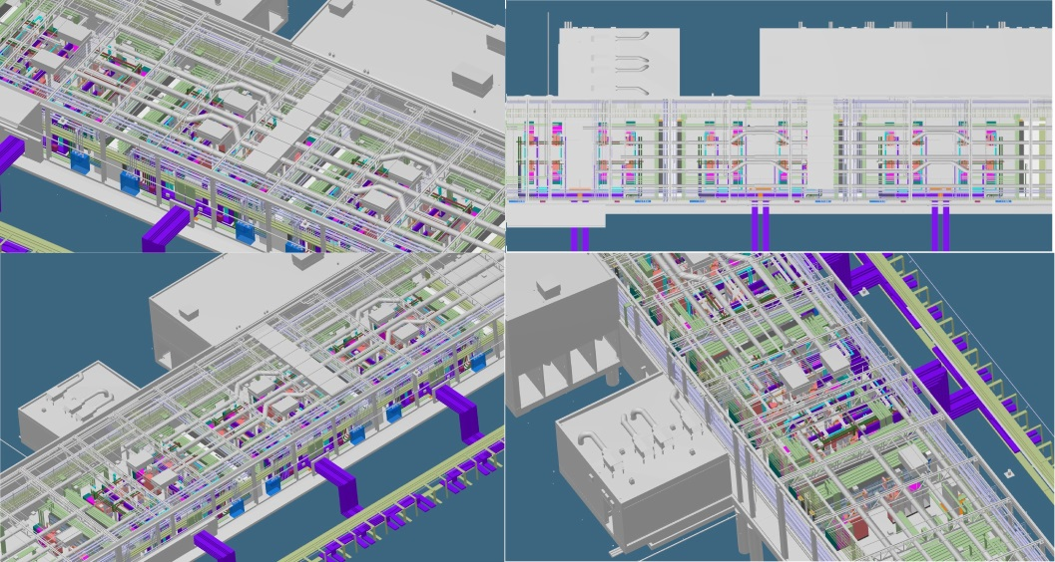
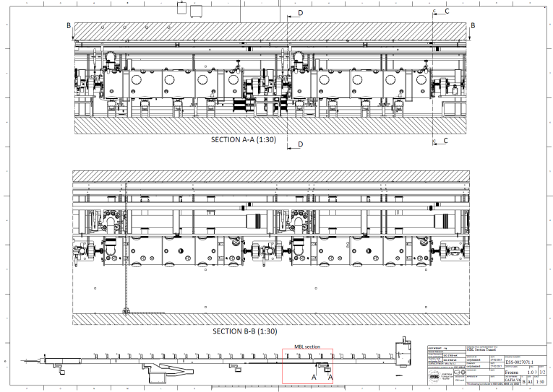
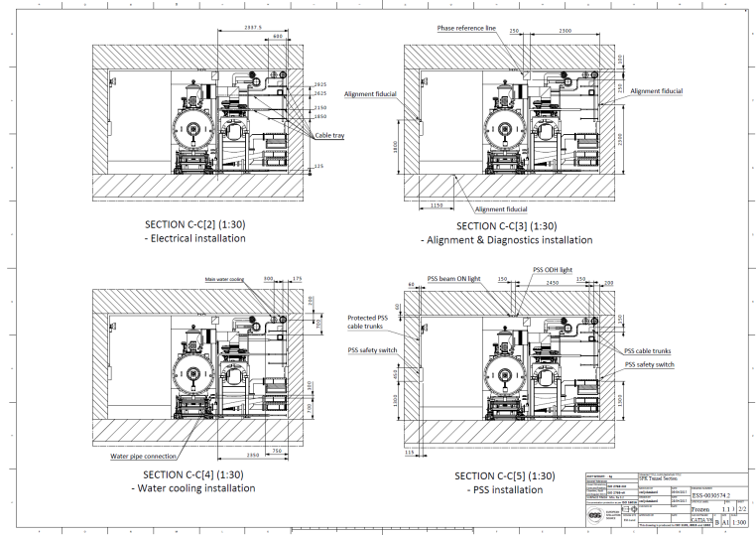
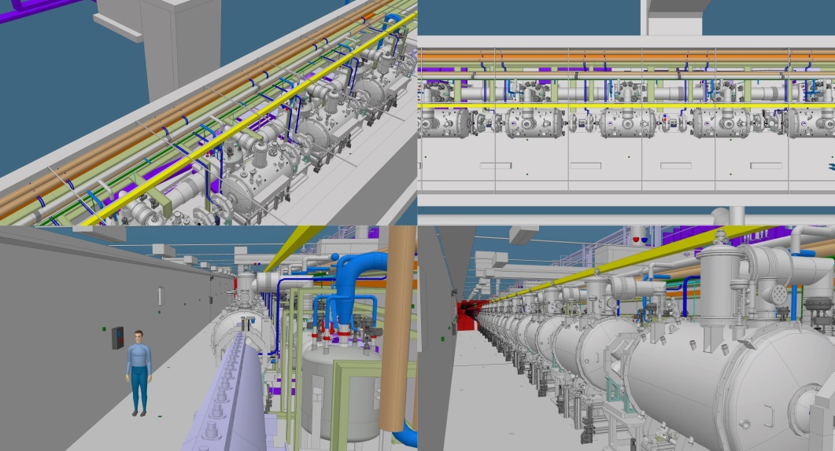
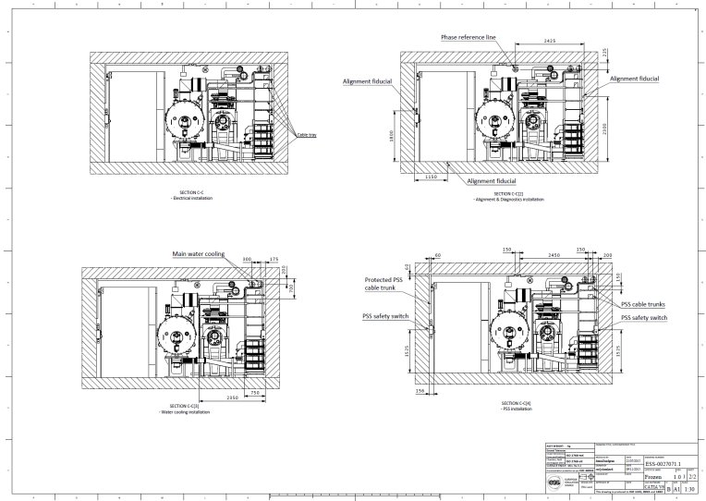
Baseline accelerator 2D drawings available
ESS-0030574 - SPK section
ESS-0027071 - MBL section

Slide 18
Installation
Initiating the ESS installation inside the construction phase

Slide 19
Accelerator Division (AD)
– Indicative tunnel installation
Slide courtesy of Eugene Tanke
Phases related to Installation, Testing and Commissioning (ITC) have been defined in ESS-0025640*:
  ITC Phase A: Installation
  ITC Phase B: Local testing without beam and without ICS
  ITC Phase C1: Local testing without beam, with ICS
    Local test including controls, e.g. controlling a power supply
  ITC Phase C2: Integrated testing without beam, with ICS
    End to end test including controls, e.g. controlling a power supply, concomitant magnet, water cooling, interlocks etc
  ITC Phase D1: Testing diagnostics with beam
    Will typically make use of a “probe” beam
  ITC Phase D2: Beam commissioning
    Goal during this phase is to prepare and deliver the required beam

Slide 20
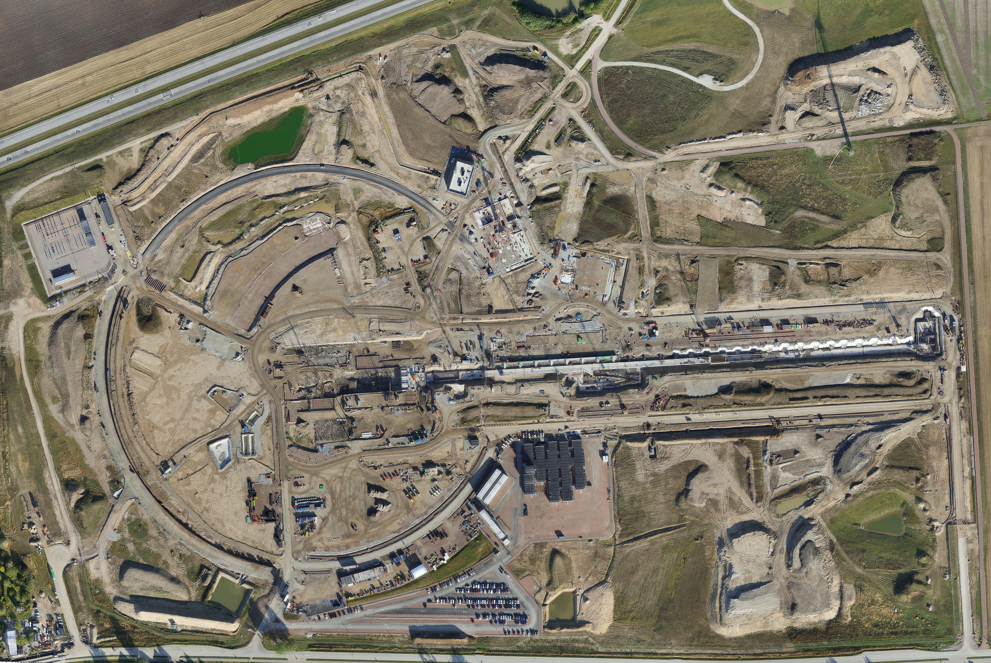
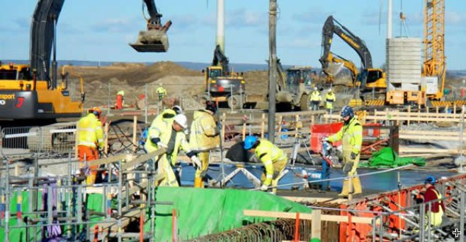
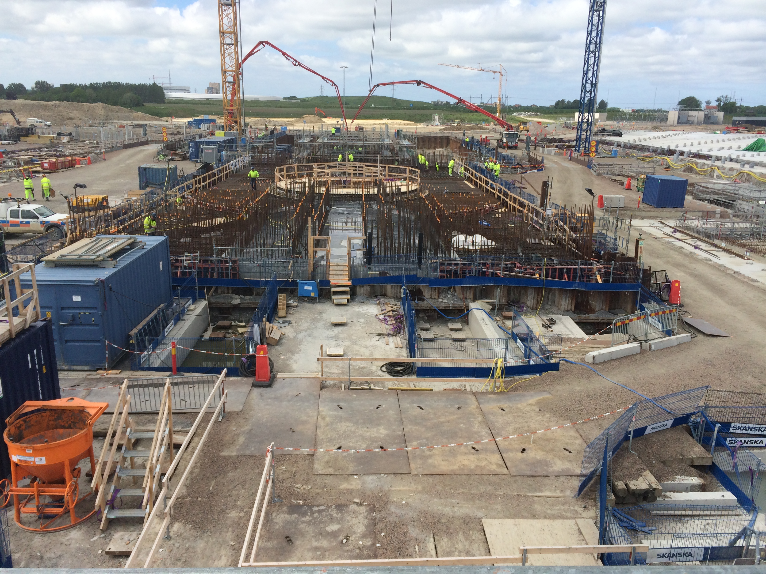
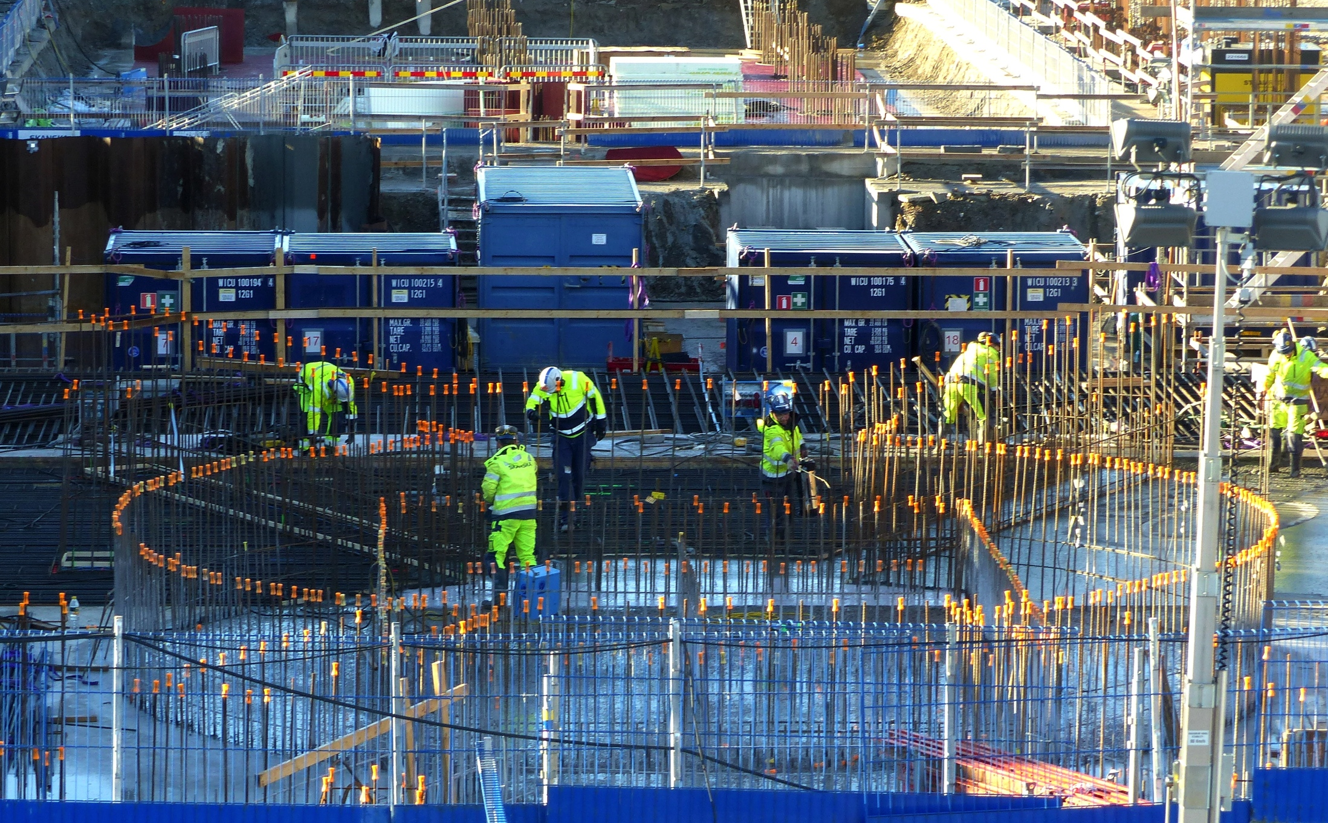
ESS is under construction and installation
Protons
Neutrons
Target
Moderator

Slide 21
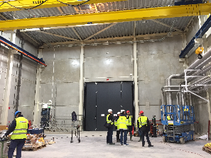





ESS is under construction and installation
G02 Coldbox & G04 Cryo compressor

Slide 22
Prototypes and testing
The first real parts of the ESS accelerator!

Slide 23

Indicative upcoming installation of ISRC&LEBT – Nov.2017
Cooling water
Fiber optics
HV power
Controls power
Vacuum
Diagnostics
Control system
H₂ gas delivery
Ground connections
Cables, power, water cooling, compressed air, drilled holes, etc. needs to be in place before the installation starts!
23

Slide 24





Preparation for the upcoming installation of ISRC&LEBT – Nov.2017
Teams from ESS already participate at the Ion Source and LEBT pre-installation in Catania

Slide 25

Cavity Prototypes
One spoke cavity installed on the cryo-insert for experiment at 2K
For both WP4 and WP5: Results of the study by TUV Nord on pressure vessel issues confirms that both spoke and elliptical CMs comply with the relevant safety specification (section 3-3 of the PED). This permited Nb procurement in Spring 2015 (as planned).
WP4 Spoke Cavities & Cryomodules
2 prototype Spoke Cavities tested vertically at 2 K
Results are gratifying - Pictures and data plots are worth a thousand words
Construction of other subsystems for the prototype CM is well underway

Slide 26



Cavity Prototypes
The 3 spoke cavities prototypes:
named: Romea, Giulietta and Germaine
Romea
Giulietta
Germaine
Cross section view of the cavity inside: the spoke bars

Slide 27

HNOSS

Slide 28






Integration Test Stand at Lund

Slide 29


Reduced Scale modulator prototype
Electrical schematic
Part I
Part II
Part I – Low Voltage driver (Feb. 2015)
on resistive loads (@1kV);
Part II – HV oil tank assembly (April 2016)

Slide 30




Reduced Scale modulator prototype
1)- Contract signed on Oct 14th 2015
3)- March 2016
HV module #1 to #6 assembled and placed in the frame;
Yellow: primary voltage of HV module #1
Magenta: primary current of HV module #1
Blue: output voltage pulse
(in open loop, no regulation);
2)- Feb 2016
All parts/components delivered;
- HV module #1 assembled;
4)- March 2016
at LTH Test Stand:
- Preliminary testing of the full HV oil tank assembly at low voltage;

Slide 31



1.2 MW of Peak Radio Frequency Power Extracted from the First ESS Klystron
May 2017, ESS Integration Test Stand:
Demonstration that the ESS Klystron could absorb over 2 MW of peak input power. Over 55% of that input power was converted into RF waves oscillating at 704 MHz (1.2 MW) to be used in the ESS Linac. Ongoing step is the development and testing of the fast interlocks and increasing operational duty factor.

Slide 32
Non Destructive Testing (NDT)
NDT (in use) for Accelerators – NDTA

Slide 33
Accelerator prototypes, testing & NDTA
Various demanding reasons dictate that accelerators follow prototype production
(cost, innovative technological solutions, available technology, etc.)
Testing is one of the key parameters for the prototypes to operate
Monitoring utilizing NDT could prove one of the key parameters for optimizing both machine reliability and availability
Initiated in ESS the study suite of
Non Destructive Testing for Accelerators (NDTA)

Slide 34
Accelerator prototypes, testing & NDTA
Monitoring and mapping with Non Destructive Testing (NDT) optimizes
  cost
  maintenance time
  personnel interventions
  real-time diagnostics (micro- and macro- properties of the ESS-Accelerator)
  Monitoring of the integrity for all components
  Generation and maintenance of engineering properties database (for the structural response of accelerator systems)
  Improve machine reliability & availability
  and so many more..
First NDTA experiments in ESS
  ESS-0042129:
  Research and development STUDY for the design and implementation of Resonant Ultrasound Spectroscopy (RUS) testing on accelerator components
Initially basis of the NDTA strategy is on Resonant Ultrasound Spectroscopy (RUS)
Foresee to combine RUS with Lazer-RUS
Long-term NDTA development involves also
High Definition Fiber Optic Sensing (HD-FOS)

Slide 35




NDTA based on RUS – Thanks to Prof. Solbrekken, University of Missouri
Preliminary RUS Testing - 3mm Sample
Preliminary RUS Testing - 1mm Sample
Repeatability and Abaqus simulations ongoing

Slide 36









More on NDTA on Nb samples

Slide 37
Open points on NDTA to address with the ESS machine operation
Structural perturbations on the accelerator samples is not (yet) acceptable
Other perturbations though would be interesting to detect them on our beams
Would vacuum induce any change on the measurements (spectra)?
Does gravity (or different fixation/supporting points) induced background influence the spectra (or other measurement noise)?
Can RUS/L-RUS produce useful spectra from accelerator systems that are firmly “hyperstatic” supported and aligned?
Can we correlate data from different NDTA techniques ?
(Strains/deformations Vs stress Vs radiation background Vs thermal dilatation Vs time of duty cycles Vs beam stability Vs luminosity Vs beam dynamics Vs..)
What is the most efficient NDTA technique?
  RUS
  L-RUS
  Quasar
  HD-FOS
  Optical fibers with FBGs (radiation hard fibers)
  Or other -sky’s the limit-

Slide 38

September 2014

Slide 39

January 2016

Slide 40

February 2016

Slide 41

January 2017

Slide 42
Thanks to..
Mats Lindroos,
Roland Garoby, David McGinnis, Eugene Tanke, Stephen Molloy,
Design Integration workGroup (DIG)
Accelerator Installation Team (AD-Inst.)
Engineering Resources Group (ERG)
for their contributions and help for the material presented.

Slide 43



Last slide
Archaeological Museum of Aegina: vases from Archaic period 700-480 B.C.
http://aegina.info/aegina/mouseia/arxaiologiko-mouseio-aeginas.html
Thank you for your attention!

Slide 44
















Financing includes cash and deliverables
SPARE SLIDE
Host Countries of Sweden and Denmark
47,5% Construction
15% Operations
In-kind Deliverables ~ 3%
Cash Investment ~ 97%
Non Host Member Countries
52,5% Construction
85% Operations
In-kind Deliverables ~ 70%
Cash Investment ~ 30%
44

Slide 45
The ESS Linac
SPARE SLIDE
The European Spallation Source (ESS) will house the most powerful proton linac ever built.
  Average beam power of 5 MW.
  Peak beam power of 125 MW
  Acceleration to 2 GeV
  Peak proton beam current of 62.5 mA
  Pulse length of 2.86 ms at a rate of 14 Hz (4% duty factor)
97% of the acceleration is provided by superconducting cavities.
The linac will require over 150 individual high power RF sources
  with 80% of the RF power sources requiring over 1.1 MW of peak RF power
  We expect to spend over 200 M€ on the RF system alone

Slide 46

The Long Pulse Concept
SPARE SLIDE
Advantage - No compressor ring required
  No space charge tune shift so peak beam current can be supplied at almost any energy
  Relaxed constraints on beam emittance
    This is especially true if the beam expansion system for the target is based on raster scanning of the beam on the target.
  No H- and associated intra-beam stripping losses
  Permits the implementation of target raster scanning
Disadvantage - Experiment requirements “imprint” Linac pulse structure
  Duty factor is large for a copper linac
  Duty factor is small for a superconducting linac

Slide 47

Target station converts protons to “slow” neutrons
SPARE SLIDE
Diameter ~ 11 m
Height ~ 8 m
Mass ~ 7000 ton (mainly steel)
Functions:
Convert protons to usable neutrons
Heat removal
Confinement and shielding
Unique features:
  Rotating target
  He-cooled W target
  High brightness moderators
Target drive housing
Monolith
liner
Steel
shielding
Neutron beam extraction
Proton beam window
Target wheel
Moderator and reflector plug
Neutron beam window

Slide 48

ESS Instruments index
SPARE SLIDE
These instruments are gradually being replaced by instrument concepts selected for construction.

Slide 49

Science Drivers for the Reference Instrument Suite
SPARE SLIDE

Slide 50



IKC 3D model guidelines - ESS-0023754
SPARE SLIDE
  Export CAD model structure - 3D model export structure:
Product (assembly) at the top level
Skeleton part
IKC delivery unit
A dedicated axis system is needed on all above mentioned insertion points
CAD Integration reference points
Geometrical points | Mechanical points IN, OUT, MID of the slot on the beam plane Installation points e.g. support interface points Operation points centerpoints of interfaces e.g. flanges
Optical points | START, EXIT, MID of the lattice/optics reqs based on LinacLego (on the beam plane)
Reference points | Fiducial and alignment points

Slide 51
Installation Services available on-site from the AD Area Supervisors
SPARE SLIDE
AD will provide installation services and support on-site to facilitate the WP installations. These resources will be available from the AD Area Supervisors, following the WP’s requests as documented in the WSCP by the System Leaders (for each WP).
Logistics:
  The System Leader(s) document in the WSCP all needs for logistics and transportation.
  Contact ESS Logistics (Jorgen.Larsson@esss.se and/or Jan.Lundin@esss.se) to organize IKC shipments to ESS Lund. All transportation and logistics of the WP shall be supervised/organized by ESS Logistics.
Alignment:
  The System Leader(s) document in the WSCP all alignment needs.
  Contact ESS Survey and Alignment Group (Fabien.Rey@esss.se) to detail the alignment steps.
Electrical installations:
  The System Leader(s) contact the AD electrical group (Frithiof.Jensen@esss.se) for all electrical-related installation support.
Vacuum installations:
  The System Leader(s) contact the AD vacuum group (Marcelo.JuniFerreira@esss.se) for all vacuum-related installation support.
Controls:
  The System Leader(s) contact ICS (Hector.Novella@esss.se) for all controls-related installation support.
  Installation support*:
  *Please, refer to next slide for details on the available installation support.
  The System Leader(s) document in the WSCP all needs/support on technicians, manpower, services and tooling on-site during their installation.
  Contact AD Installation team (Nick.Gazis@esss.se and Area Supervisors of Slide 10) to detail planning of the installation support.

Slide 52
Installation Support available on-site from the AD Area Supervisors – (1/2)
SPARE SLIDE
AD will provide installation support on-site to facilitate the WP installations. These resources will be available from the AD Area Supervisors, following the WP’s requests as documented in the WSCP by the System Leaders (for each WP).
Installation teams (manpower):
  The System Leader(s) document in the WSCP all needs for technicians and manpower for installation.
  After agreement with the Area Supervisors, technicians and manpower (upon availability) can be assigned directly under the command of the System Leaders (only during the installation of the relevant WPs).
Design teams:
  The System Leader(s) document in the WSCP all design needs for 2D-drawings and installation maps.
  After agreement with the Design Integration workGroup (AD-DIG) and upon availability of the design engineers, installation related drawings can be provided.
Electronics, tooling and consumables support:
  The System Leader(s) document in the WSCP all needs for electronics, tooling and consumables (e.g. network analyzers, hand-tools, bolts & nuts, shims, temporary support frames, air-pads etc.).
  After agreement with the Area Supervisors, basic electronics, tools and consumables can be available on-site, following the WSCP.
  Please, verify availability with the Area Supervisors.
  It is strongly advised to the WPs to organize and come on-site individually with their needed electronics, tooling and consumables – keep in mind that no-workshop/no-electronics lab is available on-site (but it will be available in close proximity).

Slide 53
Installation Support available on-site from the AD Area Supervisors – (2/2)
SPARE SLIDE
Industrial machinery support:
  The System Leader(s) document in the WSCP all needs for industrial machinery (pallet-jacks, lifting devices, truck-rents, scaffolding, etc.).
  After agreement with the Area Supervisors, industrial machinery can be available on-site, following the WSCP.
  Please, verify availability and use-process with the Area Supervisors.
  The WP can be requested to fund its specific requests via PCC code, after agreement with the Area Supervisors.
Industrial services support:
  The System Leader(s) document in the WSCP all needs for industrial services support (storage, workshop, lay-down areas, etc.).
  After agreement with the Area Supervisors, ESS central services can be provided on-site (waste management, air supply, WiFi, electricity, storage, workshop, lay-down areas, etc.), following the WSCP instructions.
Shielding and sealing materials:
  The System Leader(s) document in the WSCP all needs for shielding and sealing (fire or other) material.
  After agreement with the Area Supervisors, the ESS-approved shielding and sealing materials can be provided, following the WSCP.
Training courses and certifications:
  The System Leader(s) document in the WSCP all needs for training courses and certification related to installation.
  The WP have to comply to the certification requested by the Area Supervisors
  (according to the applicable Swedish legislation and ESS local rules).
  The WP will fund entirely the required training courses, according to their installation needs.
Installation infrastructure:
  AD will provide power (general locations), area lighting, fire extinguishers and local first aid stations

Slide 54

AD installation sequence
SPARE SLIDE
Slide courtesy of Eugene Tanke
Water pipes
Top cable trays
Cryo distribution line
Cryo valve box
Cryo valve box line
Distribution cable trays
Critical Point:
Planning might be compromised,
if the installation sequence is perturbed.
Mitigation:
Maintain the full access dates as agreed
Definition and simulations (3d model) of the installation sequence
Availability of Task Masters and other installation services
Coherent archiving of installation documentation on a central ESS level
Goal:
Ensuring the installation sequence and plan
Bottom cable trays

Slide 55
AD installation sequence
SPARE SLIDE
Current tunnel installation sequence:
Marking
Hole Drilling
Water-cooling pipes installation (inclduing dedicated supports)
Cable trays and grounding bus bar installation (inclduing dedicated supports)
Phase Reference Line (PRL) installation
Stubs (trays, waveguides, cables) installation
NCL and CDS
CryoModules (CMs) and LWUs.
High level of complexity is evident so efficient coordination is explicit!

Slide 56
Non-Destructive Testing for Accelerators – Scope & Objectives
SPARE SLIDE
Scope of the NDTA study is to introduce and describe the application of the non-destructive RUS testing on accelerator systems in order to service the goals of high availability and reliability for the ESS machine.
In order to reach the scope of the study, it is required to address the following objectives (technical issues) with respect to accelerating systems:
Real-time diagnostics of the micro- and macro- properties of the ESS-Accelerator slot components and engineering behaviour of the accelerator components
Monitoring of the integrity of the slot components
Schedule interventions (according to the ESS operations plan) for preventive maintenance
Reduce maintenance time and lower beam down-times
Gathering of information for the “normal” spectrum response of the ESS-Accelerator slots
Creation and maintenance of a database for capturing the engineering (structural, modal, etc.) properties and information for the structural response of dedicated accelerator slots
  during beam-off (reference background)
  during beam-on (radiation background)
Measuring of the resonant response of the machine during shut-downs so as to check the slot integrity
Experimental model definition of the ESS accelerator resonant response
(Slots are defined as installation sub-assemblies of the ESS accelerator )

Slide 57





ESS is under construction
SPARE SLIDE

