Slide 1
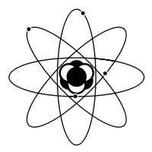


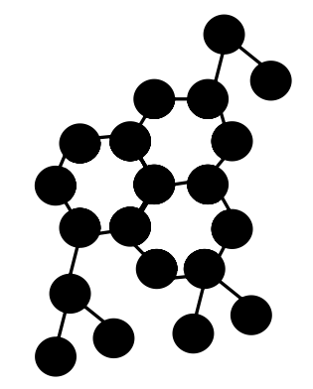


The ISOLPHARM Project
New method for production of high specific activity
radionuclides as radiopharmaceutical precursors
Alberto Andrighetto
INFN – Laboratori di Legnaro

Slide 2
Talk Overview
The SPES project at LNL
Radiopharmaceutical production
ISOLPHARM: a new method based on ISOL technique
Innovative radio-isotopes for nuclear medicine
Experimental activities
Conclusions

Slide 3
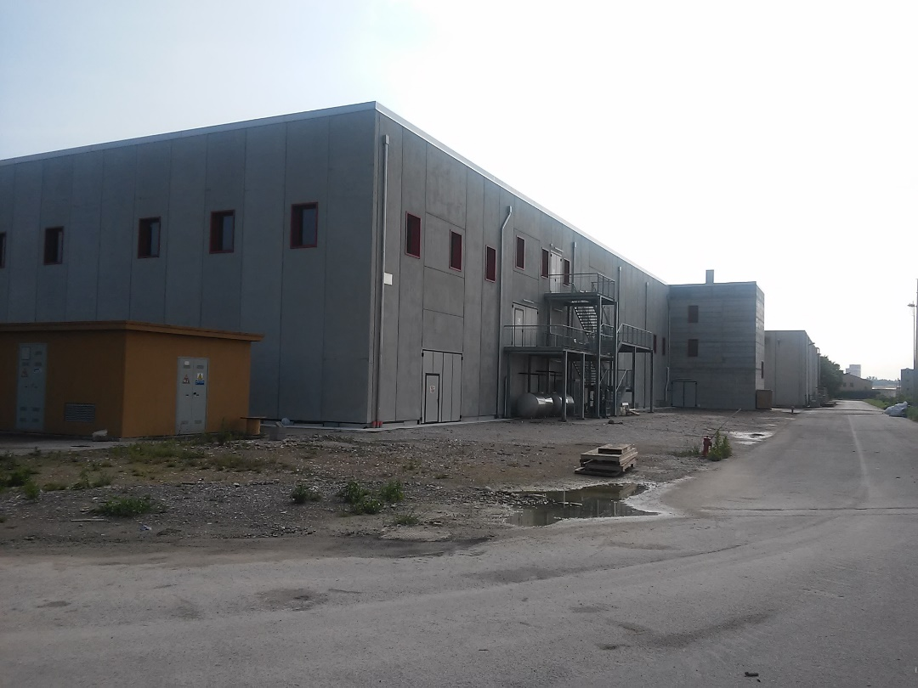
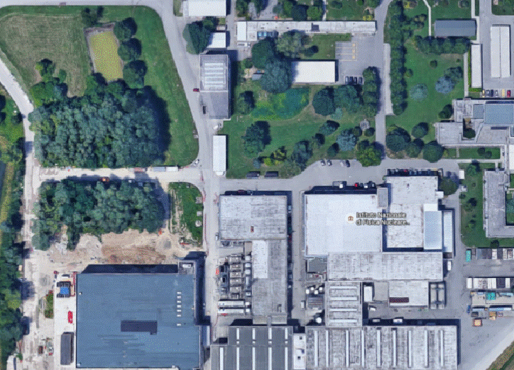
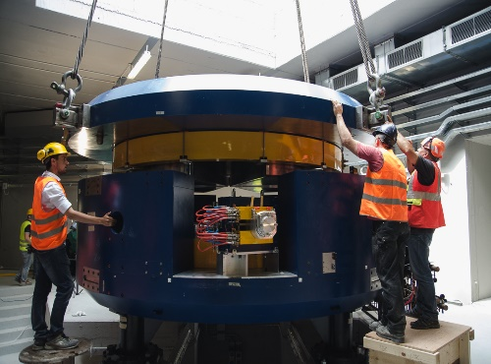
The SPES at LNL: Facility Layout
New Building:
Project financied by INFN
New infrastructure for:
Application Facility
Cyclotron
RIB facility (2th generation ISOL)
Notes:
Unico punto in cui si parla di building&infrastr., poi c’è la visita.
E’ stato realizzato l’edificio per il ciclotrone, le stazioni di irraggiamento ISOL e per le aree applicative, il sistema di selezione in massa. Il nuovo edificio è collegato all’edificio ALPI.
The new building has a surface of almost 3600 mq with an underground level connected to the third experimental hall and the ALPI building. The beam transport, together with the CB and the Medium Resolution Mass Separator, will be mounted inside the third exp hall and the RFQ will be inside the ALPI building.

Slide 4
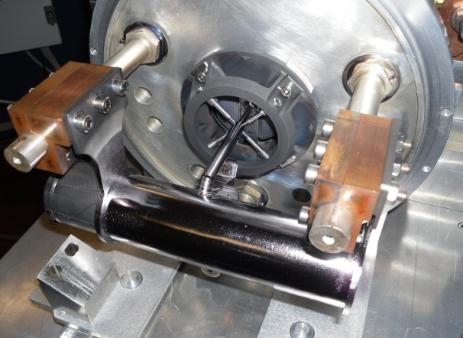
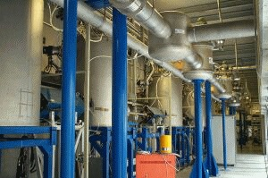
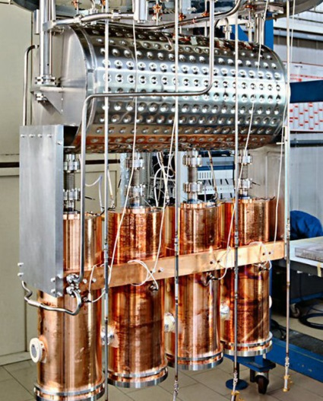
SPES-RIB (ISOL): main apparatus
1 - Driver:
Best Theratronics cyclotron
4 – RIB production source:
3 - Post Accelerator:
NEW CONCEPT
(Multi-foil UCx target)
Alpi existing complex
2 - RIB manipulation
ALPI
Mass Separator (WF)
Beam Couler
HRMS
Charge Breeder
RFQ
Target-Ion Source Complex:
optimized for 8kW beam power
- E_{proton} = 40 MeV for RIB
10^13 fission/s.
Notes:
12/06/2017
4

Slide 5
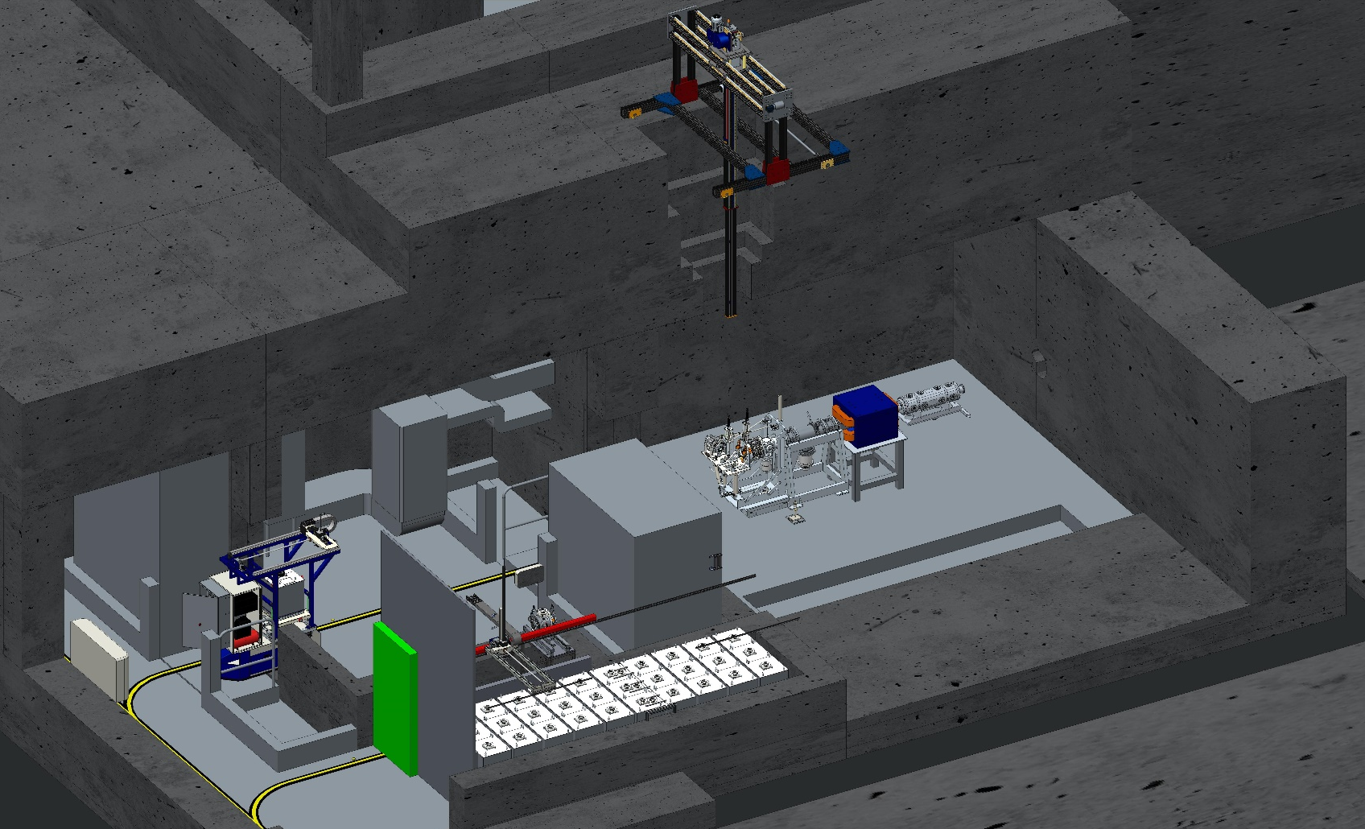
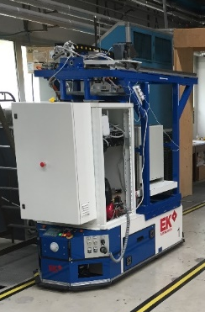
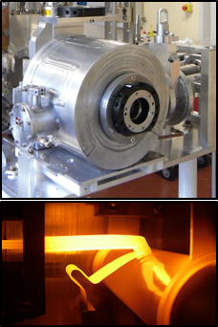
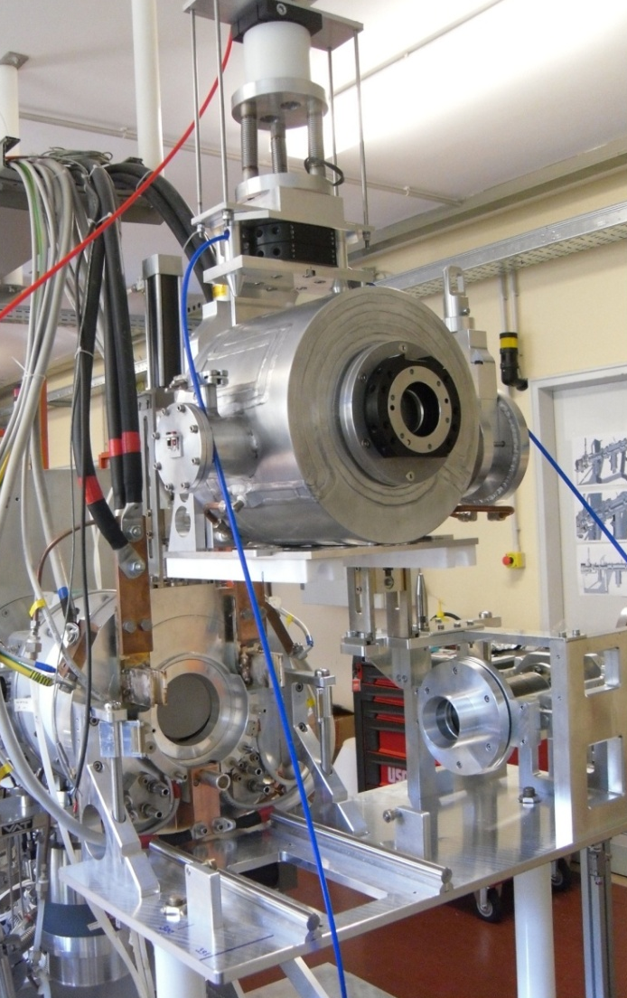
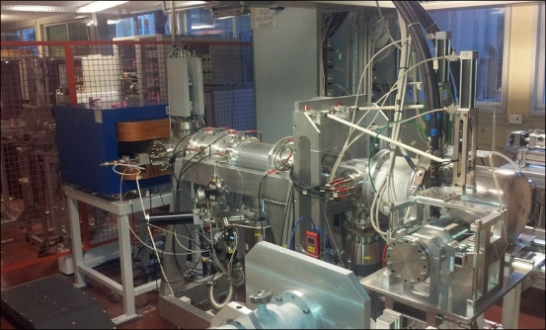
The SPES RIB source
horizontal handling device
TIS unit
vertical handling device
RIB
PROTON BEAM
front-end
temporary storage

Slide 6
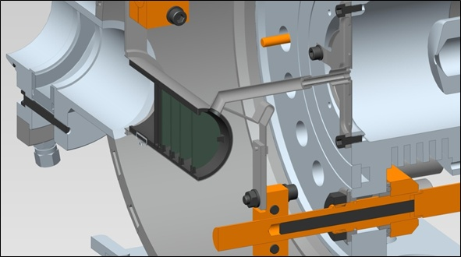
The TIS UNIT (general scheme)
Primary beam
Extraction Electrode (GND)
Fission fragments
Ions
Transfer Line
Ion Source (+HV)
Primary beam
Production target

Slide 7
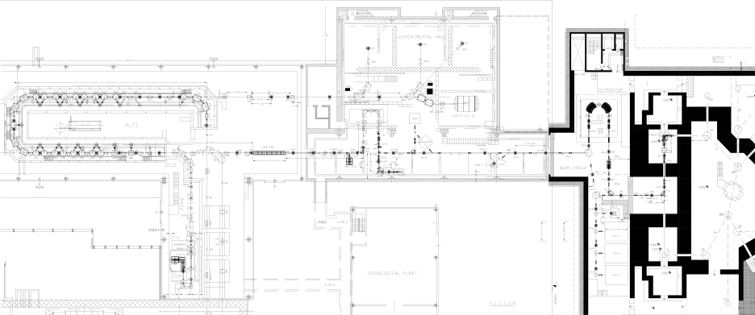
Project construction phases (RIB facility)
Exp. areas
MRMS
Phase 3
ALPI
HRMS
Phase 3.
Phase 2.
Target
RFQ
CB
Phase 1.
4) Post acceleration area
3) Beam Manipulation area
LRMS
1) Driver
Beam cooler
Phase 2.
PIAVE
Cyclotron
XTU-Tandem
1+ Exp. areas
2) RIB production area
Phase 1. - Building + First operation with the cyclotron
Phase 2. - From C.B. to RFQ + SPES target, LRMS, 1+ Beam Lines
Phase 3. - From the LRMS to the CB + rom RFQ to ALPI
Notes:
Se anche tu la fase 3 la splitti in due lo faccio anch’io: mi sembra più logico, di fatto sono due pezzi di macchina diversi, come per le fasi 2a e 2b

Slide 8
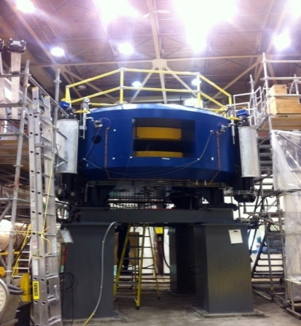
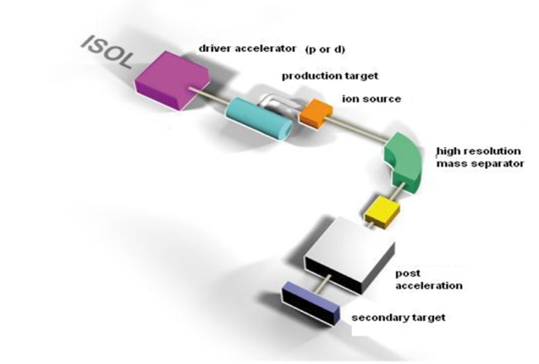
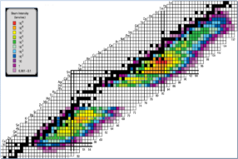

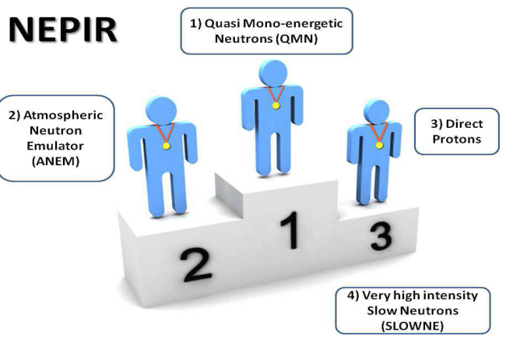
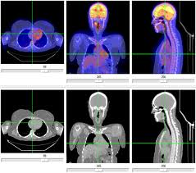
SPES: Is the future of LNL
SPES is: 1) A second generation ISOL facility (for neutron-rich ion beams)
2) An interdisciplinary research center (for p,n applications)
SPES-DRIVER
SPES-RIB facility
Financed &
Under construction
In commissioning
Cyclotron installation & commissioning:
E=70 MeV proton beam, I= 750 μA
Production & re-acceleration of exotic beams, from p-induced Fission on UCx
SPES Neutron facility
SPES for medicine
Proposal
Financed
Accelerator based neutron source
(Proton and Neutron Facility for Applied Physics)
LARAMED & ISOLPHARM projects
Radisotopes for medical applications

Slide 9
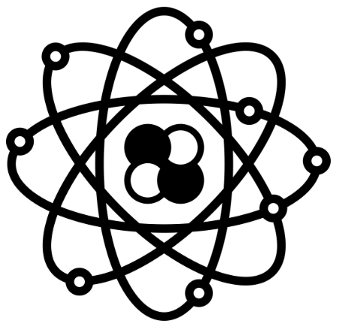

ISOLPHARM at LNL
A innovative method for medical applications
+
+
+
+

Slide 10
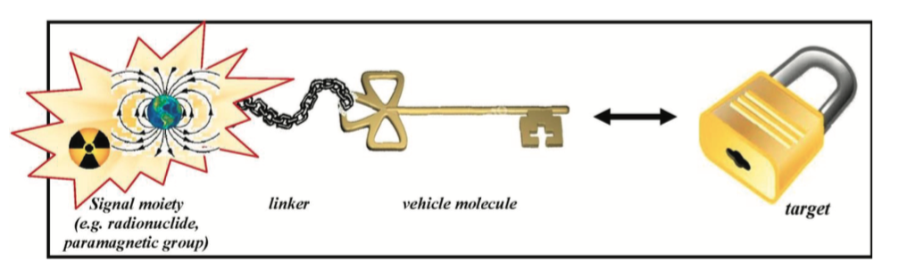
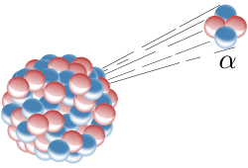
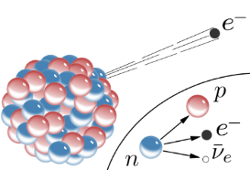
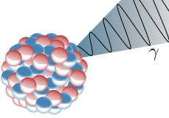
What is a radiopharmaceutical?
Radiopharmaceuticals are medicines that deliver a predefined amount of radiation to a target tissue for diagnostic or therapeutic purposes
They are made of a “radioactive core” and a “carrier system”, the latter allows the deposition of radiation onto the malignant cell population and avoids damage to healthy tissues
Radionuclides properties:
Therapeutic agents
Decay properties
Half-life
Chemical properties
Diagnostic agents
Production Feasibility

Slide 11


The Specific activity
The specific activity is a measure of the activity per mass -> GBq/mg (or Ci/mg).
A) Radionuclides diluted by isotopic impurities of the same element
Carrier-added radionuclides
(low specific activity).
B) Radionuclides without other isotopic impurity
Carrier-free radionuclides
(high specific activity).
Carrier free radionuclides are ideal to achieve high binding affinities to the receptors.
Only few sites are available on the cells -> optimization of radionuclide action !

Slide 12
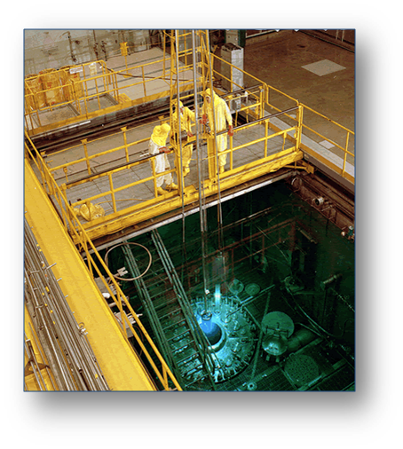
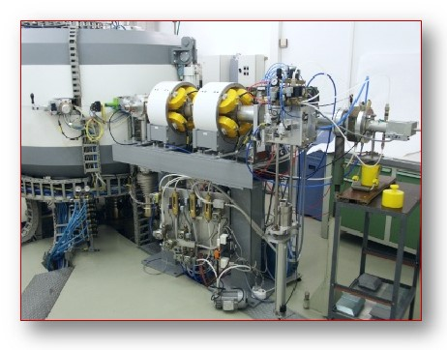
Production Methods
Nuclear reactor
2 main traditional methods
High neutron/proton fluxes required
Irradiation of targets of the same element
Direct reaction methods -> A(p,x) or A(n,x)…
Target with large activation levels
Chemical separation required
→ Isotopic impurities (Low S.A.)
Cyclotron
With ISOL technique:
Radionuclides can be easily produced as carrier-free isotopes (Mass Separation)
No nuclear reactor required for several beta- radionuclides

Slide 13
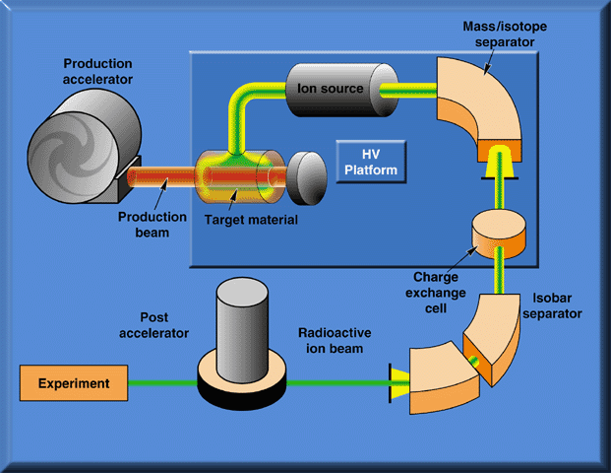
The ISOL scheme: 4 stages
Beam Separation
DRIVER
RIB Source
Beam Manipulations: Beam Cooler, Charge Breeding,
HRMS
Post-Accelerator

Slide 14
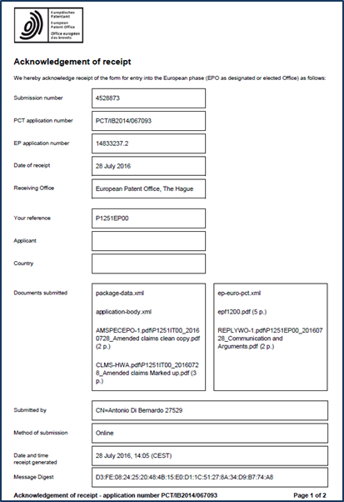
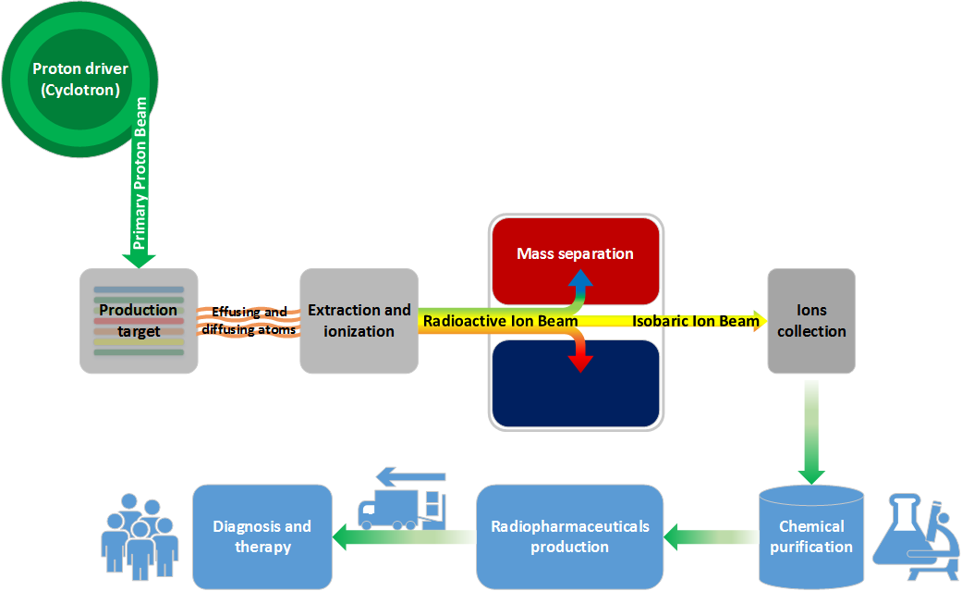
ISOLPHARM Method overview
The ISOLPHARM method is capable of selecting and isolating a
SINGLE RADIO-ISOTOPE
The ISOLPHARM patent
(EU + USA * Canada)
→ extremely high specific activity
→ the higher efficacy in therapy and diagnosis
ISOL
PHARM

Slide 15
ISOL vs others : specific activity
Radiopharmaceutical In the ‘market’ | Targeted organs | Half-life | Specific Activity (GBq/mg) #
 |  |  | ISOLPHARM technique production | Neutron capture reaction (Φ = 10¹⁴ cm⁻²s⁻¹)
⁸⁹Sr-SrCl₂ | Bone | 50.5 d | ≥ 597 | ≥ 0.004
⁹⁰Y-YCl₃ | Liver and endocrine system | 64.1 h | ≥ 9480 | ≥ 0.8*
¹²⁵I-NaI | Prostate, brain, lung, pancreas, liver | 59.4 d | ≥ 552 | ≥ 6
¹³¹I-NaI | Thyroid | 8.02 d | ≥ 3911 | ≥ 0.7
*Non carrier added ⁹⁰Y is also available from generators
Radiopharmaceutical | Targeted organs | Half-life | Specific Activity (GBq/mg)
 |  |  | ISOLPHARM technique production | 235U fission
¹³³Xe | Lung and liver | 5.25 d | ≥ 6920 | ≥ 3
Essential for the radioisotope conjugation to in-vivo carriers for targeted drug delivery
High specific activity
# Ref: http://www.nupecc.org/pub/npmed2014.pdf -> (NuPECC) – Report of Nuclear Physics for Medicine

Slide 16
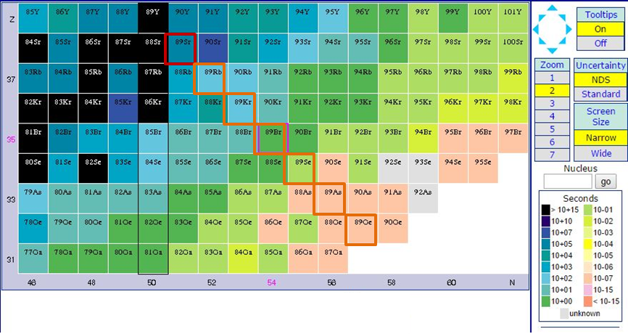
The ‘lucky’ case of ⁸⁹Sr
Strontium-89 is a neutron-rich nuclide, with a l half-life of 50.5 days
Large Yields in the ²³⁸U(p,fission)⁸⁹Sr reaction -> (p=40 MeV)
It is a pure beta emitter -> ( easy working processes )
All the isotopes of mass 89 quickly decay to Strontium-89.
⁸⁹Sr Parents:
⁸⁹Rb = 15 min
⁸⁹Kr = 3 min
⁸⁹Br = 4 sec.
⁸⁹Se = 0,4 sec.
A simple and effective mass separation will allow the production of a carrier-free strontium-89 isotope (further chemichal separation is not neccessary)

Slide 17
⁸⁹Sr Production routes
Traditional methods (reactor)
Neutron capture of ⁸⁸SrCO₃ targets
ISOLPHARM method
⁸⁸Sr(n, γ)⁸⁹Sr
²³⁸U(p, fission)⁸⁹Sr
Low Isobaric contamination in the substrate
Large Isotopic contamination in the substrate (⁸⁸Sr)
Difficult chemical separation
Easy (No) chemical separation
Low specific activity
High specific activity
~ 0,004 GBq/mg
~ 597 GBq/mg

Slide 18
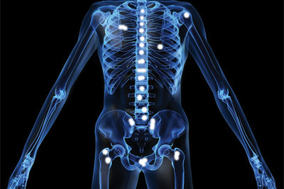
Application of ⁸⁹SrCl₂
Current use of
Strontium-89 chloride
(Metastron)
Treatment of bone metastatic pain secondary to prostatic carcinoma as ⁸⁹SrCl₂
ISOLPHARM method
Possible (?) new applications:
Radiolabeling of molecules that are directed towards specific receptors on the cells!
-> need to have carrier-free radionuclides!!
Strontium-89 chloride
(Carrier-free)

Slide 19
ISOLPHARM 1: produced radionuclides at SPES
_{(Fluka estimation)}
In target production of ⁸⁹Sr and ⁹⁰Y* using a standard UC_{x} target
Already developed and tested!
In target production of ⁶⁴Cu using a Ni-based target
Under development

Slide 20
Towards ISOLPHARM2.
Targets R&D , estimated isotopes production
of innovative radio-isotopes for medicine
+
+
+
+

Slide 21
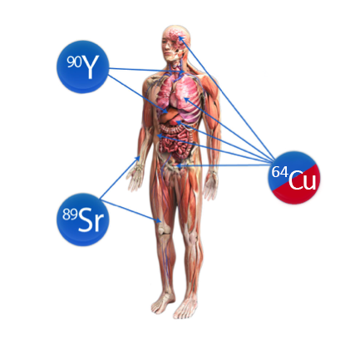
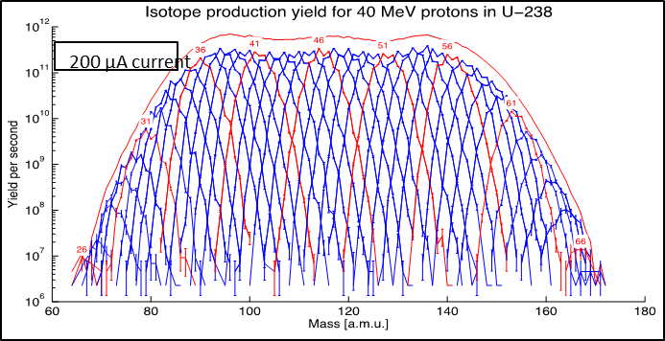
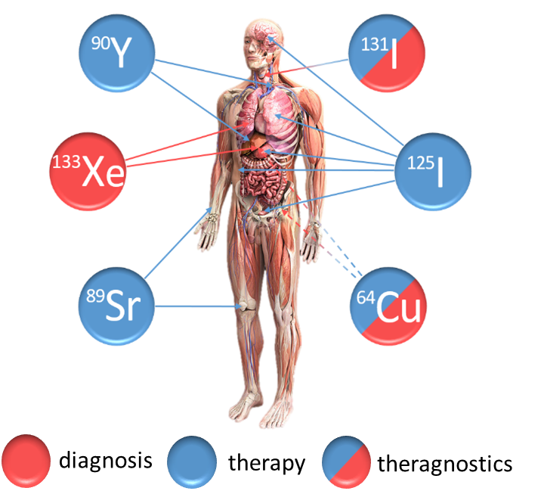
ISOLPHARM 1 & 2
ISOLPHARM 1
ISOLPHARM 2
First set of isotopes studied in the framework of ISOLPHARM collaboration:
radiopharmaceuticals available in the market
Innovative radio-isotopes produced with different types of target
radiopharmaceuticals absent in the market

Slide 22
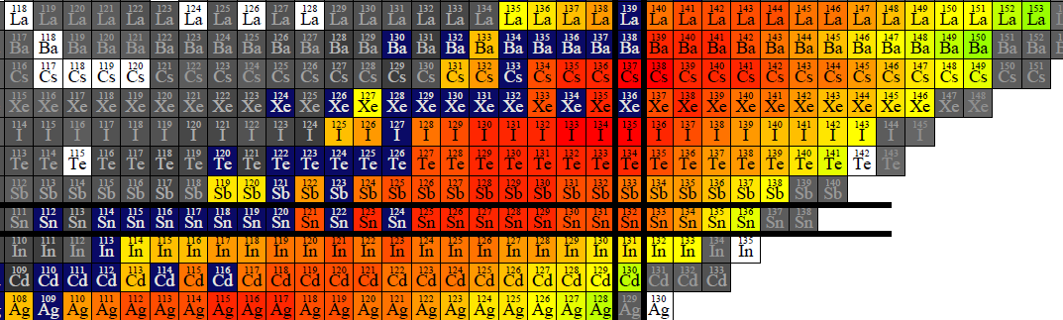
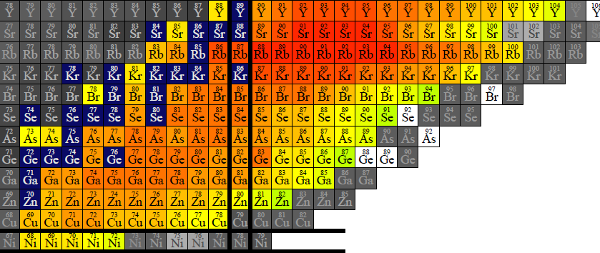
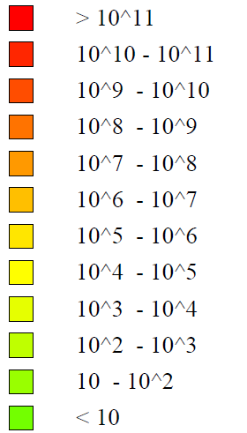
SPES UC_{X} target yield: other useful isotopes?
A lot of ISOL beams can be potentially produced:
Only a few of the produced isotopes are currently used/studied in nuclear medicine (traditional techniques allow the production of a limited variety of radioisotopes)
Is it possible that other isotopes will be interesting as radiopharmaceuticals “active core”?
Other ISOL isotopes?
ISOLPHARM 2
ISOLPHARM 1 isotopes
[nuclide/s]

Slide 23
Other ISOL Isotopes of medical interest? (UCx)
Selection criteria
Almost 60 ISOL isotopes were found!
(with different ISOL target)
Diagnosis
Theragnostics
Therapy

Slide 24
Innovative Target concepts: overview
The ISOL method requires specific targets.
Targets have to be:
  Solid
Refractory (more refractory than the element for which they were designed)
Three target concepts are currently under investigation:
  ⚛ UC_{X} new targets (Operation temperature: 2200°C)
  ⚗ Target R&D and state of art:
  ☢ Innovative isotopes production: ¹¹¹Ag
  ⚛ ZrGe target (Operation temperature: 1800°C)
  ⚗ Target R&D and state of art:
  ☢ Innovative isotopes production: As & Ga isotopes
  ☢ ^{64/67}Cu unexpected production!
  ⚛ TiC/TiB₂ target (Operation temperature: 2000°C)
  ⚗ Target R&D and state of art:
  ☢ Innovative isotopes production: Sc isotopes
Nuclear reactions studied
Designed
Tested
Nuclear reactions studied
Designed
Tested
Nuclear reactions studied
Designed
Tested

Slide 25
The impact of ISOLPHARM 2 radionuclides
Very good decay properties for the therapy
Half-life: 7.45 days
Emission: β⁻ ; End-point energy 1036.8 keV, low associated γ
Not produced as carrier-free so far!
¹¹¹Ag
Great potential to become a new radionuclide for therapy!
Handbook of Nuclear Chemistry, Springer, DOI 10.1007/978-1-4419-0720-2
⁶⁴Cu/ ⁶⁷Cu
⁶⁴Cu -> very good PET radionuclide (diagnosys) Half-life: 12.8 hours
⁶⁷Cu -> very good decay properties for therapy Half-life: 61.9 hours
Perfect matched pair -> diagnosys and therapy with the same element!
PET radionuclide -> longer half life (~4 hours) than traditional PET (¹⁸F and ⁶⁸Ga)
⁴³Sc
Better than the ⁴⁴Sc that has a hard associated g ray (~1 MeV) Half-life: 3,9 hours
Perfect matched pair with ⁴⁷Sc (Therapeutic) Half-life: 3,3 days
Better performance of tumors diagnostic procedures

Slide 26

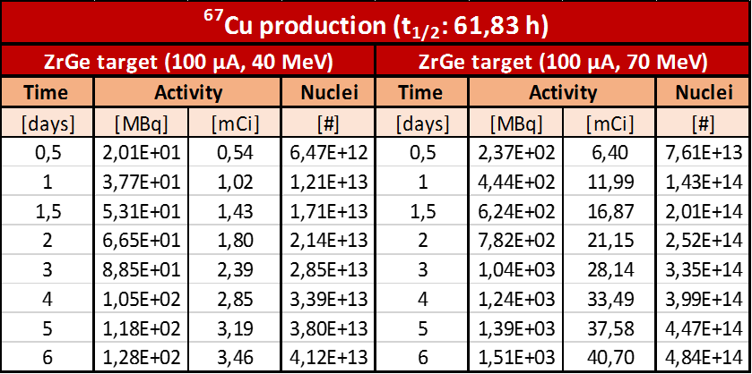
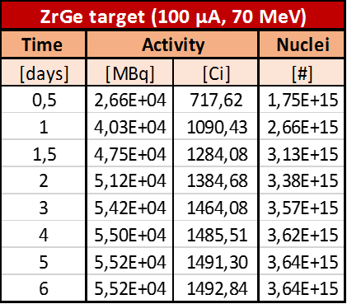
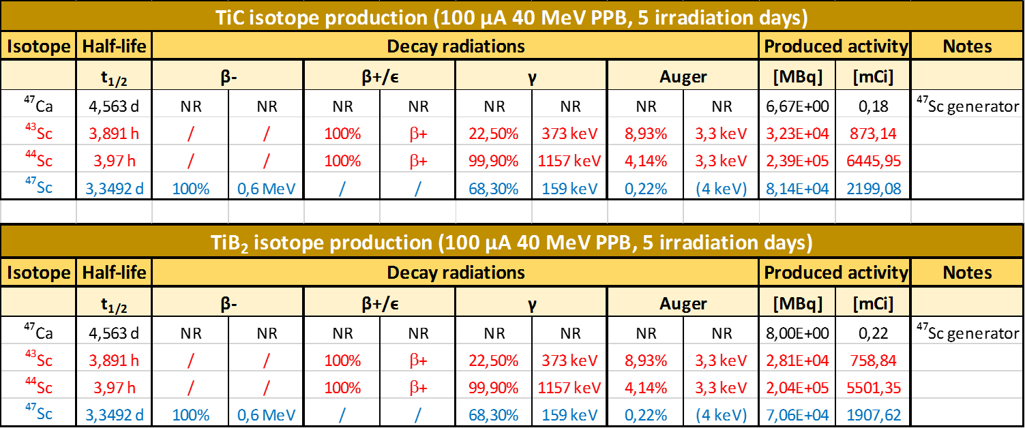
Main radionuclides for ISOLPHARM 2
(Fluka rate estimation)
¹¹¹Ag
SPES UC_{x} target PPB 40 MeV , 200 µA
⁶⁴⁻⁶⁷Cu
SPES ZrGe target PPB 70 MeV , 100 µA
⁴³⁻⁴⁴⁻⁴⁷Sc SPES TiC target PPB 40 MeV , 200 µA

Slide 27
ISOLPHARM
Experimental activities

Slide 28
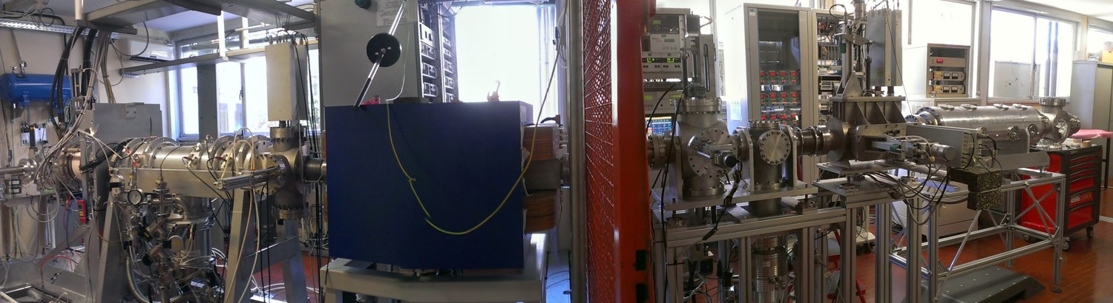
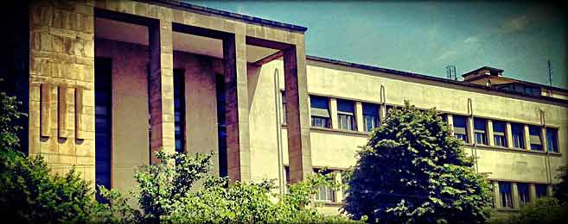
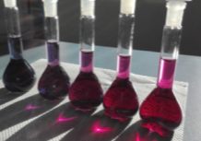
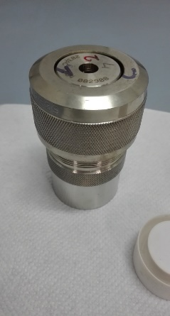
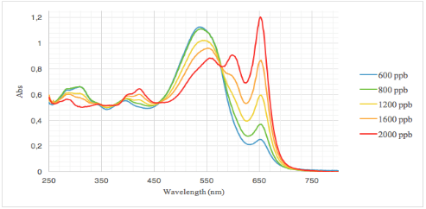
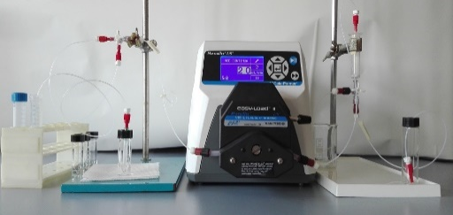
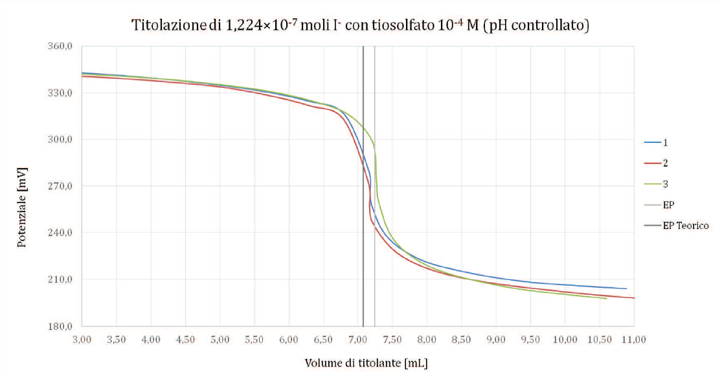
Activity done so far at LNL - UNIPD-DSF
Beam deposition @ LNL
Simulation of the process using stable ion beams thanks to the SPES test bench (front-end off-line)
Activities @ UNIPD-DSF-DSC
Extraction from the substrate, quantification and chemical separation of the deposited element
Ion beams produced, deposited, dissolved and analyzed: Sr⁺, Y⁺, I⁺, Cu⁺ (4 master, 2 PhD. students)

Slide 29
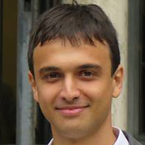
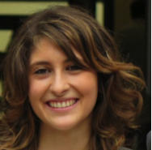
















ISOLPHARM collaboration
2014
2015
2016
2017
Field | Objective | Institutions
Nuclear physics | Generation and collection of nuclides | INFN-LNL
Radiochemistry | Chemical separation and complexation of the collected nuclides | UNIPD-DiSC
Radiopharmacy | Radiolabeling and in vitro/in vivo studies | UNIPD-DSF Reggio Emilia Hospital
Nuclear medicine | GMP development and possible clinical studies | Castelfranco Hospital

Slide 30

The nuclides studied so far: ISOLPHARM 1
Element studied at LNL-PD | Radionuclide desired
Sr | ⁸⁹Sr, ⁹⁰Sr/⁹⁰Y
Y | ⁹⁰Y
I | ¹²⁵I, ¹²⁶I and ¹³¹I
Cu | ⁶⁴Cu, ⁶⁷Cu

Slide 31





The proton driver

Slide 32




The production targets
UC_{x} target already developed and tested on-line!
Other targets under development for specific radionuclides production
UC_{x} target prototype
Porous titanium carbide (TiC)
 | Standard (graphite) | Low density (MWCNTs)
Density (g/cm³) | 4.25 | 2.59
Diameter (mm) | 12.50 | 13.07
Thickness (g/cm²) | 0.41 | 0.41
Calculated porosity (%) | 58 | 75

Slide 33




The ionization source
Surface Ion Source (SIS)
Ionized element | Desired radionuclide | Ionization source | Efficiency
Sr | ⁸⁹Sr, ⁹⁰Sr/⁹⁰Y | SIS | ~ 20 %
Y | ⁹⁰Y | PIS | ~ 1 %
I | ¹²⁵I, ¹²⁶I and ¹³¹I | PIS | ~ 20 %
Cu | ⁶⁴Cu, ⁶⁷Cu | PIS | ~ 10 %
Ag | ¹¹¹Ag | PIS | ~ 6 %
Plasma Ion Source (PIS)
Strontium Mass Scan (SIS)
Copper Mass Scan (PIS)
⁶³Cu (~70%)
⁶⁵Cu (~30%)

Slide 34



Beam acceleration and transport
Strontium and yttrium beams focalization
Electrostatic Triplets Quadrupoles and steereers system
Beam Transmission ~ 100%
Diagnostic boxes 1 and 2
(2 Faraday Cups and 2 Beam profilers)
Extraction -> 25 - 40 kV

Slide 35


Isotope mass separator
Wien Filter
⁶³Cu (~70%)
⁶⁵Cu (~30%)
Natural Copper : Mass Scan

Slide 36








Substrates for isotopes collection
Sr¹⁺ spot on the substrate
Cu¹⁺ spot on the substrate
1) Sodium Chloride
For Sr, Y and Cu
Boiling point at 10⁻⁶ mbar
Sr ~ 500 °C
Y ~ 1500 °C
Cu ~ 1200 °C
2) Activated Carbon
For I₂
At 10⁻⁶ mbar I₂ -> gas
40 mm
Polyvinyl Alcohol (PVA)
as a binder

Slide 37






Isotopes purification
1) Irradiated substrates dissolution and quantification of the deposed atoms
HNO₃ 0.1 M
Sr²⁺, Y³⁺ or Cu²⁺ quantification
via GF-AAS or ICP-AES
Ongoing collaboration with UniPD-DSF and UniPD-DSC
Iodine titration
2) Development of purification processes
Example: Separation of ⁹⁰Sr from ⁹⁰Y for ⁹⁰Y purification
-> synthesis of an ion exchange inorganic material: sodium nonatitanate
Development of Seraparation Column for Y vs. Sr

Slide 38


In vitro developments
1) Development of novel chelators for Ag⁺
Ongoing collaboration with:
TIFPA (Trento Institute for Fundamental Physics and Applications
DiSC (Department of Chemistry) UniPD
2) Development of new targeting agents
Radiolabeled molecule
Ongoing collaboration with:
DSF (Department of Pharmaceutical and Pharmacological Sciences)
Nuclear Medicine Unit Advanced Technology Department (Santa Maria Nuova Hospital Reggio Emilia – IRCCS)
Cancer cells
Novel molecules radiolabeled with innovative radionuclides as ¹¹¹Ag

Slide 39




ISOLPHARM
Conclusions.

Slide 40

ISOLPHARM possible facility layout
ISOLPHARM
Radioactive Ion Beam
Production target
Bunker ISOL 1
SPES
(nuclear physics)
Bunker ISOL 2
(ISOLPHARM)
Bunker 2 is currently empty..
New Budget is required for duplicated the ISOL source
Ion collection target

Slide 41



Summary
- At SPES it will be possible soon to produce radionuclides for medical purposes using the ISOL technique.
- The ISOLPHARM method (patent deposited) is focused on the production of radiopharmaceutical precursors with high specific activity using a proton beam ad intermediate energies.
- The ISOLPHARM collaboration is started 3 years ago. An increasing experimental activity is being carried out.
Some radionuclides (as ¹¹¹Ag , ⁴³Sc, etc) seem extremely interesting and could be used as precursors for new radiopharmaceuticals.
First step: to produce first radionuclides of medical interest for research (small quantities) when the first SPES RIB will be delivered.

Slide 42







ISOLPHARM collaborating institutions
The Italian Network
The International Network

Slide 43


Thanks for your attention!
& to the RIB production group..

