Slide 1

The influence of the “new” CRP on monitor reactions for charged particle beams.
A. Hermanne (on behalf of all CRP participants)
Vrije Universiteit Brussel (VUB), 1090 Brussels, Belgium
Notes:
Thanks to organising committee and chairman, attendance

Slide 2
Monitoring of charged particle beams
Technique to improve or confirm knowledge of beam intensity and/or energy.
Activation analysis experiments and isotope production.
Re-measurement of cross-sections (excitation function) of specific reactions on well-chosen targets.
Comparison with evaluated-recommended values.
Adapt beam parameters until good agreement.
IAEA-database
Notes:
Thanks to organising committee and chairman, attendance

Slide 3
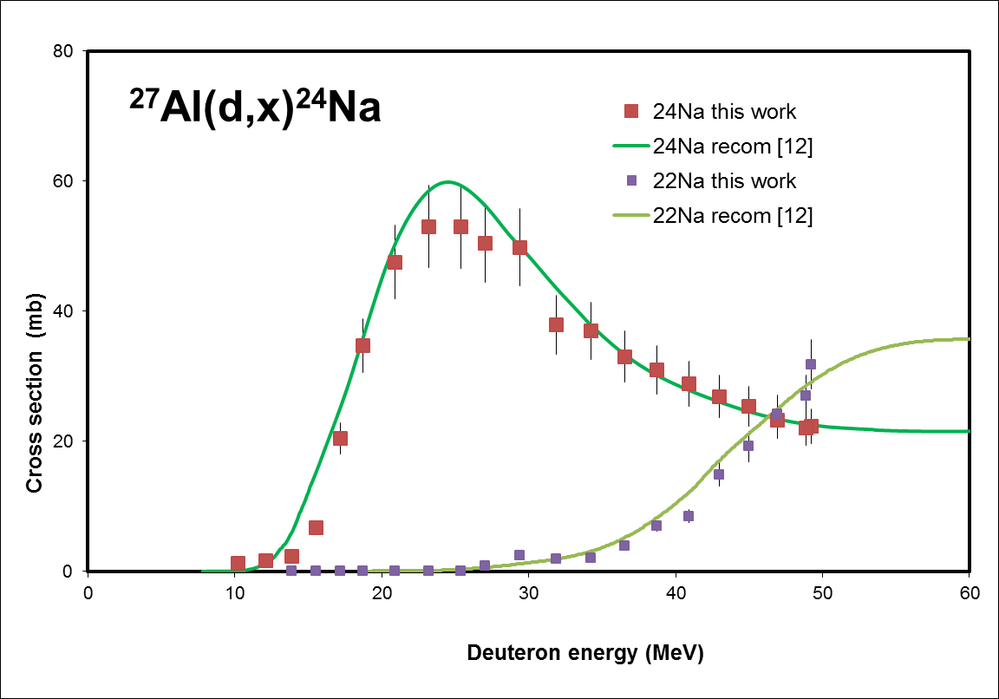
Example (recent study Ba+deuterons)
Notes:
Thanks to organising committee and chairman, attendance

Slide 4
Genesis of “new” recommended database
The IAEA organized in the 1996-2001 period a CRP : first attempt to provide standard – recommended cross-section data for monitoring and for isotope production.
The results available as hardcopy TECDOC-1211.
On-line in the medical portal (latest update 2007) https://www.nds.iaea.org/medical/monitor_reactions.html
End 2012 launch of a new CRP entitled:
“Nuclear Data for Charged-particle Monitor Reactions and Medical Isotope Production“
Aim to complement, broaden and upgrade the database.
An important goal was the improvement on accuracy and reliability of cross-sections for monitoring of proton, deuteron, alpha and ³He particle beams.
Notes:
Thanks to organising committee and chairman, attendance

Slide 5
New systematic compilation of literature, especially for recent, well documented published data.
Performing dedicated experiments.
Confirm excitation functions for the existing reactions Extend to a wider energy range.
Special attention to correction of outdated nuclear data. Latest values for γ-ray abundances and half-lives used.
Checked – corrected subgroup evaluators nuclear data.
For most beams several new reactions were added
Notes:
Thanks to organising committee and chairman, attendance

Slide 6
Added ⁴⁶Sc formation on ^{nat}Ti for p and d (⁴⁸V)
Added reactions on Cu for d and ³He (Cu backings)
Notes:
Thanks to organising committee and chairman, attendance

Slide 7
Most important progress is introduction of uncertainties on the recommended cross-sections for all monitor reactions.
Compilers provided total uncertainties on ALL experimental cross-section values.
Based on values published by the original authors or on their experience with experimental techniques.
Selected data series
Statistical fit by the Obninsk group using Padé approximation.
Recommended excitation functions with confidence interval.
Reduced uncertainties compared to the original data sets.
Adding a correction for systematic effects and correlations, overall uncertainties of the order of 5% on the individual recommended cross sections are obtained.
Notes:
Thanks to organising committee and chairman, attendance

Slide 8
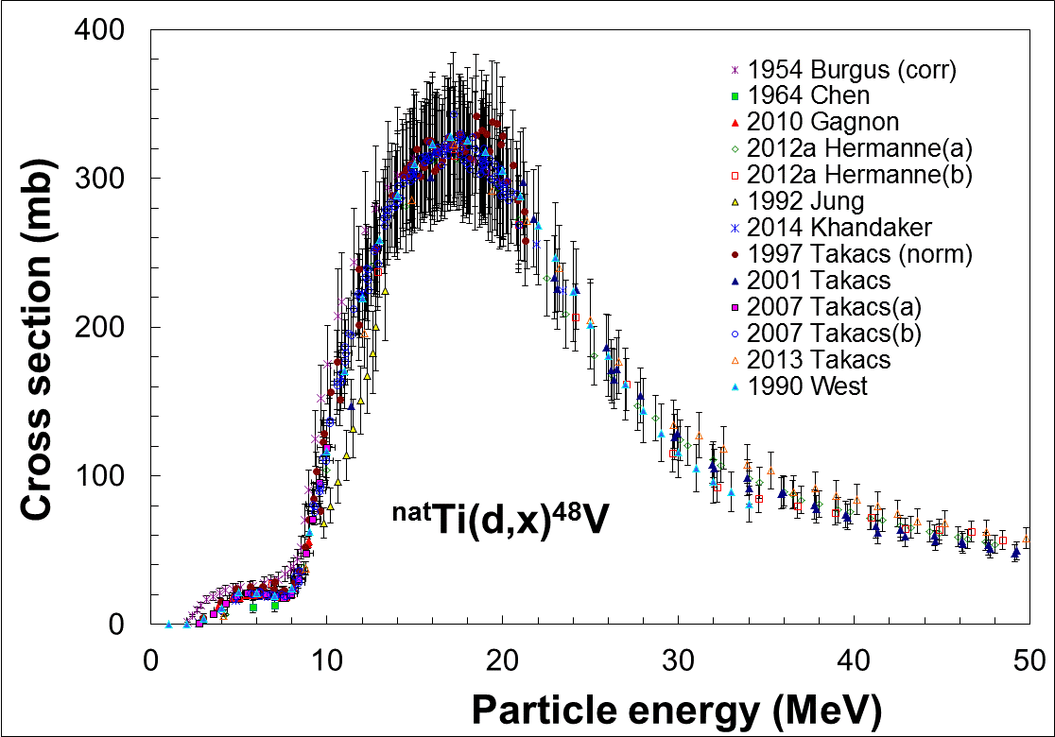
^{nat}Ti(d,x)⁴⁸V (15.97 d)
12 references
New since 2007:
Gagnon(2010),Hermanne(2012), Khandaker (2014), Takacs (2013)
Deselected:
Burgus(1954), Chen(194),
Jung (1987), Takacs(1997)
Adapt uncertainties where necessary to have consistent data.
Padé fit
18 parameters
182 datapoints
χ² = 1.04
Notes:
Thanks to organising committee and chairman, attendance

Slide 9
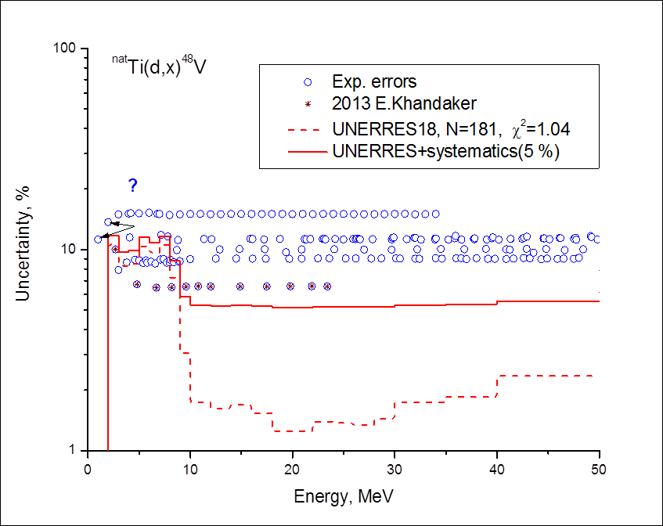
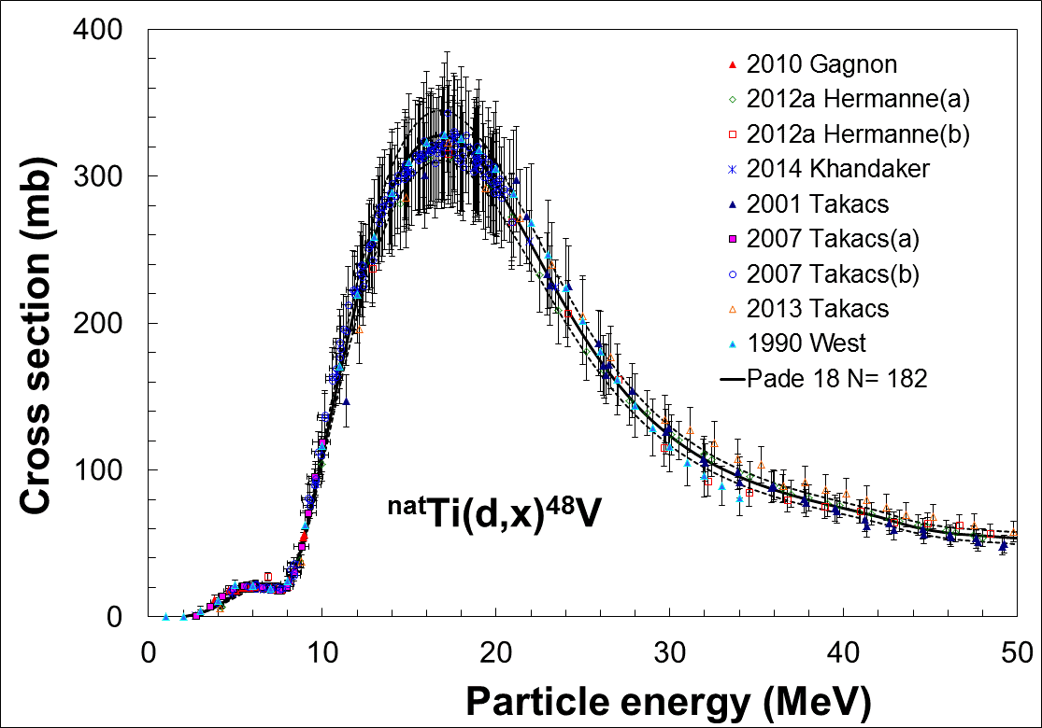
Uncertainties (5% systematics)
12% at threshold
5-6% in 10- 50 MeV range
Lower than original experiments
Useful: 8- 40 MeV range
⁴⁸Ti(d,2n)⁴⁸V T = 7.32 MeV
Low energy bump
⁴⁷Ti(d,n)⁴⁸V Q = 4.60 MeV
Presence of ⁴⁸Sc !!!!!
T_{1/2} = 43.67 h
Notes:
Thanks to organising committee and chairman, attendance

Slide 10
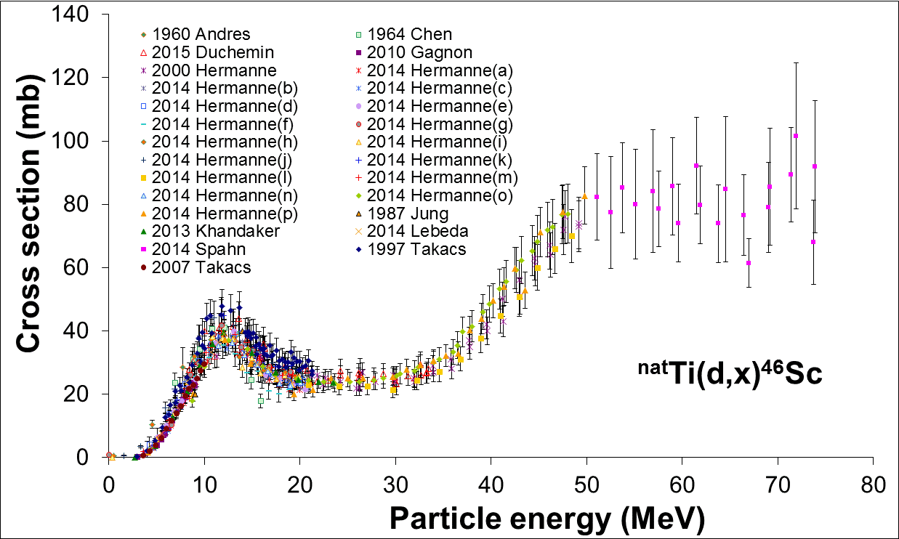
^{nat}Ti(d,x)⁴⁶Sc (83,79d)
New since 2007: All
12 Refs
Hermanne (2014): 16 sets
Deselected (7 sets)
Andres(1960), Chen (1964), Hermanne (2014) (j,k,p) Jung(1987), Takacs (1997)
Adapt uncertainties where necessary to have consistent data.
Padé fit ,
13 parameters,
372 datapoints,
χ2 = 0. 78
Notes:
Thanks to organising committee and chairman, attendance

Slide 11
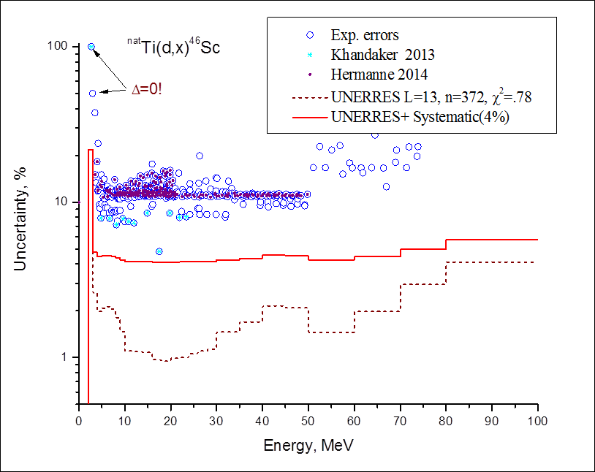
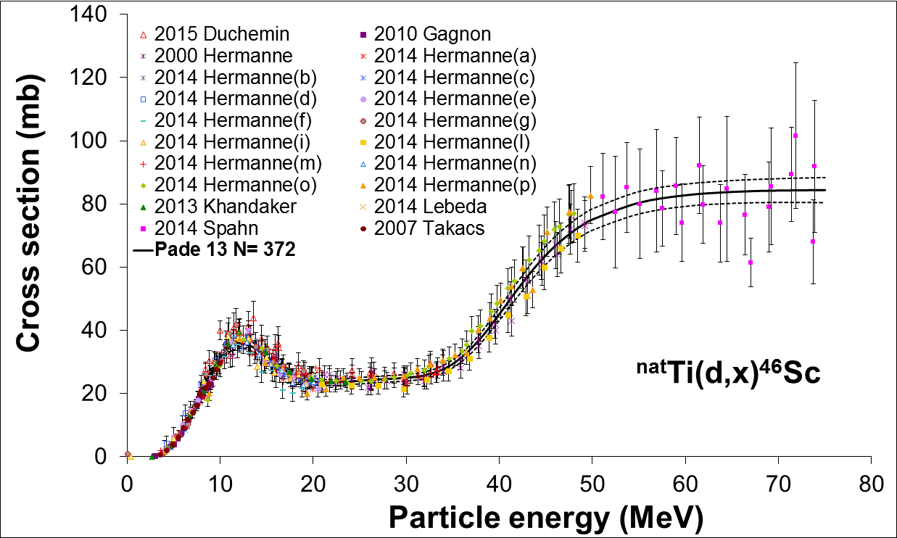
Uncertainties (5% systematics)
22% threshold
4.2 % in 12- 32 MeV range
4.8 % at 80 MeV
Lower than original
Useful 10- 80 MeV range
⁴⁸Ti(d,α)⁴⁸V Q= 3.97 MeV
High energy
⁴⁸Ti(d,2p2n)⁴⁸V
Q= 25.34 MeV
Notes:
Thanks to organising committee and chairman, attendance

Slide 12
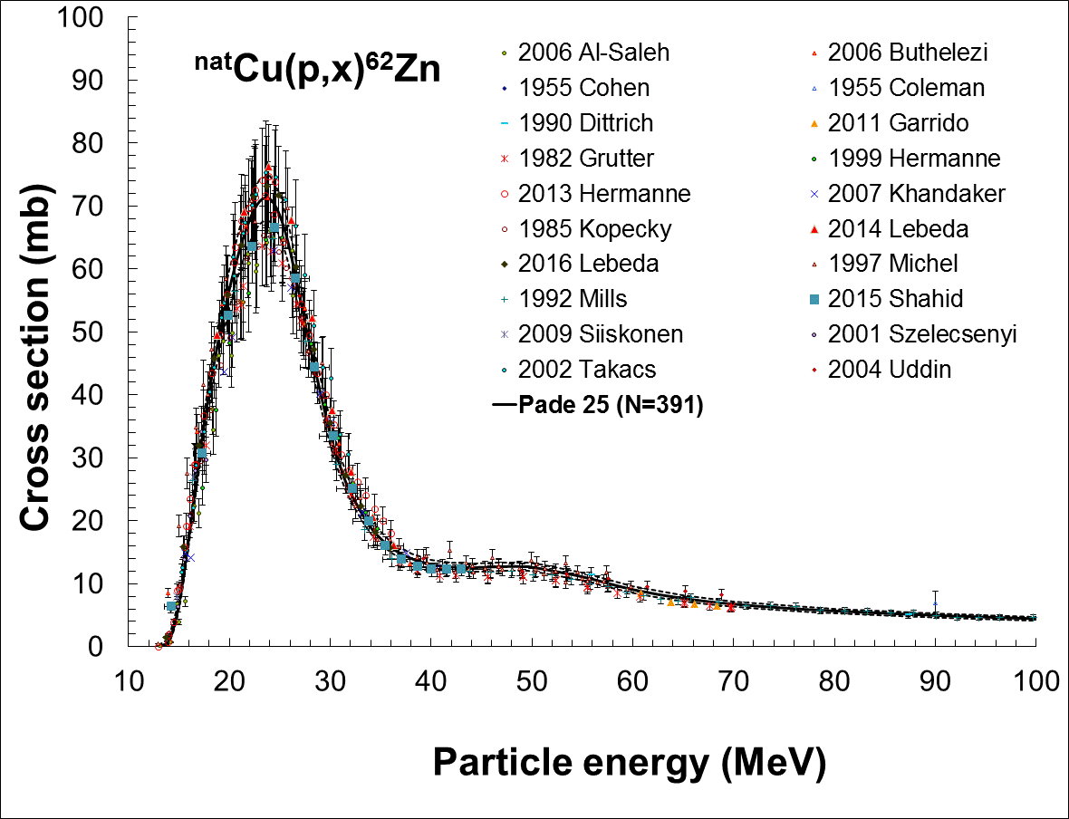
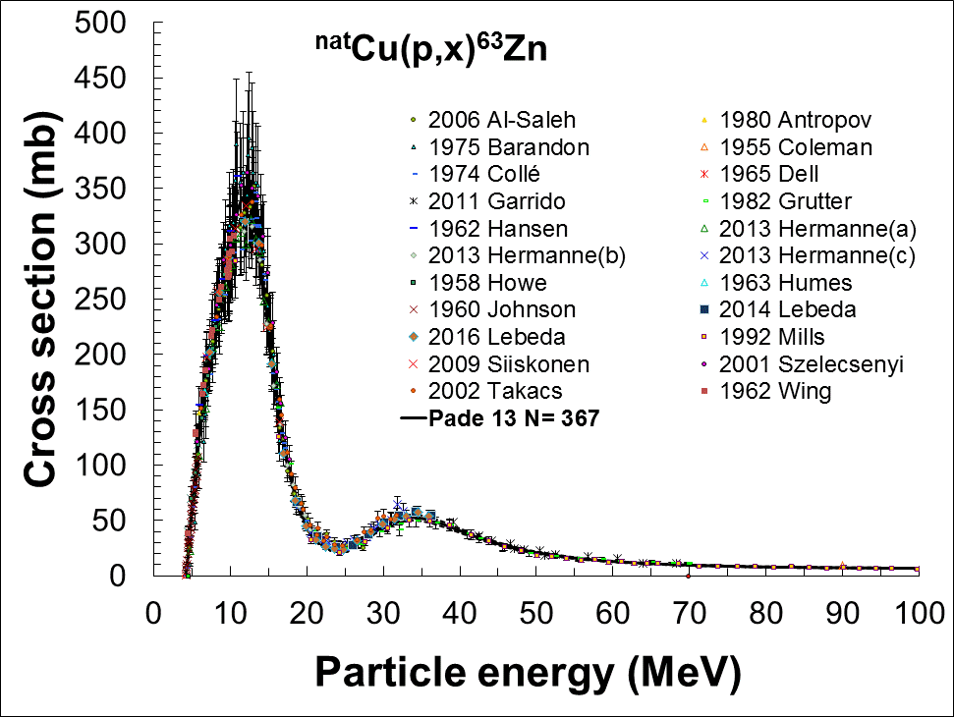
Cu(p,x)⁶²Zn (9.186h) Cu(p,x)⁶³Zn (38.47 m)
Kellet: use ENSDF
Nichols: new evaluation
BIPM-5 2013 - library LNHB
Slight changes,
No reason for discrepancy
Short half life !!!
31 Refs. 5 new 11 deselected
χ²= 1.035
10% threshold 4.7 % 7- 21 MeV
27 Refs. 9 new 7 deselected
χ²= 1.91
15- 100 MeV
80% threshold
5.2% in 25- 40 MeV range
7.2% at 100 MeV
Notes:
Thanks to organising committee and chairman, attendance

Slide 13
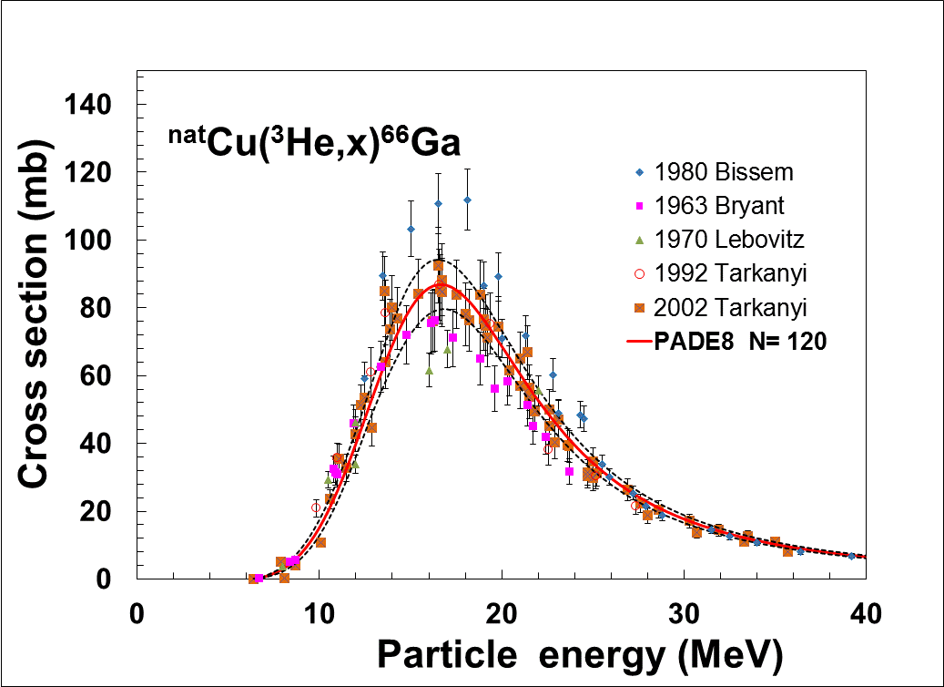
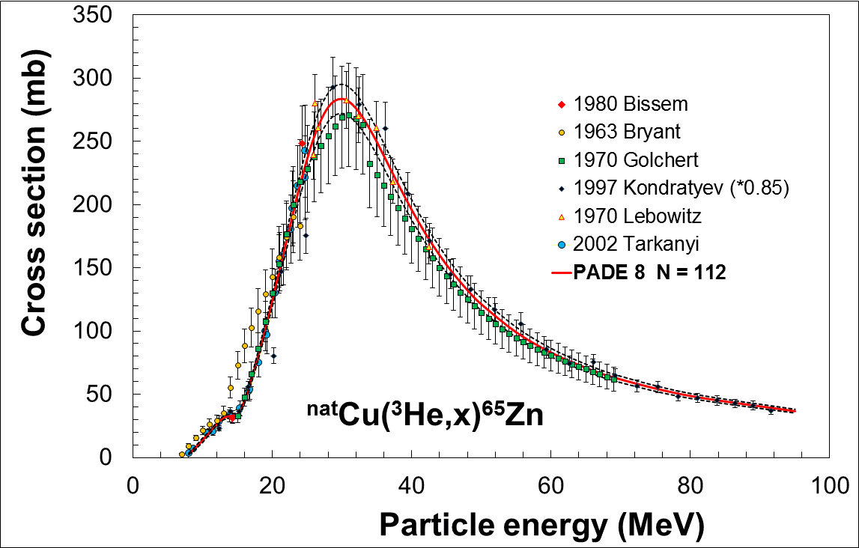
^{nat}Cu(³He,x)⁶⁶Ga ^{nat}Cu(³He,x)⁶⁵Zn
All new 5 Refs.
Golchert <15 MeV deselected
Only ⁶⁵Cu in study, no low energy
Kondratev * 0.85
χ²= 0.2
Uncertainty 20% near threshold
4.1% above 17 MeV
All new 6 Refs.
Golchert deselected
χ²= 1.69
Uncertainty 30% threshold
Below 7% above 15 MeV
Notes:
Thanks to organising committee and chairman, attendance

Slide 14
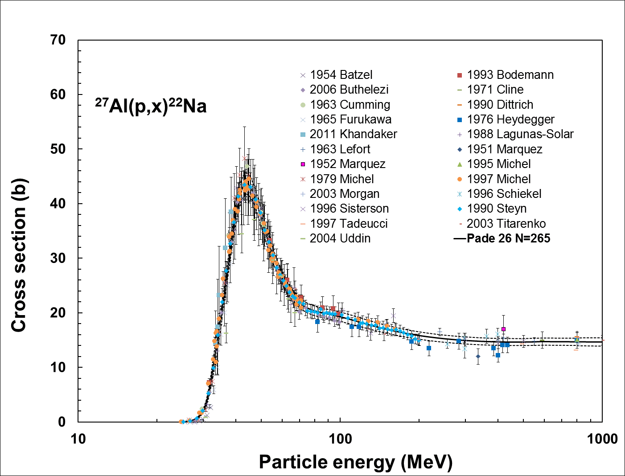
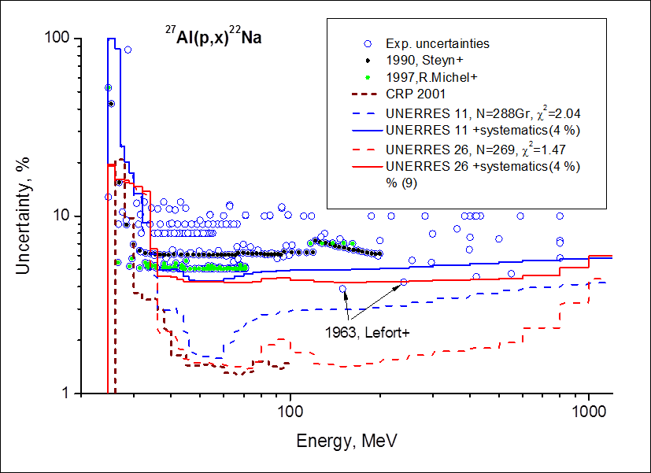
The presence of the strongly discussed bump in the ²⁷Al(p,x)²²Na excitation function around 100 MeV was confirmed by TALYS calculations as results of the onset of the reactions with separate nucleons.
High energy protons : ²⁷Al(p,x)²²Na
Up to 1000 MeV
34 Refs in total New 14 (previously < 100 MeV)
12 deselected
χ²= 1.47
Uncertainties 20% near threshold
< 4% in 45 – 800 MeV region
Notes:
Thanks to organising committee and chairman, attendance

Slide 15
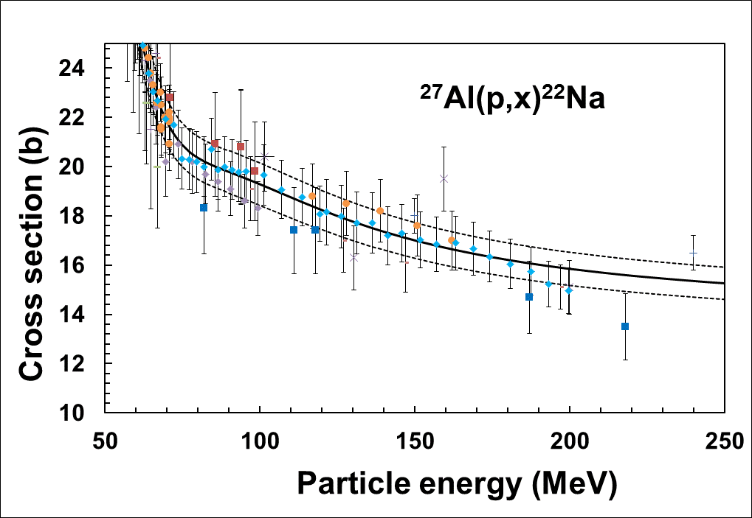
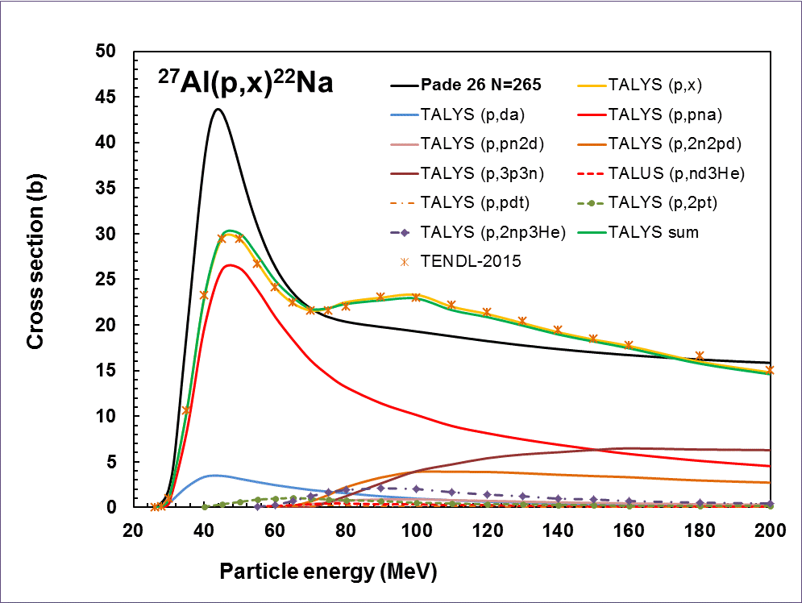
TALYS calculation
Underestimation at max
Overestimation “bump”
Sum of all = Total= TENDL2015
Strongest at low energy (p,pnα) not (p,dα)
Bump = (p,3p3n)+(p,2p2nd)
Thresholds
52.7 and 50.4 MeV
Max. Contribution 5 mb
90-120 MeV
Notes:
Thanks to organising committee and chairman, attendance

Slide 16
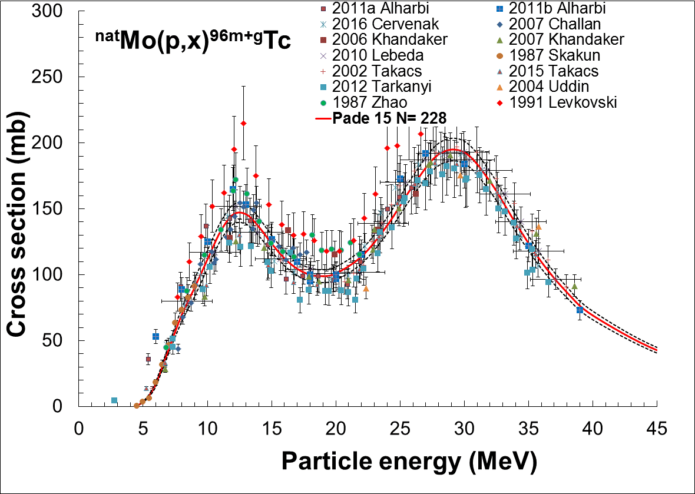
Correction factor for the ^{nat}Mo(p,x)⁹⁶Tc reaction, used as monitor in the systematic Levkovski study (1991) estimated :
0.8 by Takacs (2002) (measurement);
0.827 ± 0.05 by Qaim (2014) (comparison different reactions)
13 References
One deselected
Not Levkovski data
χ²= 1.34
Uncertainties
70% threshold
4.5- 6% up to 45 MeV
Cross-section at 30 MeV
Levkovski : 250 ± 10 mb CRP: 192.9 ± 8.4 mb
Correction factor 0.77 ± 0.07
Notes:
Thanks to organising committee and chairman, attendance

Slide 17
Monitors only part of the CRP
Diagnostic radionuclides (± 80 reactions)
SPECT- γ emitters β⁺ emitters - PET imaging generators (PET)
Therapeutic radionuclides (± 30 reactions)
Notes:
Thanks to organising committee and chairman, attendance

Slide 18
A. Hermanne¹, R. Capote², B. V. Carlson³, J. W. Engle⁴, M. Hussain⁵, A. V. Ignatyuk⁶, M. Kellett⁷, T. Kibedi⁸, Kim Guinyun⁹, F .G. Kondev¹⁰, O. Lebeda¹¹, A. Luca¹²,
H. Naik¹³, Y. Nagai¹⁴, Nichols¹⁵, F. M. Nortier⁴, I. Spahn¹⁶,
F. T. Tarkanyi¹⁷, M. Verpelli²
¹Vrije Universiteit Brussel, Brussels, Belgium
²International Atomic Energy Agency, NAPC-Nuclear Data Section, Vienna, Austria
³ Instituto Tecnológico de Aeronáutica, Brazil
⁴Los Alamos National Laboratory (LANL), USA
⁵ Government College University, Lahore, Pakistan
⁶ Institute of Physics and Power Engineering (IPPE), Obninsk, Russia
⁷LNHB, CEA Saclay, France
⁸Australian National University, Canberra, Australia
⁹Kyungpook National University, Republic of Korea
¹⁰ Argonne National Laboratory, USA
¹¹Nuclear Physics Institute, Rez, Czech Republic
¹²National Institute of Physics and Nuclear Engineering “Horia Hulubei”, Romania
¹³Bhabha Atomic Research Centre (BARC) Trombay Mumbai, India
¹⁴Japan Atomic Energy Agency (JAEA), Tokaimura Naka, Ibaraki-ken, Japan
¹⁵University of Surrey, Guildford, UK
¹⁶ Forschungszentrum Jülich (FZJ), Germany
¹⁷ Institute of Nuclear Research, Debrecen, Hungary
Notes:
Thanks to organising committee and chairman, attendance

Slide 19
Notes:
Thanks to organising committee and chairman, attendance

Slide 20
Notes:
Thanks to organising committee and chairman, attendance

Slide 21
Notes:
Thanks to organising committee and chairman, attendance

Slide 22
Notes:
Thanks to organising committee and chairman, attendance

Slide 23
Notes:
Thanks to organising committee and chairman, attendance

Slide 24
Notes:
Thanks to organising committee and chairman, attendance

Slide 25
Notes:
Thanks to organising committee and chairman, attendance

