Slide 1
Why is there something, rather than nothing – and what does
Neutrino-less Double beta Decay have to do with that?
David Nygren
Department of Physics
University of Texas at Arlington

Slide 2
Menu
The Matter-Antimatter Asymmetry of the Universe – a very fundamental question!
The Connection to Double beta-decay
Sensitivity and the Curse of Backgrounds!
¹³⁶Xe and its daughter: barium
A method for Single Atom Detection?

Slide 3
Big Bang Cosmology
  N_{particles} = N_{anti-particles}
Universe begins in perfect symmetry
particle-antiparticle annihilation occurs
outcome is photons, neutrinos, surviving particles N_{B} plus surviving antiparticles N_{B*}
  (N_{B} +N_{B*}) /N_{γ} ≈ 10⁻¹⁹
Notes:
This is what the Concordance Model of Cosmology predicts
The first Sakharov condition!

Slide 4
The Universe is not symmetric!
  Measured ratio: N_{B}/N_{γ} = 6 x 10⁻¹⁰
  N_{B*} ≈ 0
  So the prediction that (N_{B} +N_{B*}) /N_{γ} ≈ 10⁻¹⁹
is wrong, by ~ 10⁸
The universe is just 1 ppb leftovers
Notes:
no significant anti-matter anywhere

Slide 5
The Universe is not symmetric!
  Measured ratio: N_{B}/N_{γ} = 6 x 10⁻¹⁰
  N_{B*} ≈ 0
  So the prediction that (N_{B} +N_{B*}) /N_{γ} ≈ 10⁻¹⁹
is wrong, by ~ 10⁸
The universe is just ~1 ppb, leftovers
Notes:
no significant anti-matter anywhere

Slide 6
Big Bang Cosmology
Sakharov conditions:
  Universe begins in a symmetric state
  Both C and CP violation occur in some process
  Evolution of universe stays out of equilibrium long enough to establish a remnant asymmetry on matter/antimatter abundance

Slide 7
Leptogenesis
  Leptogenesis:
    Assumes heavy right-handed neutrinos ~10¹² GeV
    These neutrinos satisfy Sakharov conditions 2 & 3
    A leptonic asymmetry is created
    The leptonic asymmetry → a baryon asymmetry
    Heavy right-handed neutrinos leave imprint on:
      universe
Notes:
Satisfy Sakharov conditions for generating asymmetry: Initial Even → odd, C, CP, B-L violation, out of equilibrium → leaves fingerprint on universe
Theoretical turbulence still exists about washout.

Slide 8
Leptogenesis
  Leptogenesis:
    Assumes heavy right-handed neutrinos ~10¹² GeV
    These neutrinos satisfy Sakharov conditions 2 & 3
    A leptonic asymmetry is created
    The leptonic asymmetry → a baryon asymmetry
    Heavy right-handed neutrinos leave imprint on:
      universe
      neutrinos
Notes:
Satisfy Sakharov conditions for generating asymmetry: Initial Even → odd, C, CP, B-L violation, out of equilibrium → leaves fingerprint on universe
Theoretical turbulence still exists about washout.

Slide 9
Leptogenesis
  Forces neutrinos to be Majorana particles
    Majorana: particle and anti-particle are identical
    Neither “matter” nor “antimatter”
    Among fermions, only neutrinos could be Majorana
Notes:
Majorana particles: heavy neutrinos introduce a mass term
Why is the neutrino mass so small? electron mass 10,000,000 times larger

Slide 10
“Leptogenesis”
  Leptogenesis predicts two measurable quantities
    Predicts: n_{B}/n_{γ} ≈ 6 x 10⁻¹⁰
        prediction = measured ✓
    Predicts: m_{ν} ≈ a few 10’s of meV
        Oscillations indicate m_{ν} ≈ 50 meV ✓
  A very appealing theoretical mechanism
    Neutrinos must have a Majorana nature
    Neutrinos must have a mass ≈ 50 meV
Notes:
Majorana particles: heavy neutrinos introduce a mass term (via see-saw mechanism)
Oscillations: reactors, solar, cosmic rays, accelerators,
Why is the neutrino mass so small? electron mass 10,000,000 times larger

Slide 11
“Leptogenesis”
  Leptogenesis predicts two measurable quantities
    Predicts: n_{B}/n_{γ} ≈ 6 x 10⁻¹⁰
        prediction = measured ✓
    Predicts: m_{ν} ≈ a few 10’s of meV
        Oscillations indicate m_{ν} ≈ 50 meV ✓
  A very appealing theoretical mechanism
    Neutrinos must have a Majorana nature
    Neutrinos must have a mass ≈ 50 meV
Notes:
Majorana particles: heavy neutrinos introduce a mass term (via see-saw mechanism)
Oscillations: reactors, solar, cosmic rays, accelerators,
Why is the neutrino mass so small? electron mass 10,000,000 times larger

Slide 12
“Leptogenesis”
  Leptogenesis predicts two measurable quantities
    Predicts: n_{B}/n_{γ} ≈ 6 x 10⁻¹⁰
        prediction = measured ✓
    Predicts: m_{ν} ≈ a few 10’s of meV
        Oscillations indicate m_{ν} ≈ 50 meV ✓
  A very appealing theoretical mechanism
    Neutrinos must have a Majorana nature
    Neutrinos must have a mass ≈ 50 meV
  Neutrinoless double beta decay can occur!
Notes:
Majorana particles: heavy neutrinos introduce a mass term (via see-saw mechanism)
Oscillations: reactors, solar, cosmic rays, accelerators,
Why is the neutrino mass so small? electron mass 10,000,000 times larger

Slide 13
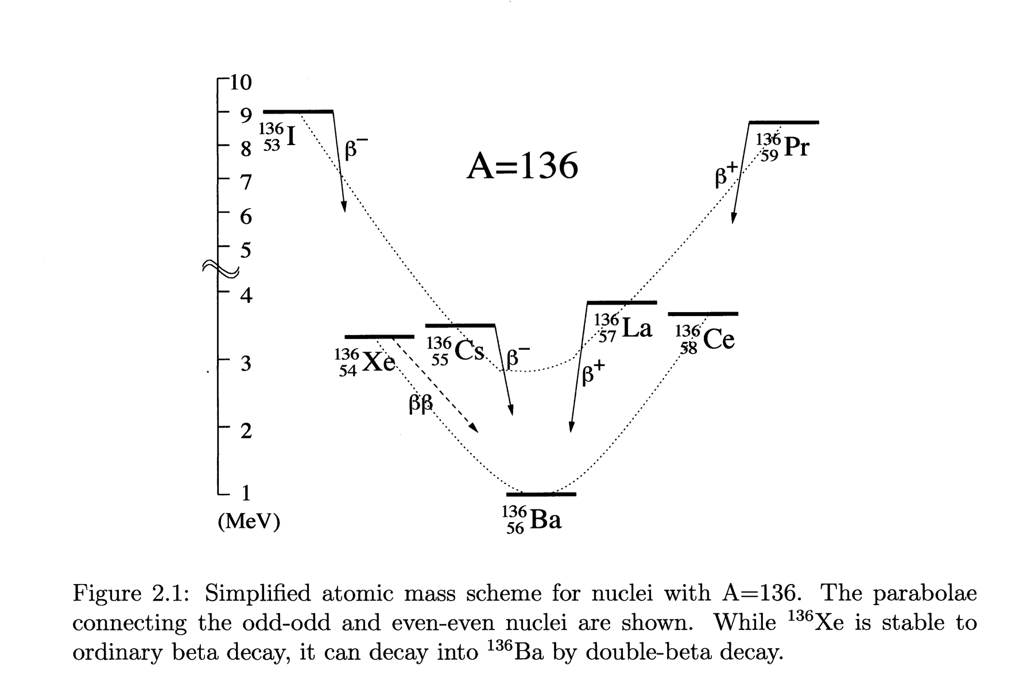
Double β decay: Rare transition between same A nuclei
  Energetically allowed for some even-even nuclei
(Z,A) → (Z+2, A) + e⁻₁ + ν₁ + e⁻₂ + ν₂
(Z,A) → (Z+2, A) + e⁻₁ + e⁻₂
(Z,A) → (Z+2, A) + e⁻₁ + e⁻₂ + χ
Double positron decay
is also possible, but is energetically disfavored
since two protons → neutrons and m_{p} < m_{n}
Notes:
Maria Goeppert-Mayer in 1934 was the first to describe the possibility of NLDBD in nuclei
Take-away: been around for ~ 80 years

Slide 14
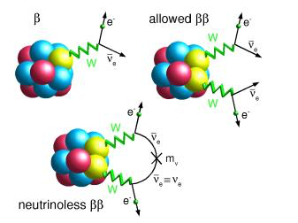
Double-Beta Decay
  An extremely rare radioactive process, energetically allowed for some even-even nuclei where m_{Z+1} > m_{Z} > m_{Z+2}
(Z,A) → (Z+2,A) + e⁻₁ + ν₁ + e⁻₂ + ν₂
Notes:
Parabolae connect odd-odd and even-even nuclei are shown; pairing energy lifts odd-even above even-even Z – N;
Calculation of matrix elements have to include contributions of all virtual intermediate excited states.

Slide 15
Neutrinoless Double-Beta Decay
Predicted in 1934
Discovered in 1987, in ⁸²Se
Observed in several isotopes since:
Violates lepton number – observation would be a profound discovery
Phase space
factor
Nuclear matrix element
Majorana mass
Notes:
wrong helicity if neutrino is massless – can transform to opposite helicity state if non-zero mass
We already know neutrino mass is non-zero from oscillation experiments.
A factor of ten in mbb → a factor of one hundred in lifetime
Background-free experiment: mbb → t^1/2

Slide 16
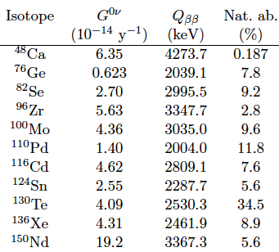
Some attractive candidates
G factor ≈ Q⁵ → higher Q is better.
Q-values above the most troublesome
γ-ray energies
²¹⁴Bi (2447 keV) and ²⁰⁸Tl (2615 keV) are more attractive, due to less background in the energy ROI
Notes:
need to avoid bismuth and Thallium gamma rays at 2447 keV, 2615 keV

Slide 17
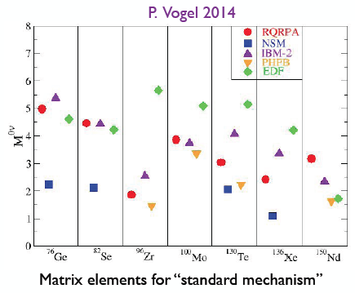
Nuclear Matrix Elements
Notes:
EDF= energy density functional method

Slide 18
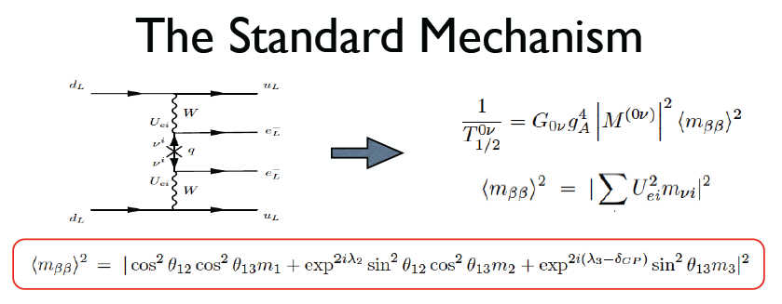
Majorana Mass
We don’t know the phases δ_{CP} and λ_{2,3}
or the absolute values of the masses
Notes:
unknown phases introduce a range for mbb, even if we know theta angles

Slide 19
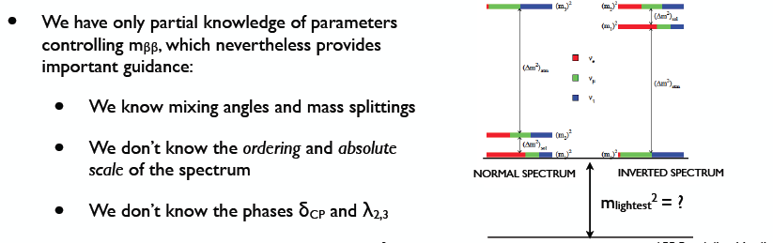
More known unknowns
Credit: Cirigliano & Wilkerson, NLDBD LRP meeting April 2015

Slide 20
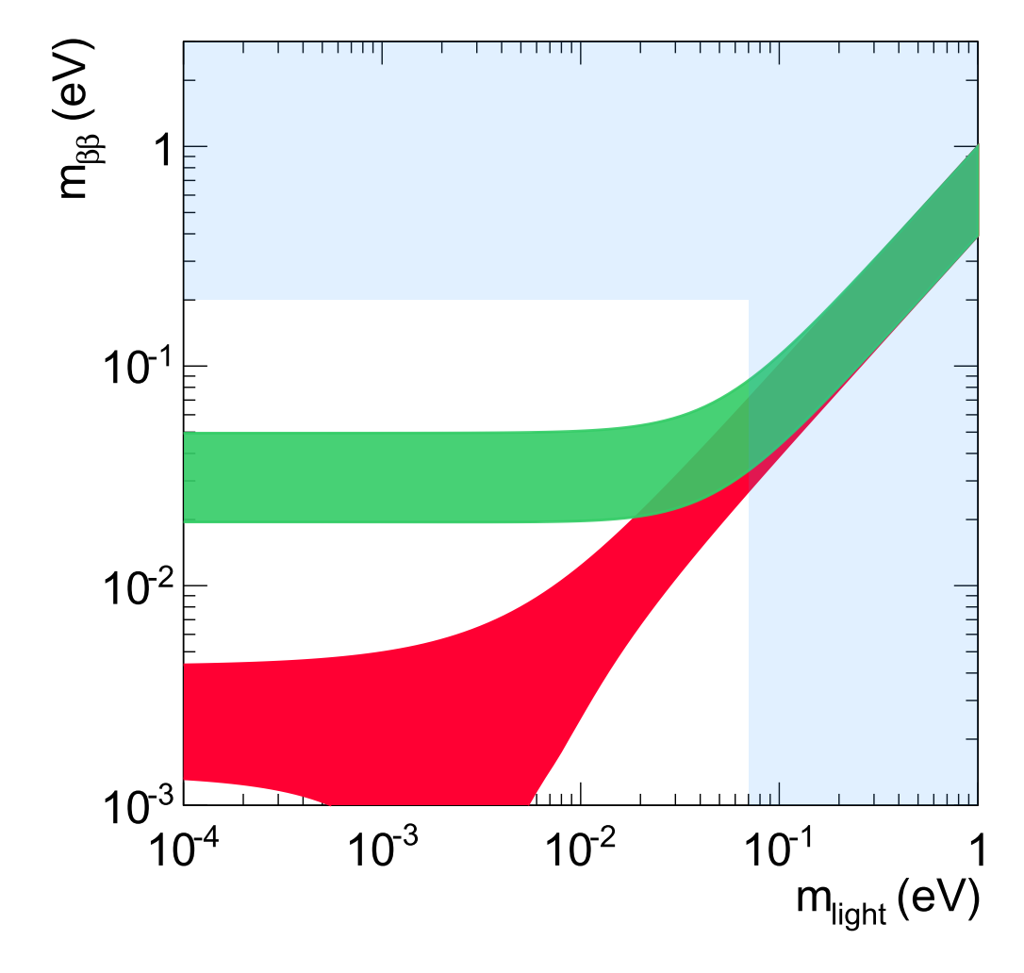
The Quest
Prediction uncertainty due to unknown neutrino parameters
Kamland Zen limit
Uncertainty on the limit due to NMEs
Green:
Prediction under inverted mass ordering
Red:
Prediction under normal mass ordering
cosmology
Notes:
Clearly, not for the faint-hearted!

Slide 21
The Quest
What would a perfect experiment look like?
1.5 ton yr of ¹⁵⁰Nd, ¹³⁰Te, or ⁸²Se
or
2 ton yr of ¹³⁶Xe
or
3 ton yr of ⁷⁶Ge
WITH ZERO BACKGROUND
cosmology
Given worst case NMEs

Slide 22
Direct Significance of Observation of Neutrino-less Double-Beta Decay (NLDBD)
→ Neutrino mass must be non-zero
  but we know that from discovery of oscillations
→ Lepton number L is not conserved
  lepton number conservation is not privileged.
→ Neutrinos must be Majorana fermions: particle = antiparticle
  Unique among fermions
  If so, nature must have a reason for that…

Slide 23
Nature of the neutrino
Majorana or not Majorana – one of the six central questions of HEP a few years back
Then, suddenly, it disappeared!
Where did it go? Who stole it?
Answer: DOE HEP traded it to DOE NP, while DOE NP traded Dark Matter (WIMP) to HEP
Actually, this is not bureaucratic deviousness.

Slide 24
Nature of the neutrino
Majorana or not Majorana – one of the six central questions of HEP a few years back
Then, suddenly, it disappeared!
Where did it go? Who stole it?
Answer: DOE HEP traded it to DOE NP, while DOE NP traded Dark Matter (WIMP) to HEP
Actually, this is not bureaucratic deviousness.

Slide 25
Nuclear Science Advisory Committee:
NSAC 2015 Long Range Plan:
“We recommend the timely development and deployment of a US-led ton-scale neutrino-less double beta decay experiment”
Notes:
Why DOE NP? Maybe a slot will open soon for new major experimental enterprise in NP…
Phased approach is also permissible

Slide 26
Nuclear Science Advisory Committee:
NSAC 2015 Long Range Plan:
“We recommend the timely development and deployment of a US-led ton-scale neutrino-less double beta decay experiment”
Where? When? How? Who?
Notes:
Why DOE NP? Maybe a slot will open soon for new major experimental enterprise in NP…
Phased approach is also permissible

Slide 27
Nuclear Science Advisory Committee:
NSAC 2015 Long Range Plan:
“We recommend the timely development and deployment of a US-led ton-scale neutrino-less double beta decay experiment”
Where? When? How? Who?
Notes:
Why DOE NP? Maybe a slot will open soon for new major experimental enterprise in NP…
Phased approach is also permissible

Slide 28
Nuclear Science Advisory Committee:
NSAC 2015 Long Range Plan:
“We recommend the timely development and deployment of a US-led ton-scale neutrino-less double beta decay experiment”
Where? When? How? Who?
Notes:
Why DOE NP? Maybe a slot will open soon for new major experimental enterprise in NP…
Phased approach is also permissible

Slide 29
Contenders!
KamLAND-ZEN – 800 kg ¹³⁶Xe in liquid scintillator
SNO+ – Te-loaded scintillator
CANDLES – ⁴⁸Ca-loaded scintillator
SuperNEMO – scintillators, tracking, and foils ⁸²Se source
GERDA I →LEGEND – ⁷⁶Ge ionization signal
Majorana – ⁷⁶Ge ionization signal
CUORE → – Scintillating bolometer - TeO
EXO → nEXO – 5 ton ¹³⁶Xe LXe TPC
LZ – 7 tons natural LXe TPC – WIMP search
NUDE – HPSeF₆ TPC
NEXT – XXX – HPXe TPC ← This talk
PANDA-X III – HPXe TPC
AXEL – HPXe TPC

Slide 30
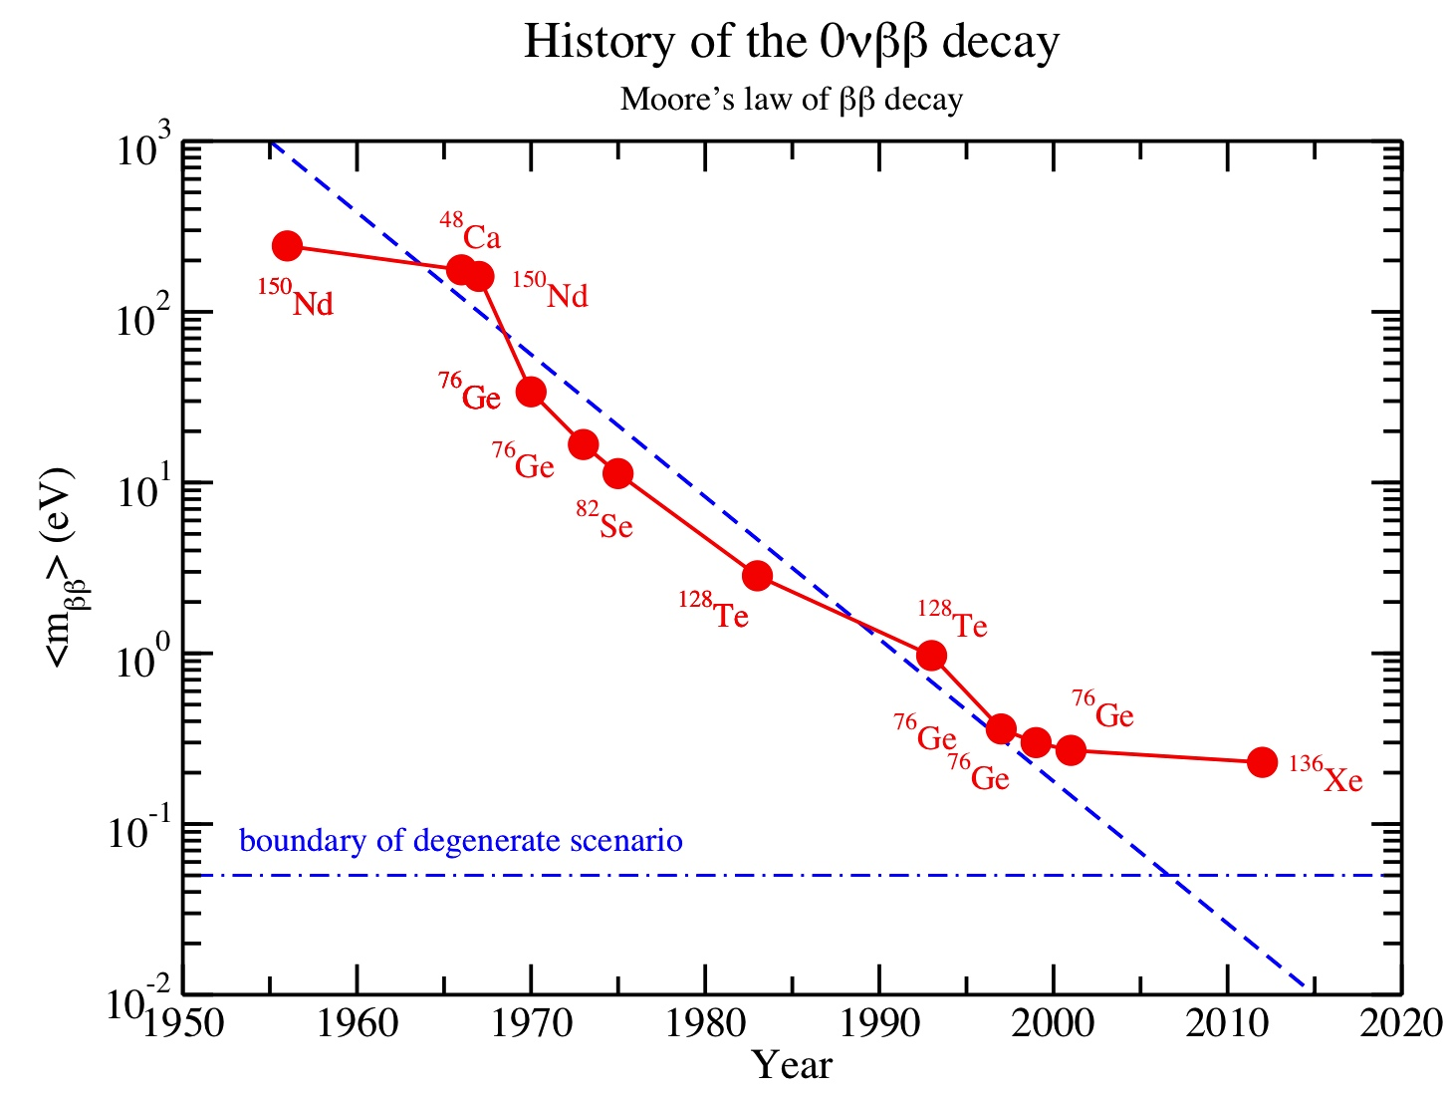
ββ trends (updated Elliott/Vogel plot by Vogel)
The Old Era
Historically, there are
> 100 experimental
limits on T_{1/2} of the
0νββ decay.
Here are the records
expressed as limits on
<m_{ββ}> using one set
of nuclear matrix
elements (RQRPA of
Simkovic et al. 2009.)
During the last decade
the complexity and
cost of experiments
has increased very
dramatically. The
slope constant is now
leveling off!
Heidlelberg-Moscow
Notes:
Take-away: Life has gotten tough, a new era: “too big and costly to fail, but maybe not good enough to succeed.”

Slide 31
Experiment: – the ideal result
Only
2-v decays
Only
0-v decays
Rate
No backgrounds above Q-value
0
Σ visible Energy
Q-value
The ideal result is a spectrum of all ββ events, with a 0-ν signal present as a narrow peak, well-separated from 2-ν tail.
Notes:
the 2-nu spectrum reaches Q, and can invade the 0-nu peak ROI if energy resolution is insufficient!

Slide 32
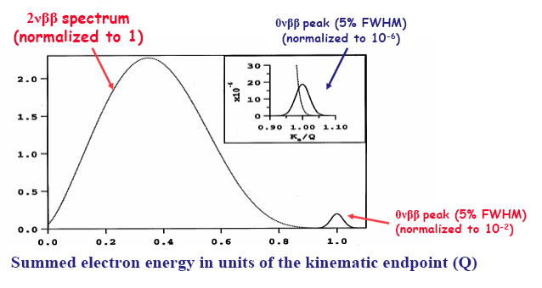
A traditional search for neutrino-less decay:
Measure summed energy of the two electrons
Not yet sufficient to reject backgrounds!
Energy resolution to prevent overlap:
δE/E ~ 1% FWHM
Notes:
Take-away: energy resolution not worse than 1% FWHM seems prudent; at 2% FWHM, no safety margin for non-gaussian effects.

Slide 33
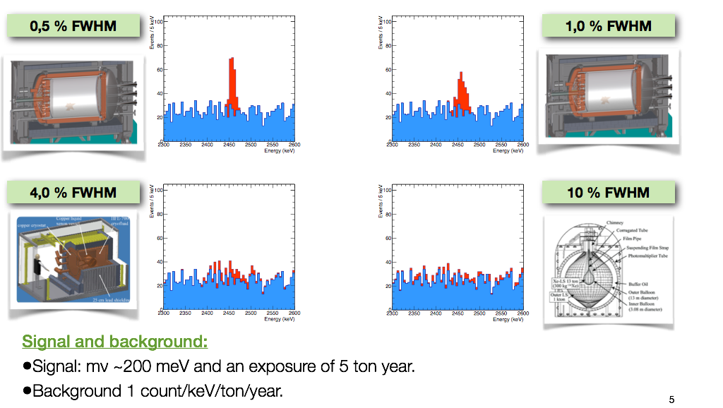
Importance of energy resolution – when backgrounds are present

Slide 34
If background is present:
b = background cts/keV
ΔE = Energy ROI
M = active isotopic mass
t_{live} = graduate students
Significant Background → brick wall !

Slide 35
If background is present:
b = background cts/keV
ΔE = Energy ROI
M = active isotopic mass
t_{live} = graduate students
Significant Background → brick wall !
γ-rays are the largest background

Slide 36
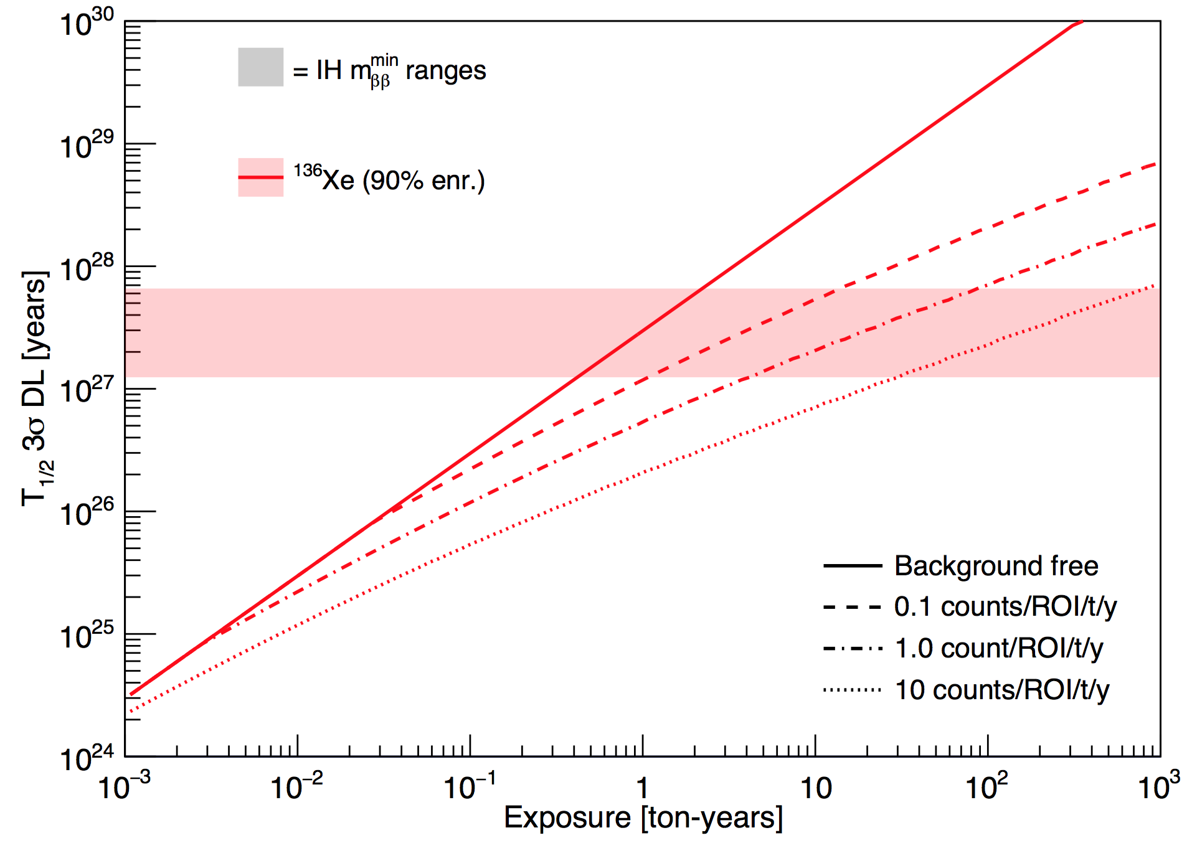
Ultimately, a ton-scale experiment with excellent background rejection (<1 ct ton yr) is the key to crossing the IH in finite time.
Run for 2-3 years
Inverted Heirachy
Run for 15 years
Run for 100 years
Run for 1000 years
1000 kg experiment

Slide 38
Background characterization
    b = counts /(keV-ton-year)
    ΔE = width of energy region of interest (keV)
  We need bΔE < 0.1 cty – this is not easy! *
  How can such low backgrounds be demonstrated?
  Easy: take 1kg, count for 100,000 years!
Notes:
Take one kg of your detector, put in a well-counter, and count for 10,000 years!

Slide 39
Background characterization
    b = counts /(keV-ton-year)
    ΔE = width of energy region of interest (keV)
  We need bΔE < 0.1 cty – this is not easy! *
  How can such low backgrounds be demonstrated?
  Easy: take 1kg, count for 100,000 years!
Notes:
Take one kg of your detector, put in a well-counter, and count for 10,000 years!

Slide 40
Approaches to background rejection:
Superb energy resolution
Heroic radio-purity & shielding
Identification of two-electron topology
Identification of decay daughter:
Z → (Z+2)

Slide 41
Approaches to background rejection:
Superb energy resolution
Heroic radio-purity & shielding
Identification of two-electron topology
Identification of decay daughter:
Z → (Z+2)

Slide 42
About Xenon
No long-lived radioactive isotopes ( ¹³⁶Xe)
Natural abundance of ~9%
Easy to enrich by centrifuge
Relatively inexpensive: 1 ton ¹³⁶Xe already exists
Important difference between liquid & gas:
  Energy partition fluctuations:
  scintillation ⬅➔ ionization
  Fluctuations are large in liquid Xe
  Fluctuations are small in gaseous Xe

Slide 43
About Xenon
No long-lived radioactive isotopes ( ¹³⁶Xe)
Natural abundance of ~9%
Easy to enrich by centrifuge
Relatively inexpensive: 1 ton ¹³⁶Xe already exists
Important difference between liquid & gas:
  Energy partition fluctuations:
  scintillation ⬅➔ ionization
  Fluctuations are large in liquid Xe
  Fluctuations are small in gaseous Xe

Slide 44
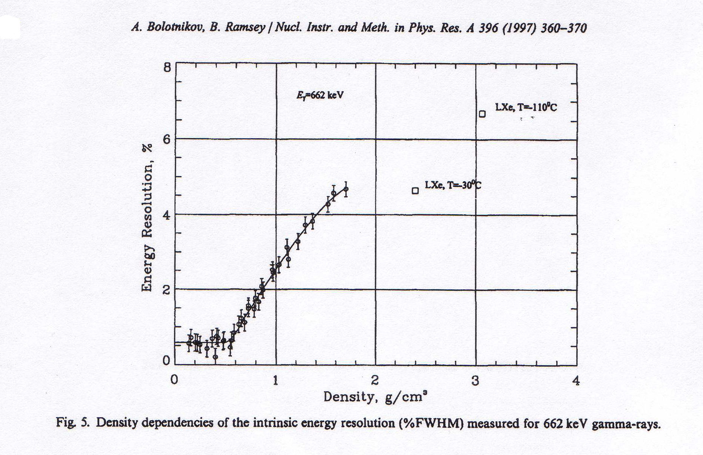
Partition fluctuations in xenon depend strongly on density!
Here, the fluctuations are normal
Fano factor
F = 0.15
Intrinsic Resolution:
δE/E ~0.6% FWHM
F = ~20
Ionization signal only
For ρ <0.55 g/cm³, ionization energy resolution is “intrinsic”
Notes:
energy partition fluctuations are due to delta rays in high atomic density + (conduction band?)

Slide 45
Intrinsic Energy resolution at Q_{ββ} = 2457 keV
  Q ≡ Energy ¹³⁶Xe --> ¹³⁶Ba: 2457 keV
  w ≡ Average energy per ion pair: 25 eV
  N = Q/w ~100,000 primary electrons
  F ≡ Fano factor (HPXe): F = 0.15 ±0.03
  σ_{N} = (F⋅N)^{1/2} = (F⋅Q/w)^{1/2} ~124 electrons rms!
δE/E = 2.35 ⋅ (F⋅w/Q)^{1/2} FWHM
δE/E = 0.3% FWHM intrinsic Gas-phase Xe
Ionization signal only!
Notes:
Only about x3 worse than Ge diodes!

Slide 46
Intrinsic Energy resolution at Q_{ββ} = 2457 keV
  Q ≡ Energy ¹³⁶Xe --> ¹³⁶Ba: 2457 keV
  w ≡ Average energy per ion pair: 25 eV
  N = Q/w ~100,000 primary electrons
  F ≡ Fano factor (HPXe): F = 0.15 ±0.03
  σ_{N} = (F⋅N)^{1/2} = (F⋅Q/w)^{1/2} ~124 electrons rms!
δE/E = 2.35 ⋅ (F⋅w/Q)^{1/2} FWHM
δE/E = 0.3% FWHM intrinsic Gas-phase Xe
Ionization signal only!
Notes:
Only about x3 worse than Ge diodes!

Slide 47
Intrinsic Energy resolution at Q_{ββ} = 2457 keV
  Q ≡ Energy ¹³⁶Xe --> ¹³⁶Ba: 2457 keV
  w ≡ Average energy per ion pair: 25 eV
  N = Q/w ~100,000 primary electrons
  F ≡ Fano factor (HPXe): F = 0.15 ±0.03
  σ_{N} = (F⋅N)^{1/2} = (F⋅Q/w)^{1/2} ~124 electrons rms!
δE/E = 2.35 ⋅ (F⋅w/Q)^{1/2} FWHM
δE/E = 0.3% FWHM intrinsic Gas-phase Xe
Ionization signal only!
Notes:
Only about x3 worse than Ge diodes!

Slide 48
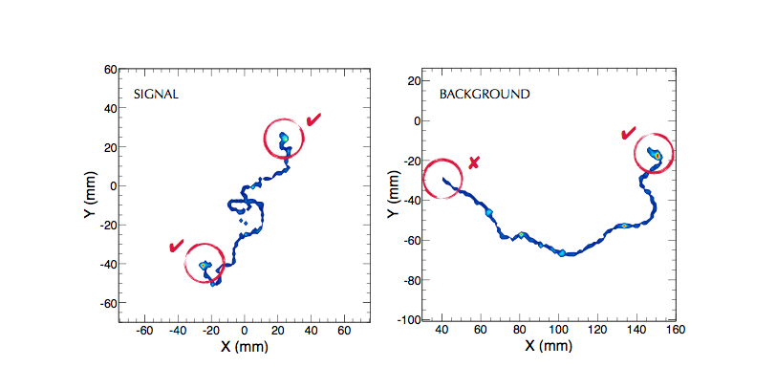
Topological signature - simulation
Two “meatballs”
= two electrons
One “meatball”
= one electron

Slide 49
Gas Phase Xenon – takeaway:
Excellent energy resolution is available–in principle–using only ionization information
Detailed topological information is available–this permits a high level of discrimination against false events caused by γ-rays

Slide 50
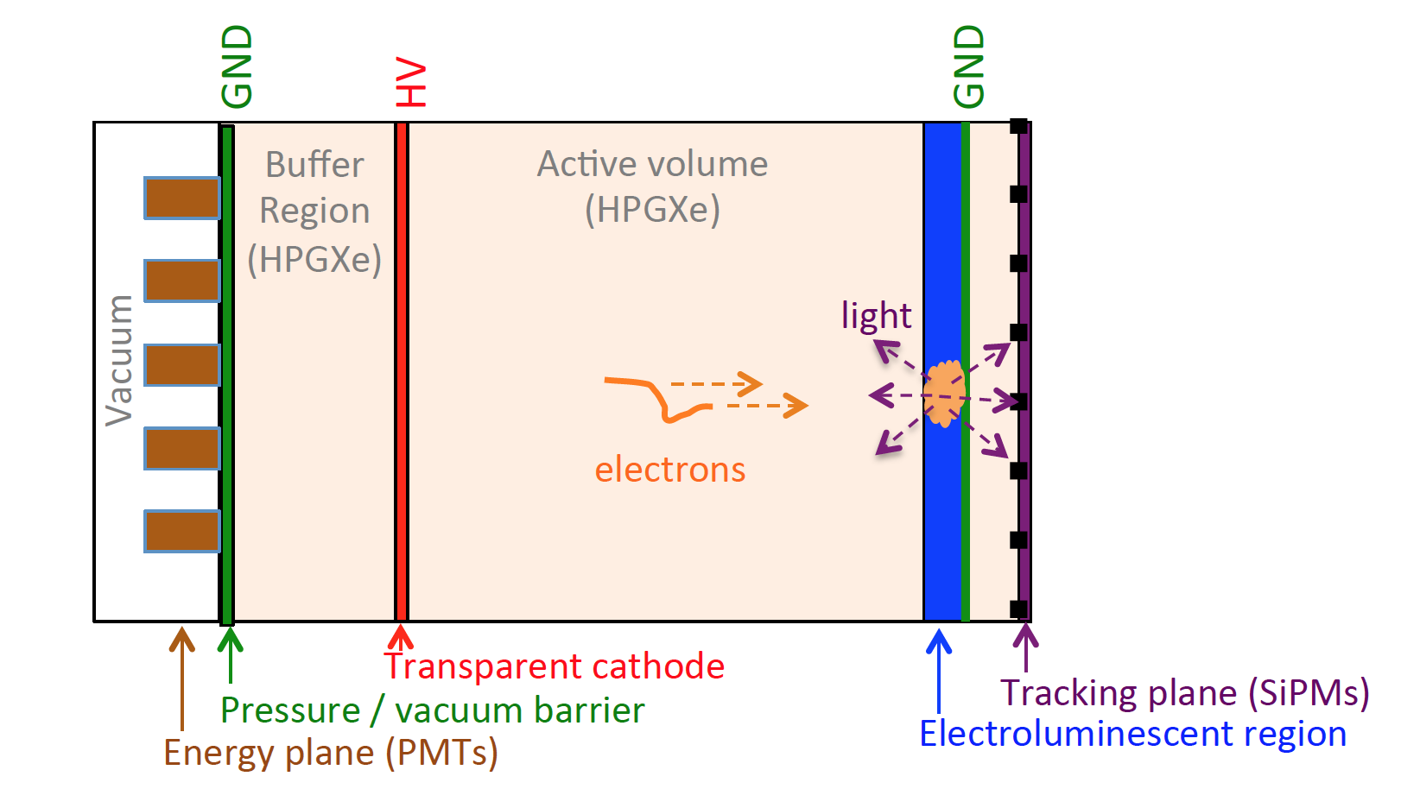
Schematic design of NEXT detectors:
Asymmetric Gas-phase TPC

Slide 51
Amplifying the charge
In high pressure gas, measuring ionization charge alone gives excellent energy resolution (δE/E = 0.3% FWHM) in principle.
Now the challenge is to amplify it without introducing excessive fluctuations.
Use electroluminescent gain mechanism (Conde & Policarpo):
Avalanche mode
-HV
EL mode
-HV
e⁻
e⁻
e+Xe → e⁻ +Xe*
e+Xe → 2e⁻+Xe⁺
e+Xe → e⁻+Xe*
γ
γ
GND
GND
Electrons get enough energy to ionize
→ big fluctuations in photon yield
Only enough energy to excite Xe
→ small fluctuations in photon yield

Slide 52
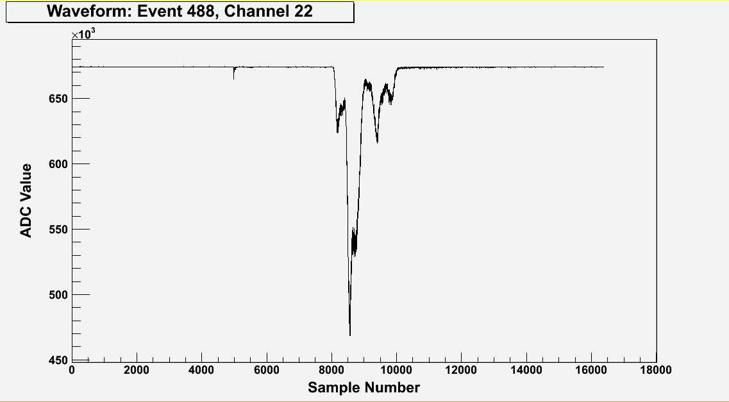
A typical ¹³⁷Cs γ waveform (sum of 19 PMTs)
~300,000 detected photoelectrons
Primary Scintillation (S1)
T0 of event
Electroluminescence (S2)
structure reflects topology
Drift Time:z-position
(~0.01mm/sample)
Drift velocity ~1 mm/ms
TIPP 2011
52
10ns/sample

Slide 53
A typical ¹³⁷Cs γ waveform (sum of 19 PMTs)
~300,000 detected photoelectrons
Phosphorescence?
After-pulsing ?
Primary Scintillation (S1)
T0 of event
Electroluminescence (S2)
structure reflects topology
Drift Time:z-position
(~0.01mm/sample)
Drift velocity ~1 mm/ms
TIPP 2011
53
10ns/sample

Slide 54
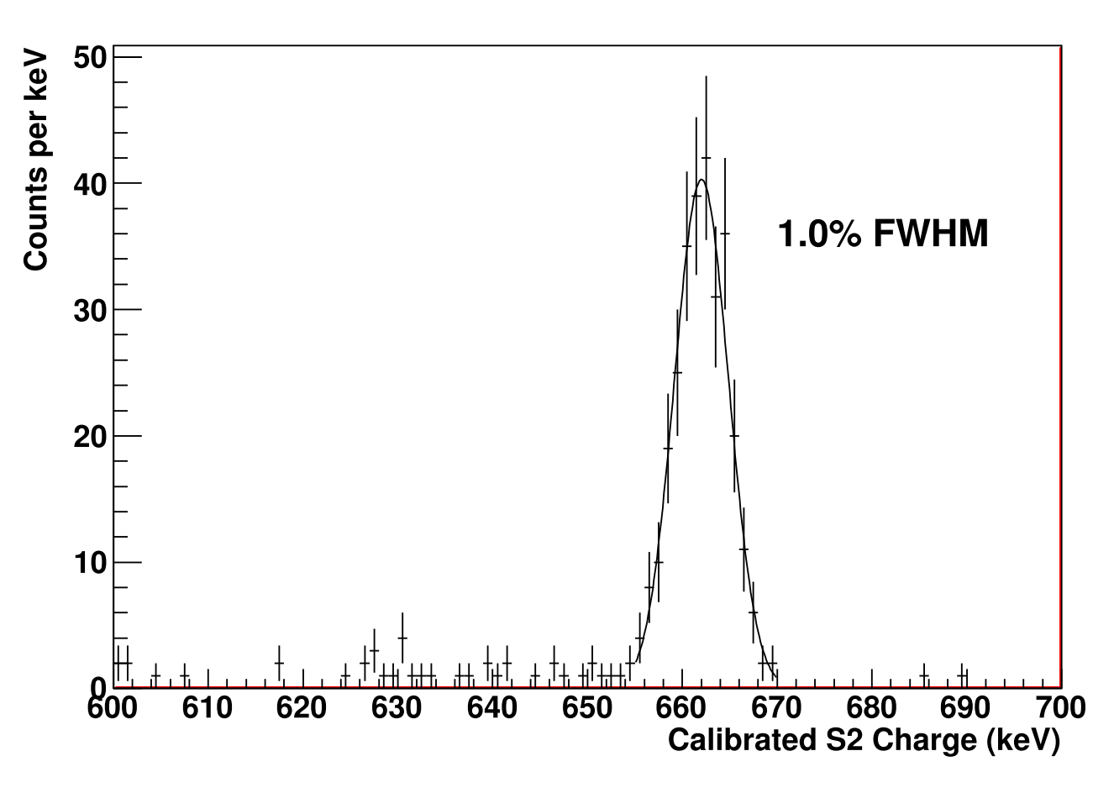
Energy Resolution from DBDM
662 keV ¹³⁷Cs gamma ray
Extrapolates to 0.57% at Q_{ββ}
Uses only ionization signal, amplified by electroluminesence
NEXT collab - NIMA708 (2013) 101-114

Slide 55
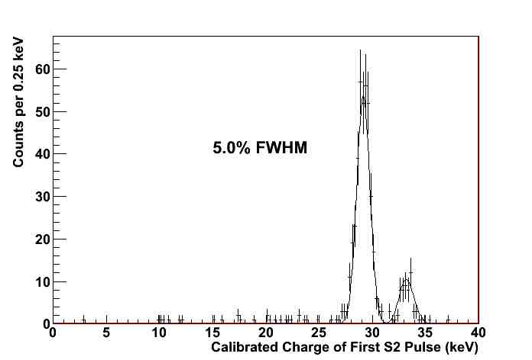
The x-ray peaks at ~30 keV are captured precisely

Slide 56
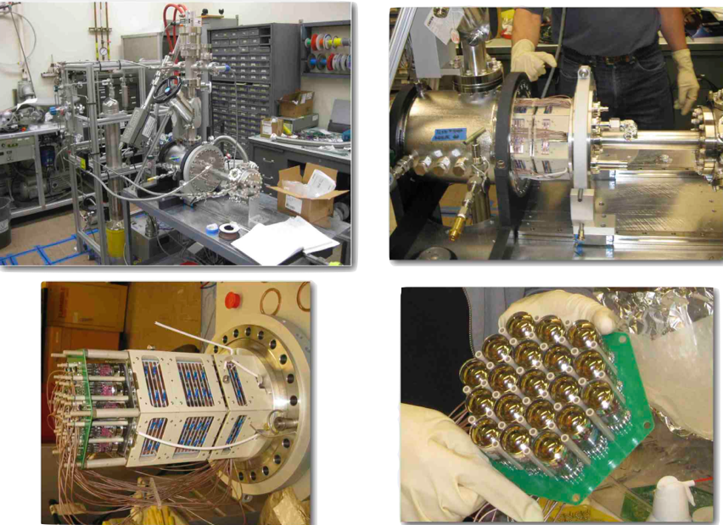
NEXT-DBDM at LBNL
Notes:
No tracking plane

Slide 57
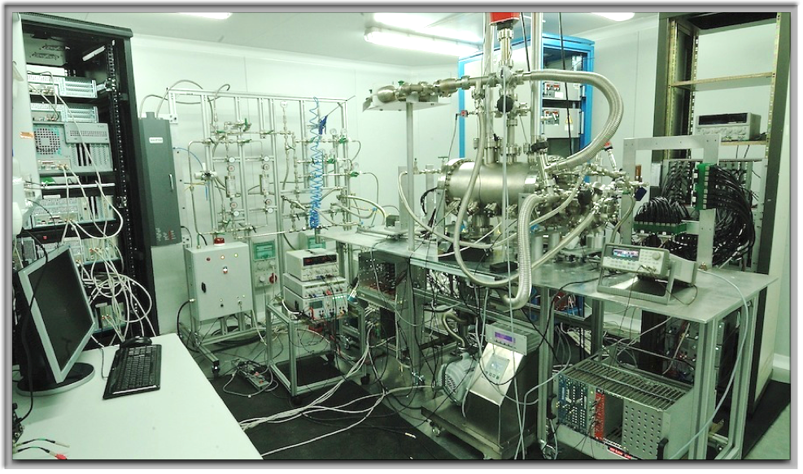
NEXT-DEMO in situ at IFIC-Valencia

Slide 58
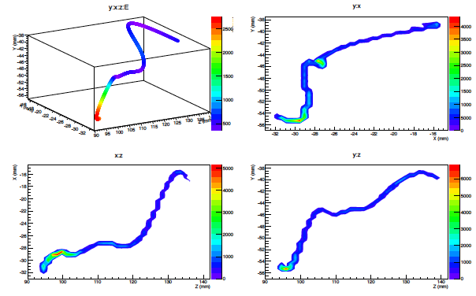
DATA: Real track from ¹³⁷Cs γ-ray – reconstructed with SiPMs
DATA from NEXT-DEMO IFIC, Valencia

Slide 59
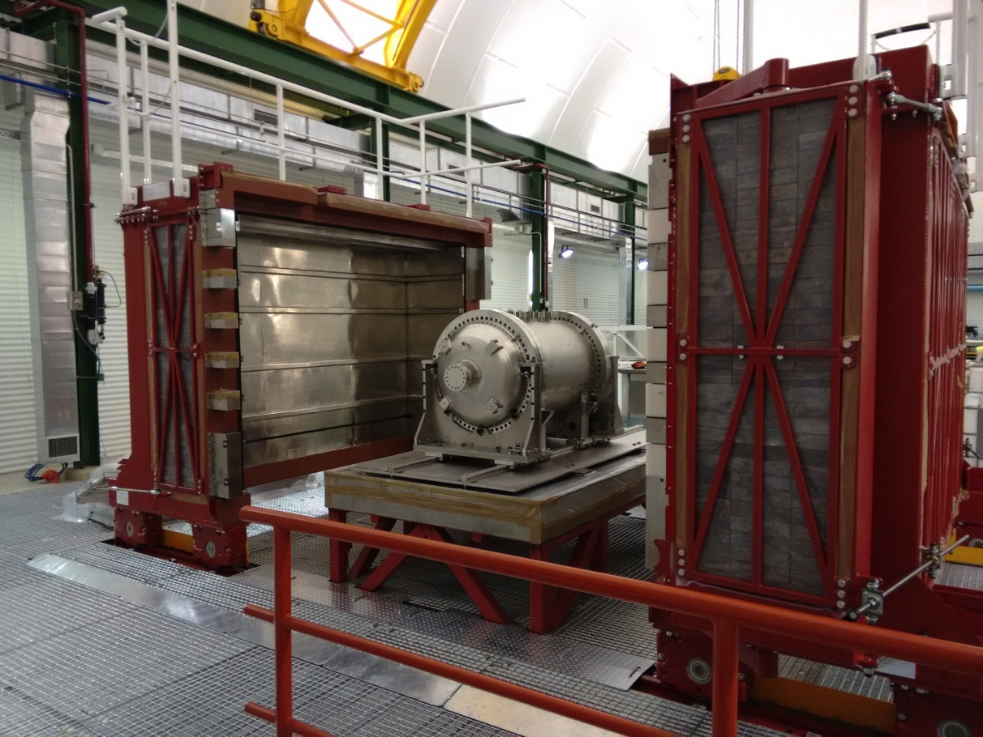
NEXT-10 at the Laboratorio Subteranneo de Canfranc (LSC) April 2017
NEXT-10 on the seismic support table, inside the Lead Castle at the LSC

Slide 60

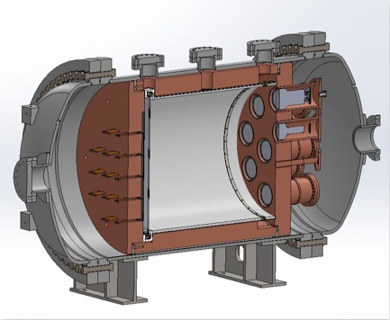



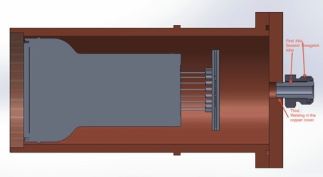
NEXT-10 at a glance
Time Projection Chamber:
10 kg active region, 50 cm drift length
Pressure vessel:
316-Ti steel, 30 bar max pressure
Tracking plane:
1,800 SiPMs,
1 cm pitch
Energy plane:
12 PMTs,
30% coverage
Inner shield:
copper, 6 cm thick

Slide 61
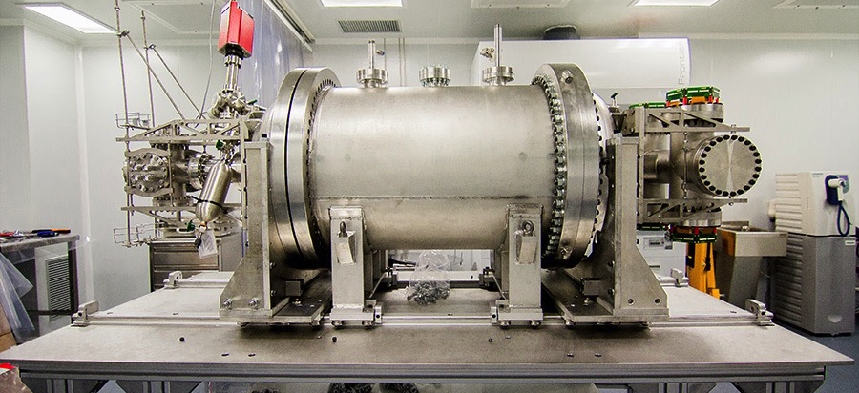
NEXT-10 at Canfranc Laboratory
Stainless Steel 316 alloy.
Radiopure and light

Slide 62
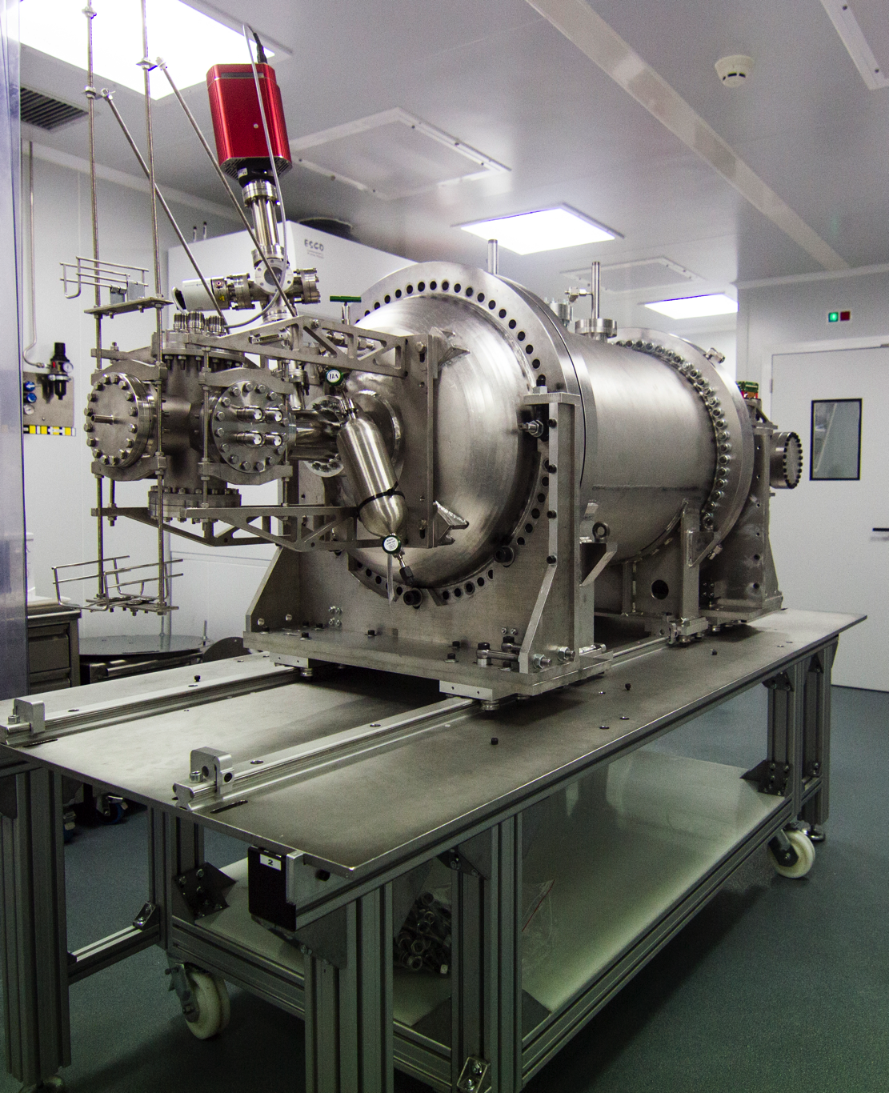
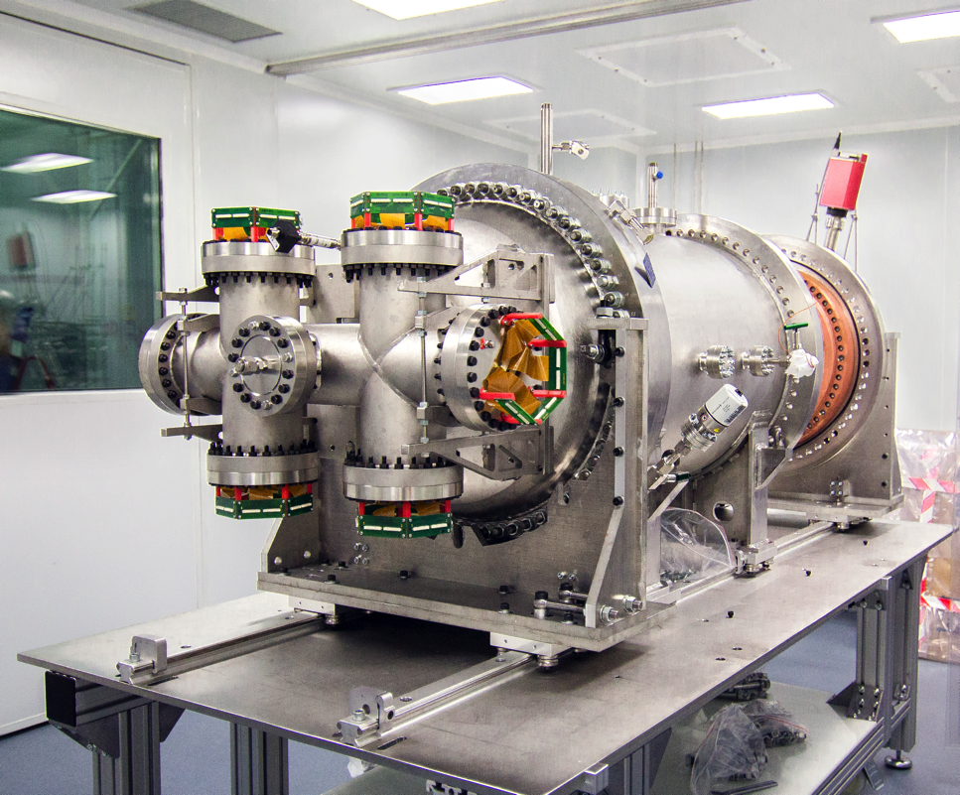
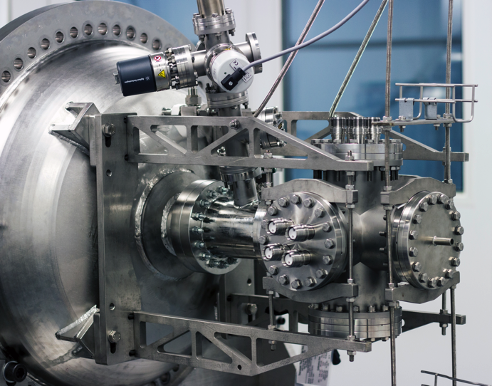
NEW (Next White)

Slide 63
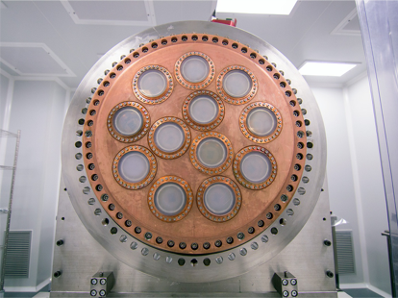
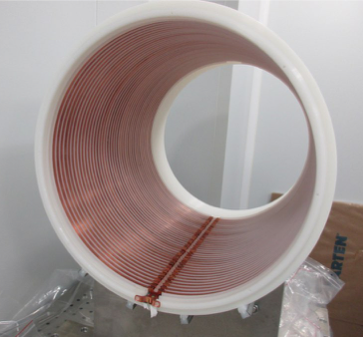
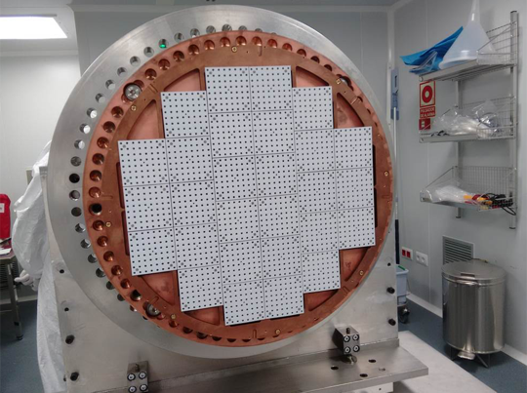
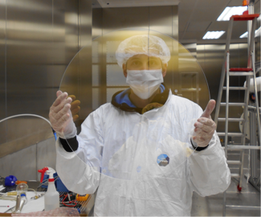
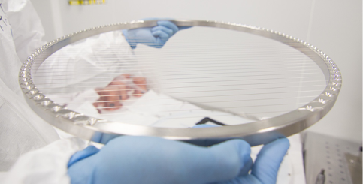
Energy Plane
Field Cage
Tracking Plane
Plates and Gates

Slide 64
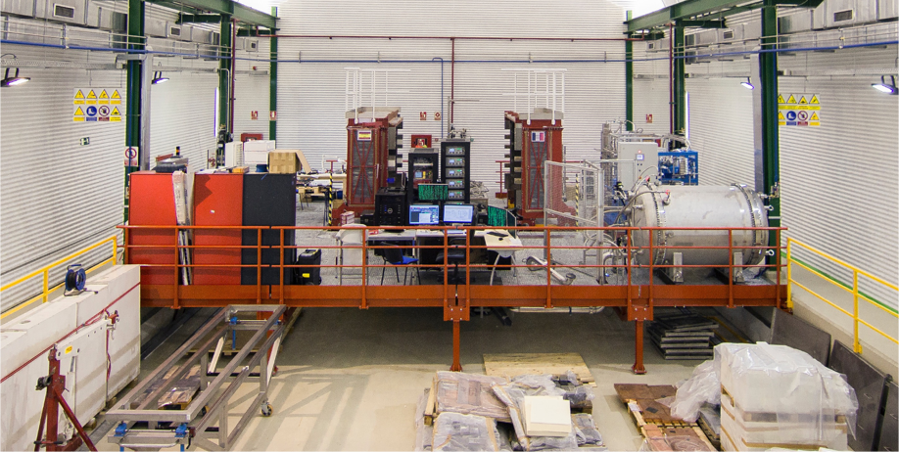
NEXT-NEW at LSC, Canfranc
Lead castle shielding
Compressor / gas system
NEXT-NEW
NEXT-100 Pressure vessel is emergency relief tank for NEW

Slide 65
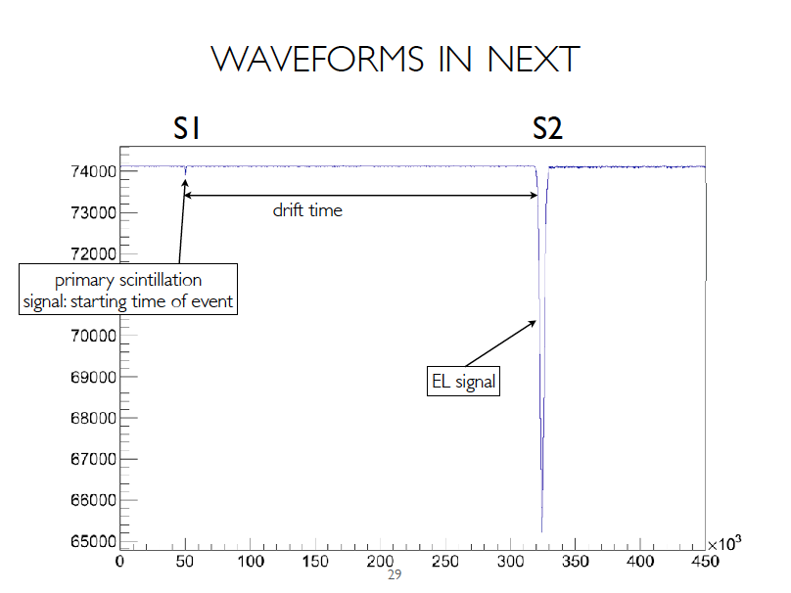

Slide 66
About gas-phase Xenon
Excellent energy resolution in gas phase:
  In real-life, maybe δE/E = 5 x10⁻³ FWHM
Topology available for background rejection
Linear gain: electroluminescence
Gas phase: non-cryogenic, flexibilities
      *****************************************
New idea for daughter identification…
  Barium tagging in situ at high pressure!
Notes:
Single electrons (γ-rays) create one endpoint blob
Double-beta decay events create two endpoint blobs
Nearly noise-less gain by EL
Automatic detection of appearance of barium!

Slide 67
About gas-phase Xenon
Excellent energy resolution in gas phase:
  In real-life, maybe δE/E = 5 x10⁻³ FWHM
Topology available for background rejection
Linear gain: electroluminescence
Gas phase: non-cryogenic, flexibilities
      *****************************************
New idea for daughter identification…
  Barium tagging in situ at high pressure!
Notes:
Single electrons (γ-rays) create one endpoint blob
Double-beta decay events create two endpoint blobs
Nearly noise-less gain by EL
Automatic detection of appearance of barium!

Slide 68
Original tagging idea:
1980 - 1991
Identify the barium daughter
by optical spectroscopy
(M.Moe PRC44 (1991) 931)
Ba⁺ system best studied
(Neuhauser, Hohenstatt,
Toshek, Dehmelt 1980)
Single ions can be detected
from a photon rate of 10⁷/s
Pursued by EXO…
But:
Triplet state is quenched
in dense gas!
Challenging, in R&D stage
²P_{1/2}
650nm
493nm
⁴D_{3/2}
metastable 80s
²S_{1/2}

Slide 69
“Tagging” the barium daughter atom
The Motivation:
    Υ-rays cannot convert xenon to barium!
The Reward:
    A (possibly) background-free experiment!
The Challenge:
    Maybe ~10²⁷ atoms in your fiducial volume!
The Solution (if any exists):
    Will not likely involve only conventional ideas!
Notes:
Free trip to Stockholm
normal backgrounds can not make barium
10^27 → one bacterium in one cubic kilometer of water.
2ν ββ decays are occurring fairly often

Slide 70
Xenon’s barium daughter
In the decay xenon → barium, the daughter atom is strongly ionized by the nascent electrons emerging from the nucleus and by shell relaxation
  Partial neutralization of barium occurs by electron capture from nearby neutral xenon atoms (ionization potential IP = 12.14 eV)
  Process stops at Ba⁺⁺ because the ionization potential of Ba⁺⁺ is 10.04 eV; it can’t take another electron from a neutral xenon atom: IP = 12.14 eV
  Ba⁺⁺ is the expected outcome in pure xenon, gas or liquid
Notes:
molecular impurities can induce unwanted chemistry

Slide 71
There might be a way to use Ba⁺⁺
The technique of Single Molecule Fluorescent Imaging may be adaptable here.
My idea is to exploit a remarkable chemical effect: the transformation of a non-fluorescent molecular precursor into a robust fluorescent state by capture and chelation of doubly ionized alkaline earth elements, such as Ca⁺⁺
Maybe Ba⁺⁺ too!
Calcium and Barium are congeners → similar chemistry

Slide 72
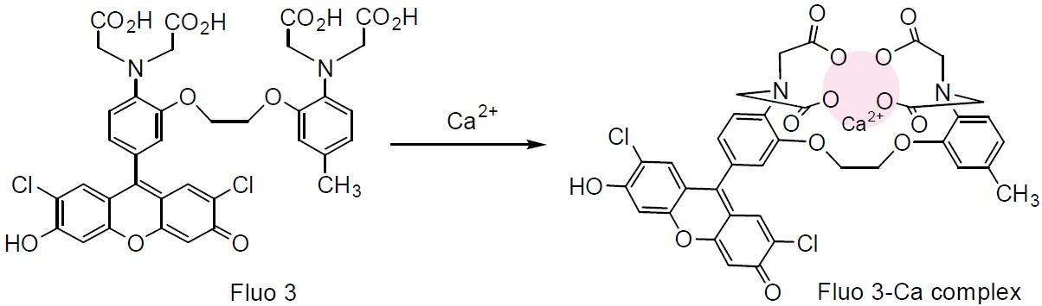
Fluo-3 converts from non-fluorescent to a fluorescent state by chelation!
Once Ca⁺⁺ is captured by Fluo-3, its responsiveness to external excitation
increases by a factor of 60 -80. Two-photon excitation with IR is also possible
This might work for Barium as well since barium and calcium are congeners.
Fluorophores exist for for Pb⁺⁺, Hg⁺⁺, Cu…)
2014 Nobel Prize in Chemistry awarded to three physicists for developing SMFI

Slide 73
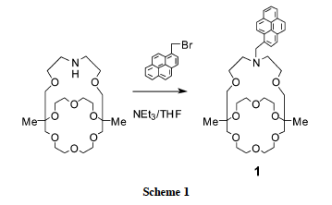
A Fluorescent indicator specific to Ba⁺⁺!
“Monoazacryptand 1”
Y. Nakahara, T. Kida, Y. Nakatasuji, M. Akashi,
Chem. Comm., Roy. Soc. of Chem., 2004, p224-225

Slide 74
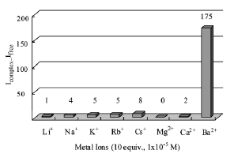

Highly specific to Ba⁺⁺ !

Slide 75
How might one use this idea?
The barium ion will move to the TPC cathode
Will it move with a unique mobility?
Or, will evanescent clusters complicate drift?
Would clustering help or hurt this scheme?
It seems necessary to measure Ba⁺⁺ mobility
  Theoretical studies underway at UTA for this…
Movement to cathode: 3D → 2D problem

Slide 76
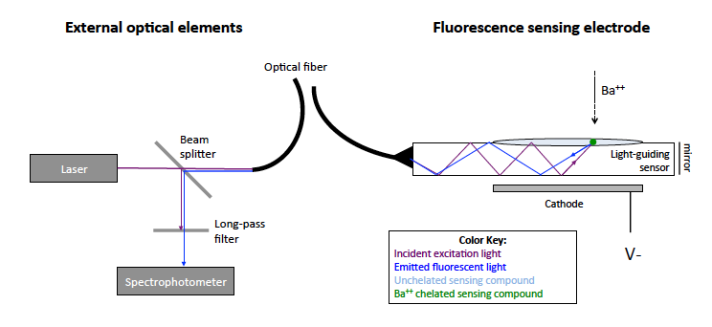
The 1-D solution:
Sensing by evanescent wave:
Notes:
Clearly out of the box thinking – some may think over the cliff too.
We are just beginning to explore this new terra incognita

Slide 77
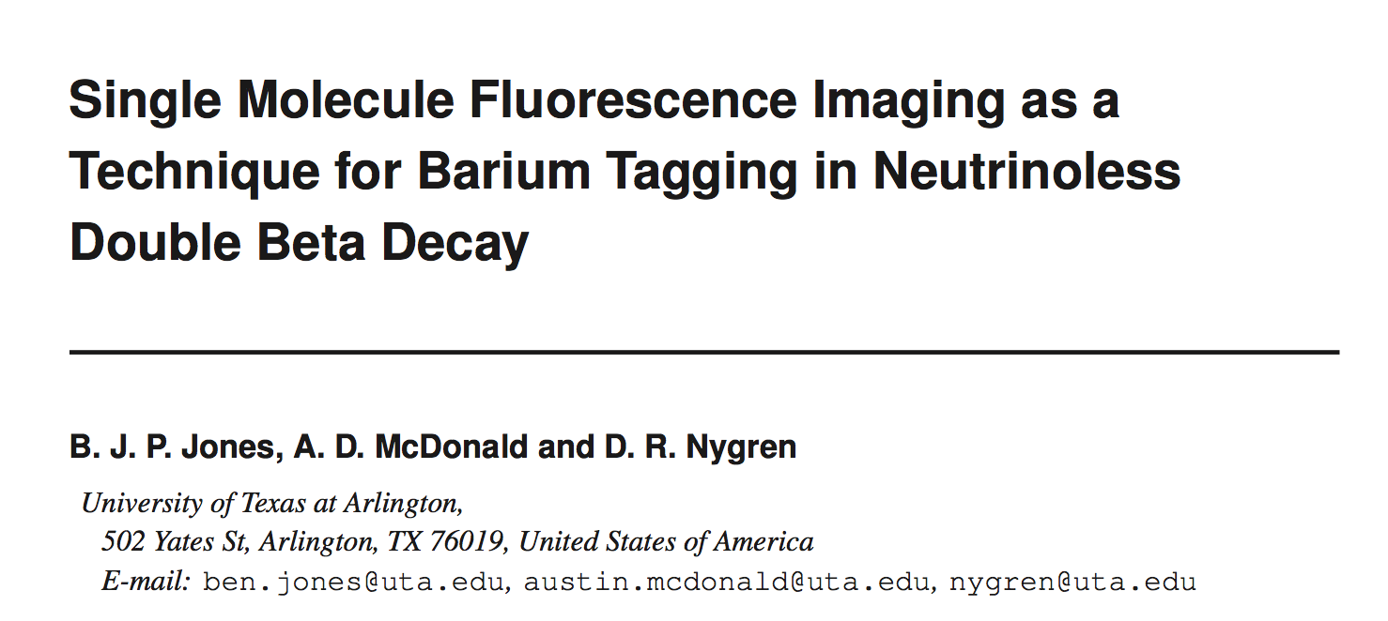
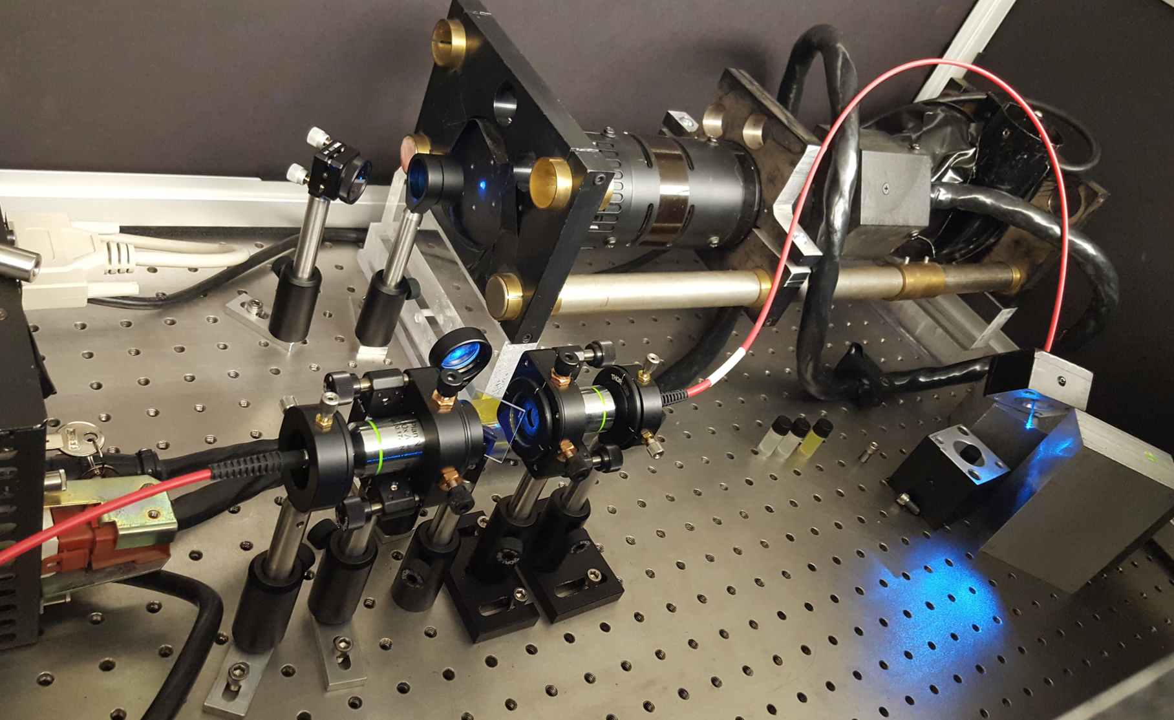
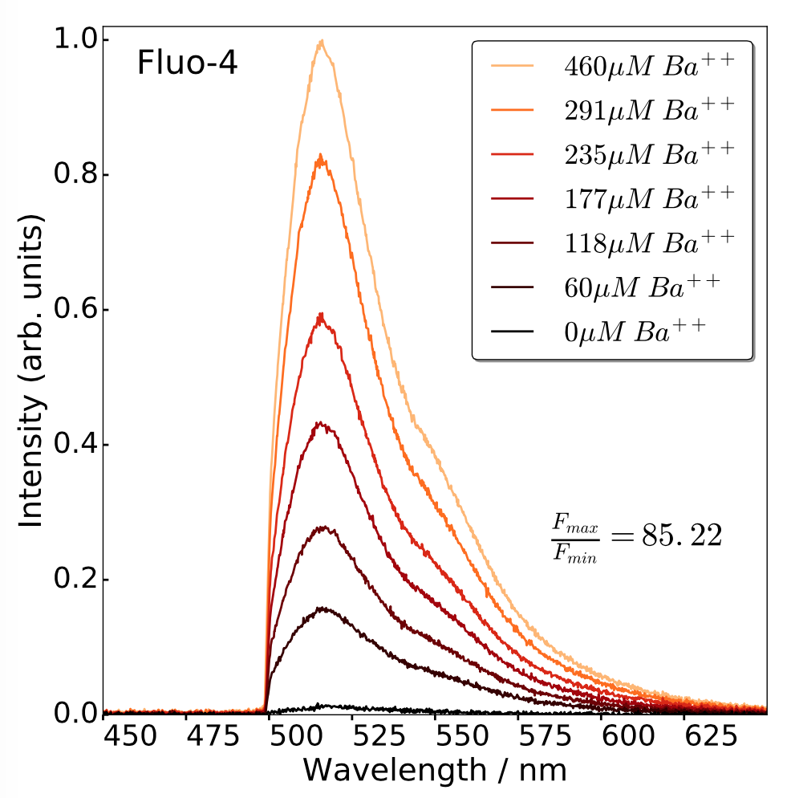
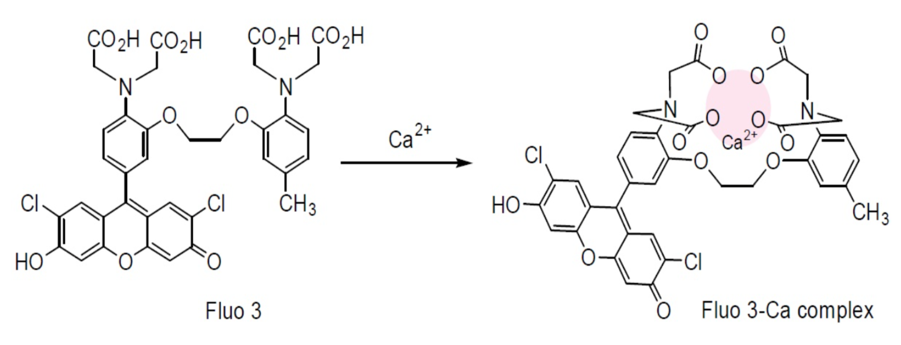
Paper submitted 09/13/16

Slide 78
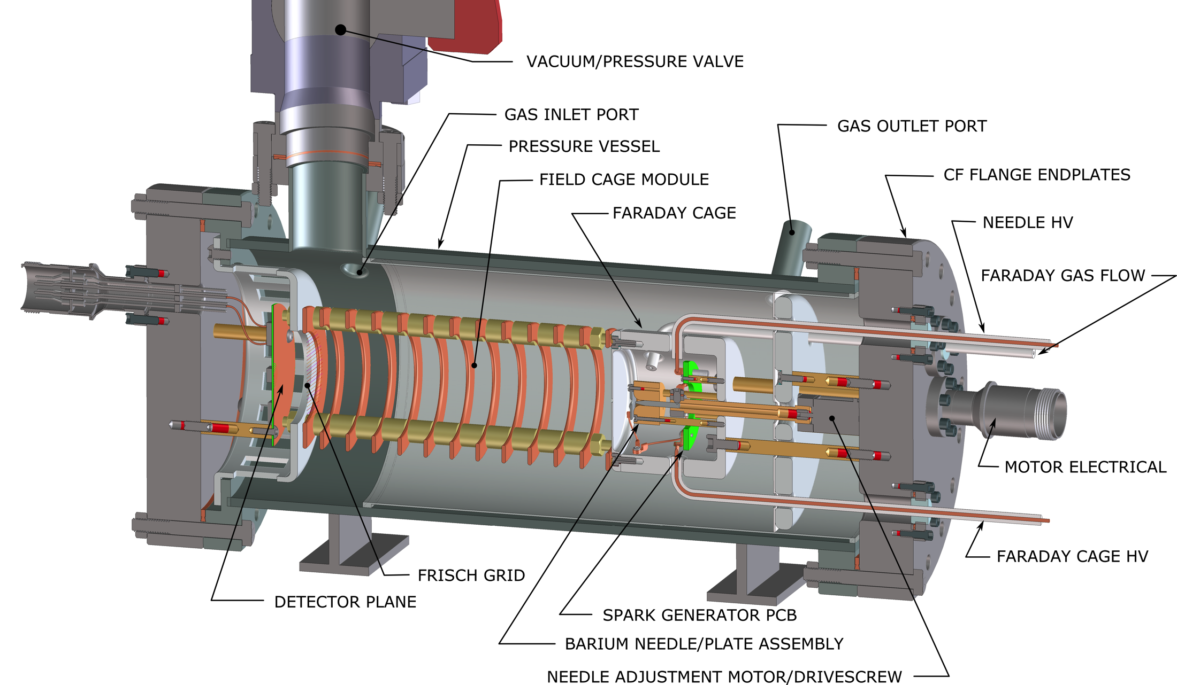
Ba⁺⁺ source & time of flight system

Slide 79
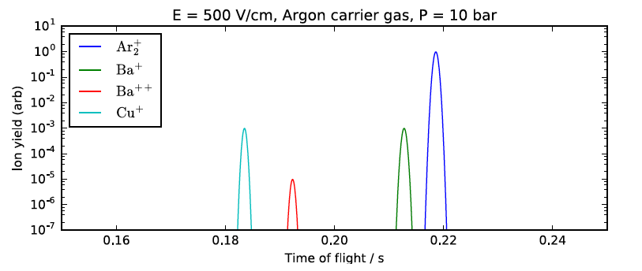
Time-of-flight separation - simulation

Slide 80
Perspective
HPXe TPC may offer a path to a (possibly) background-free NLDBD experiment
  Flexibility inherent in gas-phase xenon
  Excellent intrinsic energy resolution…
  Topological discrimination may offer N_{b} <1
  Barium daughter tag in situ at high pressure?

Slide 81
Perspective
Single molecule fluorescence imaging may facilitate the “biochemistry of ¹³⁶Xe” and a discovery of NLDBD, and provide insight into
  Why there is something, rather than nothing
Might Single Molecule Fluorescence Imaging facilitate the detection of single atoms of special nuclear materials, or their daughters?

Slide 82
Perspective
Single molecule fluorescence imaging may facilitate the “biochemistry of ¹³⁶Xe” and a discovery of NLDBD, and provide insight into
  Why there is something, rather than nothing
Might Single Molecule Fluorescence Imaging facilitate the detection of single atoms of special nuclear materials, or their daughters?

Slide 83
Thank you for
Your attention

Slide 84
Backup slides

Slide 85
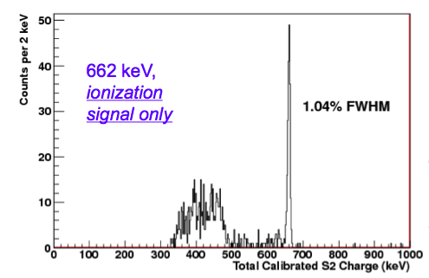
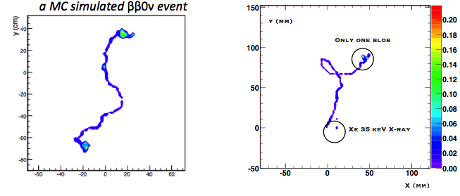
NEXT: Salient features
Excellent resolution (~1% FWHM measured at 662 keV by NEXT prototypes, extrapolates to 0.5 % FWHM at Qbb if all systematics are well controlled
Topological signature (TS) is the ability to distinguish between signal (“double electrons”) and background (“single electrons”); evidence exists that this works well.
Target = detector. Tracking establishes fiducial region, away from surfaces.
TPC: generally scalable. Economies of scale; V/S ratio increases linearly with L.
Xenon: the cheapest isotope to enrich in the market (NEXT owns 100 kg of enriched xenon, ~1 ton exists worldwide).

Slide 86
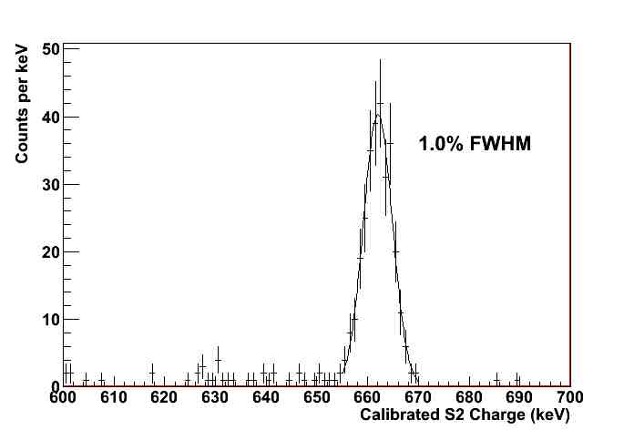
¹³⁷Cs γ-ray: 662 keV
Nearly Gaussian shape
A world record for
xenon-based detectors
Credit: Azriel Goldschmidt

Slide 87
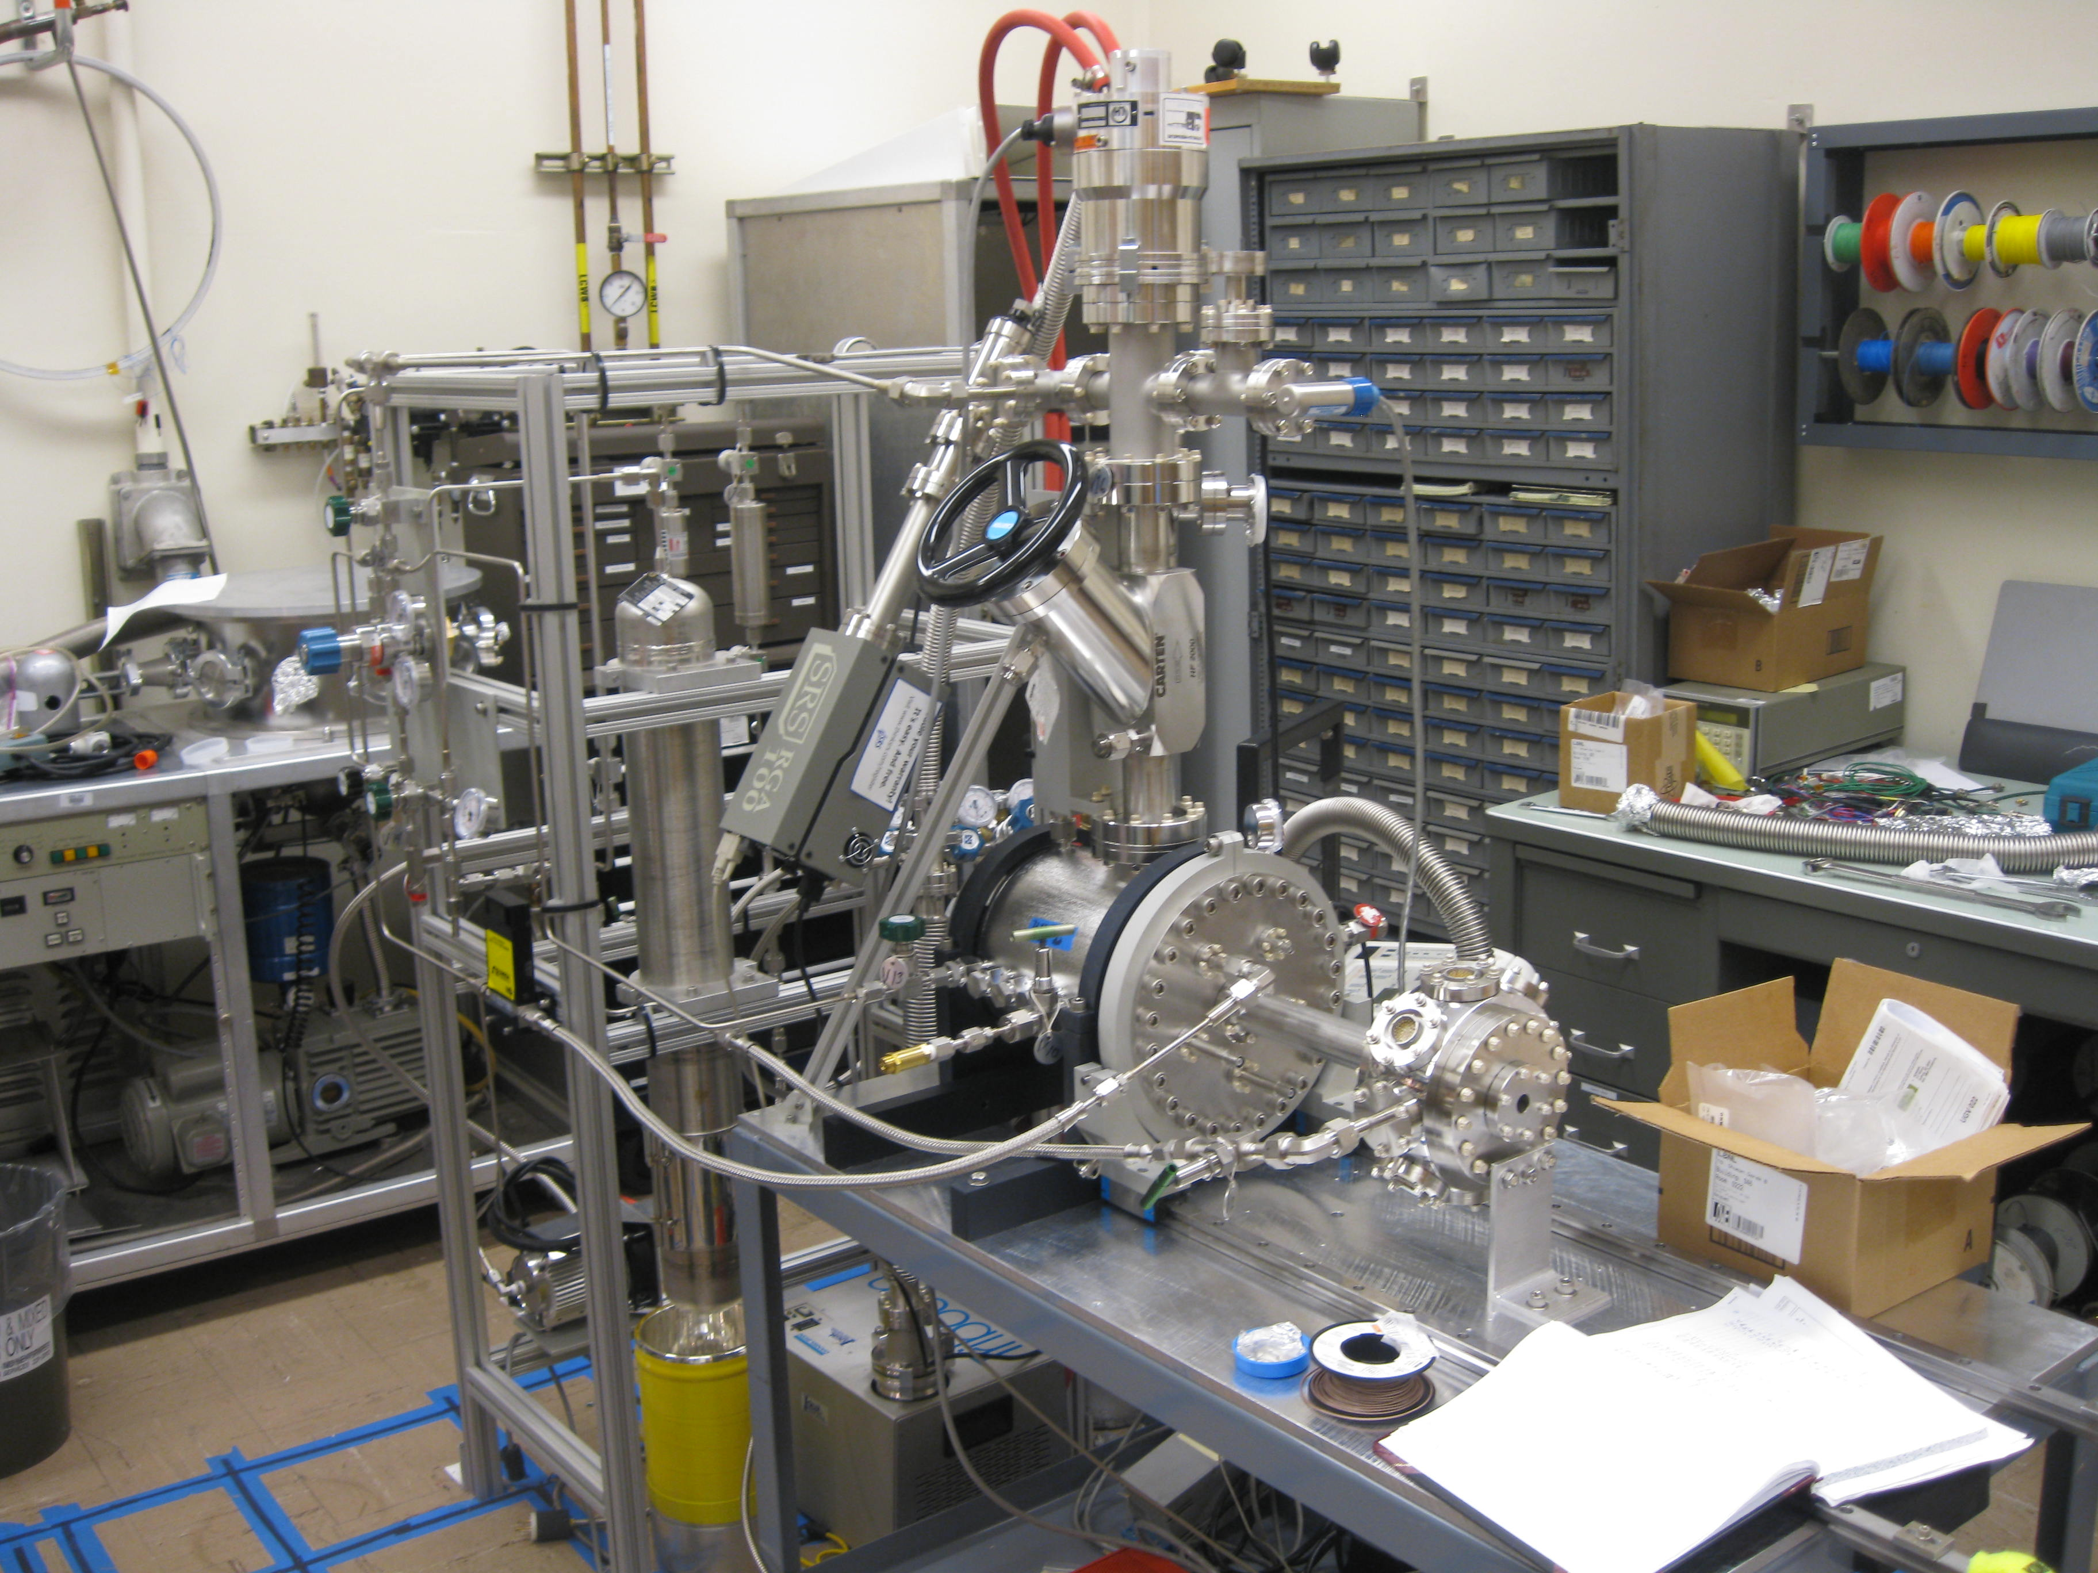
NEXT - DBDM (LBNL)
TIPP 2011
87

Slide 89



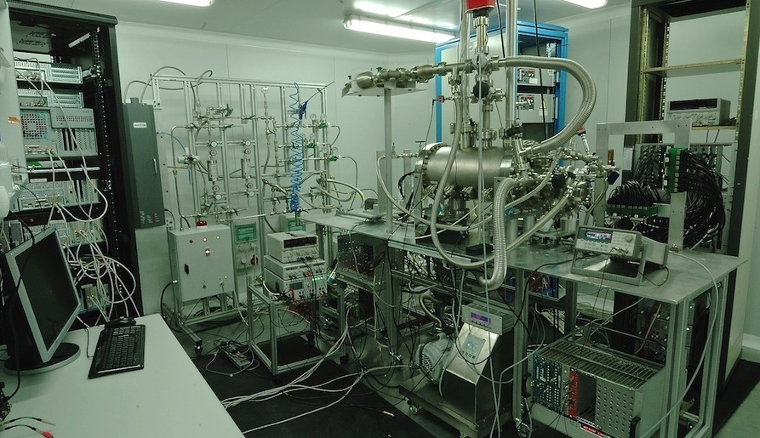

Hot Getter
Gas System
HHV modules
NEXT-DEMO
DAQ
PMTs FEE
SiPMs FEE
(IFIC)

Slide 90
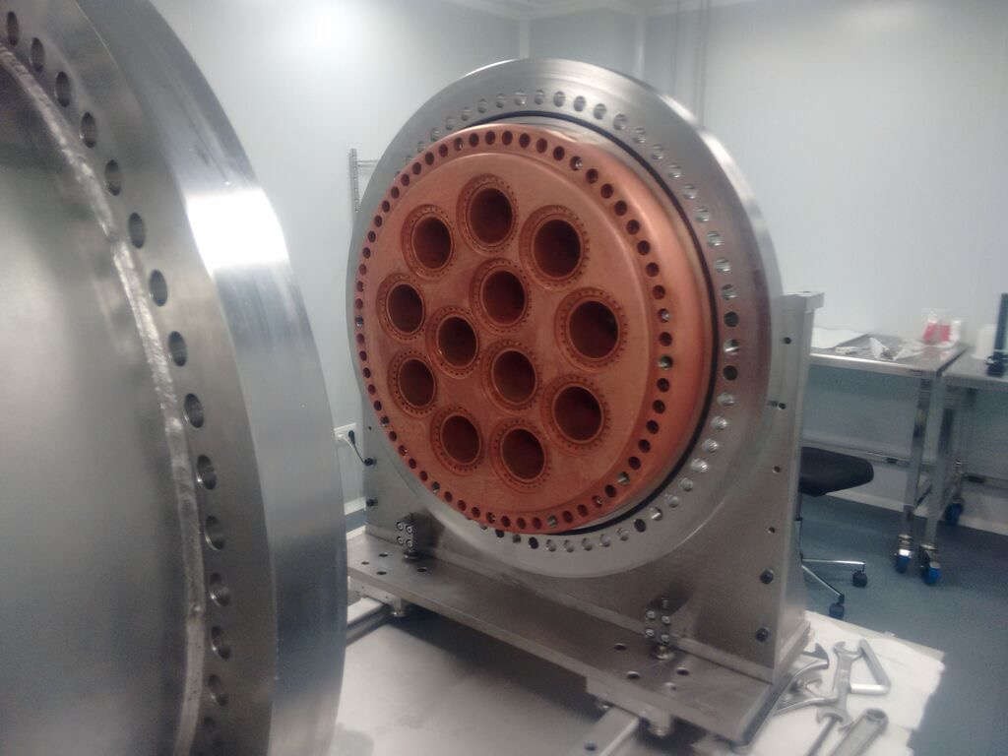



Energy Plane installation

Slide 91


Slide 92


NEXT Expected Performance
Systematic assay of ALL detector components at the LSC HPGe facility
Development of full MonteCarlo simulations
10^{–4} /(keV kg yr)

Slide 93
Topological signature - simulation

Slide 94
Reducing diffusion can improve topological signature (TS) rejection factor for single electron backgrounds
Spatial resolution in pure xenon is dominated by longitudinal and transverse diffusion of electrons.
Diffusion can be reduced by adding small amounts of a cool gas – such as CO₂.
CH₄ and CF₄ have been considered, but CH₄ requires larger fractions of additive, which quenches more the light, and CF₄ has side effects, such as dissociative attachment in the EL region.
TMA is also excellent to reduce the diffusion but appears to quench completely the xenon scintillation (no wavelength shift occurs)
Algorithmic improvements in tracking are likely, as part of this effort

Slide 95

CO2: 0.1 % (CH4: 0.5 %) —> DT < 1.5 mm
CO2: 0.05 % (CH4: 0.25 %) —> DT < 2 mm

Slide 96

Impact of diffusion reduction
The effect of blurring the “true” track (left) by 2 mm diffusion (center) or 10 mm diffusion (right). In the example, the algorithm finds a fake blob in Bi-214 event for 10 mm diffusion – but not for 2 mm diffusion

Slide 97
Outlook: NEXT
NEXT-10:
  topological signature using 2-ν decays; benefit of diffusion reduction; tracking density; optimize algorithms
NEXT-100:
  Demonstrate scalability; energy resolution; tracking; calibration; stability; limit on 0-v decay
NEXT-333 ??
  Perhaps: a set of N 300+ kg modules; enriched and depleted xenon running, discovery… ??
An HPXe Consortium of interested parties, given worldwide efforts, may be worth consideration
Notes:
HPXe Consortium

Slide 98

Background Limit:
5.8 x 10^{–4} ckky

Slide 99

The EXO-200 detector: a dual TPC
charge drift direction
cathode
crossed wire
planes and avalanche
photodiodes
field shaping rings

Slide 100


Two Types of Double Beta Decay
2ν ββ
A known standard model process and an important calibration tool
If this process is observed:
Neutrino = Anti-neutrino!
Lepton number is not conserved!
Neutrino mass ≠ 0
0ν ββ
Z
Neutrino effective mass
Neutrinoless double beta decay lifetime
Notes:
A factor of ten in mbb → a factor of one hundred in lifetime
G → 5th power of Q-value - approximately
Background-free experiment: mbb → t^1/2

Slide 101


NEXT-XX: A series of photonic TPCs
NEXT: High Pressure Xenon (HPXe) TPC operating in electroluminescent (EL) mode.
NEXT-100: 100 kg of Xenon enriched at 90% in Xe-136 (in stock) at a pressure of 15 bar.
The event energy is integrated by a plane of radiopure PMTs located behind a transparent cathode (energy plane),
PMTs also provide t₀ – essential for the z coordinate and fiducialization.
The event topology is reconstructed by a plane of radiopure silicon pixels (SiPMs) (tracking plane).
TPB coated surfaces
xenon
gas
ionization
EL mode is essential to obtain linear gain, therefore avoiding avalanche fluctuations and fully exploiting the excellent Fano factor in gas

Slide 102
Credit: Cirigliano & Wilkerson, NLDBD LRP meeting April 2015
Notes:
Unknown phases enter, three in all.
mass ordering important too

Slide 103


Slide 104
NSAC goal

Slide 105

δE/E = 3.6% FWHM
Notes:
Appropriate linear combination restores resolution if one counts all scintillation photons and ionization electrons
But scintillation signal is statistically impoverished by QE and geometry, and by noise. → poor energy resolution

Slide 106
About liquid- and gas-phase xenon
Strong “anti-correlation” observed between ionization signal and scintillation signals in LXe
The anti-correlation is due to anomalously large energy partition fluctuations between these two signals in LXe
The large energy partition fluctuations are due to fluctuations in recombination, caused by δ-rays – regions of high ionization and high atomic density
In LXe, high atomic density, recombination is strongly enhanced
In gas phase xenon, low atomic density, these partition fluctuations are absent.
Ionization signals alone, in gas phase xenon, are sufficient to realize excellent energy resolution

Slide 107
Valencia
Grid:
1 cm
New low-background SiPM implementation

Slide 108
NEXT-100 Pressure Vessel

Slide 109

James White, TAMU, 1953 - 2013

Slide 110






Thanks for your attention!
IFIC (Valencia), Santiago de Compostela, Girona, Politécnica Valencia, Autónoma Madrid
ANL, FNAL, Iowa State, Ohio State, Texas A&M, Texas Arlington
Coimbra GIAN, Coimbra LIP, Aveiro
JINR (Dubna)
A.Nariño (Bogotá)

Slide 111








the canfranc underground laboratory
2500 m water equivalent

