Slide 1


RESPONSE ASSESSMENT OF A NEW ALBEDO NEUTRON DOSIMETER FOR HEALTH PERSONNEL
S. Barros, G. Kim
The 2017 International Conference on Applications of Nuclear Techniques, Crete, Greece, June 11-17, 2017

Slide 2
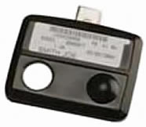
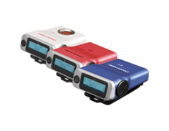
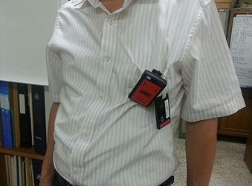
MOTIVATION
Health personnel/Nuclear powerplant workers: use of TLD required by law
However Electronic Personal Dosimeters (EPD) are preferred
  Dose estimation in real time
vs.
Source: nde-ed.org
Source: fujielectric.com
Using both can be uncomfortable and unpractical
Use of EPD in detriment of TLD
Underestimation of delivered dose

Slide 3
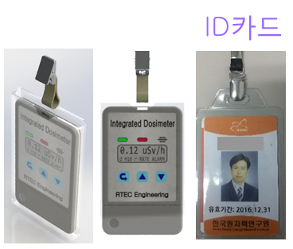
Goal
Develop an integrated dosimeter
  TLD+EPD
Induce workers to wear both dosimeter types
  Card type dosimeter
  Ease of portability
  ~ 100 g
Minimize radiation accidents
Built-in RFID wireless communication function
Gamma ray + neutron dosimeter

Slide 4
Requirements
Neutrons
Gammas
Energy: 0.025 eV ~ 5 MeV
Angular dependence: 0° ~ ± 60°
Energy: 20 keV – 1.5 MeV (±30%)
Angular dependence: ±20% (0° ~ ±60°, ¹³⁷Cs)
±50% (0° ~ ±60°, ²⁴¹Am)
Energy dependence: < 20% at 60 keV~1.5 MeV
6.2 cm
gamma
+
neutron
dosimeters
Dimensions
< 5.5 cm x 8.5 cm
< 100 g
TLD
2.3 cm

Slide 5
Requirements
Neutrons
Gammas
Energy: 0.025 eV ~ 5 MeV
Angular dependence: 0° ~ ± 60°
Energy: 20 keV – 1.5 MeV (±30%)
Angular dependence: ±20% (0° ~ ±60°, ¹³⁷Cs)
±50% (0° ~ ±60°, ²⁴¹Am)
Energy dependence: < 20% at 60 keV~1.5 MeV
6.2 cm
gamma
+
neutron
dosimeters
Dimensions
< 5.5 cm x 8.5 cm
< 100 g
TLD
2.3 cm

Slide 6
Neutron dosimeter
ALBEDO DOSIMETER
  Radiation from field neutrons
  Moderation and backscattering of neutrons by the body
  Measure over wide range of energies
  Two detectors
  Layer to cancel the direct/albedo neutrons contribution
  Borated plastic
  Measure direct and albedo contribution
Direct neutrons
Direct window
⁶Li
⁶Li
Albedo window
Albedo neutrons

Slide 7
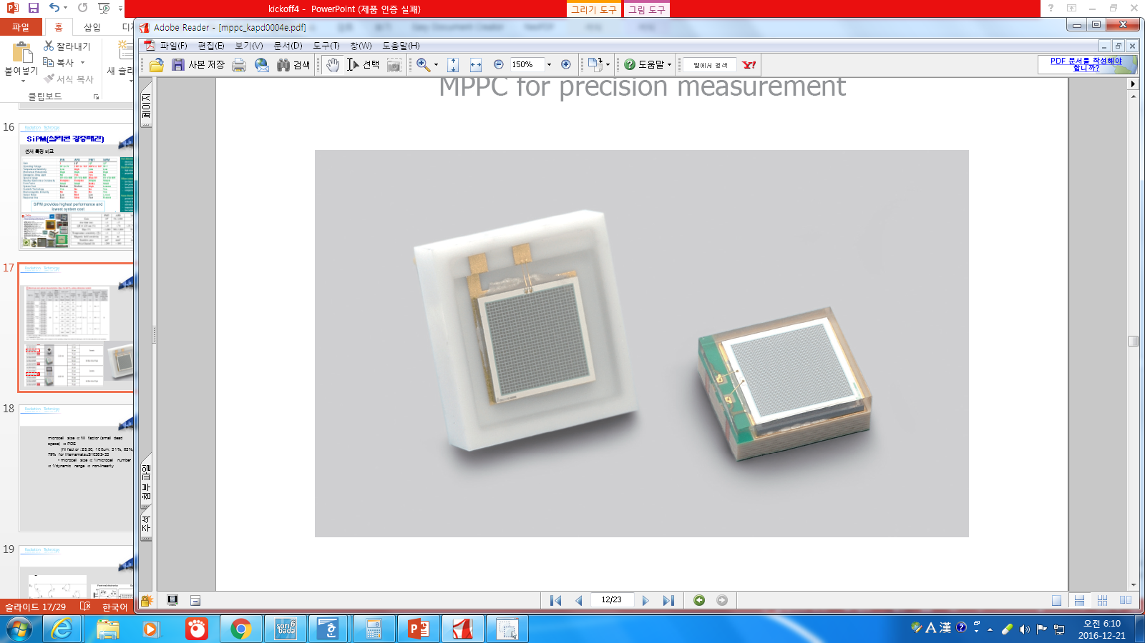
Neutron dosimeter
EJ-426 dosimeter
  ⁶LiF+ZnS:Ag thermal neutron scintillator
    Low gamma background
  SiPM (Silicon Photomultiplier)
  ⁶Li + n → α(2.05 MeV) + ³H (2.73 MeV)
  6 mm x 6 mm x 0.5 mm
Neutron
Alpha
Scintillation Light
Triton
ELJEN EJ-426 Neutron Scintillator
(⁶LiF + ZnS:Ag, 0.5mm thick.)
SiPM(Active area 6mmx6mm)
[Hamamatsu S13360-6075PE]

Slide 8
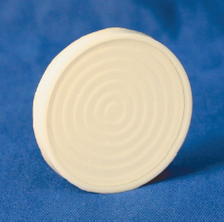
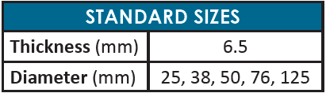
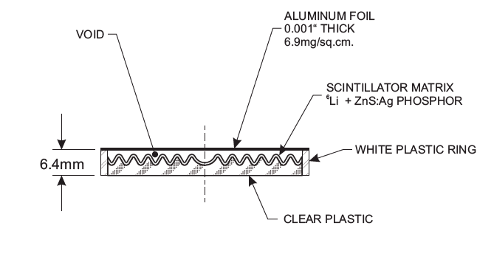
Neutron dosimeter
EJ-420 dosimeter
  ⁶LiF+ZnS:Ag thermal neutron scintillator
    Low gamma background
  ⁶Li + n → α(2.05 MeV) + ³H (2.73 MeV)

Slide 9
Neutron dosimeter
EJ-420 dosimeter
  ⁶LiF+ZnS:Ag thermal neutron scintillator
    Low gamma background
  ⁶Li + n → α(2.05 MeV) + ³H (2.73 MeV)
+ Larger ⁶Li area
- Increases size of final dosimeter

Slide 10
MCNPX implementation
Monte Carlo simulations
MCNPX
Dosimeter implementation
Korean Man voxel phantom
Response assessment
Energy dependence
Angular dependence
Scattered fraction
Dosimeter-to-body distance dependence

Slide 11
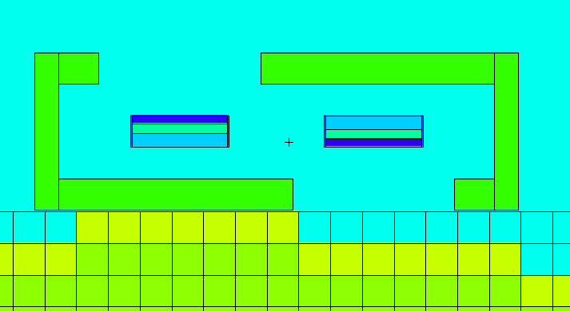
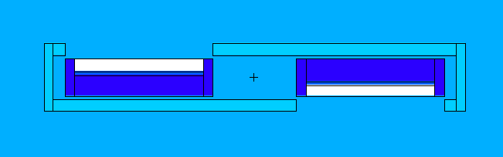
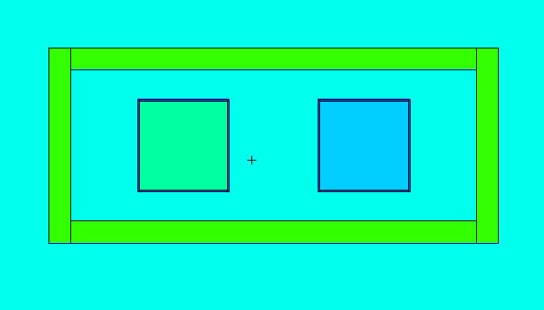
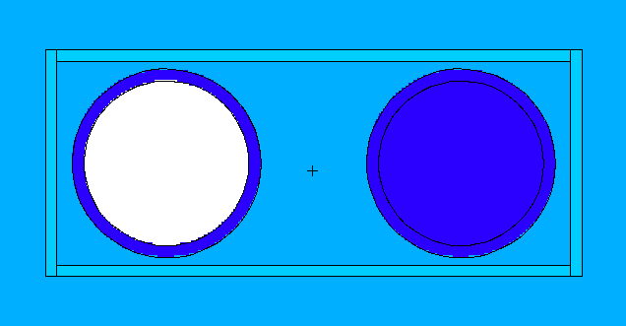
MCNPX implementation
Dosimeters
Ej-426
Ej-420
  Two dosimeters: direct and scattered components
  Borated polyethylene case 0.2 cm

Slide 12
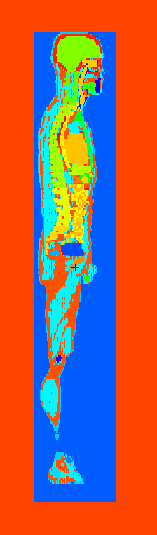
MCNPX implementation
Korean Typical Man-2 voxel phantom
  Developed by Lee C, Lee C, Park SH, and Lee JK
  Tomographic image data of an adult Korean male
  29 organs/tissues and 19 skeletal sites
  Voxel resolution of 2×2×5 mm³
  300 x 150 x 344 voxels

Slide 13
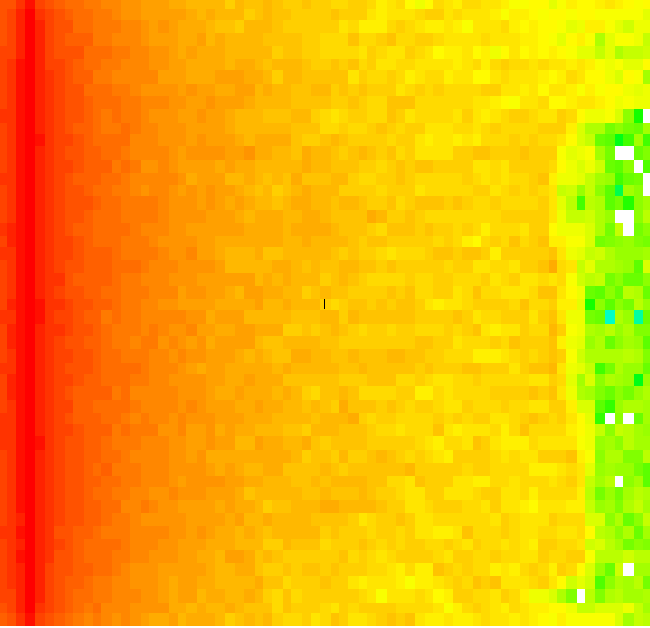
MCNPX implementation
Neutron source
Planar source
Parallel beam
Whole body
Monoenergetic
  0.01 eV – 10 MeV
  D₂O+²⁵²Cf
S(α,β) treatment
Response of the detector
  (n,t) reactions in ⁶Li
  Flag the neutrons to calculate
    Contribution from direct neutrons
    Contribution from albedo neutrons
Neutrons
Voxel phantom

Slide 14
Dosimeter response
Application areas of albedo dosimeters (Piesch and Burgkhardt)
N1 | Reactors and accelerators, heavy shielding Nuclear power stations Research reactors (near beam) Betatron, Linacs Therapy particle accelerators
N2 | Fuel element cycle, criticality, low shielding Fuel element cycle, including transportation, storage, reprocessing Experimental reactors Criticality, handling fissile materials
N3 | Radionuclide neutron sources Am-Be, Pu-Be, Ra-Be, 252Cf
N4 | Accelerators for research and technology Cyclotron: variation in targets, particles Accelerators for electrons .50 MeV Accelerators for protons, deuterons, etc.

Slide 15
Dosimeter response
Application areas of albedo dosimeters (Piesch and Burgkhardt)
N1 | Reactors and accelerators, heavy shielding Nuclear power stations Research reactors (near beam) Betatron, Linacs Therapy particle accelerators
N2 | Fuel element cycle, criticality, low shielding Fuel element cycle, including transportation, storage, reprocessing Experimental reactors Criticality, handling fissile materials
N3 | Radionuclide neutron sources Am-Be, Pu-Be, Ra-Be, 252Cf
N4 | Accelerators for research and technology Cyclotron: variation in targets, particles Accelerators for electrons .50 MeV Accelerators for protons, deuterons, etc.
Calibration with D₂O moderated ²⁵²Cf field

Slide 16
Results

Slide 17
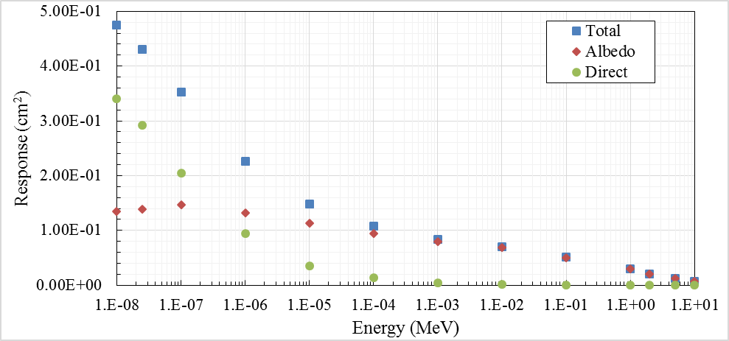
Dosimeter response
EJ-426: Contribution from albedo and direct radiation

Slide 18
Dosimeter response
EJ-426: Contribution from albedo and direct radiation
Energy (MeV) | SF
1.0E-08 | 28%
2.5E-08 | 32%
1.0E-07 | 42%
1.0E-06 | 58%
1.0E-05 | 76%
1.0E-04 | 88%
1.0E-03 | 95%
1.0E-02 | 98%
1.0E-01 | 99%
1.0E+00 | 99%
2.0E+00 | 99%
5.0E+00 | 99%
1.0E+01 | 100%
Direct contribution
  > 50% for energies below 1 eV
  < 5% for energies above 1 keV

Slide 19
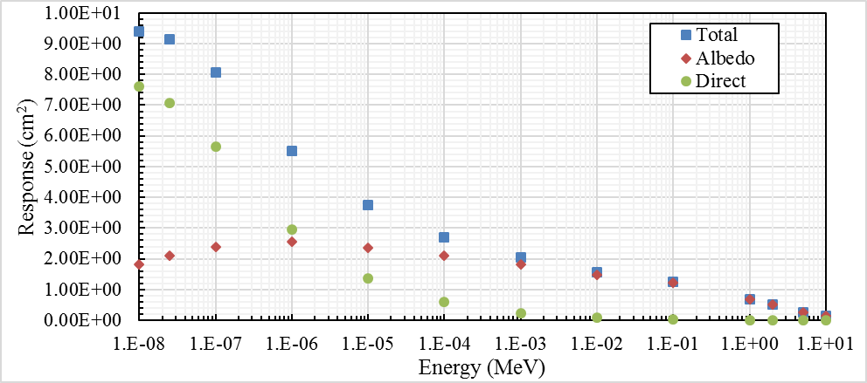
Dosimeter response
EJ-420: Contribution from albedo and direct radiation

Slide 20
Dosimeter response
EJ-420: Contribution from albedo and direct radiation
Energy (MeV) | SF
1.0E-08 | 19%
2.5E-08 | 23%
1.0E-07 | 30%
1.0E-06 | 46%
1.0E-05 | 63%
1.0E-04 | 78%
1.0E-03 | 89%
1.0E-02 | 95%
1.0E-01 | 98%
1.0E+00 | 99%
2.0E+00 | 99%
5.0E+00 | 99%
1.0E+01 | 99%
Direct contribution
  > 50% for energies below 10 eV
  < 5% for energies above 10 keV

Slide 21
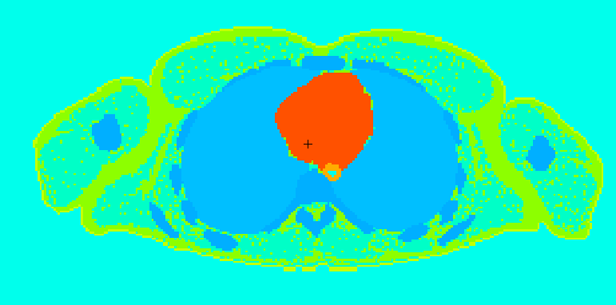
Dosimeter response
Dependence with distance to phantom
Depending on dosimeter’s type
  2x difference 1-3 cm
1 cm
3 cm
0 cm
2 cm

Slide 22
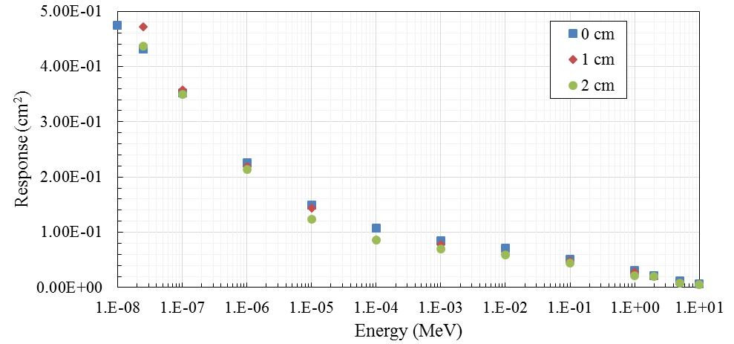
Dosimeter response
EJ-426: Dependence with distance to phantom

Slide 23
Dosimeter response
EJ-426: Dependence with distance to phantom
 | Deviation
Energy (MeV) | 0 cm vs 1 cm | 0 cm vs 2 cm
1.0E-08 | 10% | 6%
2.5E-08 | 9% | 1%
1.0E-07 | 1% | -1%
1.0E-06 | -3% | -6%
1.0E-05 | -3% | -17%
1.0E-04 | -21% | -21%
1.0E-03 | -8% | -16%
1.0E-02 | -15% | -17%
1.0E-01 | -4% | -14%
1.0E+00 | -6% | -28%
2.0E+00 | -5% | -4%
5.0E+00 | -26% | -32%
1.0E+01 | 1% | -11%

Slide 24
Dosimeter response
Dependence with distance to phantom – D₂O+²⁵²Cf
EJ-426
 | Distance to phantom (cm)
 | 0 cm | 1 cm | 2 cm | 3 cm
Response (cm²) | 9.03E-2 ± 5.60E-3 | 7.88E-2 ± 4.85E-3 | 7.44E-2 ± 4.72E-3 | 7.46E-2 ± 2.45E-3
Deviation from 0 cm |  | 13% | 18% | 17%
EJ-420
 | Distance to phantom (cm)
 | 0 cm | 1 cm | 2 cm | 3 cm
Response (cm²) | 2.11 ± 5.59E-2 | 1.92 ± 5.19E-2 | 1.86 ± 5.12E-2 | 1.83 ± 5.12E-2
Deviation from 0 cm |  | 9% | 12% | 13%

Slide 25
Dosimeter response
Angular dependence
0°
Neutrons

Slide 26
Dosimeter response
Angular dependence
0° to 60°
Neutrons

Slide 27
Dosimeter response
D₂O+²⁵²Cf – Angular dependence
EJ-426
 | Source angle
 | 0° | 15° | 45° | 60°
Response (cm²) | 7.90E-2 ± 2.05E-3 | 7.35E-2 ± 2.84E-3 | 5.93E-2 ± 2.45E-3 | 4.28E-2 ± 3.14E-3
SF | 80% | 79% | 78% | 72%
Deviation from 0° |  | 7% | 25% | 46%
EJ-420
 | Source angle
 | 0° | 15° | 45° | 60°
Response (cm²) | 1.92 ± 5.19E-2 | 1.84 ± 5.14E-2 | 1.40 ± 4.34E-2 | 1.04 ± 3.79E-2
SF | 73% | 71% | 68% | 63%
Deviation from 0° |  | 4% | 27% | 46%

Slide 28
Dosimeter response
D₂O+²⁵²Cf – Angular dependence
EJ-426
 | Source angle
 | 0° | 15° | 45° | 60°
Response (cm²) | 7.90E-2 ± 2.05E-3 | 7.35E-2 ± 2.84E-3 | 5.93E-2 ± 2.45E-3 | 4.28E-2 ± 3.14E-3
SF | 80% | 79% | 78% | 72%
Deviation from 0° |  | 7% | 25% | 46%
EJ-420
 | Source angle
 | 0° | 15° | 45° | 60°
Response (cm²) | 1.92 ± 5.19E-2 | 1.84 ± 5.14E-2 | 1.40 ± 4.34E-2 | 1.04 ± 3.79E-2
SF | 73% | 71% | 68% | 63%
Deviation from 0° |  | 4% | 27% | 46%
ISO 21909 (2005): the arithmetic mean of the response for 0°, 15°, 45° and 60° must not differ by more than 30% from the corresponding response at 0°
  Deviation of arithmetic mean 19%

Slide 29
Requirements
Neutrons
Gammas
Energy: 0.025 eV ~ 5 MeV
Angular dependence: 0° ~ ± 60°
Energy: 20 keV – 1.5 MeV (±30%)
Angular dependence: ±20% (0° ~ ±60°, ¹³⁷Cs)
±50% (0° ~ ±60°, ²⁴¹Am)
Energy dependence: < 20% at 60 keV~1.5 MeV
6.2 cm
gamma
+
neutron
dosimeters
Dimensions
< 5.5 cm x 8.5 cm
< 100 g
TLD
2.3 cm

Slide 30
Requirements
Neutrons
Gammas
Energy: 0.025 eV ~ 5 MeV
Angular dependence: 0° ~ ± 60°
Energy: 20 keV – 1.5 MeV (±30%)
Angular dependence: ±20% (0° ~ ±60°, ¹³⁷Cs)
±50% (0° ~ ±60°, ²⁴¹Am)
Energy dependence: < 20% at 60 keV~1.5 MeV
6.2 cm
gamma
+
neutron
dosimeters
Dimensions
< 5.5 cm x 8.5 cm
< 100 g
TLD
2.3 cm

Slide 31
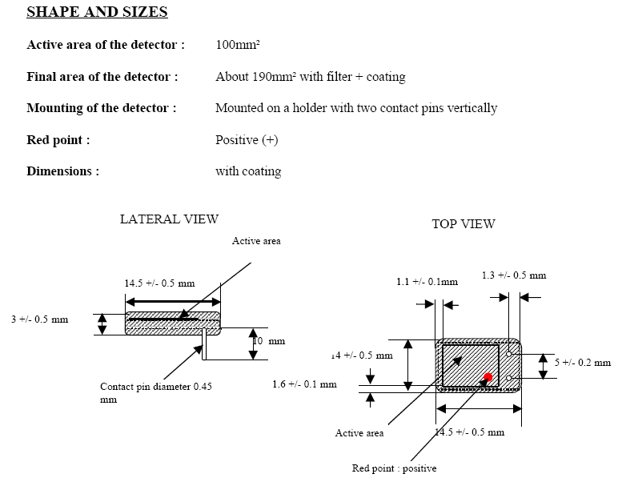

Gamma dosimeter
Eurorad Si100 Silicon detector
  Energy filter ( < ± 20% at 60 keV~1.5 MeV)
  Size: 14mm x 10mm x 3mm

Slide 32
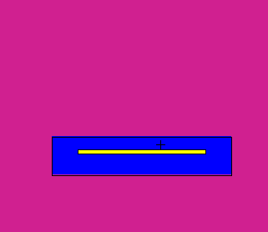
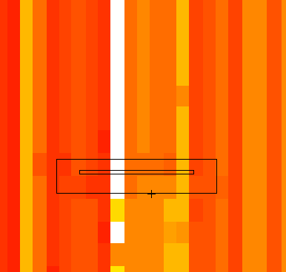
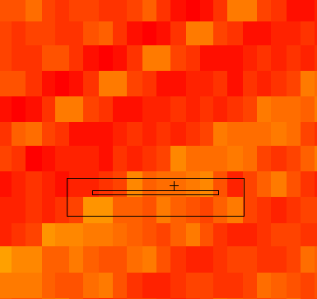
Gamma dosimeter
Monte Carlo Implementation: MCNP6
Study of energy and angular dependence
Parallel source beam
Energy dependence:
- Monoenergetic beam
- 10 keV – 5 MeV
Angular dependence:
- 0° to 90°, 5° steps
- ¹³⁷Cs (662 keV)
- ²⁴¹Am (59.6 keV)
Si dosimeter implementation
Si active area
Epoxy resin

Slide 33
Gamma dosimeter
Energy Dependence
Deviation 60 keV-2MeV: 4%
Requirement: < 20%
No additional filters necessary

Slide 34
Gamma dosimeter
Angular Dependence
¹³⁷Cs
²⁴¹Am
Deviation 0° – 60°
47.6%
Deviation 0° – 60°
47.9%
Max 20%
Max 50%
2/20/2017

Slide 35
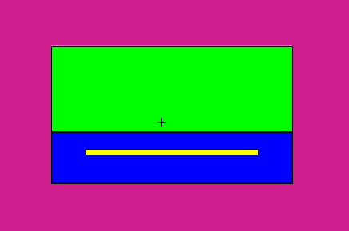
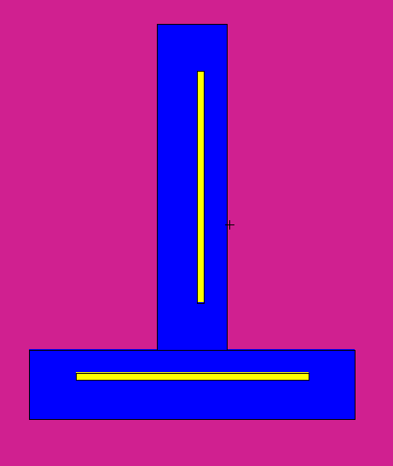
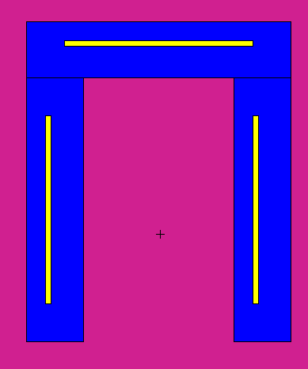
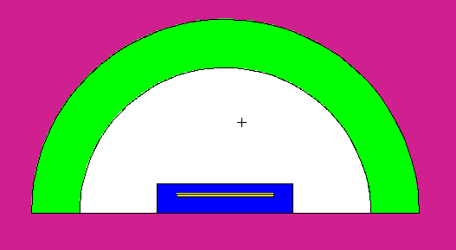
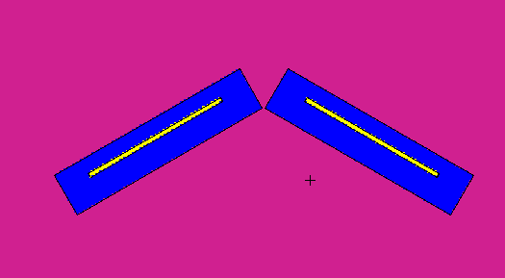
Gamma dosimeter
Angular Dependence
Reduce angular dependence by:
  Introducing filters
    Cd, Fe, PMMA, Pb
  Play with detector geometry

Slide 36
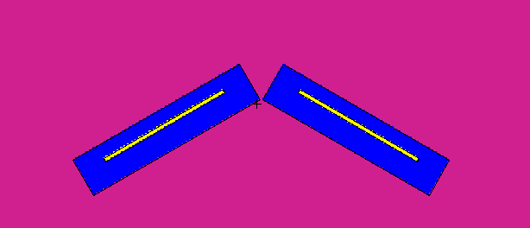
Gamma dosimeter
Angular Dependence
Best results
~3.4cm
~1cm
60°
Deviation 0° – 60°: ~0%
Dev 30° – 60°: 12%
Max dev 30° – 90°: 48%

Slide 37
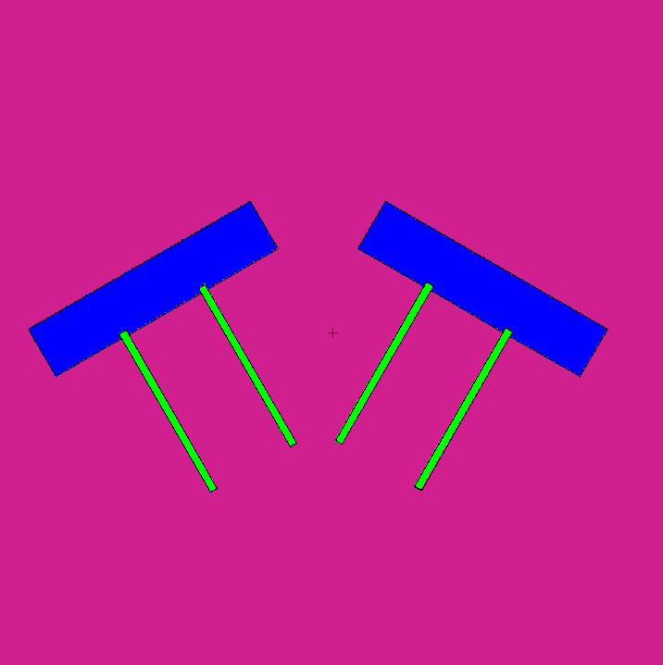
Gamma dosimeter
Angular Dependence
Best results
Difficult to implement
10°
15°
20°
30°
~3.4cm
~1cm
60°
20° inclination
Deviation 0°-60°
  ¹³⁷Cs: 17.4%
  ²⁴¹Am: 17.5%
Easier to implement
0.8 cm thick

Slide 38
Conclusions
Neutron Dosimeter
EJ-426
  Angular dependence
    Within ISO21909 requirements
  Dependence with distance within acceptable limits
    < 18%
  Small dosimeter (~ 3.04 cm width, 1.32 cm height, 1.00 cm depth)
Ej-420
  Higher efficiency
  Lower dependence with distance
  Bigger dosimeter (~ 7.10 cm width, 3.00 cm height , 1.14 cm depth)
Gamma Dosimeter
Eurorad- Si100
  Energy dependence within requirements
  Angular dependence within requirements for a specific geometry

Slide 39
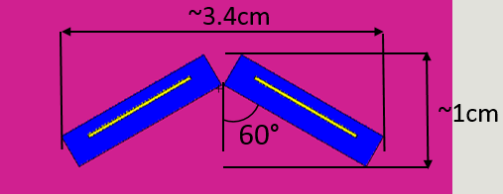
On-going and future work
Si+⁶Li dosimeters
  Algorithm to convert counts to dose
Acquire real spectra
  Simulate dosimeter response
  Dosimeter calibration

Slide 40
Thank you for your attention!
Silvia Barros (silviabarros@sejong.ac.kr)
Department of Nuclear Engineering, Sejong University

