Slide 1




Generation and Detection of Neutrons and Monoenergetic Gamma Rays for Inspection for Nuclear Threats
Richard Lanza¹, Areg Danagulian¹, Anna Erickson², John Fisher¹, Albert Foster⁴, Zach Hartwig¹, Brian Henderson¹, Igor Jovonovic³, Hin Lee¹ ,T.D. MacDonald¹, Amira Meddeb⁴, Jason Natress³, Roberts Nelson¹,Buckley O’Day^{1,5}, Zoubeida Ounaies⁴ and Paul Rose²
¹Massachusetts Institute of Technology
²Georgia Institute of Technology
³University of Michigan
⁴Pennsylvania State University
⁵Air Force Institute of Technology
INTERNATIONAL CONFERENCE ON APPLICATIONS OF NUCLEAR TECHNIQUES
CRETE, GREECE
JUNE 11 – 17, 2017

Slide 2
What are we trying to do?
Develop a reliable means for the detection of shielded nuclear materials
Minimize dose
Increase reliability of detection by using multiple particles
Do it with a transportable system if possible

Slide 3
Overview
Monoenergetic gammas for inspection
Using multiple energies for detection
Using neutrons
Accelerator technology

Slide 4
Why use Monoenergetic Photons
An order of magnitude or more reduction in dose
Enhanced sensitivity in detection and verification
Lower requirements for shielding
The ability to reduce the size of the source part of the system by an order of magnitude or more while still meeting requirements for detection and identification of SNM
Flexibility in detection through radiography and active probing with the same device

Slide 5
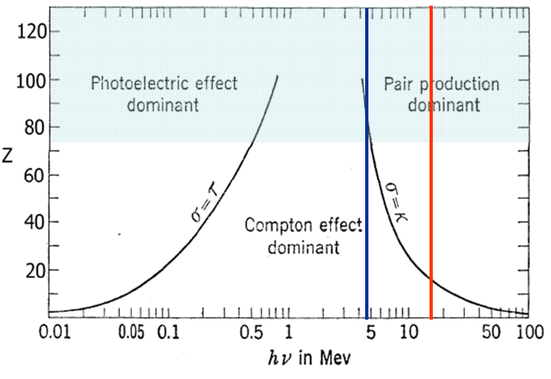
Transmission Issues
Evans, “Atomic Nucleus” 1955

Slide 6
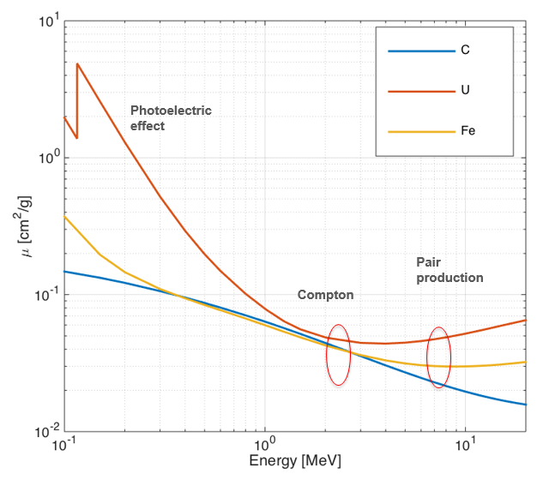
Transmission by Element

Slide 7
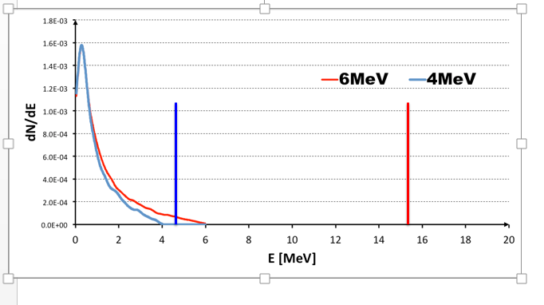
Advantage of monochromatic

Slide 8
Basic Approach
The fundamental approach is to generate both monoenergetic gamma rays and/or neutrons by means of low energy nuclear reactions.
  By selecting nuclear reactions with large positive Q values, small accelerators producing 3 to 20 MeV protons or deuterons can simultaneously produce fast neutrons and high energy ( > 10 MeV) monoenergetic gammas.
This multi-particle method images the SNM through shielding and also identifies it by inducing fission in the suspect material.
Use transmission imaging to locate high-Z materials
Use photofission and/or neutron induced fission as final check
Notes:
Most reactions will involve light nuclei

Slide 9
Some Features
Gamma ray energies are determined by nuclear physics and are not dependent on the energy of the beam
  Do not particularly need precise energy accelerator
  Compact accelerators are available commercially and are available in superconducting form
Neutrons available for final confirmation of SNM
  Intensities should enable rapid screening with subsequent ID
Going to higher power or more detectors is a COTS decision for even faster scanning
Notes:
Gamma ray energies are not tunable, but there are a lot of choices. Neutron energies can be tuned

Slide 10
Multi-Particle Interrogation Makes
Effective SNM Shielding Difficult
R. Shefield, LANL

Slide 11
Identifying SNM
Transmission measurement alone only identifies high-Z material
Use two approaches to distinguish ²³⁵U by detection of fission products
  Utilize photofission
  Probe with low energy neutrons (< 1MeV)

Slide 12
What Nuclear Reactions to use?
One Example is ¹¹B(d,n )¹²C
¹¹B(d,n )¹²C Produces High-energy Neutrons And Gamma Radiation For Efficient Uranium Fission
12C* gamma lines found for >2 MeV deuterons have intense high energy-gamma lines at 4.4 and 15.1 MeV and less intense lines at 10.7 and 12.7 MeV.
The neutrons have a peak around 12 MeV and a broad distribution at lower energies.
Isotropic gamma distribution
Notes:
Is isotropic bad? No in this case because all gammas are useable because we can use energy resolved detectors

Slide 13
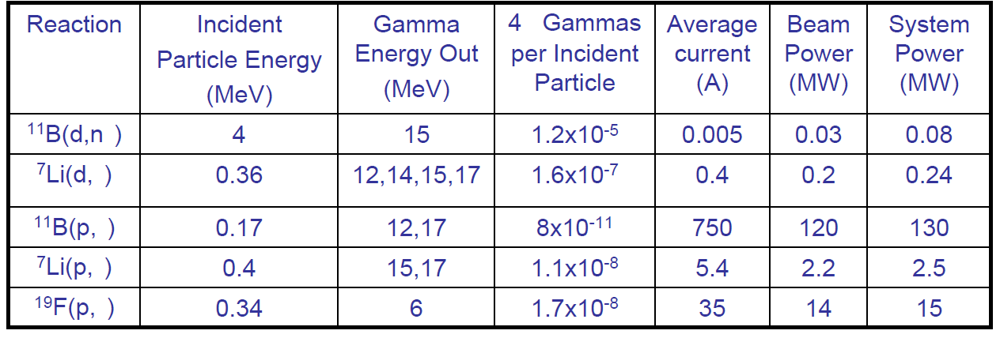
Other reactions considered
Early interest in possible low energy reactions for producing gammas, but these cross-sections are much smaller than (d,n) and require higher beam power
π
Notes:
These were ideas to cut cost of accelerators

Slide 14
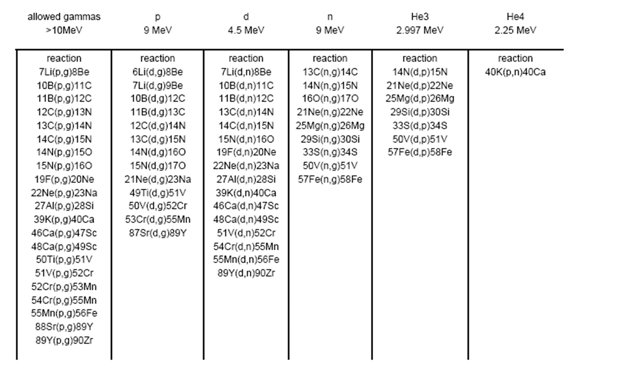
Many Interesting Potential Reactions
Notes:
Check physics journals from the 50’s and 60’s

Slide 15
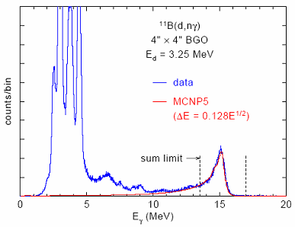
Gamma Production Rates
Gamma Energy (MeV) | Yield (gammas/s/sr)
4.4 | 4 x 10⁹
10.7 | 2 x 10⁷
12.7 | 4 x 10⁷
15.1 | 6.6 x 10⁸
LA-UR-07-2724
Notes:
Note that this is the uncorrected spectrum as detected, not the actual spectrum

Slide 16
¹¹B(d,n )¹²C
Data from Brandis et al (Crete 2010)
AIP Conference Proceedings 1336, 711 (2011)
Notes:
Good news is many neutrons but bad news is more neutrons than gammas

Slide 17
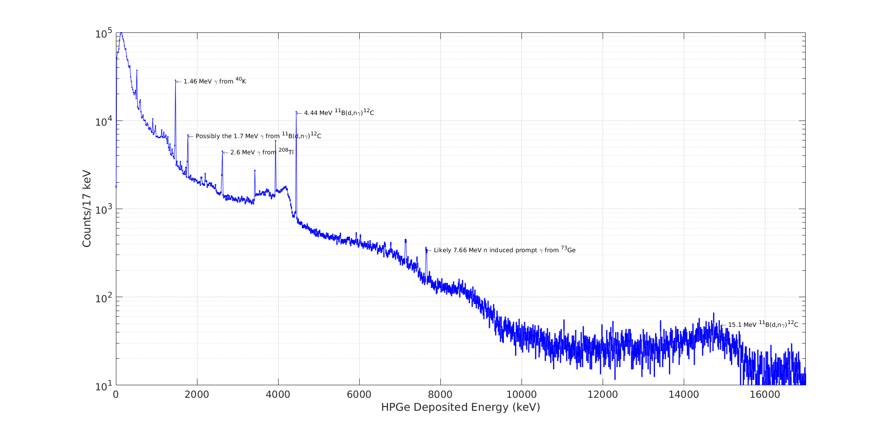
Gammas from ¹¹B(d,n )¹²C
Notes:
Note that efficiency of the HPGe drops with increasing energy. Is not corrected in this data

Slide 18
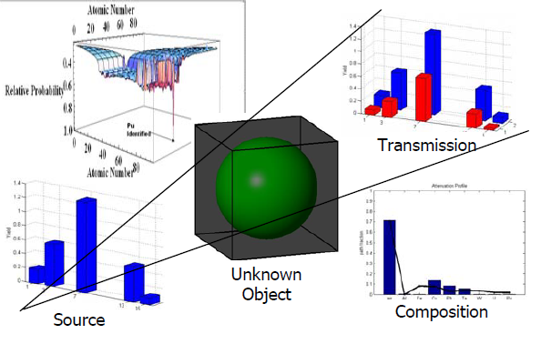
Separating Actinides Using Multiple Lines
Marc Klasky and Richard Sheffield LANL

Slide 19
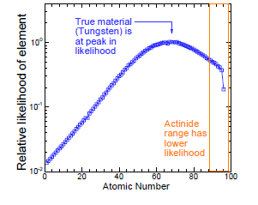
Separating Actinides with Multiple Lines
Marc Klasky and Richard Sheffield LANL

Slide 20
Summary Properties
Gamma lines are monoenergetic with energies determined by nuclear properties not accelerator
Source gammas are isotropic
System scanning can be speeded up by adding more detectors
Beam time structure allows for the use of energy sensitive detectors
Scatter can be rejected or utilized for imaging
3D imaging as an add-on
Neutron energies can be modified using p,n reactions with negative Q values
  ⁵⁰Cr(p,n)⁵⁰Mn Q = -8.42 MeV
Notes:
Pixel by pixel imaging is slow eg cargo container 2m x 6 m is 120K pixels

Slide 21
Experimental System at MIT
Notes:
A top-down view of a CAD representation of the multiple monoenergetic gamma
radiography experiment at MIT Bates

Slide 22
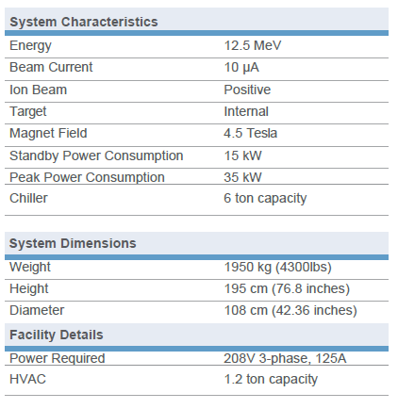
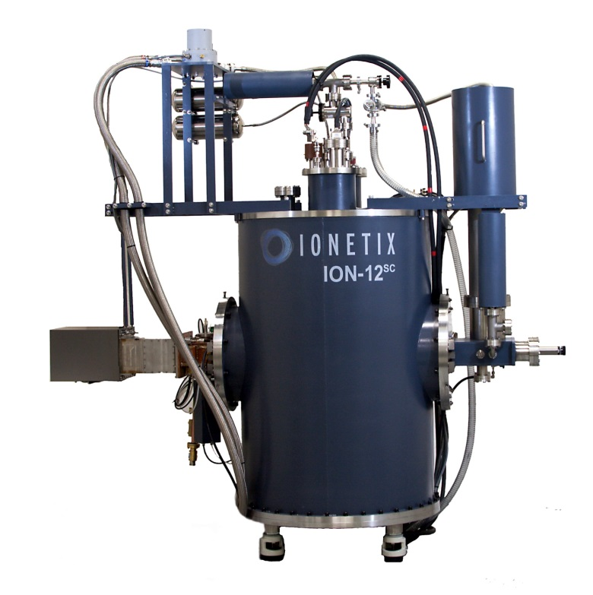
Superconducting Cyclotron IONETIX ION-12^{SC}
2 m

Slide 23
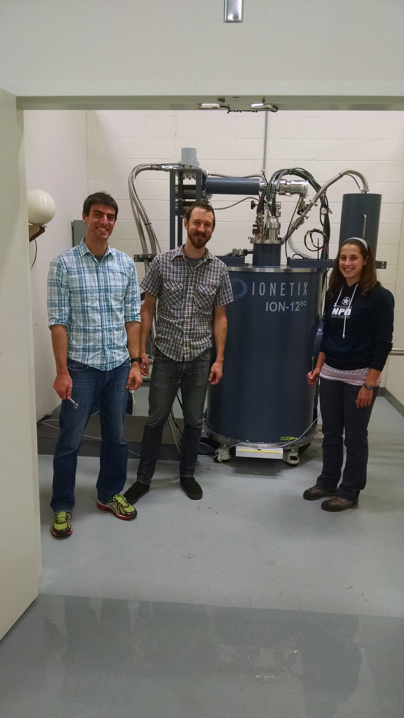
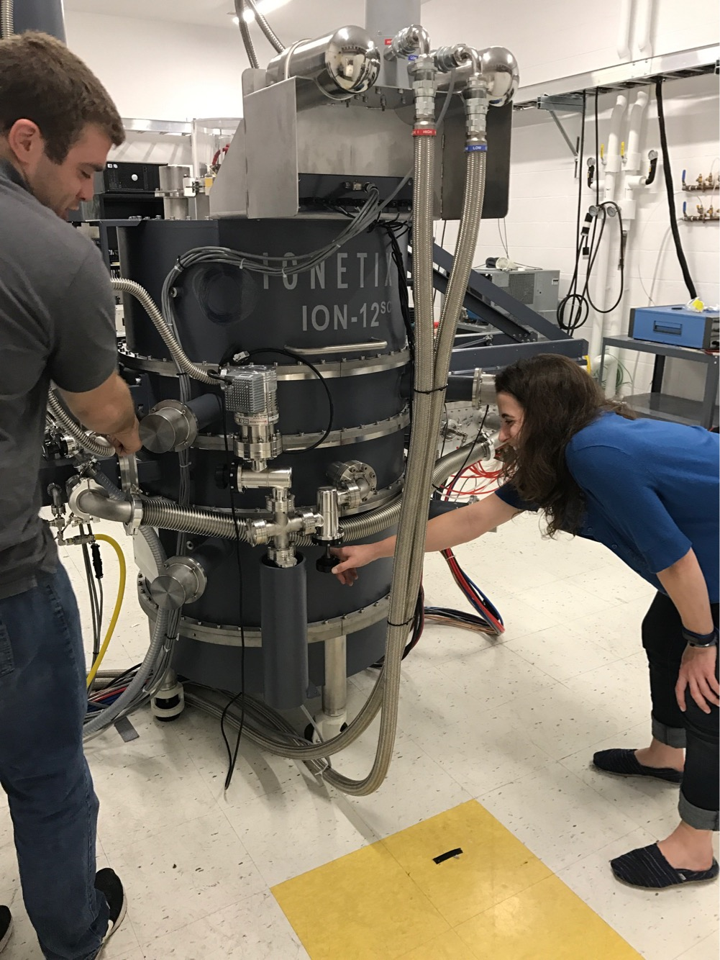
Superconducting Cyclotron installed at MIT

Slide 24
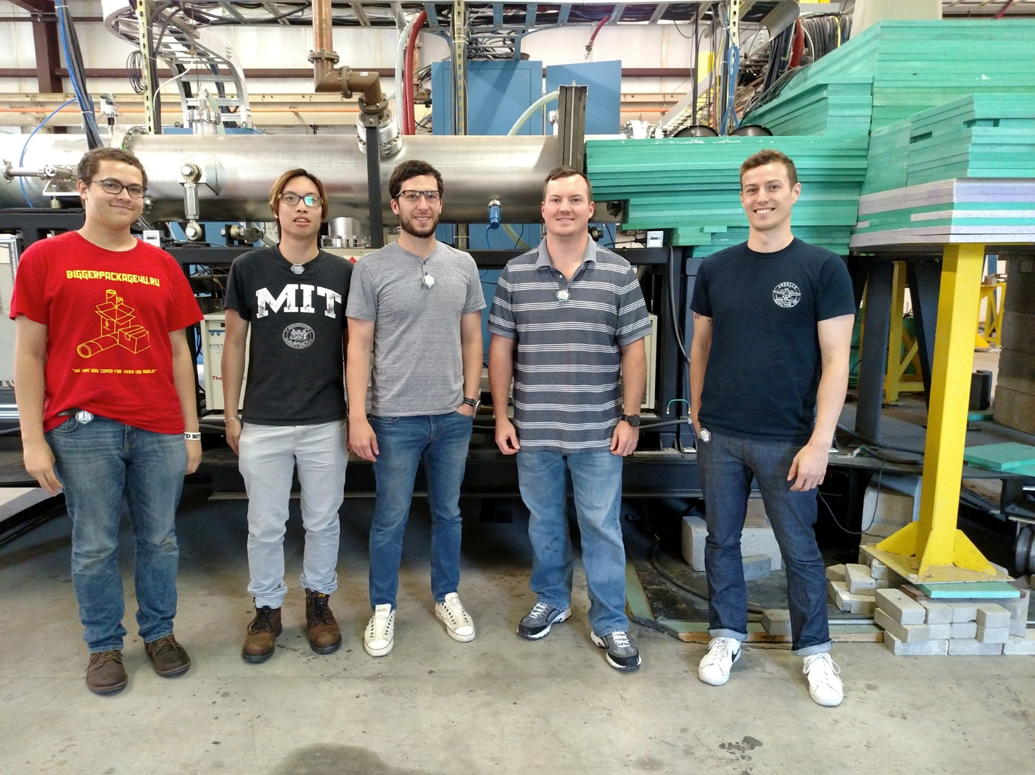
Team at MIT Bates Accelerator

Slide 25
Related Papers at Crete17
Igor Jovanovic (U. Michigan, USA) Prompt and Delayed Fission Neutrons in Active Interrogation by Monoenergetic and Multimodal Radiation Sources (37)
Brian Henderson (MIT, USA) Detection of Special Nuclear Materials Using Multiple Monoenergetic Gamma Radiography (89)
Jason Nattress (U. Michigan, USA) Spectroscopic Multi-modal Material Identification using a Nuclear Reaction-Based Quasi Monoenergetic Source (36)
Paul Rose (Georgia Tech, USA) Searching for Special Nuclear Material with Discrete Energy Nuclear Reaction Based Sources and Cherenkov Detector Array (45)

Slide 27
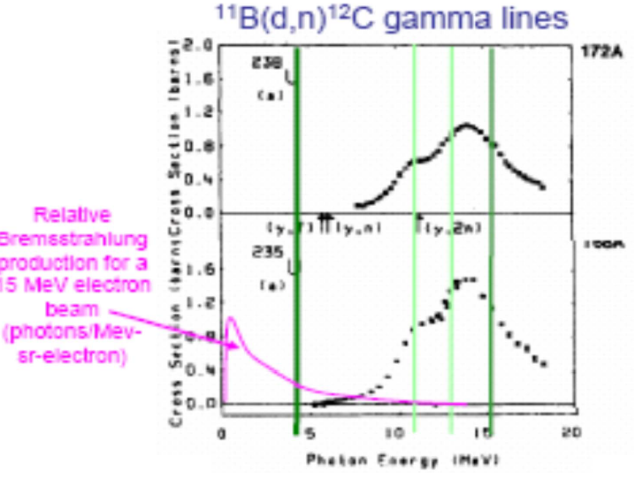
Photonuclear Cross-sections

Slide 28



Double Lane Scanner
Detector array

Slide 29
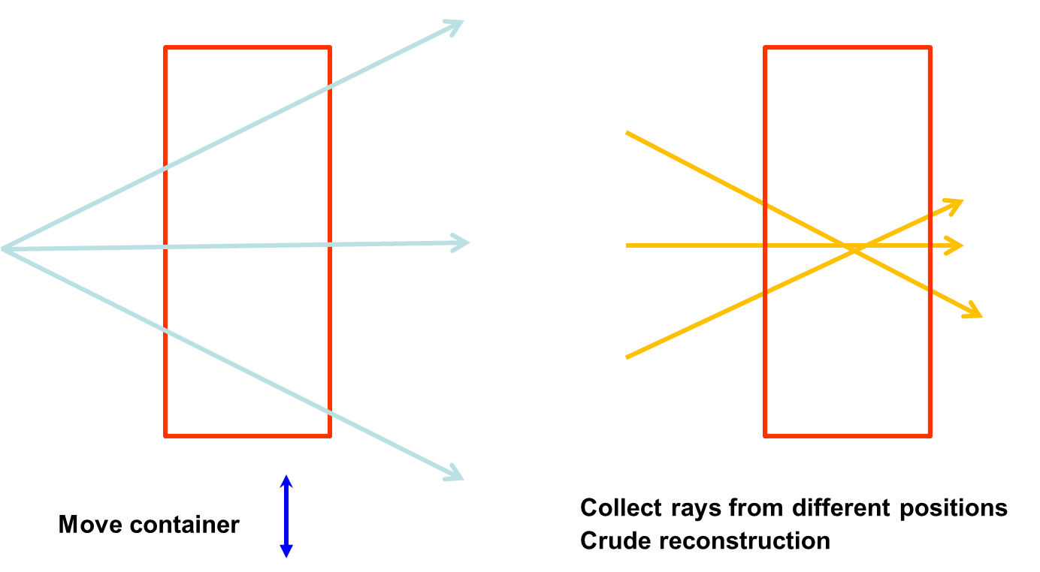
3D Imaging

Slide 30
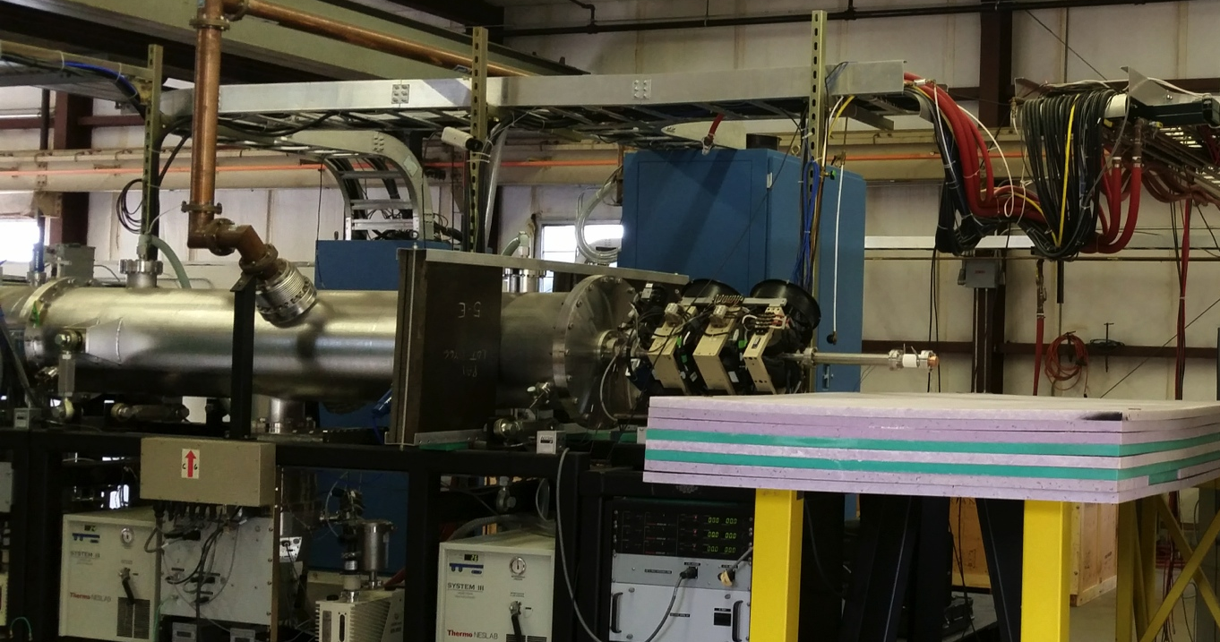
3MeV D⁺ RFQ
RF
waveguide
Beamline
d⁺ beam
d + ¹¹B → 12C + n + γ
Focusing
quadrupoles
11B target
RFQ accelerator, 3MeV
Notes:
Here are some pictures of the actual setup.
The natural B target and radiation channel is shown in the top left
A typical cargo configuration in the top right, with side and front views
Bottom left shows a flood light being used to verify the detector placement by shining it through the two sets of collimators
Bottom right shows the detector array and Pb collimator and shielding.
We see an AutoCAD rendering of the experiment on the next slide.

Slide 31
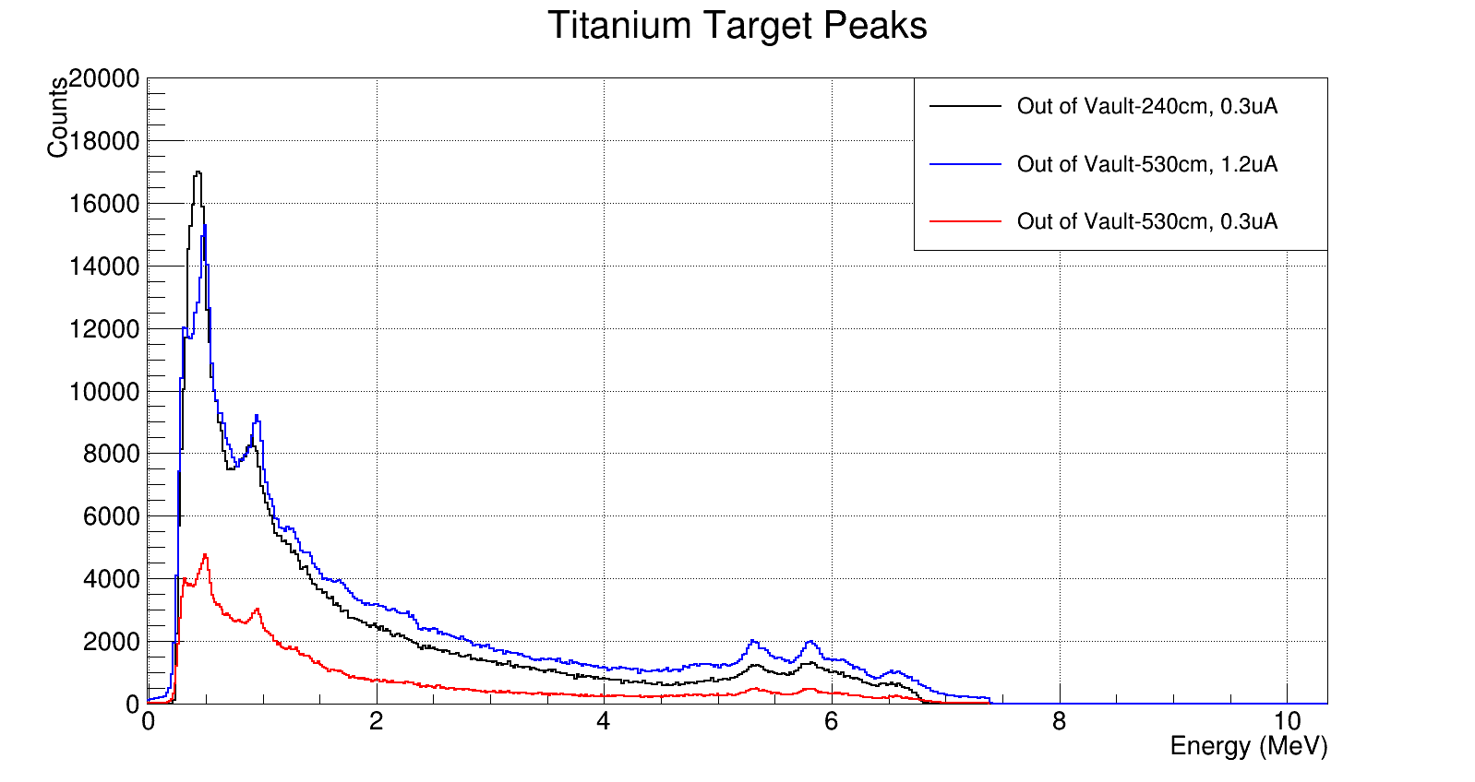
Spectrum from 12.5 MeV p on H₂O
O lines with escape peaks

Slide 32
Neutron probes
9 MeV Superconducting Cyclotron
  Generates 4.5 MeV d, or 9.0 MeV p
  Use the 9.0 MeV p in a (p,n) reaction
  e.g. ⁵⁰Cr(p,n)⁵⁰Mn Q = -8.42 MeV which results in E_{n} < 1 MeV, below fission threshold for ²³⁸U
~20 MeV Superconducting Cyclotron
  p on ¹²C generates only gammas below threshold ~19.5 MeV but have to watch for ¹³C
  Gammas and neutrons above threshold energy
Notes:
20 MeV might worry about C13

Slide 33
Cyclotrons as Neutron Sources

Slide 34
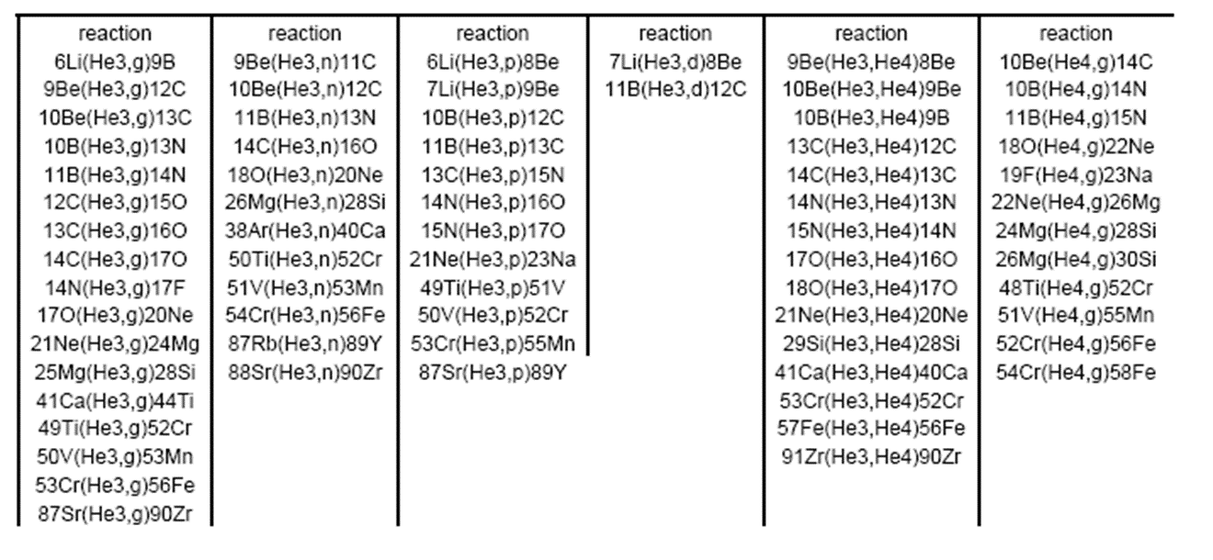
And more Potential Reactions…

