Slide 1
Measurement of formation cross-sections and decay properties for short-lived isomers produced in photonuclear interactions
Justin Delaney | CSIRO & University of Wollongong
Dr Chanel Tissot | CSIRO
Dr James Tickner | Chrysos
CSIRO MINERAL RESOURCES

Slide 2
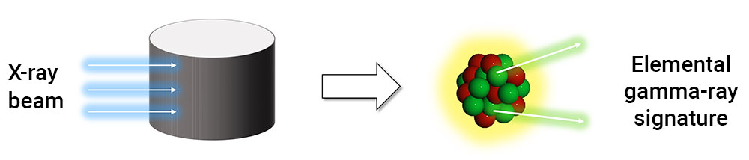
What is GAA?
CSIRO has been developing various mineral assay techniques, such as Gamma Activation Analysis (GAA) for several years.
Commercialised by Chrysos Corporation as PhotonAssay.
Primarily aimed at detection of gold and other precious metals.

Slide 3
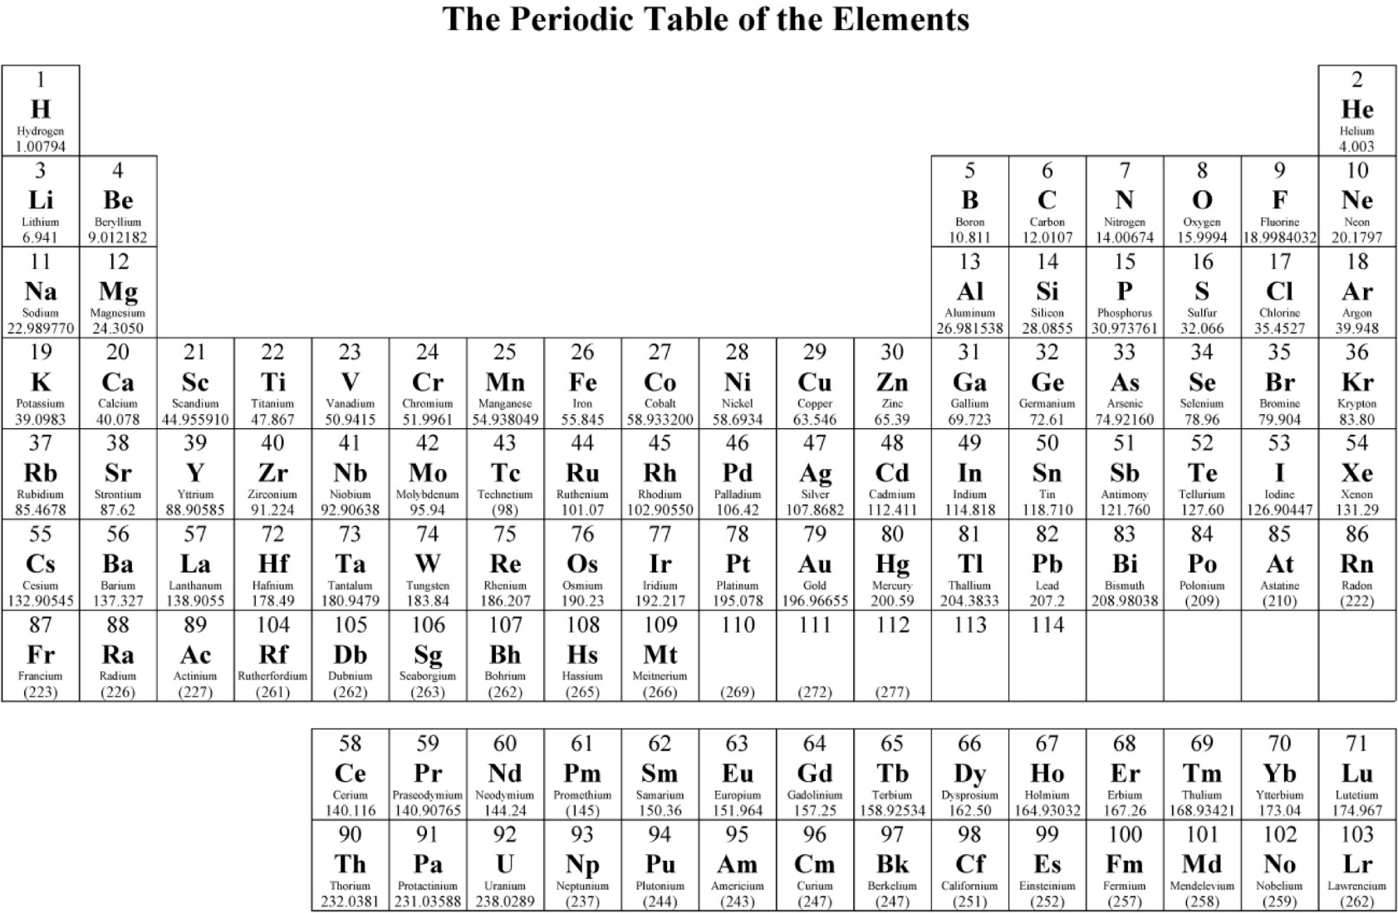
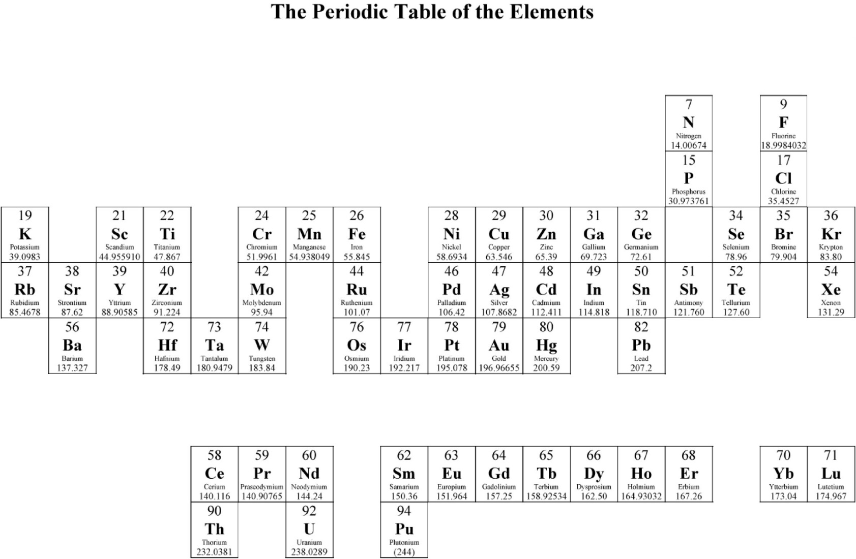
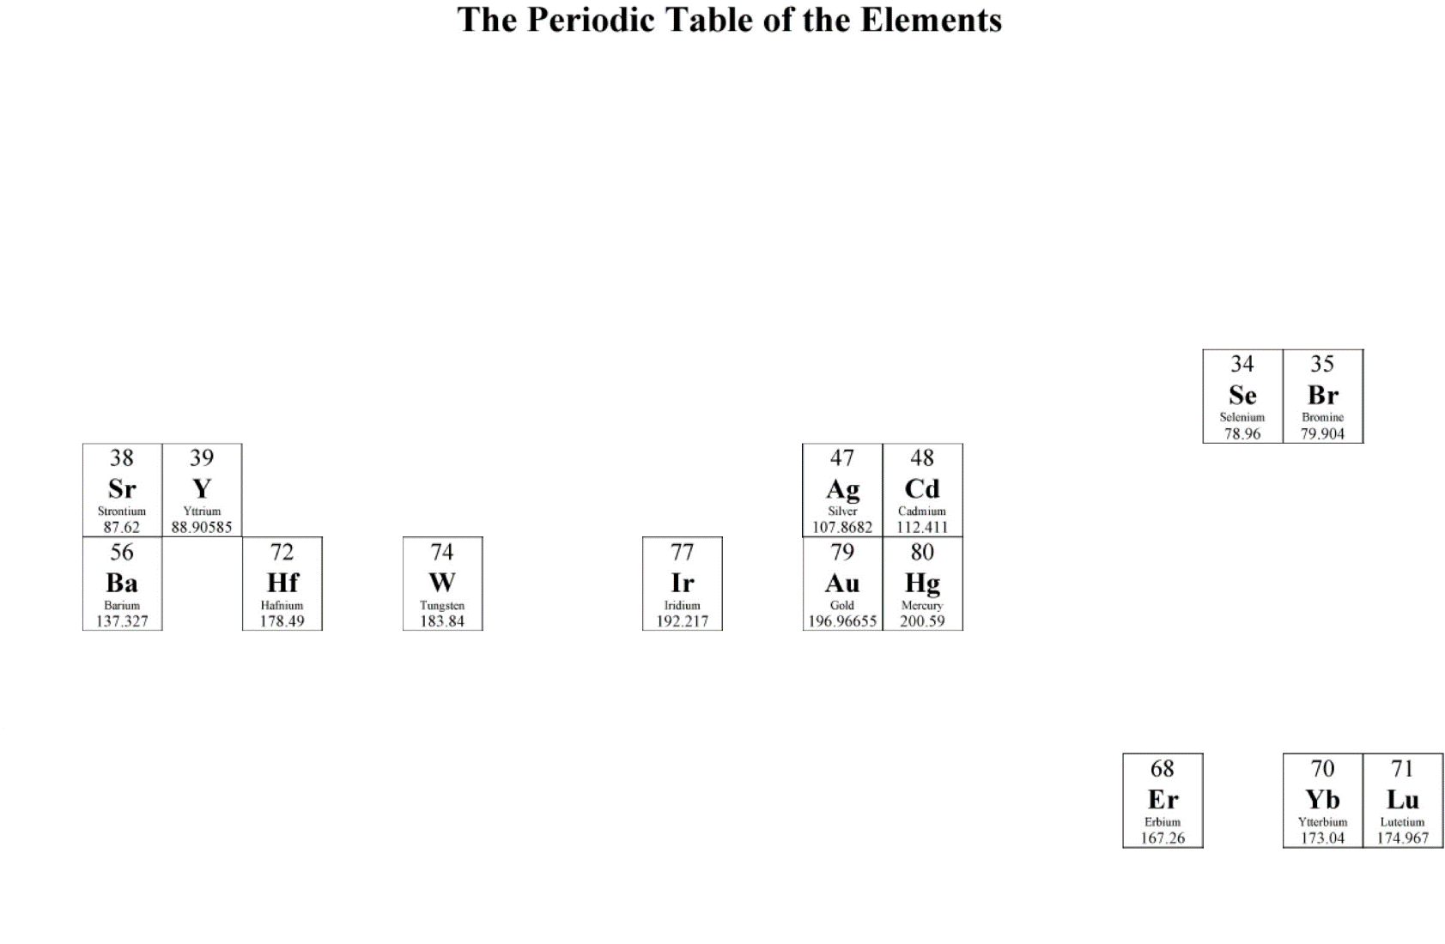
How many elements can we measure?

Slide 4
Advantages of GAA
Non-destructive
    No sample preparation required. Original sample can be preserved
Real time
    Results can be obtained in seconds/minutes
Highly sensitive
    Can measure concentrations << 1ppm
    Can measure bulk samples, unlike x-ray techniques (XRD,XRF…)
Can be used “in the field”
    Possible to deploy a complete GAA system to a mine or other industrial facility
    Doesn’t require a reactor, like NAA

Slide 5
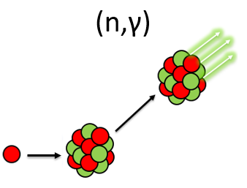
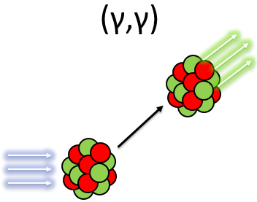
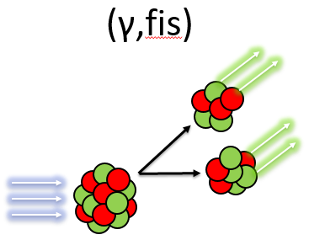
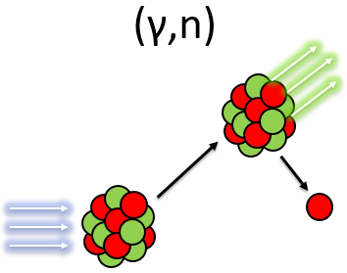
Important nuclear interactions
Several nuclear reactions can lead to the production of isomers;
σ ≈ 0-10 mb
σ ≈ 10-100 mb
σ ≈ 0.1-400 b

Slide 6

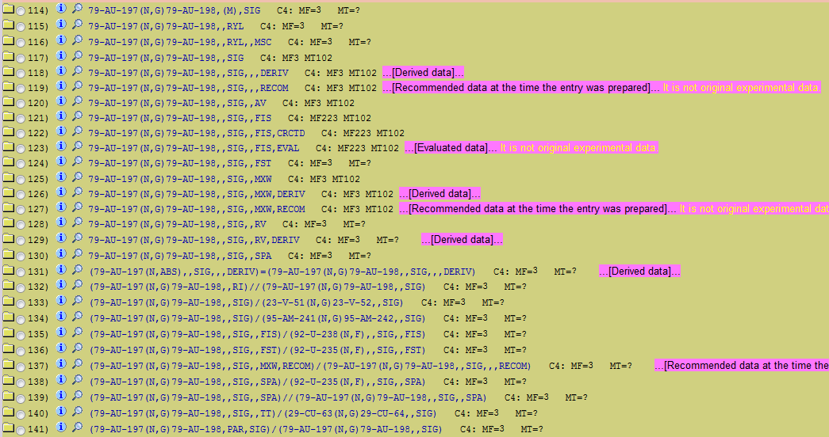
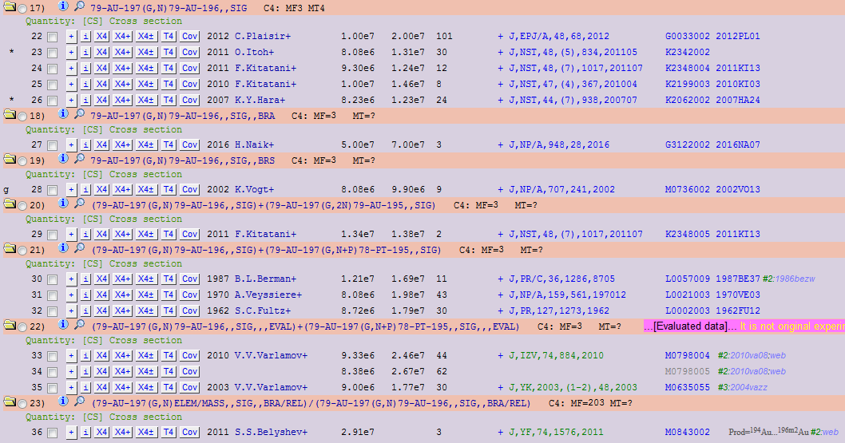
Existing literature
36
0
Number of data sets: 154
Images taken from EXFOR database:
https://www-nds.iaea.org/exfor/exfor.htm

Slide 7

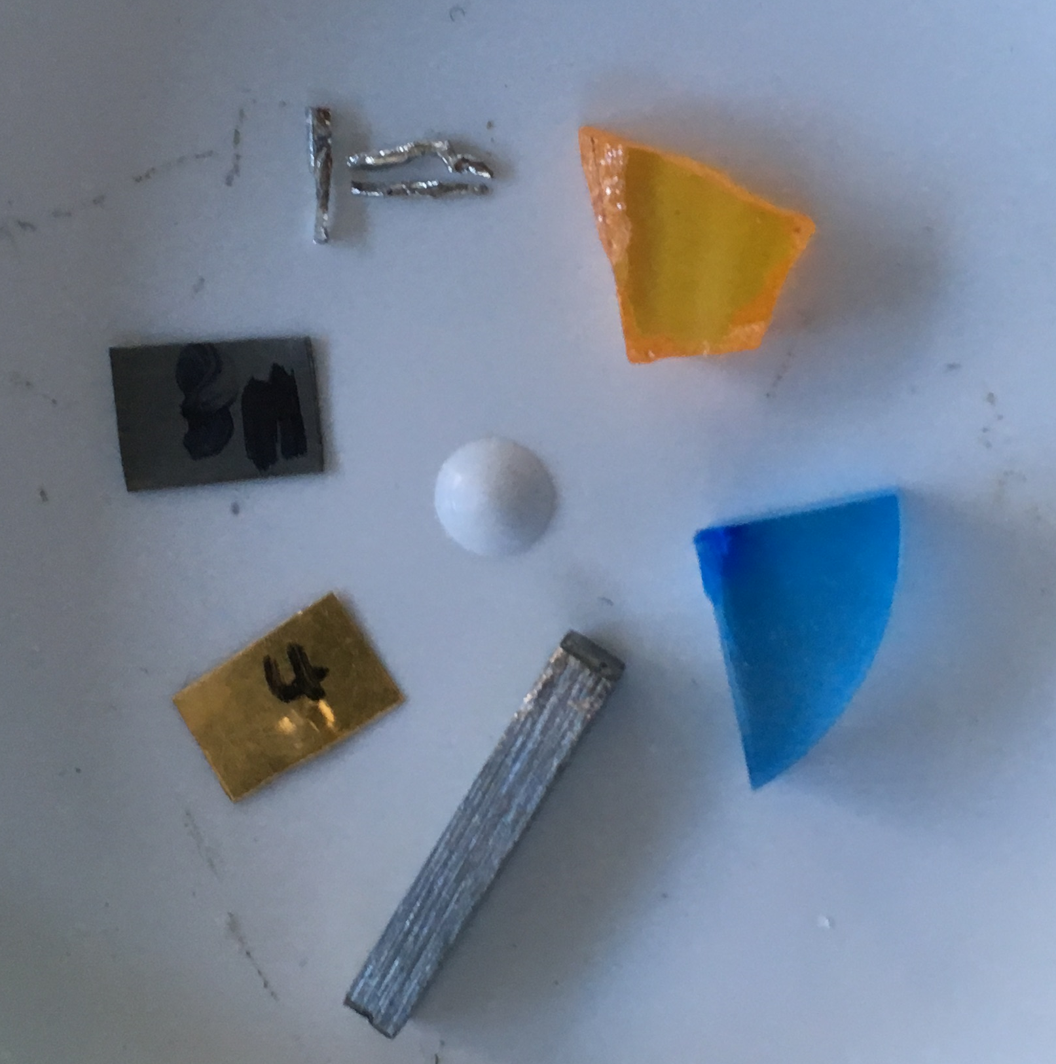
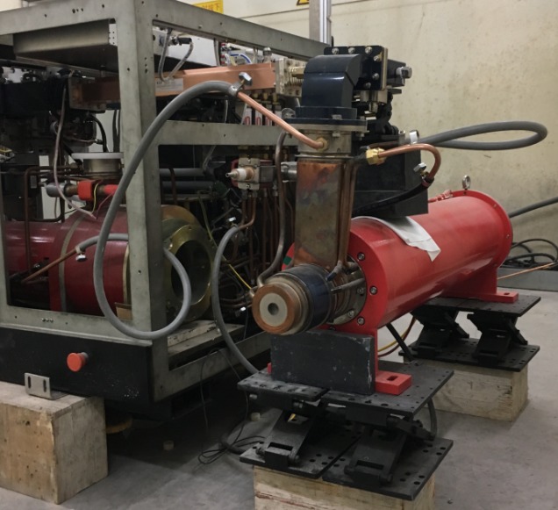
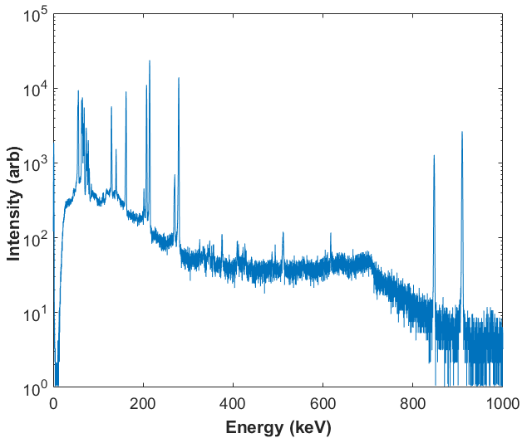
Experimental details
Results collected with a high-purity germanium detector (HPGe)
1kW electron accelerator used as bremsstrahlung source.
Could not irradiate and measure simultaneously.
Used pneumatics to rapidly move sample between linac beamline and detector station.
Measurements conducted in 0.5 MeV intervals, over 6.5 – 10.5 MeV range.
Ir
ZnSe
Hf
KBr
Au
Y

Slide 8
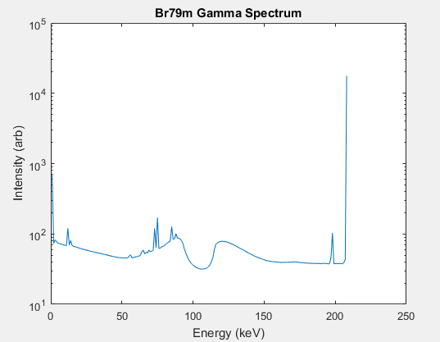
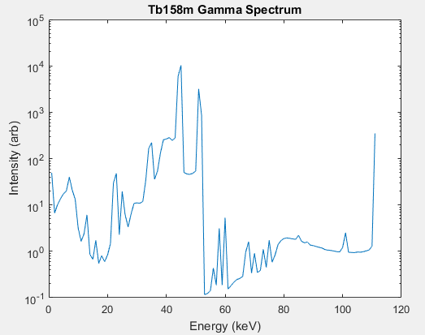
Decay properties
Includes half-life, gamma emission energies & probabilities, among others.
Quality of existing data is poor in some areas.
43.7 keV (13.9 ± 1.4)%
44.5 keV (24.7 ± 2.4)%
(207.5 ± 0.1) keV
(110.3 ± 1.2) keV

Slide 9
Decay properties
Isomer | Half life (s) | Existing emission energy (keV) | Revised emission energy (keV) | Emission probability (%) | Revised emission probability (%)
Au197m | 7.73 | 279.01 (5) | 279.0030 (12) | 70.9 | -
Br79m | 4.86 | 207.5 (1) | 207.4791 (12) | 76.3 (3) | -
Cd111m | 2912 | 150.825 (15) 245.395 (20) | - - | 29.1 (18) 94 (7)
Hg199m | 2560 | 68.894 70.818 158.3 (1) 374.1 (1) | - - 158.4053 (12) 373.9027 (12) | 17.7 (11) 29.8 (19) 52.3 13.8 (11) | -
Pd107m | 21.3 | 214.6 (3) | 214.4972 (12) | 68.7 | -
Tb158m | 10.70 | 43.744 44.482 110.3 (12) | - - 109.7845 (12) | 13.9 (14) 24.7 (24) 0.92 (3) | 13.46 21.41 -
W183m | 5.2 | 57.981 59.318 | - - | 36.3 (10) 62.3 (16) | 37.15 62.77

Slide 10
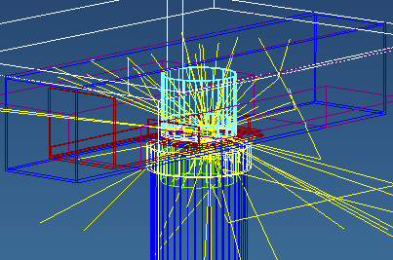


Formation cross-sections
How to measure them?
$$\frac{N_{γ}}{p_{γ}.p_{d}.t_{B}.N}=yield=\int_{E_{THR}}^{E_{MAX}}{Φ\left(E\right)σ\left(E\right)dE}$$
$p_{γ},$ $p_{d}$ can be simulated
$t_{B}$ can be calculated
$N_{γ},N$ can be measured

Slide 11
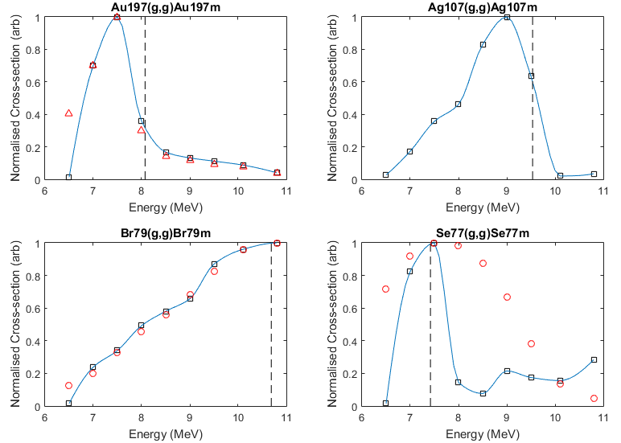


Formation cross-sections
How to extract the cross section?
Penfold-Leiss Unfolding¹:
$$y=\int_{E_{THR}}^{E_{MAX}}{Φ\left(E\right)σ\left(E\right)dE −−−→ }σ_{i}=\frac{1}{Φ_{ii}}\left[y_{i}−\sum_{j=1}^{i−1}{(Φ_{ij}σ_{j})}\right]$$
Produces non-physical solutions.
Why?
- Requires high precision results
- Assumes monoenergetic electron beam
How to extract the cross section?
Cook’s Least Structure Solution²:
$Φ∗σ=y$
- Generate several random vectors “$σ"$
- Calculate χ² statistic to find acceptable solutions
- Find solution with smallest “structure function”,
ie, the smoothest curve
$$S\left(σ\right)=∑{\left(σ_{j+1}−σ_{j}\right)}^{2}$$
2. Cook, B., Nuc. Inst. & Meth., 24, 256-268, Least Structure Solution of Photonuclear Yield Functions (1963)
1. Penfold, A. & Leiss, J., Phys Rev, 114, 5, Analysis of Photonuclear Cross Sections, (1959)

Slide 12
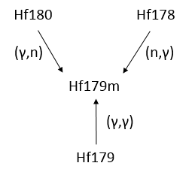
Potential limitations
Experimental uncertainties
    Linac operating parameters
    (γ,n) contributions
    (n,γ) contributions
Interference from other elements
    Activation of shielding
    Photofission of U and/or Th
High spin differences
    Isomers with large spin differences (ΔJ > 6) between excited and ground states are difficult to activate.
    Only 2 cases have been documented to date^{3,4}
Mn56
3. Belov, A.G. et al, Hyperfine Interact., 107, 167-173, Excitation of the high-spin ¹⁸⁰Hf isomer and de-excitation of the ¹⁸⁰Ta isomer in (γ,γ) reactions (1997)
4. Tickner, J., Appl. Rad. & Iso., 110, 42-46, Photoexcitation of the high-spin J=8 isomer in ¹⁷⁶Yb using 8.5 MeV end-point energy bremsstrahlung (2016)

Slide 13

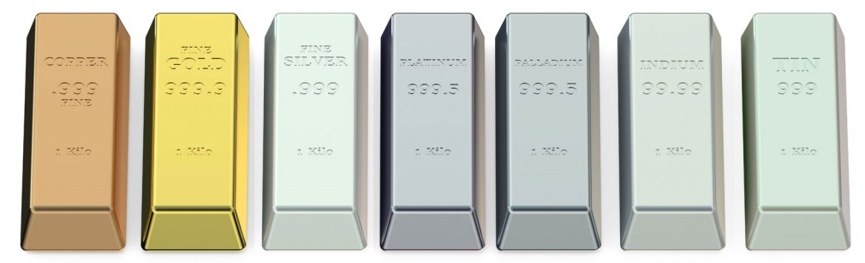
Applying GAA to industry
Recently commercialised by Chrysos Corporation as PhotonAssay.
Practical applications for real-time quality control in mining.
Gold industry alone produces >$US100 billion per year.

Slide 14
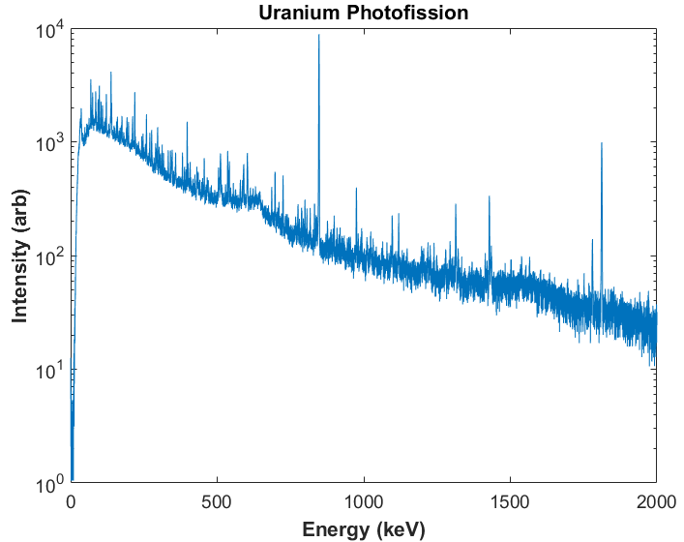
Future Work
Catalogue unmeasured (γ,γ) cross-sections.
Quantify photofission product yields for ²³⁸U and ²³²Th.

Slide 15
Thank you
  Justin Delaney
  PhD Candidate
    T +61 2 9710 6777
    E justin.delaney@csiro.au
    W www.csiro.au
CSIRO Mineral resources

