Slide 1

The groundbreaking activities of the European spallation Source
Mats Lindroos
Head of Accelerator
Adjungated Professor at Lund University, Physics department
and the ESS Accelerator Collaboration
www.europeanspallationsource.se
June 2017

Slide 2

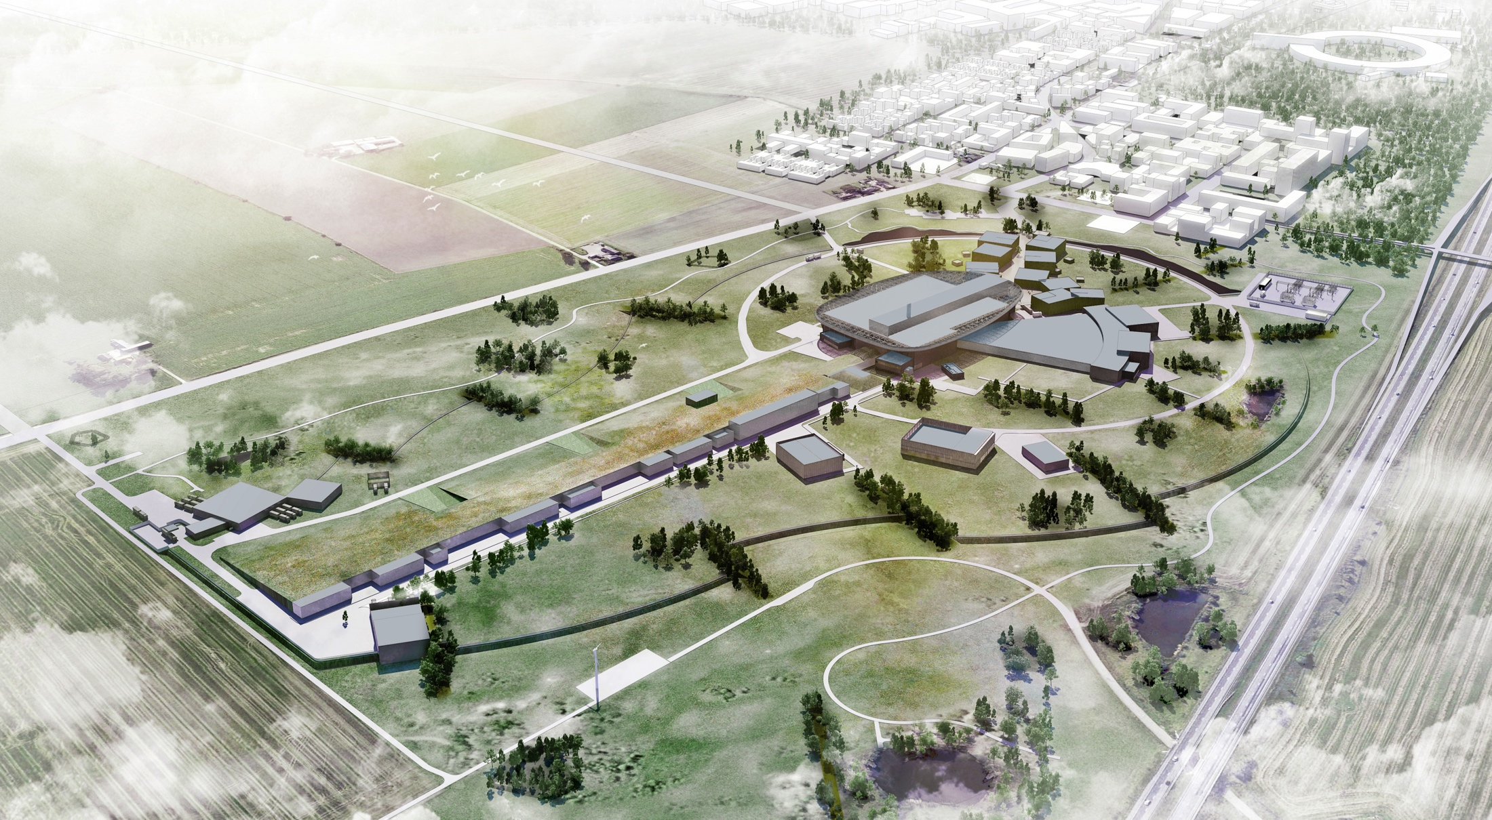



A European research center

Slide 3
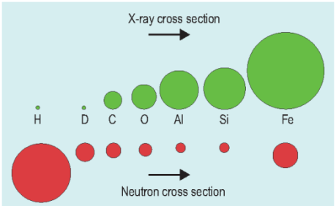
Neutrons & x-rays: similar methods, sensitive to different elements.

Slide 4
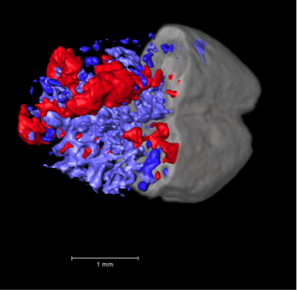
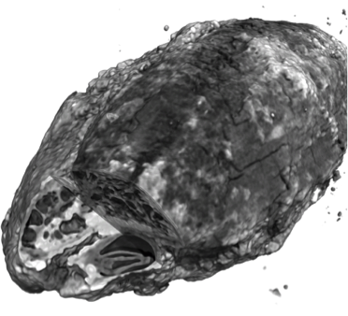
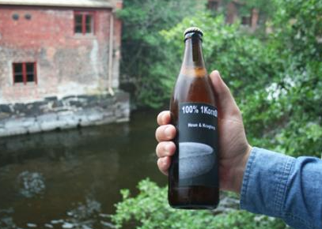
Neutron Imaging - Examples

Slide 5

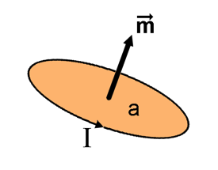
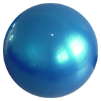
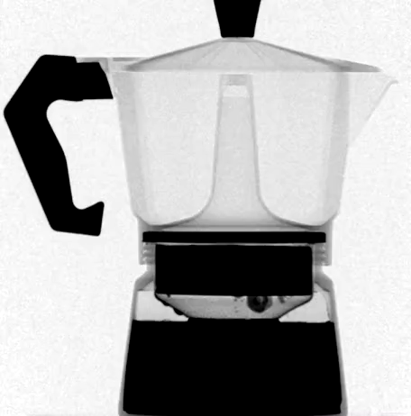
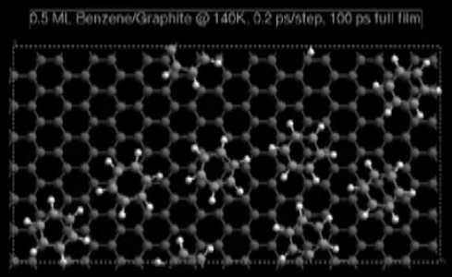
Neutrons are beautiful!
Wave
Magnetic moment
Particle
Neutral
Diffractometers - Measure structures
– Where atoms and molecules are
Spectrometers - Measure dynamics
– What atoms and molecules do

Slide 6
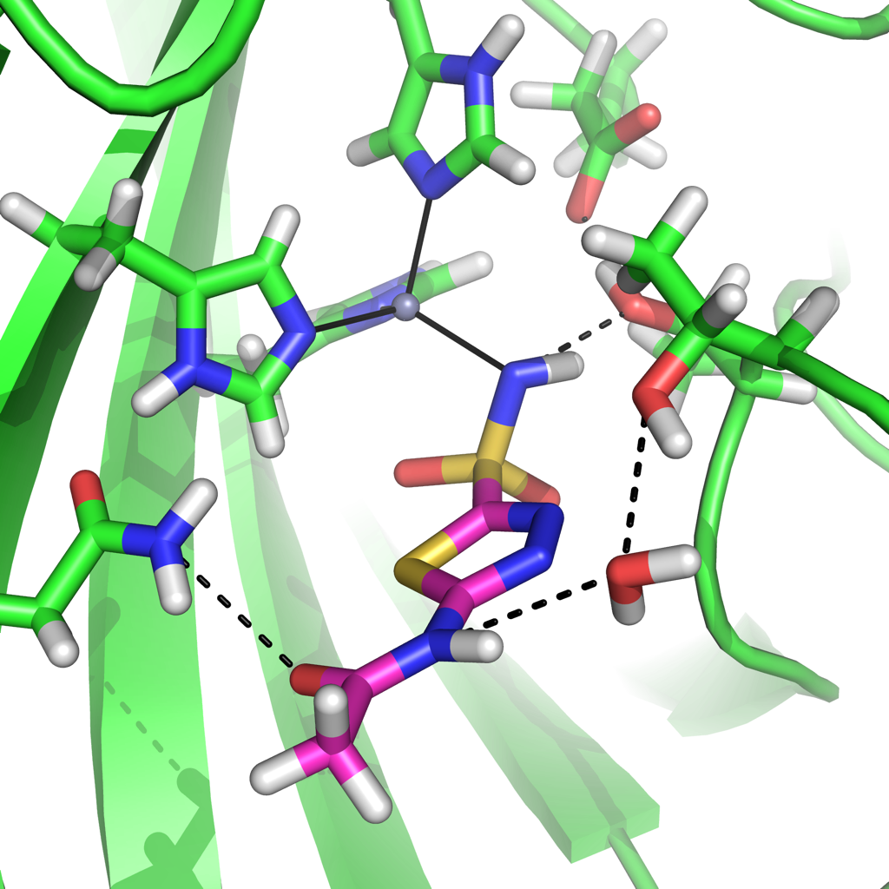
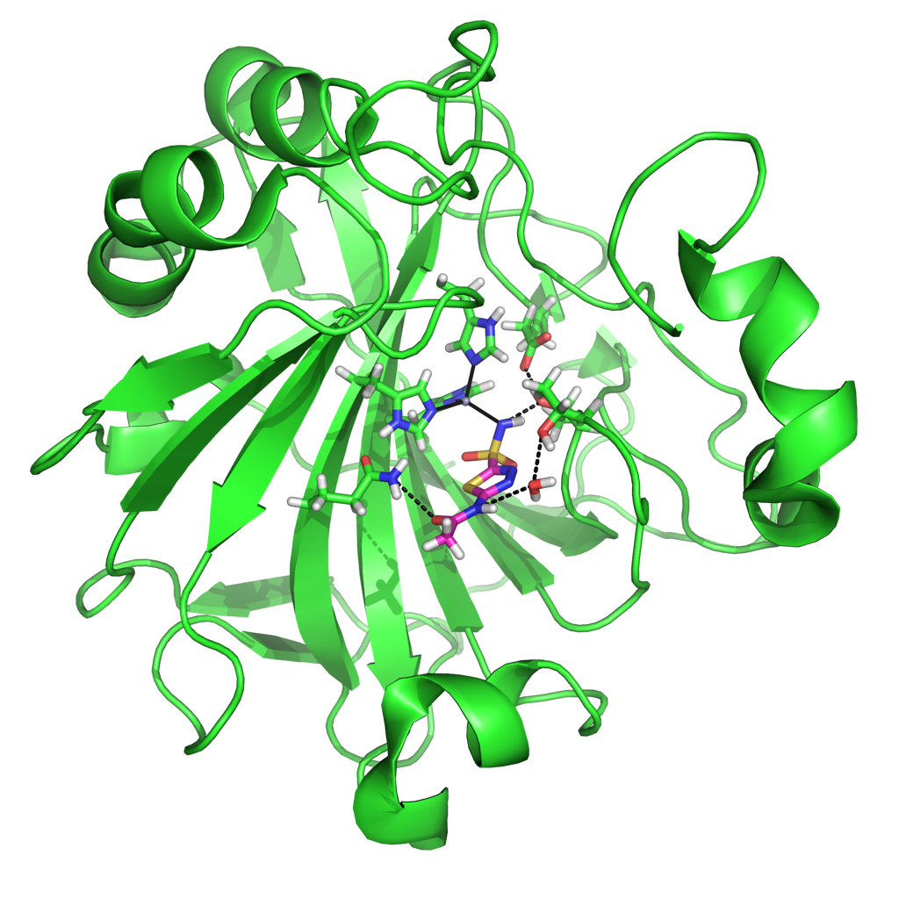
Better drugs from detailed protein maps
This enzyme transports CO₂ and regulates blood pH.
It is a major player in some cancers, glaucoma, obesity and high blood pressure
Neutron crystallography pinpoints protons and waters, showing how the drug Acetazolamide binds
Fisher, S. Z. et al. 2012 JACS
10⁻⁹ m
Notes:
Short version of manuscript:
Carbonic anhydrase (CA) is a major player in some cancers, glaucoma (an eye disease), obesity and some types of high blood pressure. The image shows CA in green.
In 2012, a study showed that Carbonic Anhydrase interaction with the drug azetazolamide by using both x-ray and neutron scattering. In CA there is an “active site” where Azetazolamide can bind and exert its pharmaceutical function. Actazolamide can be seen in this image as a stick model interacting with other atoms in the CA protein.
Acetazolamide can be seen in better detail binding with important hydrogen bindings in the active site. This represents the first determined neutron structure of a clinically used drug bound to its target. The little grey ball, is a zinc, and the rest of bindings are hydrogen bonds between CA, Acetazolamide and water. These bindings could not have been disclosed without neutron crystallography.
ESS will enable: At ESS, it will be possible to investigate smaller crystals that might give us answers about drug targets, answers that are not accessible by neutrons today.
Long version of manuscript: Slide 8: Drug-target interactions are visible with neutrons and x-ray
Full disclosure of drug-target interactions are very much wanted by pharmaceutical companies developing better drugs.
Carbonic anhydrase (CA) is a major player in some cancers, glaucoma (an eye disease), obesity and some types of high blood pressure.
Image 1: CA inhibitors have been used for decades to treat the health issues I mentioned before. The image shows the carbonic anhydrase protein in green.
In 2012, a study was published in which the authors showed that we can understand the Carbonic Anhydrase interaction with the drug azetazolamide by using both x-ray and neutron scattering. In CA, there is a so called “active site” where Azetazolamide can bind and exert its pharmaceutical function. Actazolamide can be seen in this image as a stick model interacting with other atoms in the CA protein.
Azetazolamide is a CA inhibitor, and there are several X-ray structures available of azetazolamide bound to various Carbonic Anhydrase isoforms, but these complexes do not show the functional hydrogen atoms. The functional hydrogens are the atoms that contribute to the important drug-target interactions.
Image 2: Zooming in on this image, we can see the Acetazolamide in better detail binding with important hydrogen bindings in the active site. This represents the first determined neutron structure of a clinically used drug bound to its target. The little grey ball, is a zinc, and the rest of bindings are hydrogen bonds between CA, Acetazolamide and water. These bindings could not have been disclosed without neutron crystallography.
ESS Bubble: At ESS, it will be possible to use even smaller samples than we can at other facilities today.
.

Slide 7
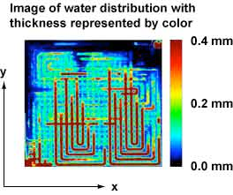
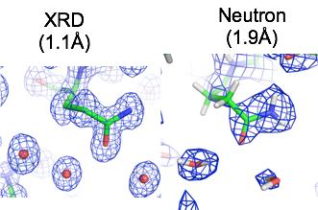
Some visions for Neutron and light sources
Higher (Room?) Temperature Super Conductors
Hydrogen storage substrate
Efficient membrane for fuel cells
Flexible and highly efficient solar cells
Understanding liquid membranes
Nano scaled structures for controlled drug release
Self healing materials – smart materials
Spintronics - Spin-state as a storage of data (10²³ gain in capacity)
CO₂ sequestration
Neutron electric dipole moment
Neutron oscillations
And much more…

Slide 8
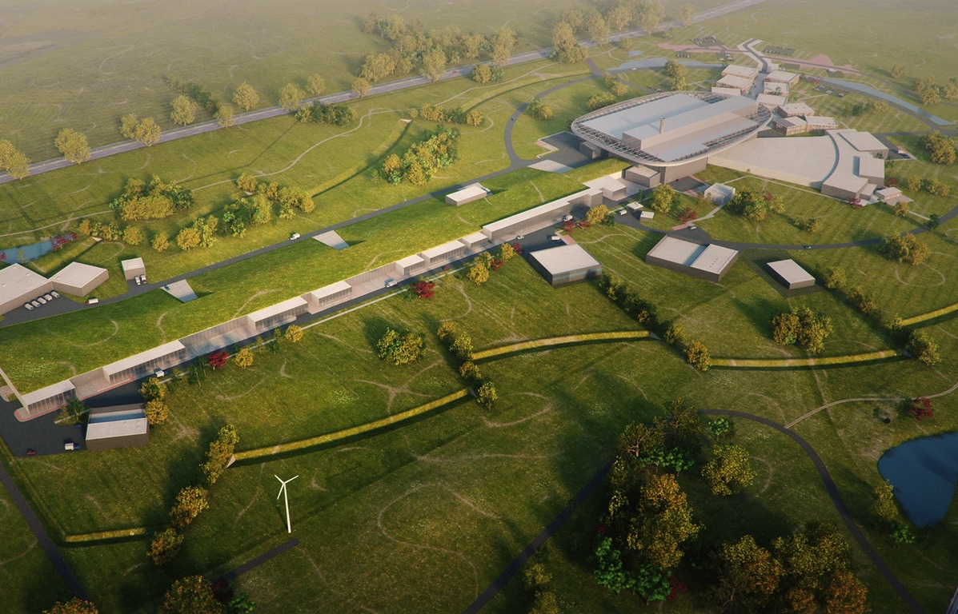
ESS design
High Power
Linear Accelerator:
Energy: 2 GeV
Rep. Rate: 14 Hz
Current: 62.5 mA
Target Station:
He-gas cooled rotating
W-target (5MW average
power)
42 beam ports
16 Instruments in Construction budget
Committed to deliver 22 instruments by 2028
Peak flux ~30-100 brighter than the ILL
Ion Source
Total cost: 1843 MEuros ₂₀₁₃

Slide 9
Neutron facilities – reactors and particle driven
10²⁰
Reactor Sources
Spallation Sources
J-PARC
ESS
HFIR
ILL
LANSCE
ISIS
CSNS
10¹⁵
MTR
HIFAR
MARIA
ORPHEE
IPNS
SALAM
HANARO
SNS
NRX
HFBR
NIST
ZING-P’
Dhruva
CARR
PIK
NRU
SAFARI-1
JRR-3
ETERR-2
FRM-II
OPAL
LVR
RSG
SINQ
IBR-II
HOR
JEEP II
KENS
X-10
WNR
Effective thermal neutron flux n/cm²-s
ZING-P
10¹⁰
CP-2
CP-1
10⁵
Berkeley 37-inch cyclotron
Particle driven pulsed
350 mCi Ra-Be source
Particle driven steady state
Pulsed reactor
Fission reactors
1
Chadwick
1930
1940
1950
1960
1970
1980
1990
2000
2010
2020
2030
Year
(Updated from Neutron Scattering, K. Skold and D. L. Price, eds., Academic Press, 1986)
Notes:
CP-1 Chicago USA
CP-2 Chicago USA
X-10: Oak Ridge, USA
NRX: Chalk River, USA
MTR: Idaho, USA
LVR: Rez, Czech Republic
HIFAR: Sydney Australia
NRU: Chalk River, USA
HOR Delft Netherlands
SAFARI-1 Pretoria South Africa
HFBR: Brookhaven, USA
HFIR: ORNL, Oak Ridge, USA
NIST: National Inst. for Stds and Tech. Gaithersburg, USA
ILL: Grenoble, France
JEEP II Kjeller Norway
MARIA Swierk Poland
ORPHEE LLB Saclay France
Dhruva: Mumbai, India
RSG: serpong, Indonesia
SINQ: PSI, Switzerland
JRR-3: Tokai, Japan
ES-Salam Algiers Algeria
HANARO: Daejon KAERI, South Chorea
ETERR-2 Cairo Egypt
FRM-II: Munich, Germany
OPAL: Sydney, Australia
CARR: Beijing China
PIK: Gatchina, Russia
ZING-P Argonne USA
WNR Los Alamos USA
KENS Tsukuba Japan
IPNS Argonne USA
IBR-II Dubna Russia
LANSCE Los Alamos USA
ISIS Oxfordshire UK
SNS Oak Ridge USA
JPARC Tokai Japan
CSNS Beijing China
ESS Lund Sweden
More reactor sources exist across the world….

Slide 10
ESS – the sale pitch!
Reactor sources
Accelerator-driven sources
ESS
Effective thermal neutron flux n/cm²-s
J-PARC
NIST
ILL
LANSCE
ISIS
FRM-II
SNS
CSNS
Year
Notes:
CP-1 Chicago USA
CP-2 Chicago USA
X-10: Oak Ridge, USA
NRX: Chalk River, USA
MTR: Idaho, USA
LVR: Rez, Czech Republic
HIFAR: Sydney Australia
NRU: Chalk River, USA
HOR Delft Netherlands
SAFARI-1 Pretoria South Africa
HFBR: Brookhaven, USA
HFIR: ORNL, Oak Ridge, USA
NIST: National Inst. for Stds and Tech. Gaithersburg, USA
ILL: Grenoble, France
JEEP II Kjeller Norway
MARIA Swierk Poland
ORPHEE LLB Saclay France
Dhruva: Mumbai, India
RSG: serpong, Indonesia
SINQ: PSI, Switzerland
JRR-3: Tokai, Japan
ES-Salam Algiers Algeria
HANARO: Daejon KAERI, South Chorea
ETERR-2 Cairo Egypt
FRM-II: Munich, Germany
OPAL: Sydney, Australia
CARR: Beijing China
PIK: Gatchina, Russia
ZING-P Argonne USA
WNR Los Alamos USA
KENS Tsukuba Japan
IPNS Argonne USA
IBR-II Dubna Russia
LANSCE Los Alamos USA
ISIS Oxfordshire UK
SNS Oak Ridge USA
JPARC Tokai Japan
CSNS Beijing China
ESS Lund Sweden
More reactor sources exist across the world….

Slide 11
ESS: The worlds first long pulse source
8
x10¹⁴
ESS 5 MW
2015 design
7
λ = 1.5 Å
Possibilities of pulse shaping
6
5
Brightness (n/cm²/s/sr/Å)
4
ESS 5 MW
2012 design (TDR)
3
SNS
1-2 MW
JPARC
0.3-1 MW
2
UK TS2
32 kW
1
UK TS1
128 kW
ILL 57 MW
0
time (ms)
1
2
3
4

Slide 12
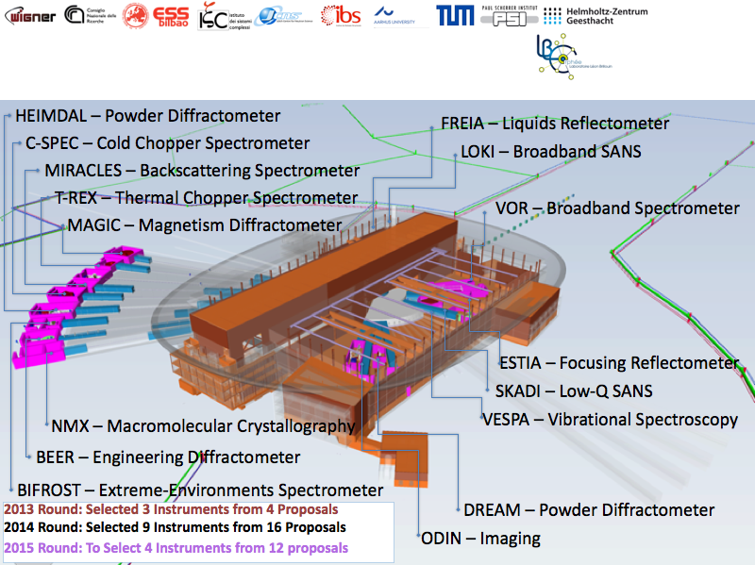
Instrument: En ny generation instrument

Slide 13
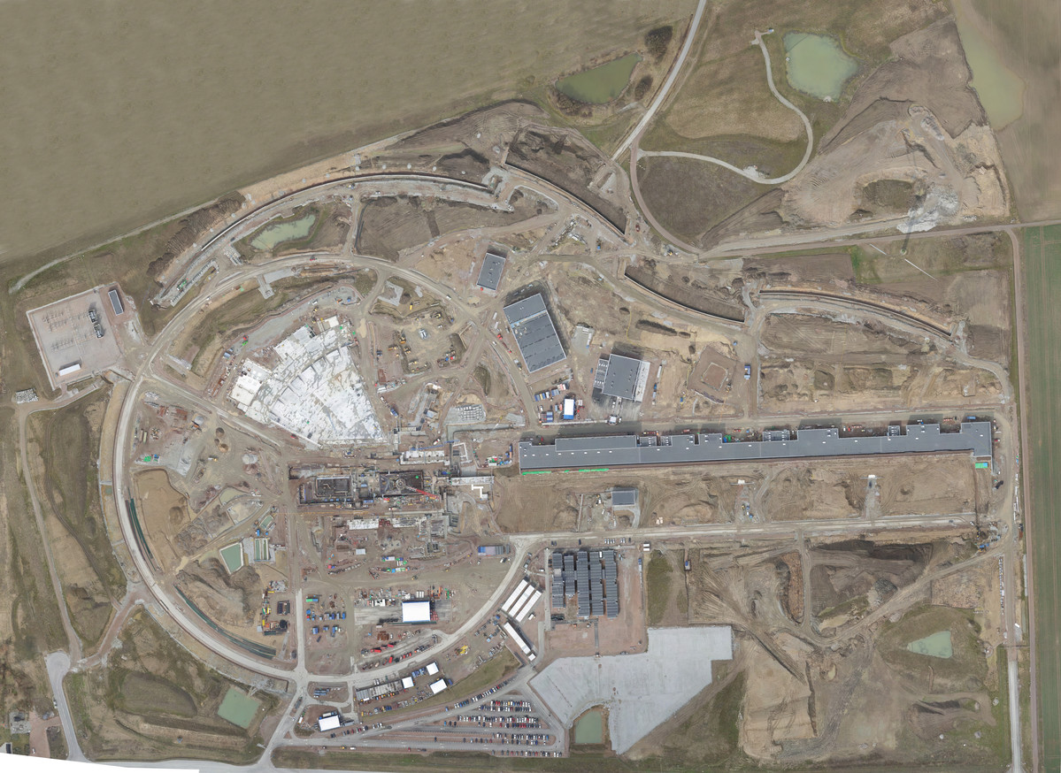

Distribution
Substation
Primary
Substation
Central Utility
Building
Exp. Hall
E01
Cryo Compressor
Building
Klystron Gallery
Front End
Building
Active
Cells
Target
Monolith
High Energy
Loading Bay
April 2017

Slide 14
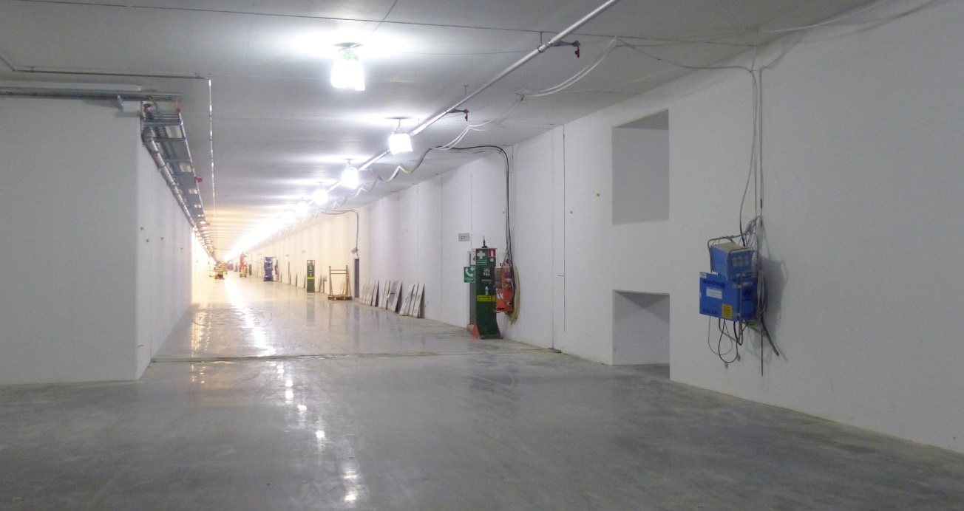
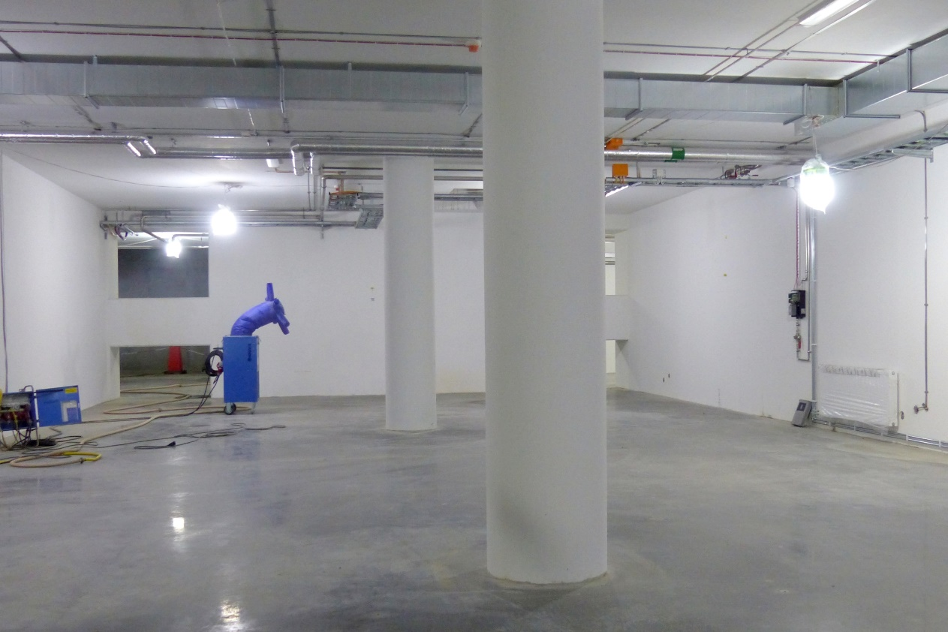
Linac tunnel
Tunnel, view from HEBT
Front End Building

Slide 15
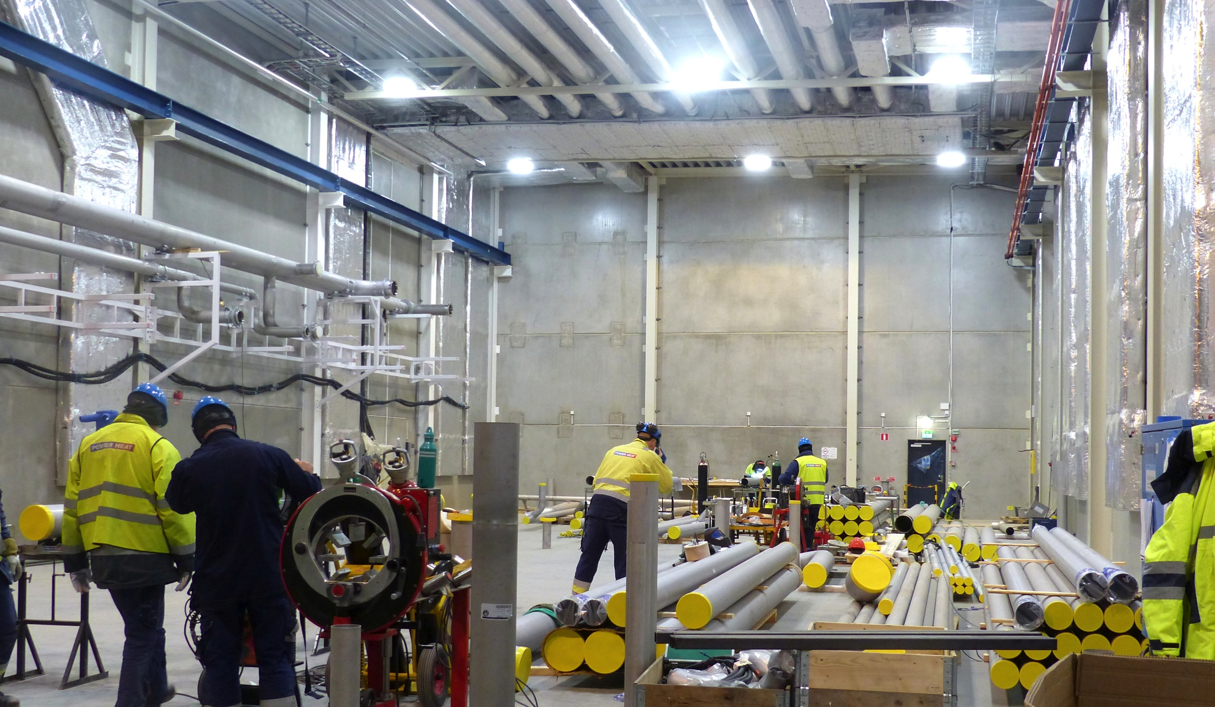
Cryo Compressor Building

Slide 16
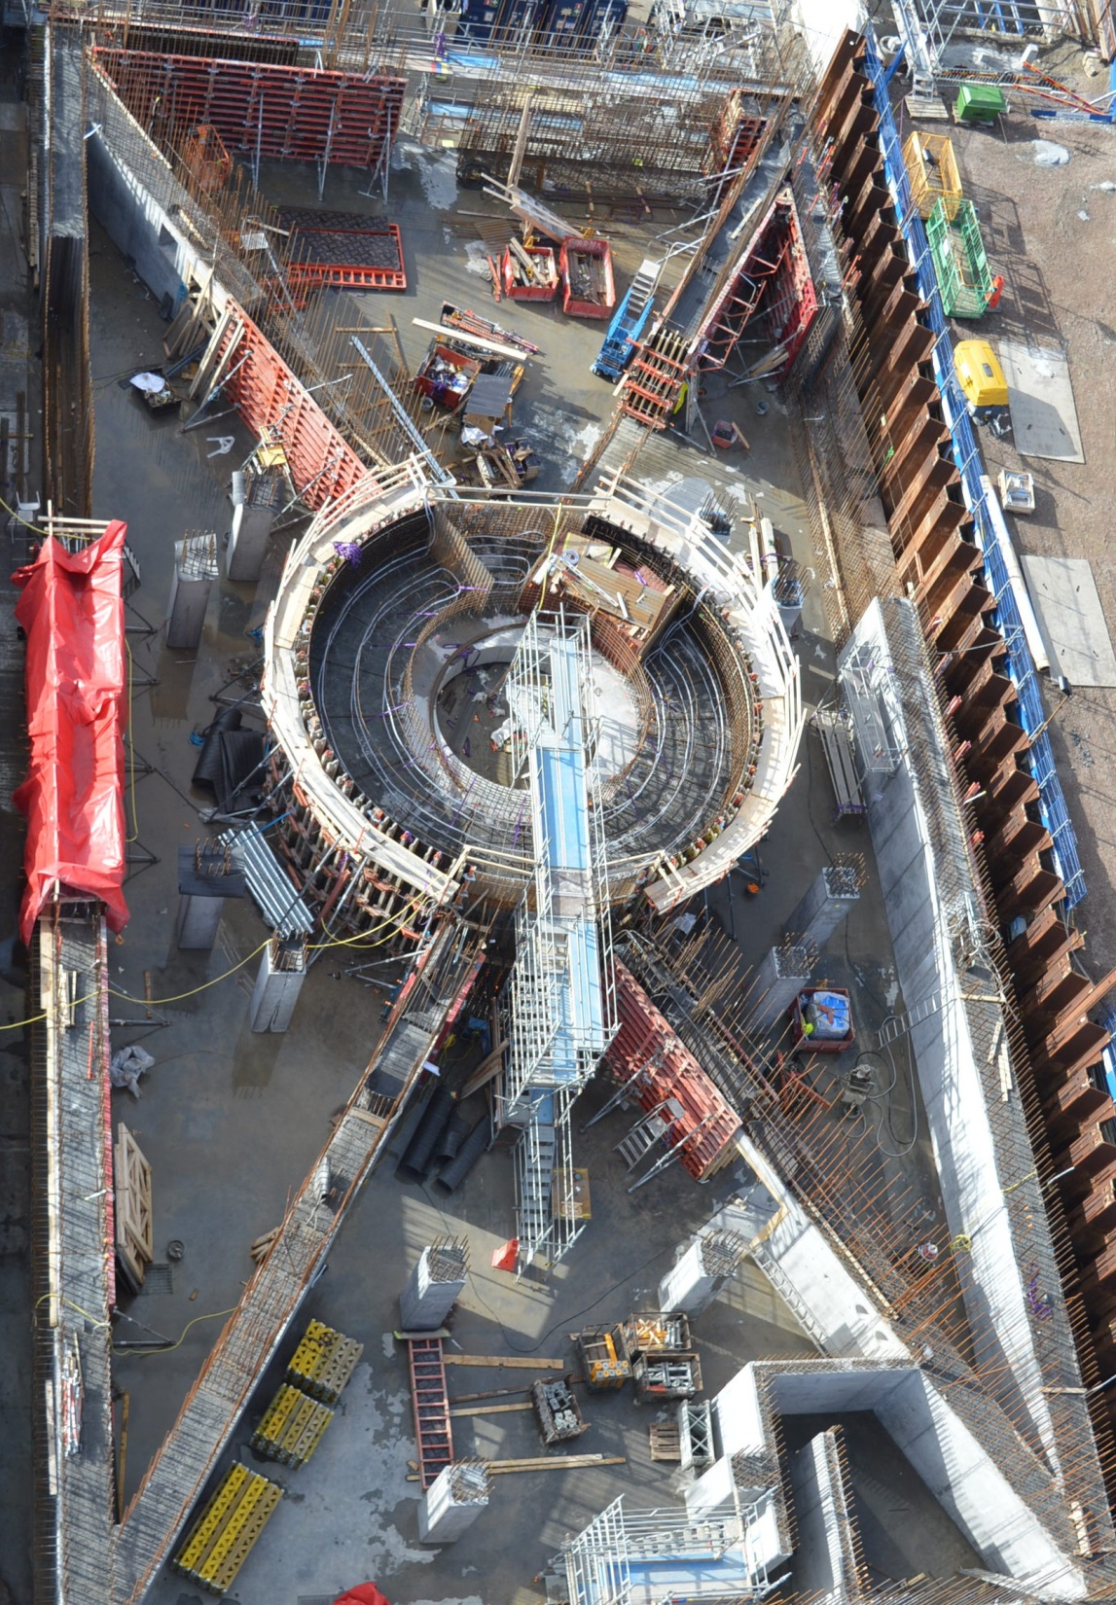
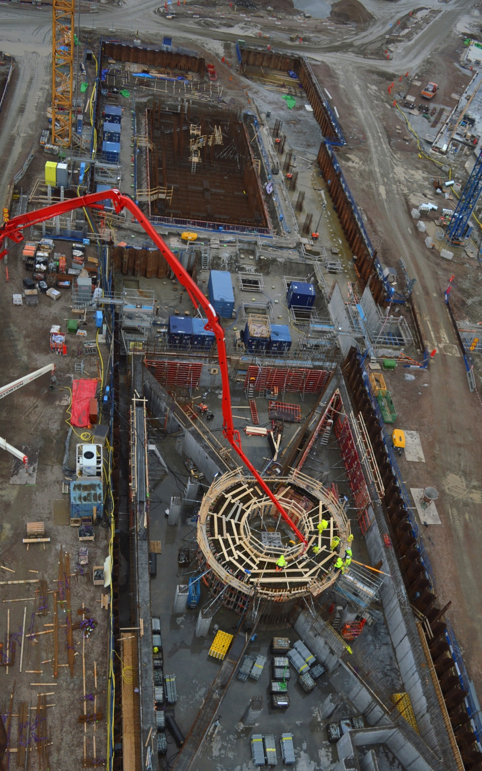
Target
Monolith & Active Cells

Slide 17
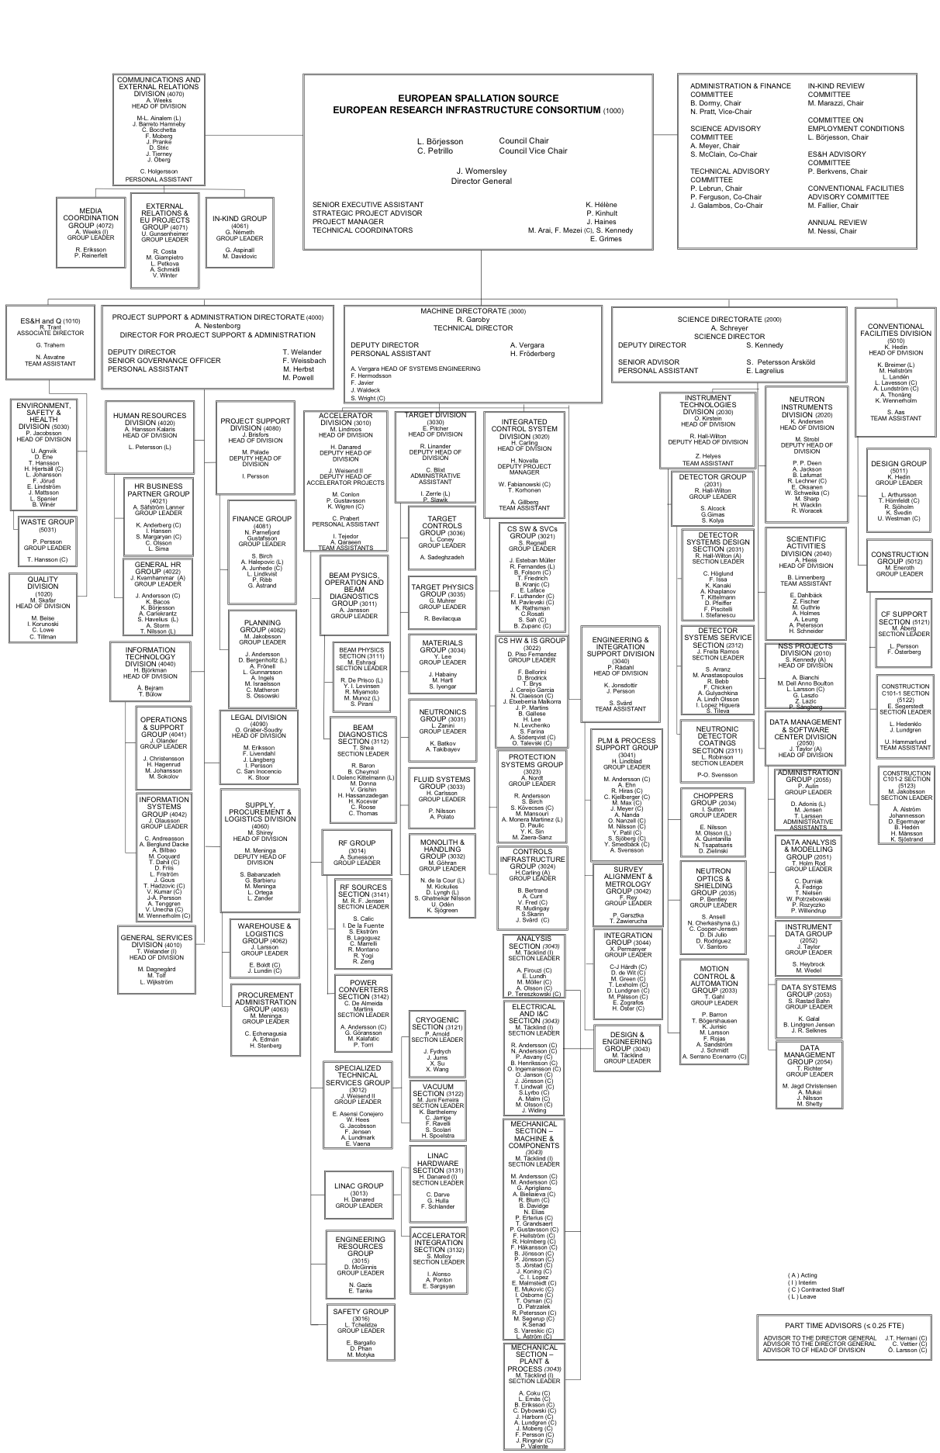


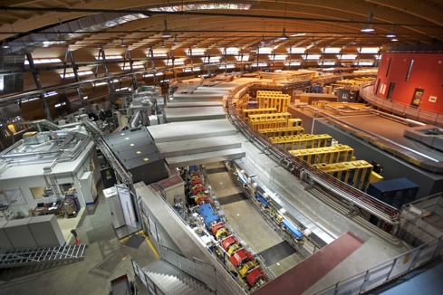
Organisation and People
401
Employees
48
Nationalities
> 45
Collaborating Institutions

Slide 18
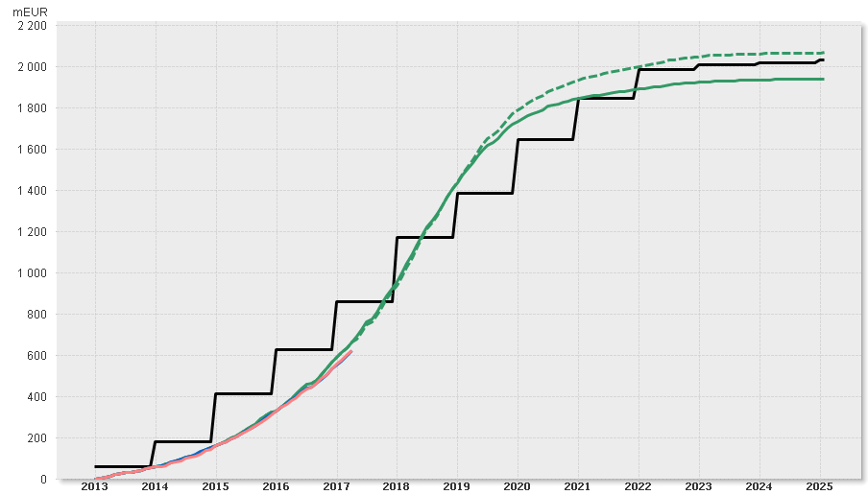

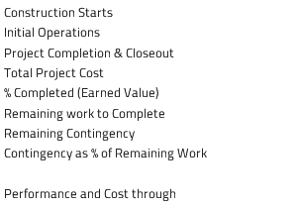

Construction funding & budget profile
M€
⧫ Start of user programme
⧫ First installations
(of Machine Systems)
Machine Ready for Beam on Target
Total Funding (Cumulative)
Total Baseline Budget incl. Contingency (Cumulative)
Total Baseline Budget excl. Contingency (Cumulative)
⧫ Construction
Starts
Total Earned Value (Cumulative)
Total Actual Cost (Cumulative)

Slide 19
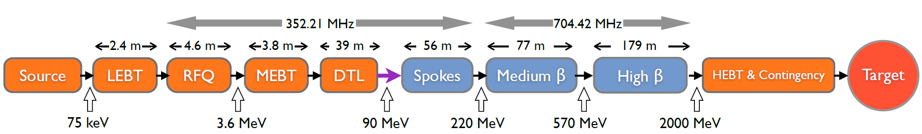
ESS linac
  Average beam power of 5 MW
  Peak beam power of 125 MW
  Acceleration to 2 GeV
  Peak proton beam current of 62.5 mA
  Pulse length of 2.86 ms at a rate of 14 Hz (4% duty factor)
96% of acceleration will be provided by superconducting cavities supplied by 150 high power RF sources (one per cavity):
  80% of the RF power sources delivering over 1.1 MW of peak RF power
  The RF system is the cost driver for the ESS accelerator.
    Low losses
    Minimimum energy use & energy recovery
    Flexibility for
    mitigation or upgrade

Slide 20



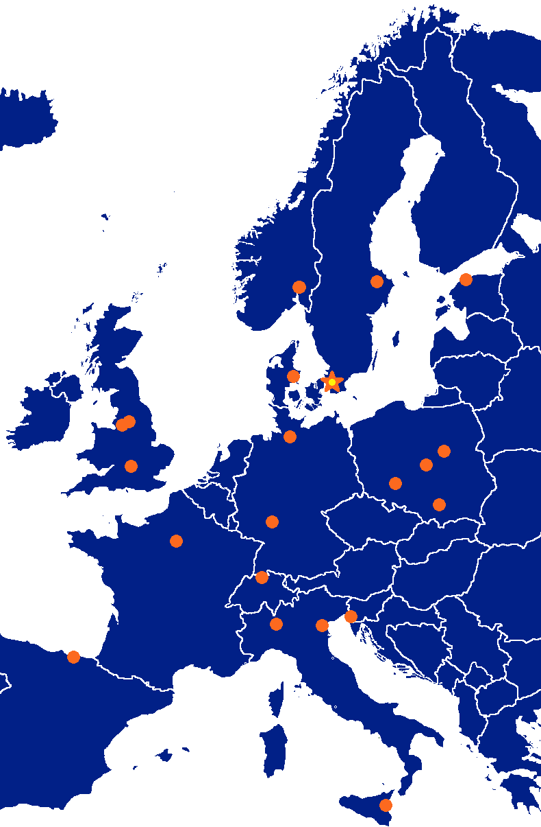



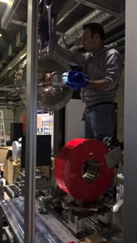




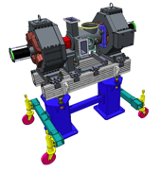


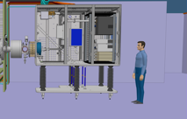



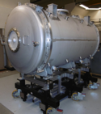
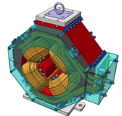

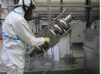

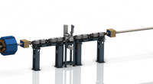




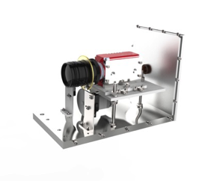
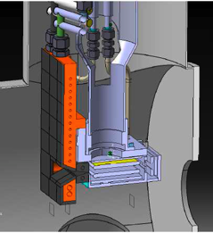
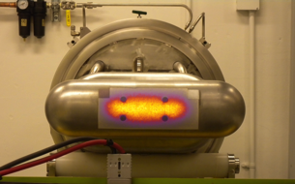

Accelerator components benefit from expert competencies all across Europe
352.21 MHz
704.42 MHz
2.4 m
4.6 m
3.8 m
39 m
56 m
77 m
179 m
Target
Source
LEBT
RFQ
MEBT
DTL
Spokes
Medium β
High β
HEBT & Contingency
75 keV
3.6 MeV
90 MeV
216 MeV
571 MeV
2000 MeV

Slide 21

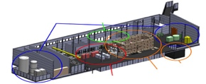



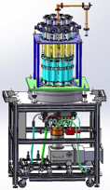
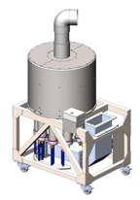



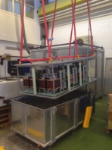
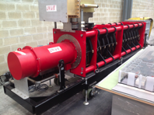
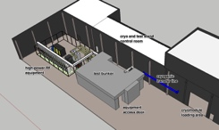
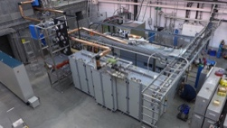
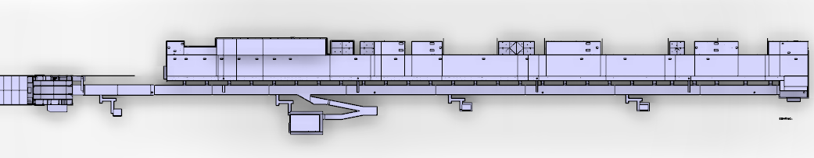









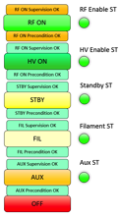


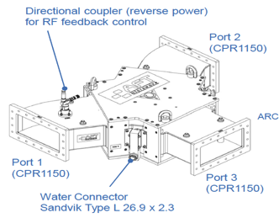
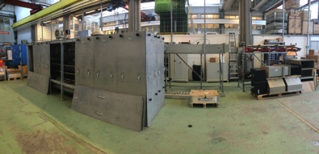
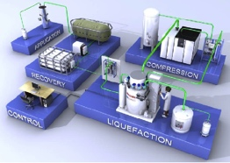

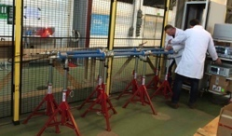

Accelerator components benefit from expert competencies all across Europe
Concept, courtesy of GRE (UK)

Slide 22








Test Stands 1, 2 in Lund and FREIA in Uppsala – Hands-on work has begun!

Slide 23

Accelerator cryoplant being completed

Slide 24



Ion source in Catania at nominal parameters

Slide 25




DTL recent achievements
5 tanks
DTL design work at ESS and in Legnaro, 3.6 ->90 MeV.
[Picture from CERN Linac4]
Tank 4: forged 304 L stainless steel
Drift tube
prototypes

Slide 26



Spoke Cavities design & prototype performances
Spoke cavity prototype test results (Jan15 – Feb16):
Excellent performances, well within specifications (both on Eacc & Qo)
Pcav<0.5W
Chemical etching
Cryomodule with 2 cavities
Ultra pure water
high pressure rinsing
THOBB3 ESS SRF Linear Accelerator Components Preliminary Results and Integration (C. Darve (ESS)
MOPVA090 ESS Superconducting RF Collaboration (C. Darve – ESS)

Slide 27






Cleanroom, RF Station, Assembly hall, Test Stand are ready in Saclay
First Medium β String in CEA Saclay Cleanroom
RF station: Power-coupler conditioning
    Re-use the current infrastructure of XFEL
Notes:
Assembly room in Saclay
Uses the current infrastructure of XFEL
Benefits from the experience of the XFEL cryomodule assembly (ALSYOM)

Slide 28






Klystrons and MB-IOT prototypes
L3 IOT
Thales/CPI IOT
Height: 3.8 m 4.5 m 3.5 m
THPIK084 Results from the
704 MHz Klystron and
Multi-Beam IOT Prototypes
For the European Spallation
Source (M. Jensen – ESS)
Klystron Prototypes (resp. CPI, Thales and Toshiba)

Slide 29
Accelerator schedule
2016
2017
2018
2019
2020
2021
2022
NCFE
RFI ISRC & LEBT
RFI
MEBT
START RFQ MACHINING
RFI
RFQ
RFI
DTL5
SC LINAC
2 GeV
READY
SPOKE CM
TESTING STARTS
Spoke & Elliptical
cavities and cryomodules
SPOKE & MB CM
PRODUCTION
LAUNCHED
MB CM
TESTING STARTS
1-11 HB CM INSTALLED
12-21 HB CM INSTALLED
SC LINAC
570 MeV
READY
TOSHIBA/CPI/THALES KLYSTRON
PROTOTYPE DELIVERED
TECHNICAL STOP
TECHNICAL STOP
RF
CPI/THALES AND L3 IOT
PROTOTYPES DELIVERED
DECISION IOT OR
KLYSTRON FOR HB LINAC
RF SYSTEM
FOR MB
READY
CDS INSTALLATION
STARTS
Cryogenics
ACCELERATOR
CRYOPLANT
COMM./READY
CDS COMMISSIONED
BEAM COMM. COMPLETED FOR NCFE but DTL5
Commissioning
START RFQ COMMISIONING
BEAM COMM. COMPLETED FOR ISRC-> MEBT
FIRST PROTONS ON TARGET
2 GeV PROTONS AVAILABLE
1370 MeV PROTONS
AVAILABLE

Slide 30
Accelerator Division (AD)
– Site Organization
BAS-U framework
ESS management
Accelerator Installation
Manager
Nick Gazis
AD and ESS central Installation Services
(ISC workgroup, etc.)
RATS AreaSuper
hiring process
Inst-Test-Commis. Plan
(MS Project)
Eugene Tanke
QA/QC
Kent Wigren
Mechanical
Mechanical
Mechanical
Safety Team
Duy Phan
Area Supervisors
and ES&H
Area Supervisor Tunnel (G01) &
FEB (levels 090 & 100)
Dennis de Wit
Area Supervisor Gallery (G02 incl.Test Stand 2)
Marcus Green
Electrical
Utilities
Electrical
Utilities
Area Supervisor Cryobuildings (G04)
Ila Sjoholm
Electrical
Utilities
RF
other..
Indeed everyone is responsible for safety
el
System Leader 1
util
other..
mech
System Leader 2
AREAS
Other..
other
Task masters (Installation Support Team)
System Leader 3, 4..

Slide 31
Challenging Installation, Testing and Commissioning (ITC)
The ESS Accelerator sub-project today has access to the cryo-buildings, test stand area and tunnel
Blue lining and drilling is now starting in the tunnel for the NCFE
Stub installation (RF transfer from gallery to tunnel) has proven very challenging but we are now starting a test installation and we are maintaining the installation schedule
We are seeing delays from several IK partners for the equipment “Ready For Installation” dates
  Technical delays of up to 3 month
  Administrative delays of 6-9 months
We are working on a new ITC schedule which resources will permit us to install efficiently the equipment as we receive it with the ambition of running parts of the linac in 2019

Slide 32

A sustainable research facility
Responsible
Carbondioxide:
- 30 000 ton/year
Renewable
Carbondioxide:
- 120 000 ton/year
Recyclable
Carbondioxide:
- 15 000 ton/year
Notes:
Högsta temp: 118 GWH
All värme: 215 GWh = 10 000 villor

Slide 33



1.8 Billion Euros:
Biggest investment in Science ever in Scandinavia?
In modern time, definitely YES!
However, Tycho Brahe’s Stjärneborg costed the Danish king 1% of the state budget in 1580.
“With better measurements of the stars positions and movements I can make much better horoscopes for you, your majesty!”
Notes:
1% would be 1.7 Billion Dollars in 2011

Slide 34
Conclusions
Collaboration has enabled ESS to get construction under way at a green field site while building up an organization for installing, testing, commissioning and operating the facility
We continue to welcome new collaborators – IK bidding for accelerator construction is coming to an end but we will operate and upgrade this facility for at least the 40 coming years
Working together we can do what might seem as impossible

Slide 35


Many thanks to all my colleagues in the ESS accelerator collaboration
Thank you for listening!
Thanks to all my colleagues at ESS!
Together we are building ESS

Slide 36


Slide 37
ESS: The worlds first long pulse source
8
x10¹⁴
ESS 5 MW
2015 design
7
λ = 1.5 Å
Possibilities of pulse shaping
6
5
Brightness (n/cm²/s/sr/Å)
4
ESS 5 MW
2012 design (TDR)
3
SNS
1-2 MW
JPARC
0.3-1 MW
2
UK TS2
32 kW
1
UK TS1
128 kW
ILL 57 MW
0
time (ms)
1
2
3
4

Slide 38
Neutron Imaging - Examples

Slide 39
Några visioner för neutronanläggningar och synkrotronljusanläggningar
Higher (Room?) Temperature Super Conductors
Hydrogen storage substrate
Efficient membrane for fuel cells
Flexible and highly efficient solar cells
Understanding liquid membranes
Nano scaled structures for controlled drug release
Self healing materials – smart materials
Spintronics - Spin-state as a storage of data (10²³ gain in capacity)
CO₂ sequestration
Neutron electric dipole moment
Neutron oscillations
And much more…

