Slide 1
Investigating Artefacts Associated with β Particle Interactions in Charge Coupled Devices
Rosie Newton¹ (r.newton1@lancaster.ac.uk)
Mike J. Scott², Malcolm J. Joyce¹
¹Engineering Dept., Lancaster University, UK
²BIC Technology Ltd., Liverpool, UK
The 2017 International Conference on Applications of Nuclear Techniques - 15th June

Slide 2
Overview
Introduction to the project
CCD operation
Identifying β clusters in CCD images
  Modelling
  Experimental
α particle research
Next steps

Slide 3
Project introduction
Problem:
  In-situ detection of radioactive contamination – in particular of α radiation sources
Aims:
  Investigate potential of charge coupled devices (CCDs) for performing spectroscopy of α and β radiation
  Design and build a spectrometer for in-situ use

Slide 4
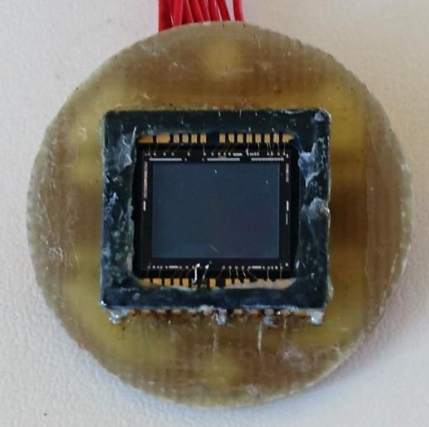
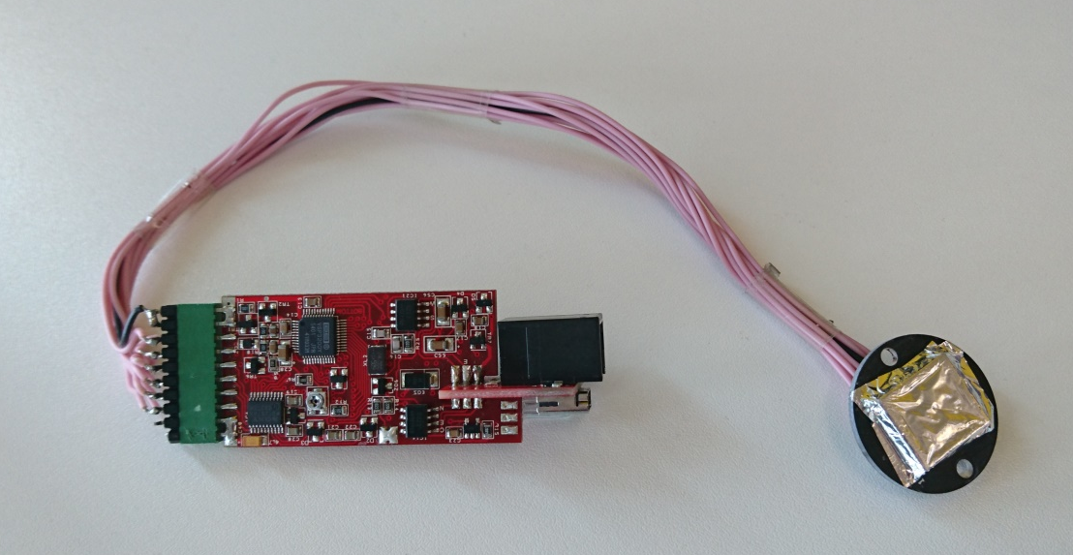
Charge coupled devices (CCDs)
Sony ICX825AL
8.98 x 6.71 mm imaging size
  1392 x 1040 pixels
    6.45 x 6.45 μm size
6.71mm
More information:
https://www.sxccd.com/ultrastar-and-ultrastar-c
8.98mm
8.1cm
Notes:
Interline CCD
If you include the interline thing make sure you explain it

Slide 5
Charge coupled devices (CCDs)
Potential for detecting charged particles/ionising radiation
Particles create electron/hole pairs in the active region
  Collected by gate electrodes
Charge can spread into multiple pixels
  Trails
  Diffusion
  Blooming
Incoming particle/radiation
Gate structure
e⁻
Active region
e⁻
e⁻
Substrate
CCD basic single pixel structure

Slide 6

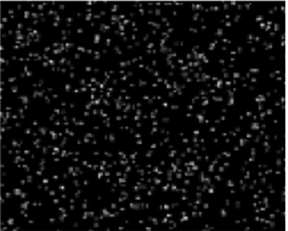
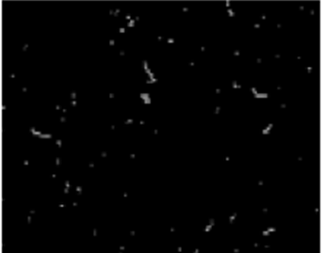
CCDs – Previous research
α (²⁴¹Am)
γ (²⁴¹Am)
β (²³⁴Th)
[1] R. Newton, J. Dykes, M. J. Scott, and M. J. Joyce, “Alpha Contamination Assay , Dosimetry and Spectrometry Using Charge Coupled Devices.”, presented at IEEE Nuclear Science Symposium, Strasbourg, 2016.

Slide 7
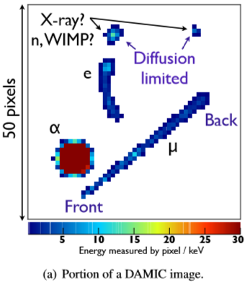
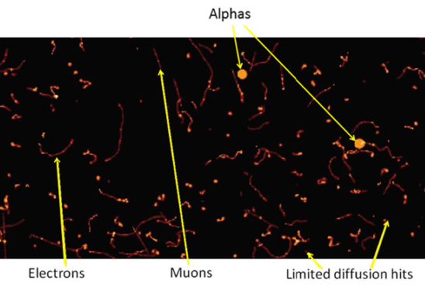
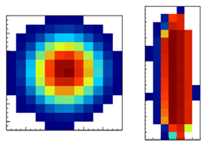
CCDs - Literature
Portion of a DAMIC image [1]
Example of a plasma (left) and bloomed (right) alpha detection [1]
Picture of an exposure of the DECam CCD to cosmic rays. Muons, alphas, electrons and low energy photons can be distinguished by their signatures on the CCD. [2]
[1] Aguilar-Arevalo, A. et al. Measurement of radioactive contamination in the high-resistivity silicon CCDs of the DAMIC experiment. J. Instrum. 10, P08014–P08014 (2015)
[2] Estrada, J . et al. Plasma effect in silicon charge coupled devices (CCDs). Nucl. Instruments Methods Phys. Res. Sect.
A Accel. Spectrometers, Detect. Assoc. Equip. 665, 90–93 (2011).
Notes:
Mention all the prominent things

Slide 8
β-particle sources
Two sources available for use:
  ¹³⁷Cs E_{max}: 512 keV
  ⁶⁰Co E_{max}: 310 keV
These will be used for both simulation and experimental research
Aim:
  Investigate the differences in the expected and actual pixel clusters for each source
  Look for a difference relating to the energies of the β particles

Slide 9
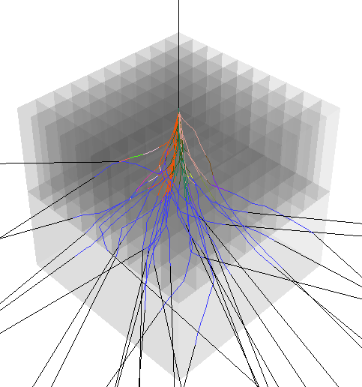
Modelling – CASINO
Software: CASINO
(monte CArlo SImulation of electroN trajectory in sOlids) [1]
30 tracks, 512 keV electrons
  [1] H. Demers, et al, “Three-dimensional electron microscopy simulation with the CASINO Monte Carlo software.,” Scanning, vol. 33, no. 3, pp. 135–46, May (2011) . http://www.gel.usherbrooke.ca/casino/

Slide 10
Modelling – CCD structure
Pixel structure used:
  2x2 binning to match software
  Pixel length and width from CCD datasheet
  Active area and substrate depth based on typical examples from literature (60 μm each) [1-3]
  No gate structure – previously shown to be negligible for these β particle energies [4]
[1] Li, F. & Nathan, A. CCD Image Sensors in Deep-Ultraviolet: Degradation Behavior and Damage Mechanisms. (Springer Science & Business Media, 2006).
[2] Burke, B., Jorden, P. & Paul, V. U. CCD technology. Exp. Astron. 19, 69–102 (2006).
[3] Aguilar-Arevalo, A. et al. Measurement of radioactive contamination in the high-resistivity silicon CCDs of the DAMIC experiment. J. Instrum. 10, P08014–P08014 (2015).
[4] R. Newton, J. Dykes, M. J. Scott, and M. J. Joyce, “Alpha Contamination Assay , Dosimetry and Spectrometry Using Charge Coupled Devices.”, presented at IEEE Nuclear Science Symposium, Strasbourg, 2016.

Slide 11
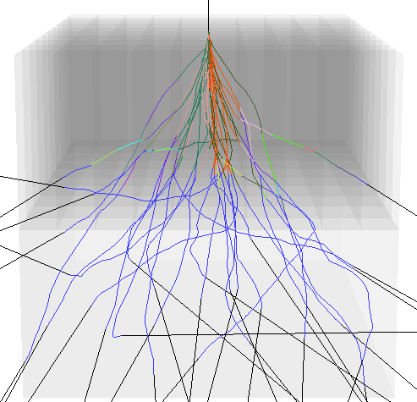
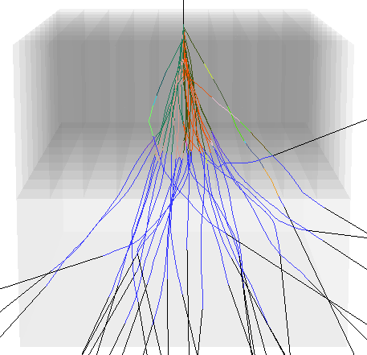
Modelling – ⁶⁰Co and ¹³⁷Cs
20 pixels (129µm)
20 pixels (129µm)
60µm
60µm
20 pixels (129µm)
20 pixels (129µm)
60µm
60µm
CASINO output for 310 keV e⁻ (⁶⁰Co)
CASINO output for 512 keV e⁻ (¹³⁷Cs)
10,000 simulated electrons (30 shown)
All regions are silicon

Slide 12
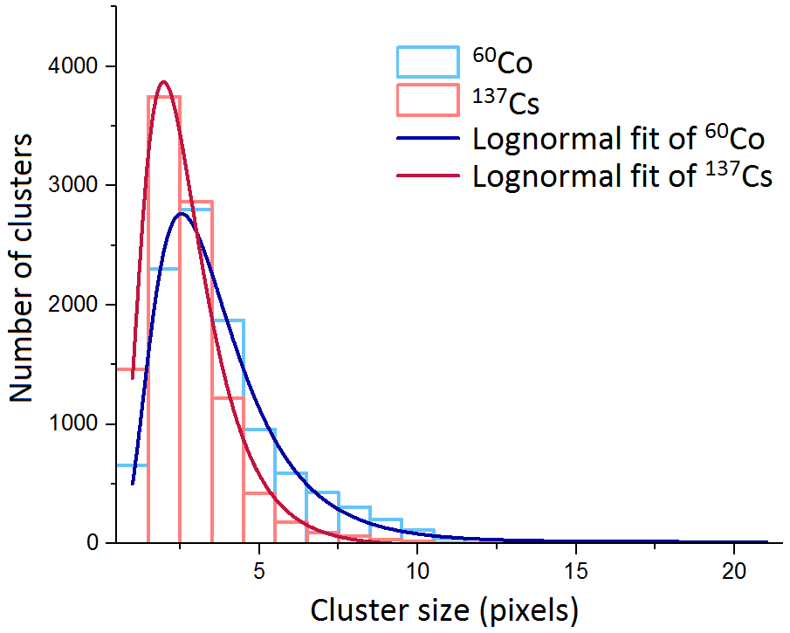
Modelling - ⁶⁰Co and ¹³⁷Cs
¹³⁷Cs peak: 2 pixels
⁶⁰Co peak: 2.5 pixels
⁶⁰Co has a greater percentage of larger clusters

Slide 13
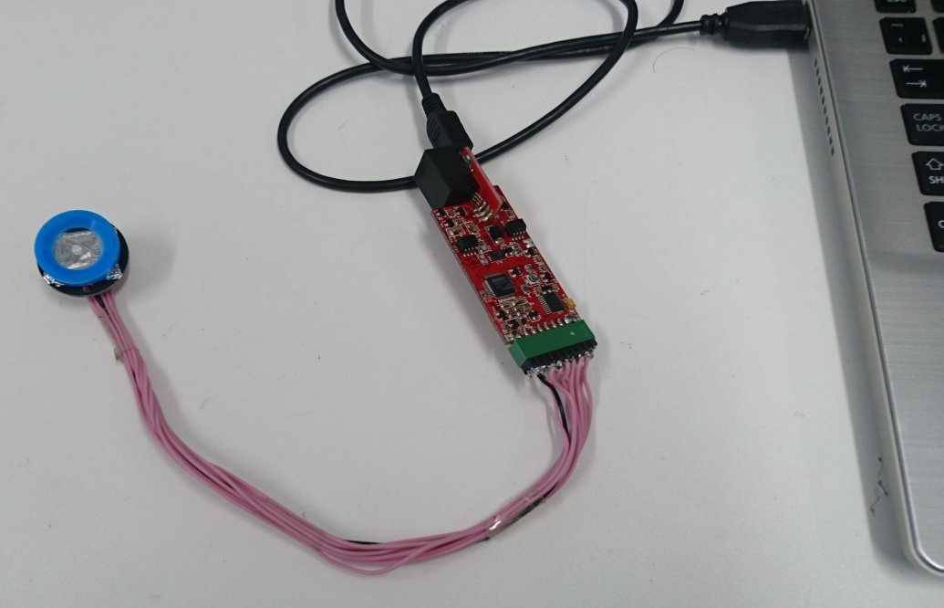
Experimental setup
CCD in contact with source
Aimed for similar counts to avoid overlapping clusters:
  ⁶⁰Co: 100s - 26,003 counts
  ¹³⁷Cs: 20s - 28,056 counts
Clusters are any pixels connected horizontally, vertically or diagonally

Slide 14
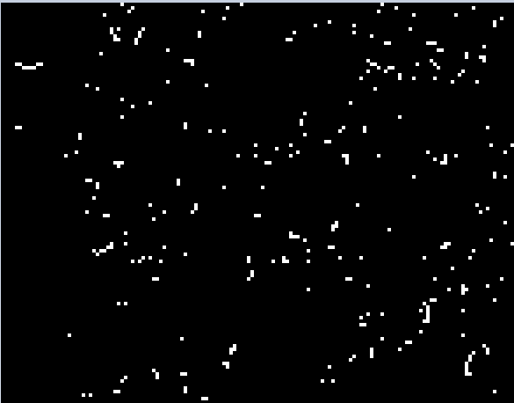
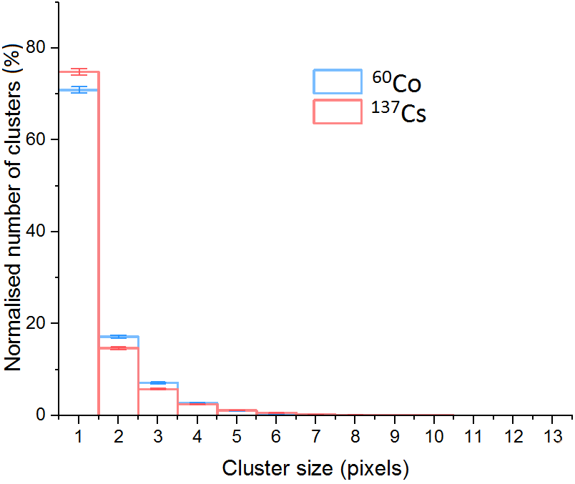
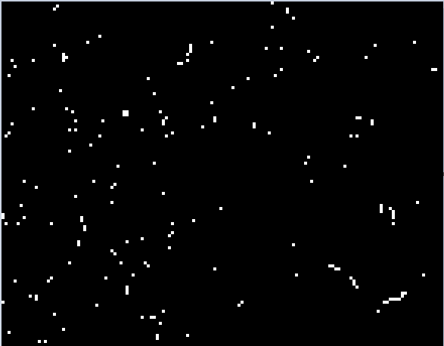
Experimental results
Image sections: 146×114 pixels
(4.5% of total image size)
⁶⁰Co
5s exposure
¹³⁷Cs
1s exposure
Notes:
4.5%

Slide 15
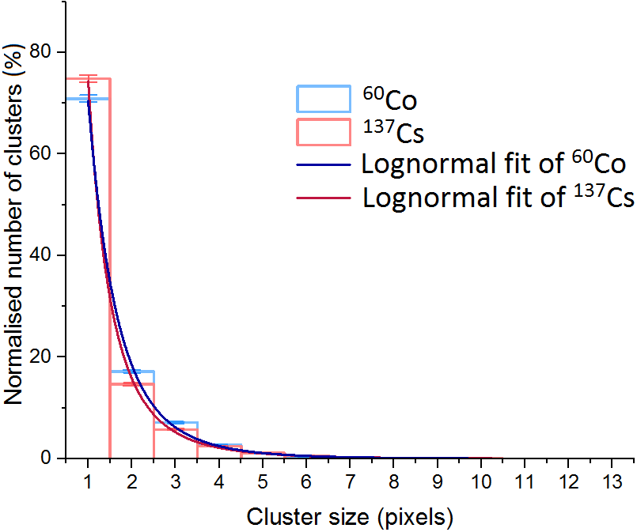
Experimental results
Lognormal fits well but peak shifted to smaller 1 pixel clusters in both cases
Smaller clusters dominated by γ radiation
Notes:
Include the screening – saw gamma but none of the longer streaks
Half mm plastic on source check in casino for attenuation

Slide 16
Comparison of results
CASINO results (β particles only)
Experimental results (β and γ)
Notes:
Equation between energy and scattering

Slide 17
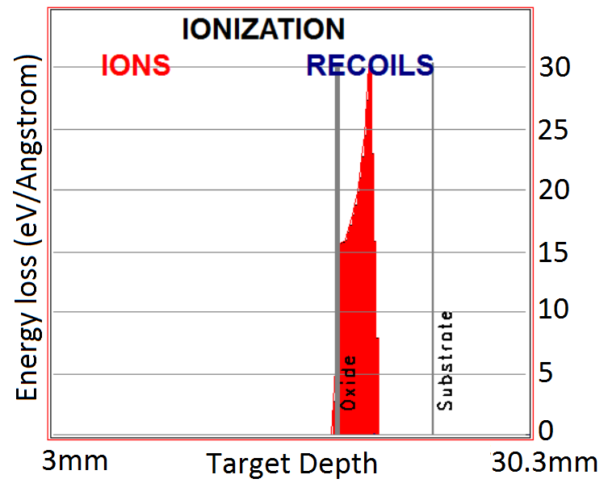
Po-210 α particle source
Single α particle energy: 5.31 MeV
No β/γ radiation
Half life: 138 days
SRIM (Stopping and Range of Ions in Matter) simulation data [1]
  [1] Ziegler, J. F., Ziegler, M. D. & Biersack, J. P. SRIM – The stopping and range of ions in matter (2010). Nucl. Instruments Methods Phys. Res. Sect. B Beam Interact. with Mater. Atoms 268, 1818–1823 (2010). http://www.srim.org/
Notes:
Po not used often – check
Includee assumptions

Slide 18
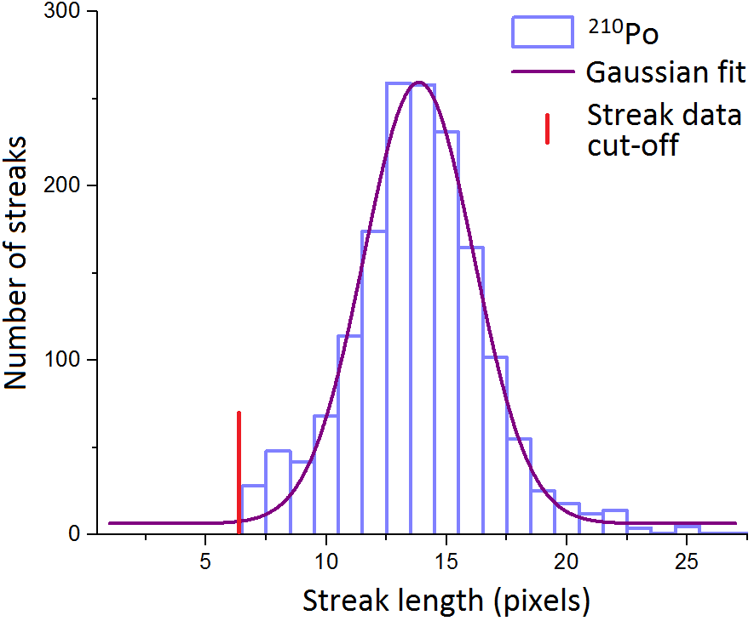
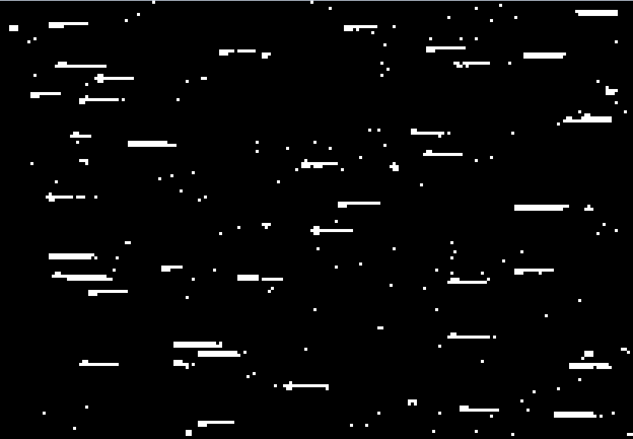
Po-210 α particle source
²¹⁰Po (30s) image section
208x144 pixels, 8.3% of total image
Experimental data, streaks counted if they consist of more than 6 pixels in length. Total number of streaks: 1625
Notes:
“no detected radioimpurities”

Slide 19
Summary
CCDs show potential for spectroscopy of radioactive contamination
CCD response to β radiation has been investigated
  Simulations show lower energy β particles scatter more and hence have longer tracks
  Experimentally, there is a small difference seen between the responses to ⁶⁰Co and ¹³⁷Cs, however the smaller clusters are dominated by γ radiation
Investigations into α clusters and blooming have started with the ²¹⁰Po source

Slide 20
Future research
Continue β investigations
  Separate the responses from β and γ radiation
  Use a β particle source with a more significantly different energy
Continue research with α particle source
  Investigate response to different α particle energies
Develop β and α identification from mixed sources

Slide 21





Acknowledgements
Thank you for listening!
r.newton1@lancaster.ac.uk
NGNCDT

