Slide 1
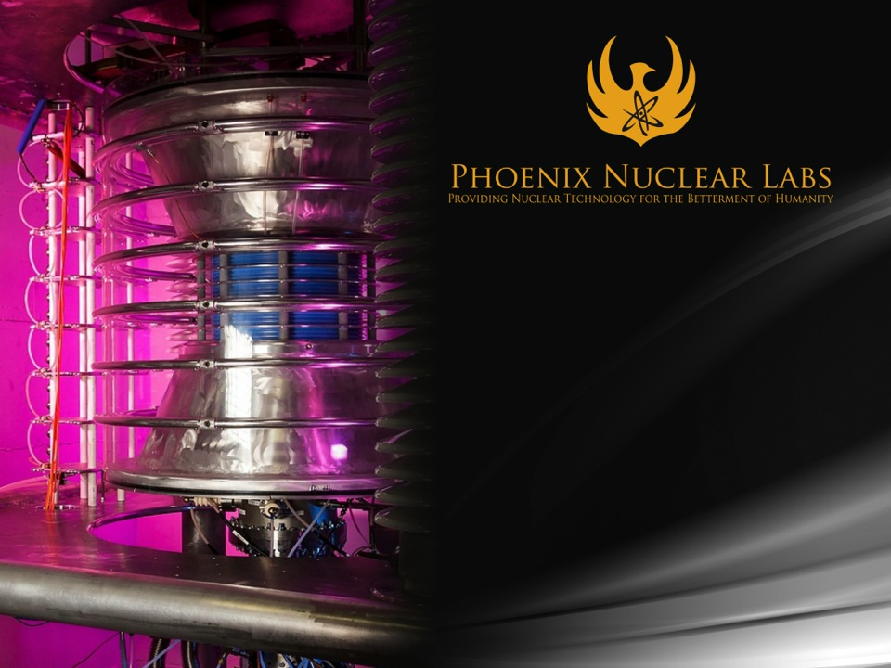
Explosive Hazard Detection with a High Yield DD Neutron Generator
June 15, 2017
Evan Sengbusch, MBA, PhD

Slide 2
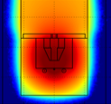
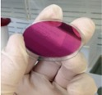
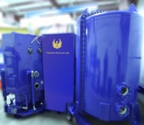
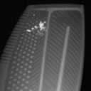
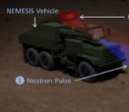
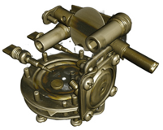
PNL Vision
Semiconductor - LED
Nuclear Fuel
NEXT-GENERATION TECHNOLOGIES
DT+Multiplier
Plasma Targets
Gas Dynamic Trap
Semiconductor - Solar
Core Accelerator
Future
Technology
Advances
2016
2017
2018
2019
2020
Technology
NEXT-GENERATION MARKETS
Nuclear Waste Transmutation
Fission/Fusion Hybrid Energy Generation
Fusion Energy
DD Radiography
IED Detect
Isotopes
DT Tomography

Slide 3



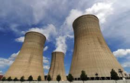


PNL Technology Niche
Neutron Tubes
Nuclear Reactors
Spallation Sources
DD
Solid
DD
Gas
DT
Solid
DD
Gas
10⁶
10⁷
10⁸
10⁹
10¹⁰
10¹¹
10¹²
10¹³
10¹⁴
10¹⁵
10¹⁶
10¹⁷
Neutrons/second
Moderate Intensity
Lower Cost/Neutron
Opens New Markets
Simple Regulations
Room-Sized (~4 m)
High Intensity
Limited Access
Expensive
Licensing Challenges
Football Field Sized
Limited Strength
Limited Markets
Tabletop Sized

Slide 4
PNL Snapshot
PNL is transitioning out of R&D and into low volume production – just reached 50 employees
A handful of commercial systems have been fielded and are operating to specification (all DD to date)
  DD neutron radiography
  H+ ion implantation
  Isotope production (R&D phase only)
Four new systems are being designed/built this year for commercial and government customers
  Same applications as above plus radiation effects testing
Expect to build first two DT systems in 2018 – ~100X more neutrons

Slide 5
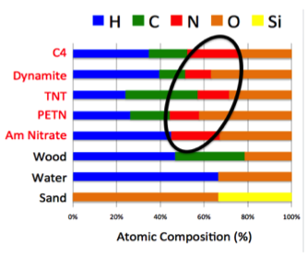
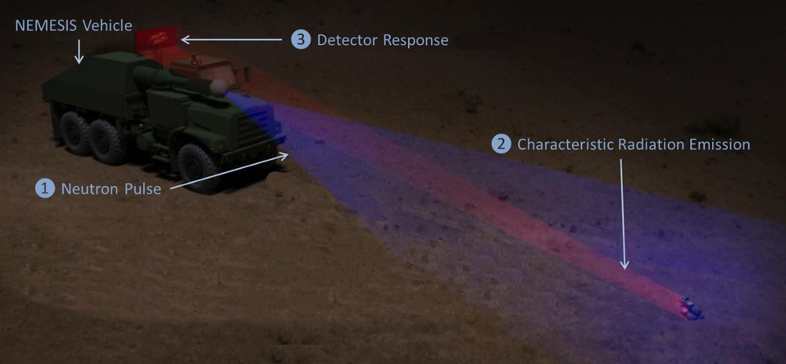
NEMESIS Conceptual Overview
Neutron Generator
2
Radiation Fingerprint Emitted
Neutrons emitted by PNL Neutron Generator
Neutrons interact with explosive
Characteristic gamma rays emitted and detected
IED

Slide 6
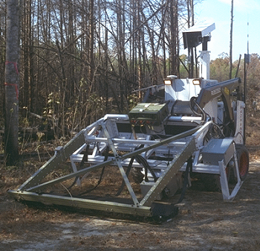
Previous Efforts
Explosives detection with Cf-252 and COTS neutron tubes has been proven, but with limitations:
  Low neutron yield (typically ~10⁸ n/s)
  Short lifetime (~1000 hours) or no ability to turn off (Cf-252)
  Stand-off distance < 0.5m in a few min to measure ~30cm depth for 20lbs. explosive
  Insufficient for many CONOPS
PNL neutron source capable of producing greater than 10¹¹ DD n/s – proven in the laboratory
Very strong source could be difference-maker in terms of operational effectiveness
Decoupling of source and detector array further increases operational flexibility and effectiveness
TNA Explosives Detection System
Mine Clearing Test at Fort Hill (mid-90’s)

Slide 7
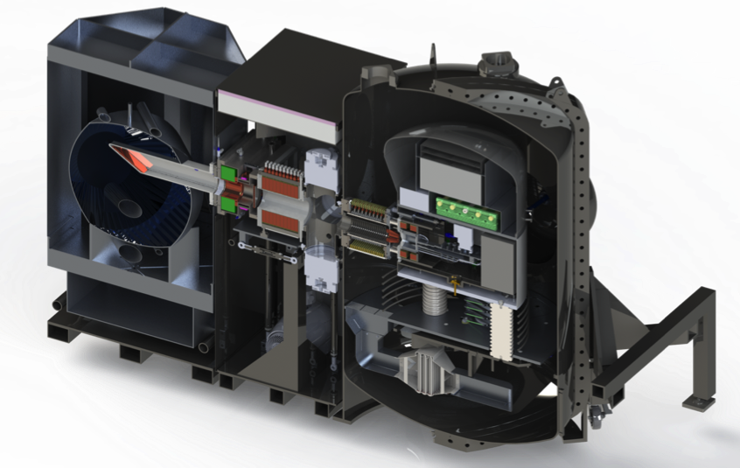
Neutron Generator
Accelerator Column
SF₆ Pressure Vessel
Moderator
Ion Source Power Supplies
Ti Target
Ion Source
Test Cavities
Solenoid Magnet
Vacuum Pumps
Waveguide Break

Slide 8
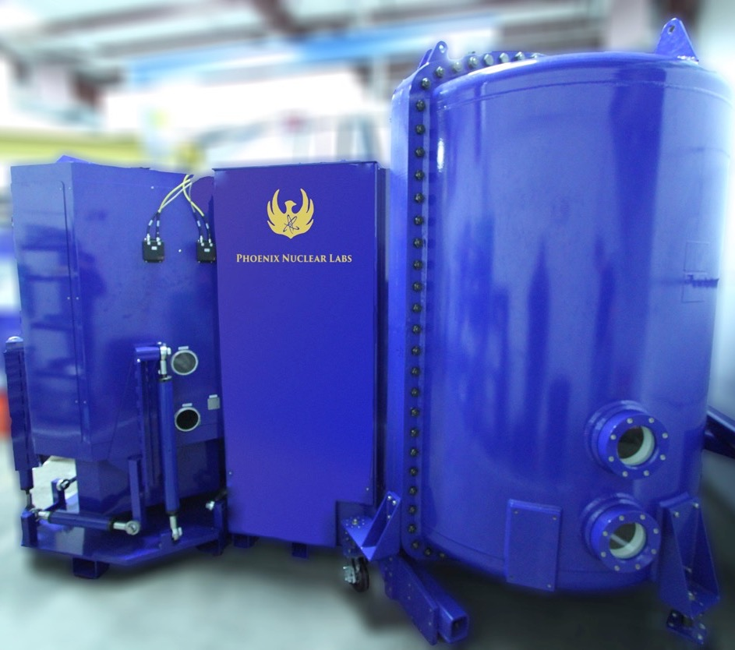
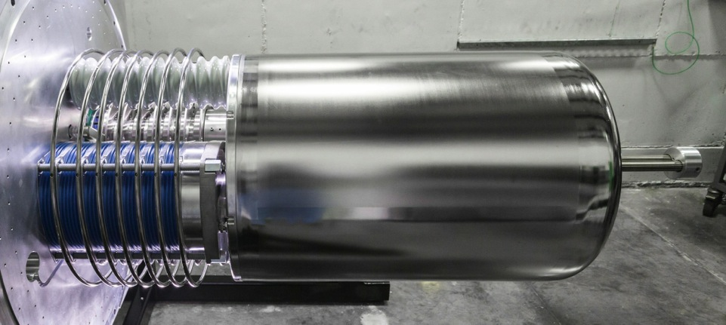
Size Reduction
4 m
1-2 m
8E10 n/s
3E10 n/s

Slide 9
Project Goals and Status
Phase I Complete:
  MCNP simulations of operational scenarios
  Vary explosive size, depth, composition, distance to source, distance to detector, etc.
  Report time to detection for given PD and PFA
Phase II Finishing in August:
  Laboratory testing with existing DD source and explosive surrogates
  Build and test detector hardware and software platforms
  Compare experimental results to Phase I simulation results
Phase III Starting this Summer:
  Design, build, and test fully integrated, mobile system in simulated operational environment – 2-year effort

Slide 10
Phase I Methodology
Key Tool: Monte Carlo Neutral Particle (MCNP) code
  Models interaction physics of neutrons and photons
  Utilizes extensive cross section databases
  Relies on millions of interactions to achieve statistically valid results
Moderator/reflector optimized for maximum signal/noise
Modeled 100’s of configs with varying:
  Explosive size
  Explosive type
  Distance to explosive
  Explosive depth
  Soil constituents
Air
Iron Reflector
10¹¹ n/s source
NaI Crystal Array
Vehicle
Sand/Soil
Explosive

Slide 11
Phase I Results
Type | Explosive | Distance from Source | Soil Type | Burial Depth | Time to Detection (H₂ / N₂)
10L Jug | TNT | 10 meters | Dry Sand | 0” | 3.9 sec / 14.0 sec
30L Jug | UN | 5 meters | Wet Soil | 12” | 212 sec / 141 sec
M107 Shell | ANFO | 3 meters | Dry Soil | 0” | 1 sec / 53 sec
TM46 Mine | TNT | 3 meters | Dry Soil | 6” | 1 sec / 137 sec
20L Jug | AN-Al | 10 meters | Dry Sand | 12” | 316 sec / 226 sec
CONOPS of interest:
  Primary alarm clearance or confirmation – likely achievable with DD
  “Real time” convoy-leading detection – likely requires DT
Typical standoff distances: 3-20 meters
Typical detection times range from <1 second to minutes
DT reduces detection times above by at least an order of magnitude

Slide 12
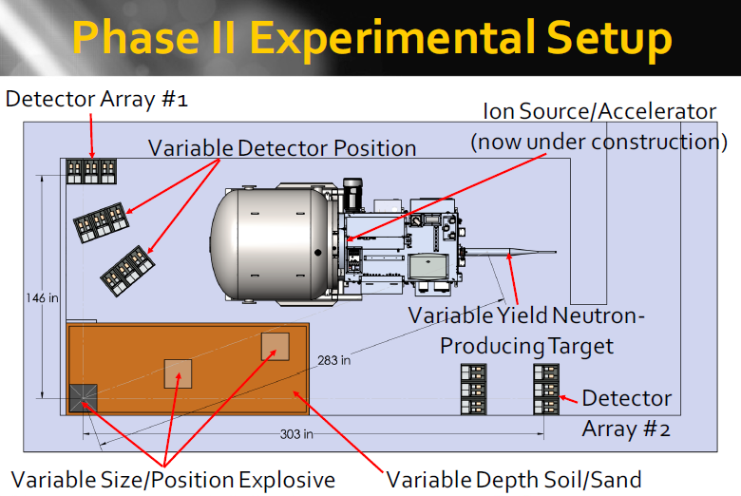

Slide 13
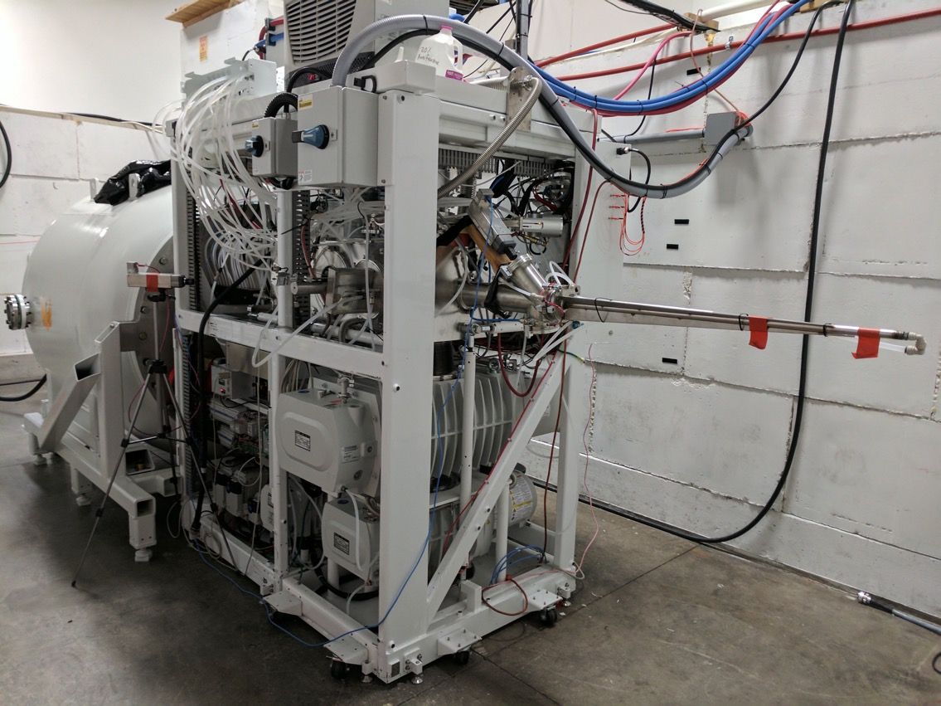
Neutron Generator Complete

Slide 14
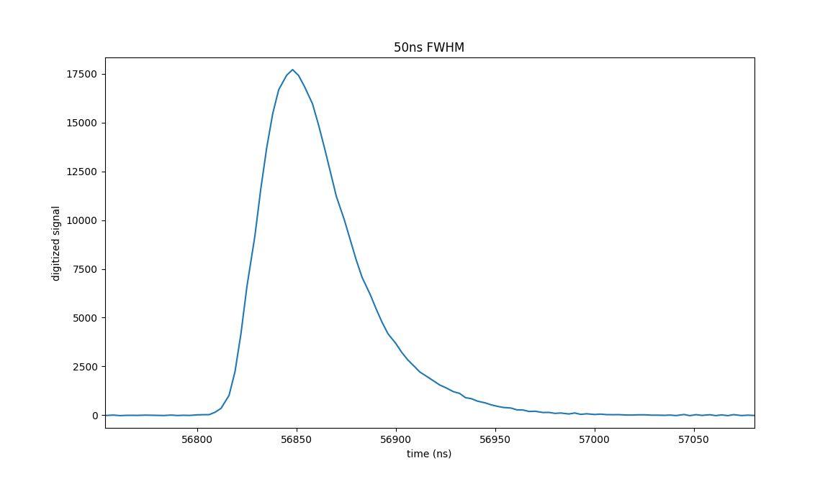
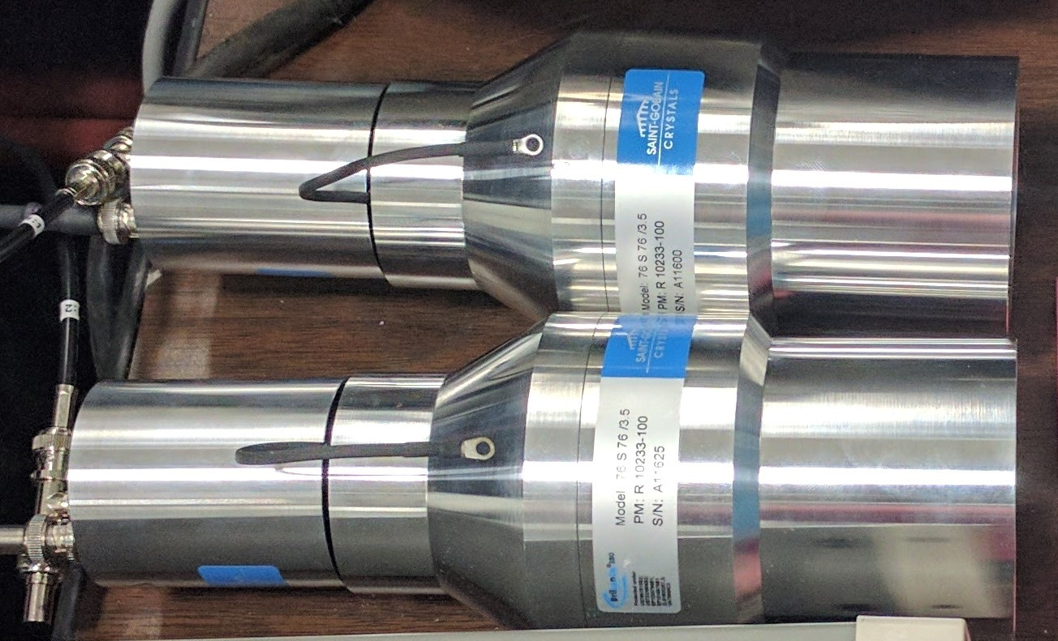
Detector Configuration
LaBr3 (fast) and NaI (cheap) arrays
Acceptable energy resolution (can resolve Si and N lines at 10.6 and 10.8 MeV)
Faster pulse width time: ~28ns vs. ~260ns for NaI
Shielding: borated polyethylene, boron carbide in silicone, lead
0.5 Mcps measured thus far using 3x10¹⁰ DD source – not at limit of source or detector
50ns pulse width

Slide 15
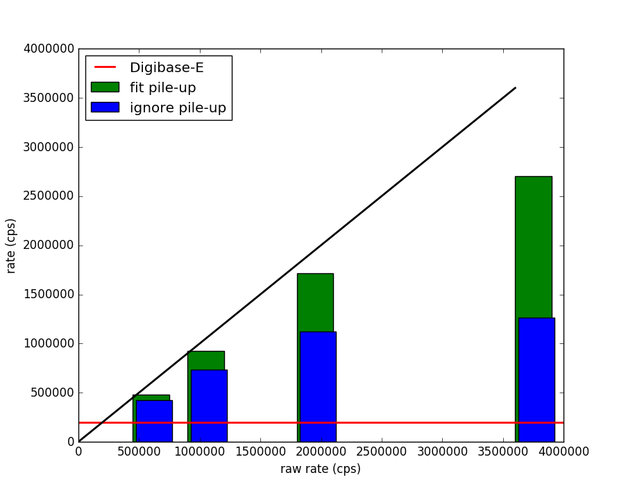
High Performance Digitizer
As count rate increases – pile-up occurs more and more
  Simpler “ignore” technique is affected first
  Even fitting the pile-up events has a limit, but at much higher rate
  Theoretical rate scales with the pulse width
  Using 4 FWHM as figure of merit gives:
    9 Mcps for LaBr₃
    1 Mcps for NaI
Main challenge: cutting the processing time
    GPU parallelization
    Cost is surprisingly competitive
No loss line

Slide 16
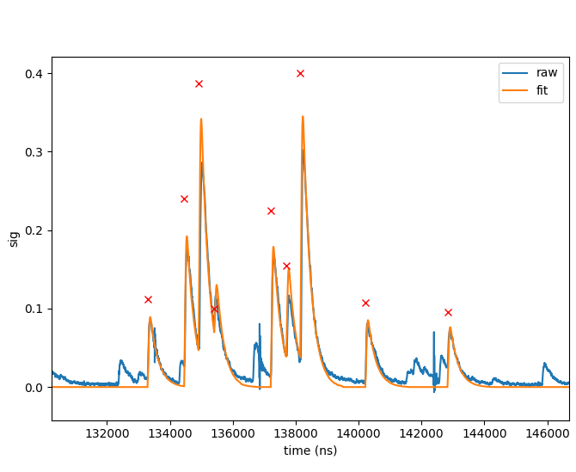
Pile-up Recovery Implemented
Example of digitized signal
  Signal below threshold not fit
  Ability to recover from three pulse pile-up
  Red X’s proportional to pulse amplitude
System can handle higher probability of pileup
Ultimately performance still to be tested with higher flux source

Slide 17
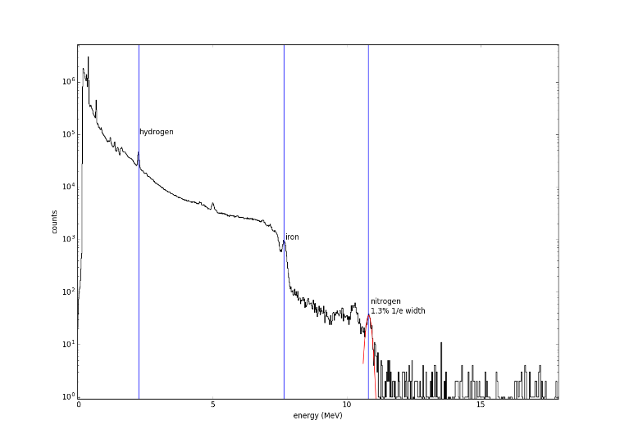
Spectrum with Urea
Urea in controlled environment
N-10.8 MeV
line seen
(note 1st escape)
Iron and hydrogen
also called out
1st escape (10.3 MeV)
Photo peak (10.8 MeV)

Slide 18
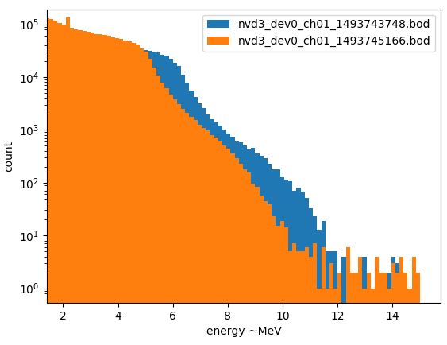
Silicon Background
7-second integration
Urea
~2 m standoff
Sand

Slide 19
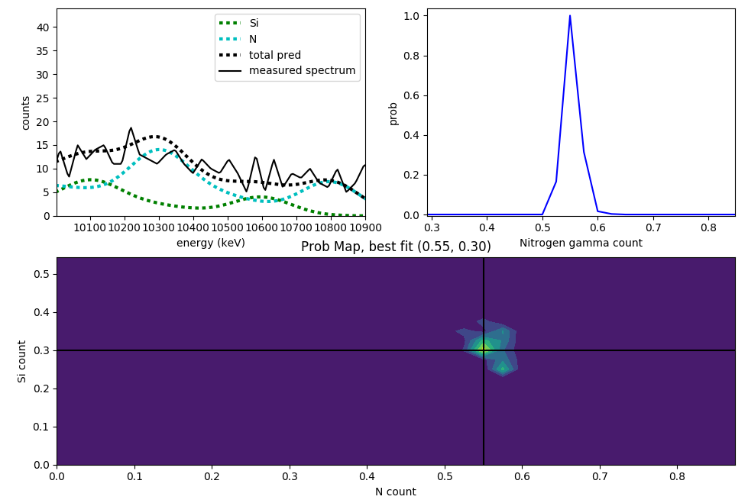
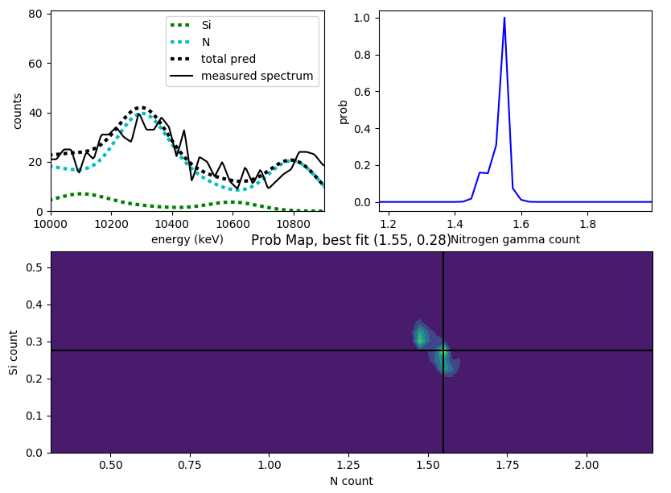
Detection Algorithm
Bayesian probability analysis utilizes forward model of detectors
Probability of N and Si concentrations calculated based on measured spectrum
Decision metric applied to probability distribution to give a simple TRUE/FALSE output for presence of explosive
No Urea
Urea

Slide 20
Conclusions and Next Steps
Experimental data taken to date have been in first order agreement (actually slightly better) than corresponding laboratory MCNP models
Additional data will be taken and analyzed:
  Stronger neutron source
  Larger standoff distances
  Variable explosive size, burial depth, etc.
Additional validation (or not) of Phase I modeling results
Phase III:
  Build and test mobile system
  Compare to CONOPS requirements
  Address the many practical concerns for fielding

Slide 21
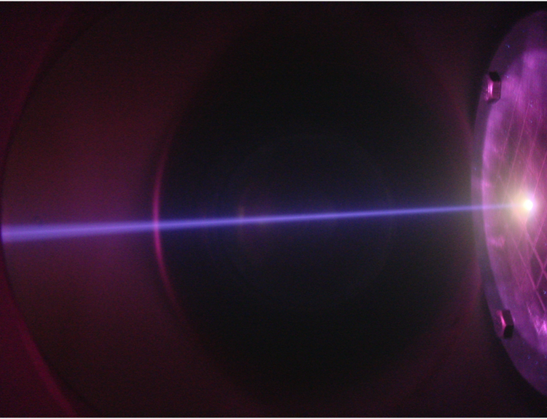
THANK YOU!
Phoenix Nuclear Labs
sengbusch@phoenixnuclearlabs.com
608-210-3060

